Slide 1
Before birth and after
WEEK 4
Week 4 · Prenatal Development and Birth
1
Notes:
Welcome to Week 4. Until now we have built tools: the three domains and the nature-and-nurture question in Week 1, the theories in Week 2, and the two-column observation record in Week 3. This week we use them on the very start of development, before birth and in the first minutes after it. The orienting question is simple to say and worth holding all week: what happens before a baby is born, what can help or harm it, and what does a newborn's first score really tell us? For anything about how the course runs, check the current syllabus; it is the authoritative source. Now let's start with a family at a clinic.

Slide 2
Embryo first, fetus later
01
THE QUESTION THIS WEEK
2
Notes:
Picture a family at a prenatal clinic visit. At one appointment the nurse says "the embryo." A few months later the same nurse says "the fetus." The family asks whether something changed or whether it is a new word for the same thing. Something did change, and by the end of the first beat you will be able to say what. DO: ask the room to write one guess on a card: what do you think changes between the embryo and the fetus? Collect four or five guesses aloud without judging them. Keep the cards; we come back to them after the prenatal periods slide, when we will see that the work changes, from building the major organs to growing and refining them.

Slide 3
Record R1: two checks
02
THE SHARED DATASET
3
Notes:
This week's shared dataset is the running case's first record, R1, which is illustrative: the child the course follows from birth to 15 years, here as a newborn in a hospital birthing room. At 1 minute after birth the five Apgar signs scored heart rate 2, breathing effort 2, muscle tone 1, reflex response 1, and skin color 1. At 5 minutes they scored heart rate 2, breathing effort 2, muscle tone 2, reflex response 2, and skin color 1. The record also notes that the newborn turns toward a touch on the cheek and opens the mouth. We will total these scores later in the deck, and we will add two World Health Organization definitions: low birth weight, less than 2,500 grams, and preterm birth, before 37 completed weeks.

Slide 4
Three periods before birth
CONCEPT 1 OF 6 · BEFORE BIRTH
Germinal: about the first two weeks
Embryonic: about weeks 3 to 8
Fetal: about week 9 to birth
Prenatal development and birth
Week 04
4
Notes:
Think of building a house: the foundation, then the frame, then the finishing work. The germinal period runs about the first two weeks, from fertilization to implantation, when the fertilized egg attaches to the wall of the uterus. The embryonic period runs about weeks 3 to 8, when the major organs and body structures form. The fetal period runs from about week 9 to birth, a time of growth and refinement. Stress the word about: these week counts are approximate, and sources draw the edges a little differently. DO: return to the cards from the hook. Ask which guesses named the real change, from building the major organs to growing them, and read two of the closest guesses aloud. Memory line: germinal settles, embryonic builds, fetal grows.

Slide 5
Embryonic vs. fetal
THE TRAP EVERYONE FALLS FOR
Embryonic: about weeks 3 to 8
Major organs form
Fetal: about week 9 to birth
Growth and refinement
Prenatal development and birth
Week 04
5
Notes:
The left column is the embryonic period, about weeks 3 to 8, when the major organs form. The right column is the fetal period, about week 9 to birth, a time of growth and refinement. The trap is to think the fetal period is when the major organs form, because it is the longest and the one people talk about most. The longest stretch is not the building stretch. DO: read out three statements and have the room vote embryonic or fetal. One, the heart and other major organs are taking shape: embryonic. Two, structures already in place are growing and being refined: fetal. Three, the basic body plan is laid down in about six weeks: embryonic. Debrief whichever statement split the room, using the house picture.

Slide 6
Genotype plus environment
CONCEPT 2 OF 6 · NATURE AND NURTURE
Genes sit on chromosomes
Genotype: your genetic makeup
Phenotype: genotype meets environment
Prenatal development and birth
Week 04
6
Notes:
Start at a family dinner before a birth: someone says the baby will be tall because it is in the genes. Partly true. A gene is a unit of heredity that carries instructions the body uses to build and run itself, and a chromosome is a threadlike structure in a cell that holds many genes; we stop there. Genotype is a person's genetic makeup. Phenotype is the observable characteristics, which result from the genotype interacting with the environment. Height is part of the phenotype: the genotype makes a range possible, and nutrition and health work on it. This is Week 1's nature-and-nurture idea in a new setting: genes and experience always work together, never one alone, and the uterus is the first environment. DO: ask for one more observable trait and have a student name both inputs.

Slide 7
Timing changes the harm
CONCEPT 3 OF 6 · TIMING MATTERS
Teratogen: can harm prenatal development
Effect depends on timing, dose, individual
CDC: no known safe amount of alcohol
Prenatal development and birth
Week 04
7
Notes:
A teratogen is a substance or condition that can harm prenatal development. Its effect depends on timing, dose, and the individual, and the embryonic period is generally the most sensitive time for major structures. This is Week 2's sensitive-period idea turned around: a structure that is forming is open to help and to harm. The pinned example is alcohol, and we quote the issuing body exactly. The Centers for Disease Control and Prevention states: "There is no known safe amount of alcohol use during pregnancy." Never soften it. A second theory adds context: Bronfenbrenner's ecological model places the pregnancy inside a family, a clinic, a workplace, and a culture. Prenatal care, the regular health care before birth, is named in words only. DO: ask why less sensitive never means safe, and take two answers.

Slide 8
Labor in three stages
CONCEPT 4 OF 6 · BIRTH
First: the cervix dilates
Second: the baby is born
Third: the placenta is delivered
Prenatal development and birth
Week 04
8
Notes:
Labor is the process of giving birth, and we describe it in three stages. In the first stage, the cervix, the opening of the uterus, gradually dilates so the baby can pass through; it is usually the longest stage. In the second stage, the baby is born. In the third stage, the placenta, the organ that forms during pregnancy and passes nutrients and oxygen to the developing baby, is delivered. We give no durations as rules, because every labor is different. A common slip is to think labor ends when the baby arrives; the baby's arrival is the second stage. DO: read three moments out of order, the placenta is delivered, the cervix opens, the baby is born, and have the room put them in order: cervix, baby, placenta.

Slide 9
Five signs, two checks
CONCEPT 5 OF 6 · THE FIRST SCORE
Heart rate, breathing, tone, reflex, color
Each sign scored 0, 1, or 2
Checked at 1 and 5 minutes
Prenatal development and birth
Week 04
9
Notes:
The Apgar score comes from Apgar (1953), "A Proposal for a New Method of Evaluation of the Newborn Infant", in Current Researches in Anesthesia and Analgesia. It rates five signs: heart rate, breathing effort, muscle tone, reflex response or grimace, and skin color. Each sign is scored 0, 1, or 2, at 1 and 5 minutes after birth, so each total runs from 0 to 10. MedlinePlus states that a score of 7, 8, or 9 is normal, and a 10 is uncommon. Give one row of the scoring table as an example: heart rate scores 0 if absent, 1 if below 100 beats per minute, and 2 if more than 100 beats per minute. The next slide puts these five signs to work on record R1.

Slide 10
Record R1: 7, then 9
WORKED EXAMPLE · RECORD R1
1-minute total = 7
5-minute total = 9
Change: 9 − 7 = 2
Prenatal development and birth
Week 04
10
Notes:
Total record R1 aloud. At 1 minute: 2 + 2 + 1 + 1 + 1 = 7. At 5 minutes: 2 + 2 + 2 + 2 + 1 = 9. The change is 9 − 7 = 2: muscle tone rose from 1 to 2 and reflex response rose from 1 to 2, and 1 + 1 = 2 matches. The maximum is 5 signs × 2 = 10, so 9 sits 10 − 9 = 1 below it, because skin color stayed at 1, body pink with hands and feet blue. Both totals fall in the normal range of 7, 8, or 9. Write it the Week 3 way: scores in the observed column, readings in the interpretation column. DO: pause before each total, collect predictions, then reveal 7 and 9. Close on the reading: these totals describe the newborn's condition in the first minutes and predict nothing about intelligence or later development.

Slide 11
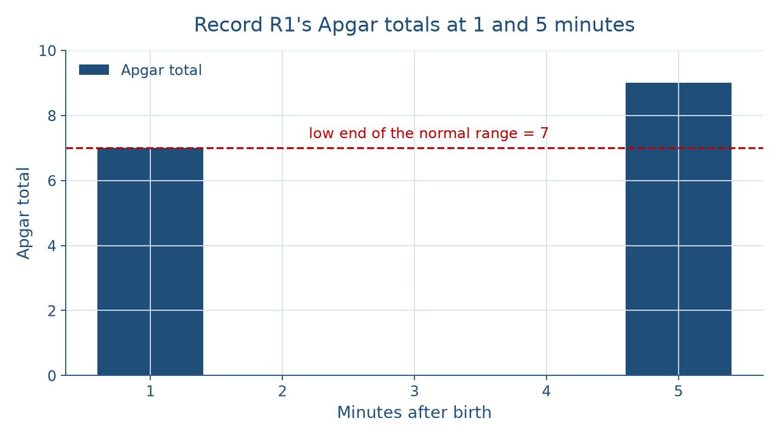
Two checks, both normal
THE PICTURE OF THE TWO CHECKS
Prenatal development and birth
Week 04
11
Notes:
The figure shows two bars for record R1: the 1-minute total of 7 and the 5-minute total of 9, on a scale from 0 to 10. A dashed line at 7 marks the low end of the normal range of 7, 8, or 9. The first bar reaches the line; the second stands two higher. Say the reading in words so no one depends on the picture: both totals are in the normal range, and the rise of 2 came from muscle tone and reflex response. Then name the two classic wrong turns. A 7 read as a problem is wrong, because 7 is normal. A score read as predicting intelligence is wrong, because the Apgar describes the condition at two moments. DO: ask a volunteer to describe the chart aloud to a classmate who cannot see it, in two sentences.

Slide 12
Weight vs. timing
CONCEPT 6 OF 6 · TWO DEFINITIONS
Low birth weight
Less than 2,500 grams
Preterm birth
Before 37 completed weeks
Prenatal development and birth
Week 04
12
Notes:
The World Health Organization defines low birth weight as a weight at birth of less than 2,500 grams, on the left. It defines preterm birth as a baby born alive before 37 completed weeks of pregnancy, on the right. One is about weight and one is about timing, so a baby can meet one definition, both, or neither. Like the Apgar score, these describe a birth, not a child's future. DO: give the room two invented newborns. First, born at 39 completed weeks, weighing 2,350 grams: low birth weight, not preterm. Second, born at 35 completed weeks, weighing 2,700 grams: preterm, not low birth weight. Ask each pair to say which question they checked first, weight or timing, and stress that the two questions are always asked separately.

Slide 13
Check the chatbot's reading
AUDIT THE AI · THIS ACTIVITY
Paste record R1's ten sign scores
Watch for a 7 called a problem
Correct it from the pinned source
Prenatal development and birth
Week 04
13
Notes:
In this activity, students open Claude, or another chatbot on the course's list, and paste this prompt: "A newborn's Apgar signs at 1 minute were heart rate 2, breathing effort 2, muscle tone 1, reflex response 1, skin color 1, and at 5 minutes 2, 2, 2, 2, 1. Total each check and explain what the scores mean for this child." A likely error is that the tool calls the 1-minute 7 borderline or worrying, or says the scores hint at later development. The correction: the totals are 7 and 9, MedlinePlus states that 7, 8, or 9 is normal, and the score describes the newborn's condition at 1 and 5 minutes, not a forecast. DO: have pairs compare the tool's answer with this deck, mark each sentence right or wrong, and fix one by hand. The judgment rule for this audit: the tool drafts; you check.

Slide 14
A snapshot, not a forecast
Germinal, embryonic, fetal: settles, builds, grows
Record R1: 7 at 1 minute, 9 at 5
Next: infancy's physical development
BEFORE NEXT WEEK
14
Notes:
Recap in order. The germinal period settles, the embryonic period builds the major organs, and the fetal period grows and refines. A phenotype results from the genotype interacting with the environment. A teratogen's effect depends on timing, dose, and the individual, and the CDC states there is no known safe amount of alcohol use during pregnancy. Labor has three stages. Record R1 scored 7 at 1 minute and 9 at 5 minutes, both normal. Low birth weight is about weight, and preterm birth is about timing. Next week, Infancy and Toddlerhood: Physical Development reads R1's touch-on-the-cheek behavior as a reflex. DO: exit ticket. Each student writes one sentence explaining why a 7 is not a problem, and one wrong turn they will now catch. Collect and read three aloud.

