Slide 1
A milestone is a window
WEEK 5 · THE BODY'S FIRST TWO YEARS
Week 5 · Infancy and Toddlerhood: Physical Development
1
Notes:
Welcome to Week 5, the first of three weeks on infancy and toddlerhood. Before anything else, point students to the current syllabus as the authoritative source for how the course runs, then keep this opening on the ideas. The week's orienting question: how do bodies and brains grow in the first two years, and how do you read a milestone fairly? Preview the path. We build the brain in words, meet the six newborn reflexes, split motor skills into gross and fine, read the WHO windows of achievement, state safe sleep as the issuing bodies state it, and close on feeding. Promise one habit for the whole session: every age is a typical range, never a deadline. Then move to the hook on the next slide.

Slide 2
Shouldn't she be walking?
01
THE HOOK · A WELL-BABY VISIT
2
Notes:
Open with a scene students can picture: a well-baby visit at a busy pediatric clinic, an illustrative scene. A parent holds a 10-month-old on one knee and asks the nurse, "Shouldn't she be walking by now?" Across the waiting room, a grandparent watches a toddler pull up to stand at a chair. Both adults are doing what students will do all term: watching a child and wondering what is typical. DO: give the room one minute to write the reply they would give the parent, then collect three replies aloud. Sort them on the board into replies that name one age and replies that name a range. Keep the board; by the end of the session, the range replies will have their evidence.

Slide 3
Three records, six windows
02
SHARED DATA · DATASET A AND DATASET H
3
Notes:
Introduce this week's shared data by name: the running case's records R1, R2, and R3 (Dataset A) read against the WHO motor windows (Dataset H). Remind students that the running case is illustrative, constructed for the course, and describes no real child. R1 is the newborn in a hospital birthing room, the same record Week 4 used for the Apgar scores of 7 at 1 minute and 9 at 5 minutes. R2 is the 9-month-old in the family home, and R3 is the 14-month-old at a childcare center's morning drop-off. Dataset H is real: the WHO Multicentre Growth Reference Study Group (2006) windows for six gross motor milestones. DO: write R1, R2, and R3 across the top of the board with their ages, so each later slide can hang its concept on the right record.

Slide 4
Build paths, then prune
CONCEPT 1 OF 6 · THE BRAIN
Synapses: formed in great numbers
Pruning: use it or lose it
Myelination speeds signals
Plasticity: experience shapes the brain
A milestone is a window
Week 05
4
Notes:
A neuron is a nerve cell that receives and sends signals. A synapse is the tiny gap where one neuron passes a signal to another. In infancy the brain forms synapses in great numbers and then prunes the ones that go unused; synaptic pruning is often summed up as use it or lose it. Myelination wraps nerve fibers in a fatty coating that speeds signals, and plasticity is the brain's ability to be shaped by experience. Call back Week 1: nature and nurture work together, because genes set the schedule and experience decides which connections stay. Name the trap: pruning is not damage; it strengthens the connections a child uses. DO: use the analogy of unpaved paths across a new park, worn smooth where people walk, and ask which paths stay.

Slide 5
Six reflexes nobody taught
CONCEPT 2 OF 6 · NEWBORN REFLEXES
Rooting: turns toward a cheek touch
Moro: arms fling out, then in
Sucking, palmar grasp, stepping, Babinski
Most fade in the first months
A milestone is a window
Week 05
5
Notes:
A reflex is an automatic, unlearned response to a particular touch, sound, or movement. Name the six. The rooting reflex: the baby turns toward a touch on the cheek and opens the mouth. The sucking reflex: sucking when something touches the roof of the mouth. The Moro reflex: a startle in which the arms fling out and then come back in. The palmar grasp reflex: fingers close around an object pressed into the palm. The stepping reflex: stepping motions when held upright with the feet on a flat surface. The Babinski reflex: the toes fan out when the sole is stroked. Most fade in the first months. DO: read each description aloud without its name and have the room call out the reflex; reveal the name after each guess.

Slide 6
R1: behavior, then concept
WORKED EXAMPLE · READING RECORD R1
Did: turns toward a cheek touch
Apgar: 7 at 1 minute, 9 at 5
Shows: the rooting reflex
Ethology: helps a newborn feed
A milestone is a window
Week 05
6
Notes:
Walk record R1 in the course's order, with the behavior in the left column and the interpretation in the right, the two-column habit from Week 3. What the newborn did: turns toward a touch on the cheek and opens the mouth. What it shows: the rooting reflex, an automatic, unlearned response that most children lose in the first months. Which theory explains it: the ethological view from Week 2 asks what an inborn behavior does for survival, and rooting helps a newborn find the breast or bottle to feed. What a second theory adds: nature and nurture as interaction, since the reflex needs no practice. The record's Apgar totals, 7 at 1 minute and 9 at 5 minutes, were read in Week 4. DO: have pairs say the reading in one plain sentence, then share two.

Slide 7
Gross vs. fine motor
CONCEPT 3 OF 6 · TWO KINDS OF MOTOR
Gross: large muscles
Sitting, crawling, walking
Fine: small muscles, hands
Grasping a spoon, a pea
A milestone is a window
Week 05
7
Notes:
Gross motor skills are movements that use the large muscles of the body, such as sitting, crawling, standing, and walking. Fine motor skills use the small muscles, especially of the hands and fingers, such as grasping a spoon or picking up a small piece of food, like a pea. Use the scene of a toddler climbing three carpeted steps in a library's children's room while an older sibling turns the pages of a board book: climbing is gross motor, and turning pages is fine motor. Name the trap: motor development is not only the big milestones families talk about. DO: call out walking to the table, picking up a pea, climbing onto a booster seat, and lifting a cup by its handle; the room answers gross, fine, gross, fine.

Slide 8
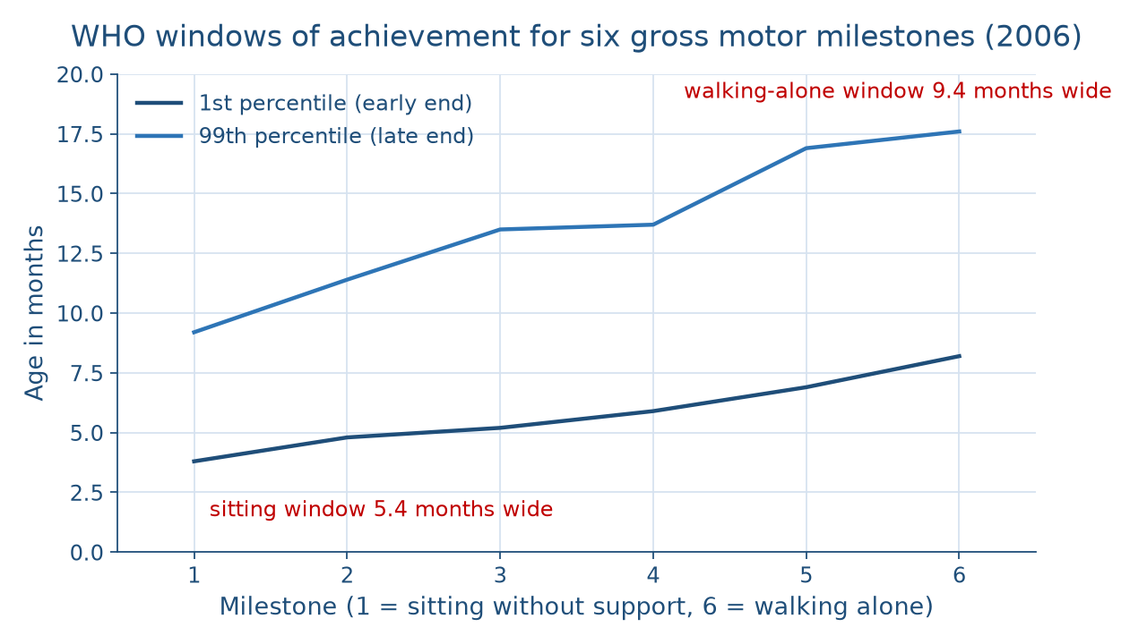
Later milestones, wider windows
CONCEPT 4 OF 6 · THE WHO WINDOWS
A milestone is a window
Week 05
8
Notes:
Show the picture before naming the pattern. The figure plots the six WHO windows in order: sitting without support, standing with assistance, hands-and-knees crawling, walking with assistance, standing alone, and walking alone. The lower line is the 1st percentile age, the age by which 1 percent of the children in the study had reached the milestone; the upper line is the 99th percentile age. The windows run 3.8 to 9.2, 4.8 to 11.4, 5.2 to 13.5, 5.9 to 13.7, 6.9 to 16.9, and 8.2 to 17.6 months. DO: before explaining, ask the room what happens to the gap between the two lines from left to right, collect three predictions, then confirm that it grows, so later milestones have wider windows.

Slide 9
Inside the window
WORKED EXAMPLE · R2 AND R3
R2, 9 months: sits (3.8 to 9.2)
R2, 9 months: crawls (5.2 to 13.5)
R3, 14 months: walks alone (8.2 to 17.6)
Widths: 5.4, 8.3, 9.4 months
A milestone is a window
Week 05
9
Notes:
Read the running case against the windows. R2, at 9 months in the family home, sits without support and crawls on hands and knees: 9 months falls inside the sitting window of 3.8 to 9.2 months and inside the crawling window of 5.2 to 13.5 months. R3, at 14 months at the childcare center, walks alone: 14 months falls inside the walking-alone window of 8.2 to 17.6 months. Work the widths: 9.2 − 3.8 = 5.4 months, 13.5 − 5.2 = 8.3 months, and 17.6 − 8.2 = 9.4 months, so the walking window is 9.4 − 5.4 = 4.0 months wider than the sitting window. DO: work each subtraction live, pausing for predictions, then have the room say most children walk alone somewhere between about 8 and 18 months.

Slide 10
Deadline vs. window
THE TRAP EVERYONE FALLS FOR
Wrong: walk by 12 months
Wrong: crawling is required
Fair: about 8 to 18 months
Fair: some children skip crawling
A milestone is a window
Week 05
10
Notes:
Name the two classic wrong turns. First, a milestone age read as a deadline, as in children walk at 12 months; the fair sentence is that most children walk alone somewhere between about 8 and 18 months. Second, crawling read as a required step before walking; the fair sentence is that some children skip hands-and-knees crawling and go straight to pulling up, standing, and walking. Add the course's line: a child outside a window is a reason for a family to talk with a health professional, never a conclusion we draw. This is Week 3's warning in a new setting: a single observation never describes the whole child. DO: return to the hook's board, cross out each one-age reply, and rewrite it as a range together.

Slide 11
Back to sleep, every sleep
CONCEPT 5 OF 6 · SAFE SLEEP
AAP 2022: on the back, every sleep
All naps and at night, until age 1
Firm, flat, non-inclined surface
NICHD: 1994 Back to Sleep; 2012 Safe to Sleep
A milestone is a window
Week 05
11
Notes:
State the guidance exactly as the issuing body states it. The American Academy of Pediatrics' 2022 safe sleep policy statement says to place babies on their backs for every sleep, for all naps and at night, until age 1, on a firm, flat, non-inclined surface. The NICHD launched the Back to Sleep campaign in 1994 and expanded and renamed it the Safe to Sleep campaign in 2012, 18 years later. Name the trap: stomach sleeping read as safe for an infant who sleeps better that way; the 2022 statement does not change for that. The course quotes the body and never turns guidance into advice for one baby. DO: show the scene of a parent choosing a crib in a store, and ask which source a report should quote: the store display or the AAP.

Slide 12
One recommendation, many families
CONCEPT 6 OF 6 · FEEDING
WHO: exclusive breastfeeding, first 6 months
Continuing up to 2 years or beyond
Stated as that body's recommendation
No family ranked by how it feeds
A milestone is a window
Week 05
12
Notes:
Feeding is the first physical routine a family builds with a baby, and families do it in many ways: some breastfeed, some use formula, and many combine the two. The World Health Organization recommends exclusive breastfeeding for the first 6 months, with breastfeeding continuing up to 2 years of age or beyond. Exclusive breastfeeding means feeding an infant only breast milk, with no other food or drink. The course states it as that body's recommendation and ranks no family by how it feeds a baby. This is evenhandedness, the same rule Week 1 set for families and cultures. DO: ask the room to rewrite the sentence a family who uses formula has failed so that it states the recommendation without judging anyone, and read two rewrites aloud.

Slide 13
Audit the chatbot
THIS WEEK'S AUDIT · CHECK THE CHATBOT
Paste the R2 and R3 prompt
Check: an age stated as a deadline?
Check: stomach sleeping called safe?
The tool drafts; you check
A milestone is a window
Week 05
13
Notes:
This activity puts a chatbot such as Claude, Gemini, or ChatGPT to work on this week's material. DO: paste this exact prompt: An illustrative 9-month-old sits without support and crawls on hands and knees, and an illustrative 14-month-old walks alone. Using the WHO Motor Development Study (2006), say whether each is on track, and say whether a baby who sleeps better on the stomach can sleep that way. Then check the reply for three named errors: stating an age as a deadline, such as babies walk at 12 months; judging either child as ahead or behind, when the windows describe groups; and calling stomach sleeping safe, which contradicts the American Academy of Pediatrics' 2022 statement. Compare every window it gives with 3.8 to 9.2, 5.2 to 13.5, and 8.2 to 17.6 months. The tool drafts; you check.

Slide 14
A milestone is a window
Prune what goes unused; myelin speeds
Six reflexes; most fade early
Walking alone: 8.2 to 17.6 months
Next: thinking and first words
BEFORE NEXT WEEK
14
Notes:
Recap in the order taught. The brain forms synapses in great numbers, prunes the unused ones, and speeds signals through myelination, and pruning is growth, not damage. Newborns have six reflexes, from rooting to Babinski, and most fade in the first months. Gross motor uses large muscles and fine motor small ones. The WHO windows are wide: walking alone runs from 8.2 to 17.6 months, and R2 and R3 fall inside their windows. Safe sleep follows the AAP's 2022 statement, and the WHO recommends exclusive breastfeeding for the first 6 months. Next week, Week 6 stays with these infants and turns to their thinking and first words through Piaget's sensorimotor stage. DO: give an exit question: write one sentence that reads R3 against its window, and collect the cards.

