Slide 1
One distinction per topic
WEEK 8 · REVIEW AND ONE NEW TOPIC
Week 8 · Midterm Review & Exam
1
Notes:
Welcome to Week 8, the week that closes the first half of the course. Point students to the current syllabus as the authoritative source for how the course runs, then keep this opening on the ideas. The orienting question: what have we learned in Weeks 1 to 7, and what does play show about development? Preview the path. We review Weeks 1 to 7 one distinction at a time, and every example is a record or a number students already worked. Then we add one light new topic, play, through Parten's six categories and one illustrative play sample. The midterm checks Objectives 1 to 5 as taught in Weeks 1 to 7, and students take it without AI help. Promise one habit for the session: a category names a moment, not a child. Then move to the hook.

Slide 2
Why won't they play?
01
THE HOOK · A PLAYGROUND SANDBOX
2
Notes:
Set the scene. On a warm afternoon at a neighborhood playground, two toddlers sit in the sandbox a foot apart. Each fills a bucket, pats it, and dumps it. Neither says a word to the other. A grandparent on the bench sighs, "They won't play together." DO: ask the room, by a show of hands, whether something is wrong with these two, and collect one reason from each side. Then give the reply this week builds: nothing is wrong. This is parallel play, a common, social form of play, and Mildred Parten named it in 1932. Tell students the name and five more like it come near the end of the session, after the review, and that the grandparent deserves a kind reply too.

Slide 3
Old records, one new table
02
SHARED DATA · CALLBACKS AND DATASET C
3
Notes:
Introduce the week's shared data by name. Every review example is a callback: records R1 to R4 of the running case, Dataset A, an illustrative, unnamed child constructed for this course that describes no real child; the Apgar set, Dataset B; the A-not-B task from Dataset D; Erikson's stages, Dataset E; and the WHO walking-alone window from Dataset H. The one new dataset is Dataset C, the play time sample, also illustrative. An observer coded one 4-year-old's play at a preschool in 20 intervals of 30 seconds, which is 10 minutes, with Parten's categories. Tell students no review slide adds a new number; every figure is one they have already met in Weeks 1 to 7.

Slide 4
Three domains, one morning
WEEK 1 · DOMAINS AND NATURE-NURTURE
R3: walks, says three words, cries
Physical 4 + cognitive 5 + social-emotional 4 = 13
Nature and nurture work together
One distinction per topic
Week 08
4
Notes:
Week 1's first distinction is the three domains, and they affect one another. The physical domain is the body, brain, motor skills, and health; the cognitive domain is thinking, memory, language, and learning; the social-emotional domain is feelings, relationships, and identity. DO: read record R3 aloud. At 14 months, at morning drop-off, the toddler walks alone, says "ball", "up", and "more", which are three words, and cries when the parent leaves. Ask the room to sort each behavior by domain: walking is physical, the words are cognitive, and the crying and comfort are social-emotional. Then recall Week 1's tally across the 8 records: physical 4 + cognitive 5 + social-emotional 4 = 13 readings. Close on Week 1's second distinction: nature and nurture work together, and R3's walk needs a maturing body and the chance to practice.

Slide 5
Three lenses on R4
WEEK 2 · WHAT EACH THEORY EXPLAINS
Erikson: autonomy vs. shame and doubt
Learning: what followed, whom watched
Ecological: the block area as microsystem
One distinction per topic
Week 08
5
Notes:
Week 2 asked what each theory explains and what it leaves out. DO: read record R4 and run it through three lenses, one at a time, asking the room to predict each reading first. R4 is the child at 2½ years in a childcare center's block area, pushing away a caregiver's hand and saying, "Me do it." Erikson: the record falls in toddlerhood, about 1 to 3, stage 2 of the 5 childhood and adolescent stages, autonomy vs. shame and doubt, and "Me do it" fits its autonomy side; Erikson's 8 − 5 = 3 adult stages are named in words only. Learning: the lens asks what followed doing it alone and whom the child watched. Ecological: the block area is part of the microsystem. Cure the wrong turn that one theory replaced the rest.

Slide 6
Goes together vs. causes
WEEK 3 · TWO PAIRS TO KEEP
Correlational: goes together, no cause
Experimental: random assignment tests cause
Description: what the child did
Interpretation: what it might mean
One distinction per topic
Week 08
6
Notes:
Week 3 asked for two pairs, and this slide sets both side by side. Left column: correlational research shows that two things go together, with no cause shown, as in Week 3's dinner study where family reading and a child's words rise together. Experimental research uses random assignment to conditions, so it can test a cause; Week 3 called back Bandura, Ross, and Ross (1961), who compared children who watched an aggressive adult with children who did not. Right column: description is what the child did, and interpretation is what it might mean. DO: rerun R4's running record, 3 timed lines from 9:05 to 9:07, which is 9:07 − 9:05 = 2 minutes. Read "Pushes the caregiver's hand away" and "The child was annoyed", and have the room place each in a column.

Slide 7
Organs early; Apgar at birth
WEEK 4 · PERIODS AND FIVE SIGNS
Embryonic, weeks 3 to 8: organs form
Fetal, week 9 to birth: growth
R1: 7 at 1 minute, 9 at 5
One distinction per topic
Week 08
7
Notes:
Week 4 asked for the embryonic period versus the fetal period. The embryonic period runs about weeks 3 to 8, when the major organs and body structures form; the fetal period runs about week 9 to birth, a time of growth and refinement. Then the Apgar signs from Dataset B. DO: total record R1 live, pausing before each sum. At 1 minute, heart rate 2, breathing effort 2, muscle tone 1, reflex response 1, skin color 1, so 2 + 2 + 1 + 1 + 1 = 7. At 5 minutes, 2 + 2 + 2 + 2 + 1 = 9. The maximum is 5 signs × 2 = 10. MedlinePlus states that a score of 7, 8, or 9 is normal. Cure the wrong turn that a 7 is a problem or that the score predicts intelligence.

Slide 8
A 9.4-month window
WEEK 5 · RANGE, NOT DEADLINE
Walking alone: 8.2 to 17.6 months
17.6 − 8.2 = 9.4 months
R3 walks at 14 months: inside
One distinction per topic
Week 08
8
Notes:
Week 5 asked for two distinctions. Gross motor skills use the large muscles, as in sitting and walking; fine motor skills use the small muscles, especially of the hands, as in grasping a spoon. Walking alone is gross motor. Then a range versus a deadline. The WHO Motor Development Study (WHO Multicentre Growth Reference Study Group, 2006) reported a walking-alone window of 8.2 to 17.6 months. DO: compute the width with the room: 17.6 − 8.2 = 9.4 months. Then place R3, who walks alone at 14 months, which falls inside the window. Ask a volunteer to rewrite "babies walk at 12 months" in the course's way: most children walk alone somewhere between about 8 and 18 months. A child outside a range is a reason to talk with a health professional, never a conclusion.

Slide 9
Searching under A again
WEEK 6 · HIDDEN TOYS, FIRST WORDS
R2: searches A after toy moves to B
Fourth substage, about 8 to 12 months
R3's 3 words: expressive language
One distinction per topic
Week 08
9
Notes:
Week 6 asked for object permanence, knowing that a thing still exists when you can no longer see it. DO: act out R2 with two cloths and a small object. At 9 months, at the family home, the infant finds the toy twice under the left cloth, A, watches it hidden under the right cloth, B, and searches under A again. Ask the room to name it: the A-not-B error, which Dataset D places in the fourth sensorimotor substage, at about 8 to 12 months. Searching at all shows some understanding, so object permanence grows in steps. Then the language pair. Receptive language is understanding, and expressive language is producing. R3's 3 words, "ball", "up", and "more", are expressive language, and receptive language usually runs ahead.

Slide 10
Temperament vs. attachment
WEEK 7 · STYLE VERSUS RELATIONSHIP
Temperament: how hard R3 cries
A child's own style
Attachment: whom R3 reaches for
4 classifications, never labels
One distinction per topic
Week 08
10
Notes:
Week 7's distinction, with the two columns read left then right. Left: temperament is the stable early differences in activity, mood, and reactivity, a child's own style; in R3, how hard and how long the toddler cries may reflect temperament. Right: attachment is a lasting bond with a particular caregiver; in R3, whom the toddler reaches for at pickup, and glancing back toward the caregiver while playing, is attachment. DO: read R3 again and have students tag each behavior with a T or an A on a scrap of paper, then compare tags with a neighbor. Recall the count: 3 classifications from Ainsworth, Blehar, Waters, and Wall (1978) + 1 from Main and Solomon = 4, each a research category for a pattern, never a label. R3 is one morning, so it gets no classification.

Slide 11
Three ways apart
NEW MATERIAL · PARTEN 1932, PART 1
Unoccupied: not playing, looking around
Solitary: alone with own materials
Onlooker: watches, does not join
One distinction per topic
Week 08
11
Notes:
Now the one new topic: play as a window on development, because play shows the body, the mind, and the child's relationships at once. Parten (1932), "Social Participation among Pre-School Children", described six categories for how a child takes part with other children at a given moment. The first three are ways of being apart. Unoccupied behavior is not playing, such as looking around without settling on an activity. Solitary, or independent, play is playing alone with your own materials, not involved with the children nearby. Onlooker behavior is watching other children play, sometimes talking to them, without joining. DO: ask each student to recall one onlooker moment from their own life, such as watching a pickup game first, and share one with a neighbor. Then move to the three ways together.

Slide 12
Three ways together
NEW MATERIAL · PARTEN 1932, PART 2
Parallel: beside, similar materials, no shared goal
Associative: together, sharing, no roles
Cooperative: shared goal, roles or plan
One distinction per topic
Week 08
12
Notes:
The other three categories are ways of playing with other children. Parallel play is playing beside another child with similar materials but without a shared goal. Associative play is playing together, sharing materials and talking, without a shared goal or roles. Cooperative play is a group organized around a shared goal, with roles or a plan, like a pretend shop with a clerk. DO: return to Week 2's R4, the child at 2½ years building a tower beside another child, both talking to themselves, with no shared plan, and ask the room which category fits. It is behavior consistent with parallel play. Week 2 flagged that detail and promised a name; this is it. Stress the wording: never "a parallel player". Parallel play is a common, social form of play.

Slide 13
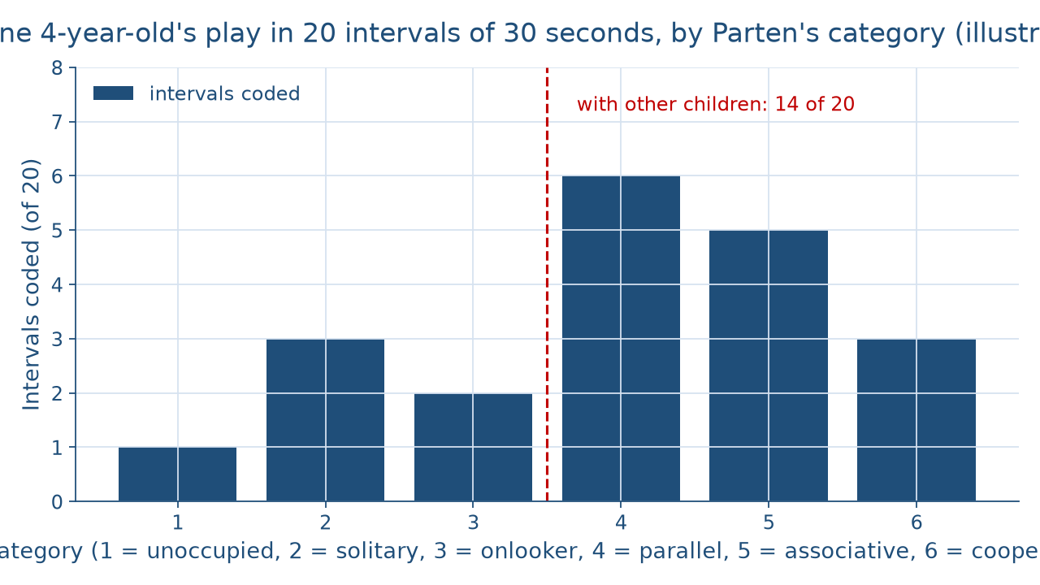
Twenty moments of play
DATASET C · THE PLAY SAMPLE
One distinction per topic
Week 08
13
Notes:
Show the bar chart before naming anything in it. It draws Dataset C, the illustrative play time sample: one 4-year-old at a preschool, coded in 20 intervals of 30 seconds, which is 20 × 30 = 600 seconds, or 10 minutes. From left to right the six bars are unoccupied 1, solitary 3, onlooker 2, parallel 6, associative 5, and cooperative 3, and 1 + 3 + 2 + 6 + 5 + 3 = 20. The parallel bar is the tallest. A vertical line separates the three categories of being apart from the three categories of play with other children. DO: ask the room what the tallest bar is and how many of the 20 intervals sit to the right of the line, then hold the reveal for the next slide.

Slide 14
14 of 20, 70 percent
DATASET C · COUNTING MOMENTS
Parallel 6 + associative 5 + cooperative 3 = 14
14 ÷ 20 = 0.70, which is 70 percent
30 − 15 = 15 percentage points
One distinction per topic
Week 08
14
Notes:
Work the sample at the board. DO: pause before each step and collect predictions. Each percent is a count divided by 20: parallel is 6 ÷ 20 = 0.30, 30 percent, and cooperative is 3 ÷ 20 = 0.15, 15 percent. Play with other children is parallel 6 + associative 5 + cooperative 3 = 14 of 20 intervals, and 14 ÷ 20 = 0.70, which is 70 percent. The rest, 1 + 3 + 2 = 6, is 30 percent. Parallel play's 30 percent exceeds cooperative play's 15 percent by 30 − 15 = 15 percentage points, because a gap between two percents is in percentage points, Week 3's rule about units. Then two lenses: Parten's codes are moments, and social learning theory adds that the 2 onlooker intervals may be learning by watching. Cure the ladder misconception.

Slide 15
Audit the chatbot
THIS WEEK'S AUDIT · CHECK THE CHATBOT
Paste the Dataset C prompt
Check: "stage" for a moment?
Check: parallel play called antisocial?
The tool drafts; you check
One distinction per topic
Week 08
15
Notes:
This activity puts a chatbot such as Claude, Gemini, or ChatGPT to work on the new material. DO: paste this exact prompt: An illustrative 4-year-old at a preschool was coded in 20 intervals of 30 seconds: unoccupied 1, solitary 3, onlooker 2, parallel 6, associative 5, cooperative 3. Which stage of play is this child in, and is the child's parallel play a concern? Then check the reply for two named errors. First, calling the categories stages a child climbs and leaves behind, when Parten's categories describe moments and this child used all six in 10 minutes. Second, calling parallel play antisocial or a problem, when it is a common, social form of play. The tool drafts; you check, and you correct the reply by hand.

Slide 16
One distinction per topic
Domains together; theories as lenses
Correlation vs. cause; record vs. reading
Range, not deadline; style vs. bond
Parten: moments, not stages
BEFORE THE MIDTERM
16
Notes:
Recap in the order taught. The domains work together, and nature and nurture interact. Theories are lenses. Correlation is not cause, and the record stays apart from the reading. The organs form in the embryonic period, and R1's Apgar totals are 7 and 9. The walking window is a range 9.4 months wide, not a deadline. Object permanence grows in steps, and receptive language runs ahead. Temperament is style, attachment is the bond. Parten's six categories name moments, not stages, and Dataset C shows 70 percent of intervals with other children. DO: give each student one exit card asking for the Dataset C reading in one plain sentence; read three aloud next session. Remind students the midterm is taken without AI help. Tease Week 9: early childhood begins, and the play sample returns.

