Slide 1
Surprising answers are windows
WEEK 9 · THINKING FROM 2 TO 6
Week 9 · Early Childhood: Physical and Cognitive Development
1
Notes:
Welcome to Week 9, the first of two weeks on early childhood. Before anything else, point students to the current syllabus as the authoritative source for how the course runs, then keep this opening on the ideas. The week's orienting question: how do bodies and minds change from about 2 to 6, and how do two theories explain the change? Preview the path. We watch motor skills grow, meet Piaget's preoperational stage with its strengths and limits, turn to Vygotsky's ideas about learning with others, teach theory of mind with the false-belief task, and close on early literacy, where both theories meet. Tell students the line to carry all week: a surprising answer is a window on thinking, not a mistake. Then move to the hook.

Slide 2
Is the moon following us?
01
THE HOOK · A CAR RIDE AT NIGHT
2
Notes:
Open with an illustrative scene. A family car is on a dark road, and a 4-year-old in a car seat stares out the back window and says, "The moon is following us. It wants to come home with us." DO: give the room one minute to write what that sentence shows about how the child is thinking. Collect four replies aloud and sort them on the board into two piles: replies that call it a mistake and replies that describe a way of thinking. Keep the second pile. Point out that the sentence carries three of this week's ideas: the child gives the moon a want, judges its motion from one seat, and says it aloud to people who answer. Piaget and Vygotsky, both named in Week 2, would notice different things in it.

Slide 3
One record, two tasks
02
SHARED DATA · DATASETS A, C, AND D
3
Notes:
Introduce this week's shared data by name. Record R5 of the running case (Dataset A) is illustrative, constructed for the course, and describes no real child; it was written at 4 years in a preschool classroom. In a puppet game, the child says the first puppet will look for the ball "in the basket, where she left it", though the ball was moved. While drawing, the child says quietly, "Now the roof. Then the door." Dataset D gives two standard Piaget tasks this week, the three mountains task and the conservation of liquid task, each with a typical earlier and later response. Dataset C is the illustrative play time sample from Week 8: one 4-year-old, 20 intervals of 30 seconds, coded with Parten's categories. Every number this week comes from these three.

Slide 4
Bigger moves, finer hands
CONCEPT 1 OF 7 · MOTOR SKILLS
Gross: run, jump, hop, climb
Large muscles of the body
Fine: draw, cut, button, zip
Small muscles of the hands
Surprising answers are windows
Week 09
4
Notes:
Early childhood runs from about 2 to 6. Week 5's split still holds: gross motor skills use the large muscles of the body, and fine motor skills use the small muscles, especially of the hands. In early childhood, gross motor skills grow from steady walking into running, jumping, hopping, and climbing. Fine motor skills grow from scribbling into drawing shapes and people, using scissors, and handling buttons and zippers. Use the illustrative playground: one child climbs the slide ladder and another hops along a painted line, both gross motor, while a third cuts a paper star, which is fine motor. DO: name the four playground movements and ask for a show of hands, gross or fine, for each. Then stress that the course pins no single age for any early-childhood motor skill; every age is a typical range, never a deadline.

Slide 5
One thing stands for another
CONCEPT 2 OF 7 · THE PREOPERATIONAL STAGE
Preoperational: about 2 to 7
Symbolic thought: a block as a phone
Pretend play: symbols in action
Surprising answers are windows
Week 09
5
Notes:
The preoperational stage is Piaget's second stage of cognitive development, placed at about 2 to 7, in which children use symbols and pretend play but show egocentrism, centration, and animism and do not yet conserve. Start with the strength. Symbolic thought is the ability to let one thing stand for another, such as a word for an object, a drawing for a house, or a block for a phone. Pretend play is play in which a child acts as if one thing were another; it is symbolic thought in action. Use the illustrative kitchen-table scene: a 3-year-old holds a wooden block to one ear and talks to a grandparent. Call back Week 6: the infant who could hold an object in mind now lets objects stand for other things. Name the trap: the stage's name lists what is missing, but its gain is real.

Slide 6
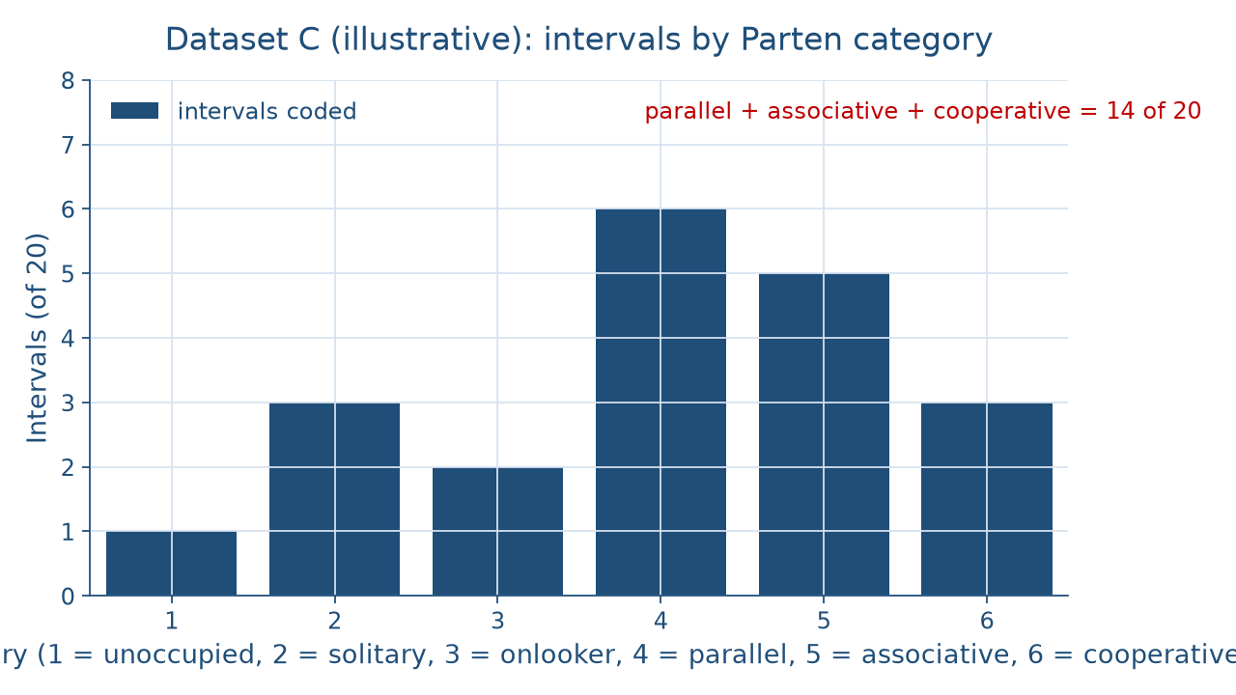
What the codes can count
WORKED EXAMPLE · THE PLAY TIME SAMPLE
Surprising answers are windows
Week 09
6
Notes:
Show the picture before naming the pattern. The bars are Dataset C, the illustrative 10-minute time sample from Week 8: unoccupied 1, solitary 3, onlooker 2, parallel 6, associative 5, and cooperative 3, for 20 intervals. Parallel is the tallest bar. DO: ask the room to add the last three bars, then reveal the settled results. Parallel 6 + associative 5 + cooperative 3 = 14 of 20 intervals; 14 ÷ 20 = 0.70, which is 70 percent play with or beside other children. Associative 5 + cooperative 3 = 8 of 20, which is 40 percent. Cooperative alone is 3 of 20, or 15 percent, and parallel's 30 percent exceeds it by 30 − 15 = 15 percentage points. Then the honesty note: the codes record social participation, not pretend, so this sample cannot count pretend play. Ask what new code would.

Slide 7
Seeing versus caring
CONCEPT 3 OF 7 · EGOCENTRISM
Three mountains: what does the doll see?
Preoperational: picks their own view
Egocentrism: hard to take another's view
Not selfishness
Surprising answers are windows
Week 09
7
Notes:
Egocentrism, in Piaget's sense, is a young child's difficulty taking another person's point of view. In Piaget and Inhelder's three mountains task (Dataset D), a child sits before a model of three mountains while a doll sits on another side, and the child is asked what the doll sees. The typical preoperational response is to pick the child's own view; the later, concrete operational response, taught in Week 11, is to pick the doll's view. DO: hold up a picture facing you and ask a volunteer what the person beside them sees, then link that to the task. Name the trap: egocentrism read as selfishness. The child is not refusing to care about the doll. Egocentrism is a limit on seeing from another place, not a lack of caring, and a stage's ages are approximate, never a timetable.

Slide 8
Taller glass, same water
CONCEPT 4 OF 7 · CENTRATION AND CONSERVATION
Preoperational: the tall glass has more
Centration: on the height alone
Later: the same, with a reason
Animism: the moon wants to come home
Surprising answers are windows
Week 09
8
Notes:
Teach three terms together. Centration is focusing on one striking feature of a situation, such as the height of the water in a glass, and ignoring the others, such as its width. Animism is giving life, thoughts, or feelings to things that are not alive, as when the child in the hook says the moon wants to come home. Conservation is the understanding that an amount stays the same when its appearance changes, as long as nothing is added or taken away. In the conservation of liquid task (Dataset D), water is poured from a short, wide glass into a taller, thinner glass. The typical preoperational response is that the tall glass has more; the later response is that it is the same, with a reason. DO: act out the pour with two clear cups and ask the room to predict a 4-year-old's reply. Cure the trap: failing conservation is not low intelligence.

Slide 9
Help that steps back
CONCEPT 5 OF 7 · LEARNING WITH OTHERS
Zone of proximal development: alone versus with help
Private speech guides a task
Scaffolding: Wood, Bruner, and Ross (1976)
R5: "Now the roof. Then the door."
Surprising answers are windows
Week 09
9
Notes:
Move from Piaget's lens to Vygotsky's sociocultural theory, named in Week 2: thinking develops through social interaction and cultural tools such as language. The zone of proximal development is the gap between what a child can do alone and what the child can do with help from someone more skilled. Private speech is talking to oneself out loud to guide a task. Scaffolding is support that is adjusted to the learner and withdrawn as the learner's skill grows; the term comes from Wood, Bruner, and Ross (1976), "The Role of Tutoring in Problem Solving". Use the illustrative block tower on a living-room rug: a hint, then a point, then silence. DO: read record R5's drawing line aloud, "Now the roof. Then the door.", and ask which term fits. It is private speech, and the drawing is fine motor work too.

Slide 10
Who named scaffolding?
THE TRAP EVERYONE FALLS FOR
Wrong: Vygotsky coined scaffolding
Wrong: scaffolding means doing it for them
Fair: Wood, Bruner, and Ross (1976)
Fair: support withdrawn as skill grows
Surprising answers are windows
Week 09
10
Notes:
Name the two classic wrong turns about scaffolding. First, credit: scaffolding is often presented as Vygotsky's own word. The fair sentence is that the term comes from Wood, Bruner, and Ross (1976) and is usually linked to Vygotsky's ideas because it fits the zone of proximal development so well. Second, meaning: scaffolding is often read as doing the task for the child. The fair sentence is that scaffolding is support adjusted to the learner and withdrawn as skill grows, so a parent who builds the tower has not scaffolded anything. Add a third trap from the same section: private speech read as a sign of a problem, when it helps children guide their own actions. DO: show both wrong sentences and have pairs rewrite each in under a minute, then read two rewrites aloud.

Slide 11
Where will the puppet look?
CONCEPT 6 OF 7 · THEORY OF MIND
R5: "in the basket, where she left it"
The ball was moved
False belief understood
Most pass at around age 4
Surprising answers are windows
Week 09
11
Notes:
Theory of mind is the understanding that other people have beliefs, wants, and knowledge that can differ from your own and from reality. A false-belief task tests it by asking where someone will look for an object that was moved while they were away. The task comes from Wimmer and Perner (1983), "Beliefs about Beliefs", in Cognition, and a puppet version was used by Baron-Cohen, Leslie, and Frith (1985). Most children pass false-belief tasks at around age 4. DO: read the first half of record R5 with behavior in the left column and interpretation in the right, the Week 3 habit. The child says the first puppet will look for the ball "in the basket, where she left it", though the ball was moved; that is false belief understood. Then contrast: the three mountains task asks what someone sees, and this task asks what someone believes.

Slide 12
Stories before reading
CONCEPT 7 OF 7 · EARLY LITERACY
Talk, stories, rhymes, print
Scribbles and pretend writing
Letters are symbols; questions scaffold
Surprising answers are windows
Week 09
12
Notes:
Early literacy is the talk, stories, sounds, and early marks on paper that come before and support reading and writing, such as being read to, playing with rhymes, noticing print, and pretend writing. Use the illustrative library story time: a librarian reads aloud, stops before the last page, asks what the bear will do, and waits; one child points to a big word on the cover, and another child later scribbles loops and reads them to a stuffed rabbit. Both theories see something here. For Piaget, letters and words are symbols, so early literacy grows out of symbolic thought. For Vygotsky, the librarian's question and her pause are support inside the children's zone of proximal development. DO: ask the room which detail in the scene each theory would point to first, and take one answer for each.

Slide 13
Two lenses, one record
WORKED EXAMPLE · R5 WITH TWO THEORIES
Vygotsky: private speech guides the drawing
Theory of mind: false belief understood
Piaget: the drawing is symbolic thought
Preoperational, about 2 to 7
Surprising answers are windows
Week 09
13
Notes:
Walk R5 in the course's order. What the child did: said the first puppet will look "in the basket, where she left it", though the ball was moved, and said quietly while drawing, "Now the roof. Then the door." What it shows: false belief understood, and private speech guiding a fine motor task. Theory one, Vygotsky's sociocultural theory: the quiet talk is a tool the child uses to guide the drawing, the same kind of guidance an adult once gave out loud. Theory two, Piaget's cognitive-developmental theory: the drawing of a house is symbolic thought, the gain of the preoperational stage, placed at about 2 to 7. DO: have pairs write the one plain sentence, then read the vetted one: the puppet answer shows false belief understood, which most children reach at around age 4, and the quiet talk while drawing is private speech.

Slide 14
Audit the chatbot
THIS WEEK'S AUDIT · CHECK THE CHATBOT
Paste the R5 prompt
Check: scaffolding credited to Vygotsky?
Check: egocentrism called selfish?
The tool drafts; you check
Surprising answers are windows
Week 09
14
Notes:
This activity puts a chatbot such as Claude, Gemini, or ChatGPT to work on this week's material. DO: paste this exact prompt: An illustrative 4-year-old says a puppet will look for a ball in the basket where she left it, though the ball was moved, and says quietly while drawing, Now the roof. Then the door. Explain both with Piaget and Vygotsky, and say who coined scaffolding. Then check the reply for two errors chatbots often make on this material. First, crediting scaffolding to Vygotsky as his own word; the term comes from Wood, Bruner, and Ross (1976). Second, calling the child's egocentrism selfish, or calling the private speech a warning sign. Correct each by hand against the chapter. Close on the rule for this audit: the tool drafts; you check every claim about a study or an age.

Slide 15
Surprising answers are windows
Preoperational: symbols, with limits
Zone, private speech, scaffolding (1976)
False belief: most pass around age 4
Next: initiative and parenting styles
BEFORE NEXT WEEK
15
Notes:
Recap in the order taught. Gross and fine motor skills grow from about 2 to 6, read as ranges. Piaget's preoperational stage, about 2 to 7, gains symbolic thought, and in Dataset C 14 of 20 intervals, 70 percent, were play with or beside others, though the codes cannot count pretend. Egocentrism is a limit on seeing from another place, not selfishness. Centration, animism, and not yet conserving are the stage's other limits. Vygotsky's zone of proximal development and private speech show learning with others, and scaffolding belongs to Wood, Bruner, and Ross (1976). Most children pass false-belief tasks at around age 4. DO: ask each student to write the R5 reading in one plain sentence before leaving. Next week, Week 10, stays in early childhood: Erikson's initiative vs. guilt and the parenting-styles model.

