Slide 1
The reason is the evidence
WEEK 11 · THE SCHOOL-AGE MIND
Week 11 · Middle Childhood: Physical and Cognitive Development
1
Notes:
Welcome to Week 11, the first of two weeks on middle childhood, the years from about 6 to 11. Before anything else, point students to the current syllabus as the authoritative source for how the course runs, then keep this opening on the ideas. The week's orienting question: how do bodies and minds change in the school years, and what does a school-age child's thinking let them do that a preschooler's did not? Preview the path. We describe the body in words, name Piaget's concrete operational stage, read conservation, class inclusion, and seriation, meet information processing, take on two popular ideas about learning and intelligence, and close on learning differences. The deck's title is the week's habit: the reason a child gives is the evidence, not the answer alone.

Slide 2
Why sort the cards twice?
01
THE HOOK · A KITCHEN TABLE
2
Notes:
Open with a scene students can picture, an illustrative one: a child of about 8 spreads a baseball-card collection across a kitchen table and sorts it into piles by team. Then the child sweeps the piles together and lines the cards up by the year printed on each one. A younger sibling asks, why are you doing it again? The child says, because now I want to see which ones are oldest. DO: give the room one minute to list every mental move the child makes, then collect answers. Expect grouping, ordering, switching rules, and explaining a reason out loud. Name each one as a preview: classification, seriation, executive function's switching, and a stated reason. A preschooler handed the same cards would likely sort by color or pick favorites.

Slide 3
One record, two tasks
02
SHARED DATA · DATASET A AND DATASET D
3
Notes:
Introduce this week's shared data by name: the running case's record R6 (Dataset A) read against Dataset D's conservation-of-liquid and class-inclusion tasks. Remind students that the running case is illustrative, constructed for the course, and describes no real child. R6 was written at 7 years, in an after-school program: after water is poured from a short, wide glass into a tall, thin glass, the child says it is the same, because you could pour it back. Dataset D is the standard set of Piaget tasks, each with a typical earlier and later response. This week uses two of them. The class-inclusion task shows a child 7 dogs and 3 cats and asks whether there are more dogs or more animals. The stage names and order are keyed; the ages are approximate.

Slide 4
Steady growth, smoother skills
CONCEPT 1 OF 8 · THE BODY
Growth: slower and steadier than before
Gross motor: run, throw, ride a bike
Fine motor: handwriting, scissors, shoelaces
Every skill read as a range
The reason is the evidence
Week 11
4
Notes:
Growth in middle childhood is slower and steadier than in infancy and early childhood. Children keep getting taller and stronger, but the dramatic changes of the first years give way to a gradual climb, and that steady pace leaves room for skill. Call back Week 5's two kinds of motor skills. Gross motor skills use the large muscles, and running, jumping, throwing, catching, and riding a bike grow smoother and better coordinated. Fine motor skills use the small muscles, especially of the hands, and handwriting, cutting with scissors, and tying shoelaces grow more precise. Health in these years rests on everyday habits such as active play, sleep, and regular checkups, said in words. Every skill is read as a range, never a deadline; a question about one child's health belongs with that family's health professional.

Slide 5
Logic about real things
CONCEPT 2 OF 8 · PIAGET'S THIRD STAGE
Concrete operational: about 7 to 11
Reasons about objects and events present
Preoperational before: about 2 to 7
Ages are signposts, not a timetable
The reason is the evidence
Week 11
5
Notes:
Piaget described 4 stages of cognitive development, and the concrete operational stage is the third. Define it with the chapter's words: Piaget's third stage, at about 7 to 11, in which children reason logically about concrete things, the real objects and events in front of them, and can conserve, classify, and seriate. Call back Week 9's preoperational stage, at about 2 to 7, when a child's answer follows how things look. Work the spans aloud: the preoperational stage runs about 7 − 2 = 5 years, and the concrete operational stage about 11 − 7 = 4 years. Then cure the timetable error. A child does not switch stages on a birthday; the ages are approximate signposts, and the stage names and their order are what students hold on to. Reasoning about pure ideas comes in Week 13.

Slide 6
R6: behavior, then concept
WORKED EXAMPLE · READING RECORD R6
Did: watches the pour
Says: same; could pour it back
Shows: conservation of liquid
Reason: reversibility
The reason is the evidence
Week 11
6
Notes:
Walk record R6 in the course's order, behavior in the left column and interpretation in the right, the two-column habit from Week 3. What the child did: watches water poured from a short, wide glass into a tall, thin glass. What the child said: it is the same, because you could pour it back. What it shows: conservation of liquid, the understanding from Week 9 that an amount stays the same when its appearance changes, as long as nothing is added or taken away. The reason, you could pour it back, is reversibility, mentally running the pour backward to the first glass. Place it on Dataset D: the preoperational response says the tall glass has more; the concrete operational response says it is the same and explains why, and R6 gives the later response. DO: ask the room what a child who says the same because my teacher said so has shown; that child has not yet shown conservation, because the reason is the evidence.

Slide 7
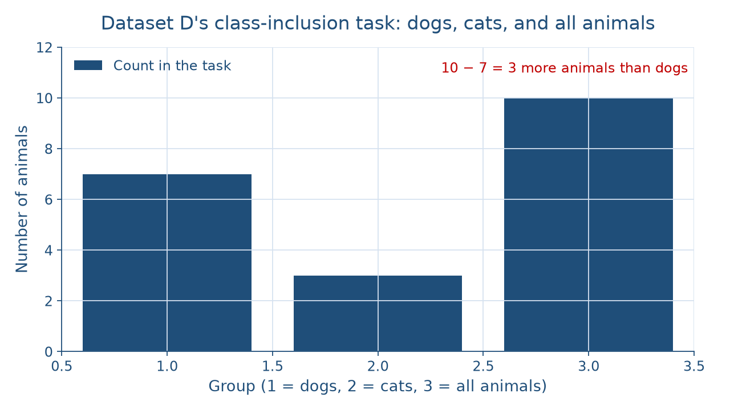
Which group is bigger?
CONCEPT 3 OF 8 · CLASS INCLUSION
The reason is the evidence
Week 11
7
Notes:
Show the picture before naming the pattern. The figure has three bars for Dataset D's class-inclusion task: dogs at 7, cats at 3, and all animals at 10. The animals bar is the tallest because it holds both the dogs and the cats, and it stands 3 higher than the dogs bar. DO: before naming anything, ask the room which bar answers the question, are there more dogs or more animals? Collect answers, then name the concept. Class inclusion is understanding that a smaller group is part of a larger group, so the larger group must hold at least as many members. A preoperational child compares the dogs bar with the cats bar and says more dogs. A concrete operational child compares the dogs with the animals bar and says more animals.

Slide 8
Seven dogs, ten animals
WORKED EXAMPLE · THE COUNTS
7 dogs + 3 cats = 10 animals
10 − 7 = 3 more animals
7 of 10 are dogs: 70 percent
Gap: 40 percentage points
The reason is the evidence
Week 11
8
Notes:
Work the class-inclusion counts step by step. Total the animals: 7 dogs + 3 cats = 10 animals. Compare the smaller group with the larger group: the dogs are inside the animals, so there are 10 − 7 = 3 more animals than dogs. Work the shares: 7 of 10 animals are dogs, which is 70 percent, and 3 of 10 are cats, which is 30 percent. Compare the shares: 70 − 30 = 40 percentage points, because a difference between two percentages is in percentage points. DO: run the four steps live, pausing before each one for a prediction, then reveal the result. Close the slide with classification and seriation from the hook: sorting cards by team is classification, and lining them up by year is seriation. Name the honest limit too: R6 carries no class-inclusion task, so it cannot show how this child answers it.

Slide 9
The mind's work in parts
CONCEPT 4 OF 8 · INFORMATION PROCESSING
Attention: focus on what matters
Working memory: a few items, seconds
Processing speed: how fast
Executive function: plan, inhibit, switch
The reason is the evidence
Week 11
9
Notes:
Information processing is an account of thinking that describes the mind's work in parts and describes their growth as gradual improvement. Attention is focusing the mind on what matters for a task while tuning out the rest. Working memory is the small mental workspace that holds a few pieces of information in mind for a few seconds while a person uses them. Processing speed is how quickly the mind takes in information and carries out a mental task. Executive function is the set of skills that steer thinking toward a goal: planning, inhibiting, and switching. DO: use the family board game. A 9-year-old tracks the cards played this turn, ignores the television, plans two moves ahead, waits for a turn, and changes strategy when play reverses. Have pairs name the part behind each move, then reveal: working memory, attention, planning, inhibiting, switching.

Slide 10
Working vs. long-term memory
THE TRAP EVERYONE FALLS FOR
Working: seconds, while you use it
Cards played this turn
Long-term: days to years
Rules learned last summer
The reason is the evidence
Week 11
10
Notes:
Name the classic wrong turn: working memory read as long-term memory, since both are called memory. Working memory holds a few pieces of information for a few seconds while you use them, such as the cards played this turn. Long-term memory stores knowledge for days or years, such as the rules of the game learned last summer. A child can know the rules well and still lose track of the cards played. Call back Week 6, where early memory in infancy was described in words; this week the course splits memory into the two kinds and keeps them apart. DO: read three illustrative notes aloud, remembering a friend's birthday, holding a phone number long enough to dial it, and recalling a song from years ago, and have the room sort each into working or long-term memory before you confirm.

Slide 11
Metacognition vs. learning styles
CONCEPT 5 OF 8 · MYTH VERSUS EVIDENCE
Metacognition: thinking about thinking
Test, notice, adjust
Learning styles: not supported
Pashler and colleagues, 2008
The reason is the evidence
Week 11
11
Notes:
Metacognition is thinking about one's own thinking, such as noticing which spelling words one still misspells and choosing how to study them. Use the scene of a 10-year-old at a library homework table who takes a practice test, notices the silent-letter words are wrong, and studies those: test, notice, adjust. Then state the evidence plainly. The learning-styles idea is the popular claim that teaching matched to a preferred style, such as visual or auditory, improves learning. Pashler, McDaniel, Rohrer, and Bjork (2008), Learning Styles: Concepts and Evidence, reviewed the research and found no adequate evidence for it, so it is not supported. A preference is real; the payoff from matching is not. DO: ask the room for one study habit that is metacognition, then confirm each answer that involves checking one's own learning.

Slide 12
A score compares, never defines
CONCEPT 6 OF 8 · INTELLIGENCE
IQ: standardized score, same-age comparison
Not fixed; not a measure of worth
Multiple intelligences: Gardner, Frames of Mind
Limited empirical support
The reason is the evidence
Week 11
12
Notes:
Intelligence testing began with Binet's early tests in France, named in words. An IQ score is a standardized score that compares a person's performance on an intelligence test with the performance of others of the same age. The key word is compares: the score places one child's test performance among children of the same age, at the time of testing, so it is not fixed and it is never a measure of worth. Gardner's Frames of Mind (1983) proposed multiple intelligences, several distinct kinds of intelligence rather than one general ability. Teachers like it because it honors many talents, and the documented criticism is that it has limited empirical support. Teach it with that criticism attached. DO: ask the room to finish the sentence, an IQ score tells you, and reject any ending that says what a child is worth.

Slide 13
Professionals identify; observers describe
CONCEPT 7 OF 8 · LEARNING DIFFERENCES
Learning disability: a specific-skill difficulty
Special education: instruction and services
Federal law: Individuals with Disabilities Education Act
Never assess or label a child
The reason is the evidence
Week 11
13
Notes:
Children learn in different ways and at different rates. A learning disability is a difficulty in learning a specific skill, such as reading, writing, or math, that is not explained by a lack of teaching or effort, and qualified professionals identify it with careful assessment. Special education is instruction and services designed for a child with a disability so the child can learn at school; in the United States it is governed by the federal Individuals with Disabilities Education Act, named in words with no figure keyed. Then draw the firm line from Week 3's observation rules: an observer never assesses, screens, or labels a real child. Noticing that a child reads slowly is noticing a behavior at one moment, not a disability. DO: ask students to rewrite the sentence, that child has a reading problem, as a behavior description.

Slide 14
Stage versus gradual growth
CONCEPT 8 OF 8 · TWO LENSES
Piaget: reversibility, a new stage
Concrete operational, about 7 to 11
Information processing: working memory
Holds back the taller level
The reason is the evidence
Week 11
14
Notes:
Read R6 with two theories. Piaget's cognitive-developmental theory: R6's reason shows reversibility, the logic Piaget placed in the concrete operational stage, at about 7 to 11. The information-processing view adds that the child holds the before-and-after glasses in working memory and holds back the pull of the taller water level, and it describes the change as gradual growth in these abilities, not a sudden new stage. Neither lens is the one right answer. DO: have pairs write the reading in one plain sentence, then share two. The sentence to land on: saying the tall glass holds the same amount because you could pour it back shows conservation with reversibility, which Piaget placed in the concrete operational stage, at about 7 to 11, and an information-processing view adds that the child is holding both glasses in working memory.

Slide 15
Audit the chatbot
THIS WEEK'S AUDIT · CHECK THE CHATBOT
Paste the R6 prompt
Check: stage ages stated as exact?
Check: learning styles called a finding?
The tool drafts; you check
The reason is the evidence
Week 11
15
Notes:
This activity puts a chatbot such as Claude, Gemini, or ChatGPT to work on this week's material. DO: paste this exact prompt: An illustrative 7-year-old watches water poured from a short, wide glass into a tall, thin glass and says it is the same, because you could pour it back. Using Piaget's theory, name the stage this shows and the age it begins, and suggest a learning style that would help this child. Compare the response with the week's reading. A likely error is an exact age, such as children reach this stage at 7; the correction is that Piaget's ages are approximate, about 7 to 11. A second likely error is recommending a visual or hands-on style; the correction is that Pashler and colleagues found no adequate support for learning styles. The judgment rule: the tool drafts; you check.

Slide 16
The reason is the evidence
Concrete operational: about 7 to 11
7 dogs + 3 cats = 10 animals
Working memory is not long-term memory
Next: self-esteem, friendship, moral reasoning
BEFORE NEXT WEEK
16
Notes:
Recap in the order taught. Growth is steady and motor skills grow smoother, read as ranges. Piaget's concrete operational stage, at about 7 to 11, is logical thinking about real things. Conservation shows in the reason, and reversibility is picturing the pour run backward. In the class-inclusion task, 7 dogs + 3 cats = 10 animals, so there are 3 more animals than dogs. Information processing splits thinking into attention, working memory, processing speed, and executive function, and working memory is not long-term memory. Learning styles is not supported, an IQ score is a same-age comparison, and multiple intelligences has limited empirical support. DO: exit ticket, write R6's reading in one plain sentence. Then tease next week: Week 12 turns to self-esteem, friendship, bullying, and moral reasoning.

