Slide 1
Read the whole child
WEEK 15 · CONTEXTS AND THE SYNTHESIS
Week 15 · Contexts of Development and the Course Synthesis
1
Notes:
Welcome to Week 15, the last teaching week of the course. Point students to the current syllabus as the authoritative source for how the course runs, then keep this opening on the ideas. The week's orienting question: how do family, culture, poverty, childcare, and adversity shape development, and what does the running case show across every period? Preview the path. We describe families in many forms and culture without ranking, read poverty and adverse childhood experiences as associations rather than destinies, name what childcare quality looks like, and build resilience from protective factors. Then we read all eight records of the running case at once. The deck's title is the week's habit: read the whole child, in context, and never judge a child from one record or one figure.

Slide 2
Three households, one street
01
THE HOOK · THREE HOUSEHOLDS
2
Notes:
Set the scene in words. In the first household, a family has moved to a new city in the middle of the school year, and a 10-year-old is starting at a new school. In the second, a grandparent has become the full-time caregiver of a 6-year-old grandchild. In the third, a 9-year-old walks to an after-school program every afternoon while the parents finish work. None of these children is behind or ahead; each is growing inside a set of people, places, and rules. DO: ask the room to name one setting in each household's week, then one rule or value around it. Collect three answers on the board and keep them; they return as microsystems and the macrosystem later in the deck. Cure the wrong turn early: one family structure is not the only healthy one.

Slide 3
Eight records, one child
02
SHARED DATA · DATASET A AND DATASET H
3
Notes:
Introduce the shared data by name. Dataset A is the running case: an illustrative, unnamed child, constructed for this course and describing no real child, followed from birth to 15 years through eight records, R1 to R8. The 8 records come from 7 settings, because the childcare center appears twice, for R3 and R4. Week 1 read these records only by age, setting, and domain; this week we read them with every concept the course has taught since. Dataset H supplies this week's sourced figures, each with its issuing body and year: the Census Bureau's child poverty figure and the CDC's adverse childhood experience figures, said in words and never quizzed. Make the boundary plain now: the records pin no family income, family form, culture, or ACE, so the population figures say nothing about this child.

Slide 4
Many family forms
CONCEPT 1 OF 7 · FAMILY
Many forms: one parent, two, grandparents, blended
Children develop well in many forms
What matters: warmth, routines, low conflict
Family is a microsystem
Read the whole child
Week 15
4
Notes:
Teach the family in its many forms. A family form is the structure of a child's household: two parents, one parent, grandparents, foster or adoptive parents, a blended family with stepparents, two mothers or two fathers, or several generations under one roof. Children develop well in many family forms. Research points inside the family, to warmth, steady routines, support, and low conflict; family conflict and support are among the strongest influences, more than the form. Call back Week 1: in Bronfenbrenner's (1979) model the family is a microsystem, and the grandparent household from the hook is one microsystem among many. DO: read aloud two sentences about the grandparent household, one that says it is not a real family and one that describes the routines; ask which ranks a form and which describes, then keep the descriptive one.

Slide 5
Culture shapes, never ranks
CONCEPT 2 OF 7 · CULTURE
Sleep, independence, and learning differ
Culture sits in the macrosystem
Describe each practice; rank none
AAP 2022: back, firm, flat, until 1
Read the whole child
Week 15
5
Notes:
Culture is the shared values, practices, languages, and expectations of a group, which shape what families expect of children around sleep, independence, and learning; in the ecological systems model it sits in the macrosystem. Give one example each. Sleep: families differ in bedtimes and naps. Independence: some families expect early chores or sibling care, others expect children to stay close to adults longer. Learning: some communities expect learning by watching and pitching in, others by asking adults questions. Each practice makes sense inside its own community, and the course ranks none. One rule holds across every culture's bedtimes: the American Academy of Pediatrics' 2022 safe sleep guidance places babies on their backs for every sleep until age 1, on a firm, flat surface. State it as that body's guidance, never as advice about one baby.

Slide 6
Pathways, not destiny
CONCEPT 3 OF 7 · POVERTY
Census Bureau: 13.7 percent in 2023
Up 1.3 percentage points
Pathways: stress, resources, neighborhoods
Associations, never a destiny
Read the whole child
Week 15
6
Notes:
Give the issuing body's figure first. The Census Bureau reported that the Supplemental Poverty Measure child poverty rate was 13.7 percent in 2023, up 1.3 percentage points. The Supplemental Poverty Measure is the Census Bureau's measure that counts a household's resources after taxes, government benefits, and necessary expenses. Say the figure in words with its body and year; the quiz never asks for it. Then teach the poverty pathways: family stress, fewer resources such as food, stable housing, books, and health care, and neighborhood conditions. Call back Week 3's distinction: these are associations across many children, not causes for one child. DO: write the sentence 'Poverty decides how a child turns out' on the board; ask pairs to rewrite it with the word association. The rewrite to land on: poverty is associated with development across many children, many do well, and supports change the odds.

Slide 7
Quality vs. price
CONCEPT 4 OF 7 · CHILDCARE
Quality: warm, responsive caregivers
Small groups, safe settings, activities
Not quality: price or new furniture
Head Start began in 1965
Read the whole child
Week 15
7
Notes:
Childcare quality is what research means by good early care and education: warm, responsive caregivers, small group sizes, safe settings, and stimulating activities, read from what caregivers do rather than from what a program costs. Head Start began in 1965 as an eight-week summer demonstration project, recorded by the Administration for Children and Families. Then name one debate and settle nothing: what do long hours in childcare mean for young children over time? One side links many early hours with more behavior problems for some children; the other says the links are small, quality matters, and many children benefit. DO: describe two rooms, one where a caregiver sits with 4 toddlers and answers each babble, one with new furniture and a high fee; ask which shows quality. The first does; the second describes price and looks. Argue no policy question about funding.

Slide 8
ACEs: links, not destinies
CONCEPT 5 OF 7 · ADVERSITY
CDC: 63.9 percent at least one
17.3 percent four or more
63.9 − 17.3 = 46.6 percent one to three
Correlational: links, not causes
Read the whole child
Week 15
8
Notes:
Adverse childhood experiences are potentially stressful or harmful events in childhood, such as abuse, neglect, and serious household challenges, abbreviated ACEs. The ACE Study was the original CDC–Kaiser Permanente study, with data collected from 1995 to 1997 and reported by Felitti and colleagues. The CDC later reported that 63.9 percent of U.S. adults reported at least one ACE and 17.3 percent reported four or more, using 2011–2020 data. DO: work the nested shares live. Everyone with four or more also has at least one, so 63.9 − 17.3 = 46.6 percent reported one to three. Then call back Week 3: the research asked adults to look back and compared answers with health, which is correlational, so it shows links, not causes. Close on the rule: an ACE count is neither a diagnosis nor a destiny, and no one counts a real child's ACEs.

Slide 9
Resilience grows from supports
CONCEPT 6 OF 7 · RESILIENCE
Kauai study: nearly 700 children, 1955
A caring adult
Problem-solving skills
Community supports
Read the whole child
Week 15
9
Notes:
Resilience is positive adaptation despite adversity; it grows from protective factors in the child, the family, and the community rather than being a fixed trait that some children have and others lack. Protective factors are supports that make positive development more likely in the face of adversity. Werner and Smith's study of nearly 700 children born on Kauai in 1955, named in words, found that many children who grew up with serious adversity developed well, and it pointed to protective factors: a caring adult, problem-solving skills, and community supports. DO: return to the 9-year-old at the after-school program from the hook. Ask the room to name each protective factor in the scene: the staff member is a caring adult, the step-by-step math builds problem-solving skills, and the program itself is a community support. Cure the wrong turn that resilience is a trait.

Slide 10
Four records, four concepts
WORKED EXAMPLE · RECORDS R1 TO R4
R1: Apgar 7 and 9; rooting reflex
R2: sits, crawls; A-not-B error
R3: walks alone; secure base; first words
R4: parallel play; Me do it
Read the whole child
Week 15
10
Notes:
Begin the synthesis in time order, and keep every reading as a range. R1, the newborn in a hospital birthing room: the Apgar total is 2 + 2 + 1 + 1 + 1 = 7 at 1 minute and 2 + 2 + 2 + 2 + 1 = 9 at 5 minutes, both inside the normal range from Week 4, and turning toward a touch on the cheek is the rooting reflex from Week 5. R2, 9 months at home: sitting inside the WHO window of 3.8 to 9.2 months, and the A-not-B error from Week 6. R3, 14 months at childcare drop-off: walking alone inside 8.2 to 17.6 months, a secure base, and first words. R4, 2½ years in the block area: parallel play from Week 8 and autonomy. DO: read each record's behavior aloud and have the room name the concept before you reveal it.

Slide 11
Four more, to age 15
WORKED EXAMPLE · RECORDS R5 TO R8
R5: false belief; private speech
R6: conservation with reversibility
R7: fairness; loyal friendship
R8: imaginary audience; moratorium; 7:30 a.m.
Read the whole child
Week 15
11
Notes:
Continue the synthesis. R5, 4 years in a preschool classroom: saying the first puppet will look in the basket, where she left it, shows false belief understood, and the quiet talk while drawing is private speech, from Week 9. R6, 7 years at an after-school program: the poured water is the same because you could pour it back, conservation with reversibility from Week 11. R7, 11 years at an after-school club: a rule that is not fair if new kids never get a turn, and a best friend who has your back, from Week 12. R8, 15 years at a youth program: the imaginary audience from Week 13, a pattern consistent with identity moratorium from Week 14, and a 7:30 a.m. start, 60 minutes earlier than the AAP's 2014 position of no earlier than 8:30 a.m. DO: ask which record carries three domains at once; the reply to land on is R8, with R3 as the other.

Slide 12
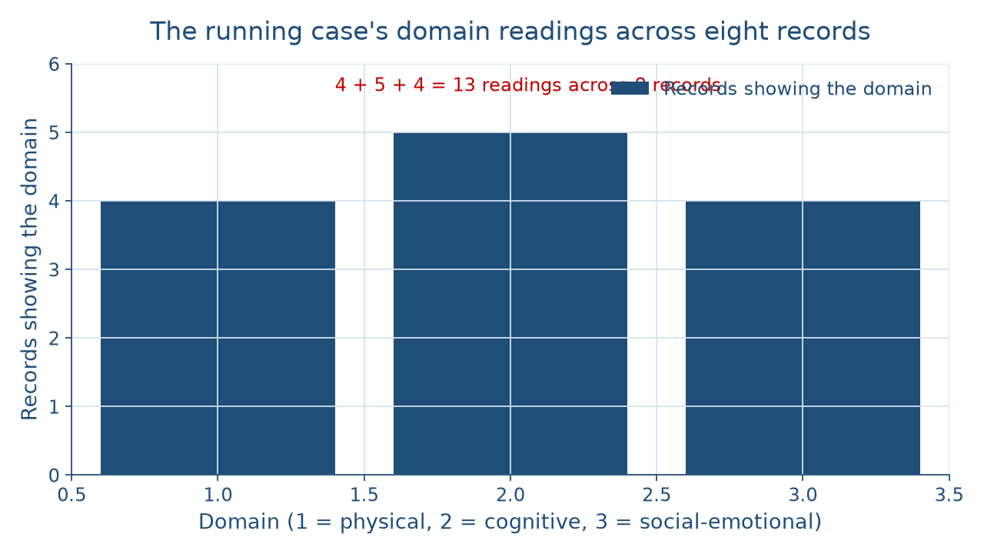
Thirteen readings, eight records
WORKED EXAMPLE · THE DOMAIN TALLY
Read the whole child
Week 15
12
Notes:
Show the picture before naming the reason. The bar chart has three bars, one per domain: physical at 4 records, cognitive at 5, and social-emotional at 4, so 4 + 5 + 4 = 13 domain readings across 8 records. Call back Week 1: this is the same tally, and it still holds after every concept the course has added. Why 13 and not 8? Five records show one domain each, R1, R4, R5, R6, and R7; R2 shows 2; and R3 and R8 show 3 each, so 5 + 2 + 3 + 3 = 13. DO: before revealing the arithmetic, ask the room to predict whether the bars should add to 8; collect a show of hands, then walk the sum and land on the reason. The domains overlap because they work together at every age, which is why the course never studies one domain alone.

Slide 13
Seven settings, five systems
WORKED EXAMPLE · THE SYSTEMS
Microsystems: the 7 settings
Mesosystem: R3's drop-off; exosystem: R8's start
Macrosystem: values about childcare
Chronosystem: 15 − 0 = 15 years
Read the whole child
Week 15
13
Notes:
Place the whole case in Bronfenbrenner's systems, from the inside out. The 7 settings are microsystems: a hospital birthing room, a family home, a childcare center, a preschool classroom, an after-school program, an after-school club, and a youth program. R3's drop-off and pickup, where a parent hands the child to a caregiver, is a mesosystem link. R8's 7:30 a.m. start is set by a district decision, an exosystem the teen does not take part in. The culture's values and laws about who cares for young children are the macrosystem. The records run from birth to 15 years, a chronosystem of 15 − 0 = 15 years. DO: ask what the records cannot show. The reply to land on: no family income, family form, culture, or ACE is pinned, so no poverty or adversity reading is drawn. In R3, a caregiver's comfort is one protective factor the records do show.

Slide 14
Settings vs. inner crises
WORKED EXAMPLE · TWO LENSES
Bronfenbrenner: settings and systems
Same child, seven settings
Erikson: stages 1, 2, and 5
A sequence of inner crises
Read the whole child
Week 15
14
Notes:
Read the whole case through two theories and say what each adds. Bronfenbrenner's ecological systems: every record happens in a setting, and the settings link, shift, and sit inside wider systems, so the same child is read differently in each of the 7 settings; it names settings, not inner change. Erikson's psychosocial theory, from Childhood and Society (1950): R3's comfort and secure base bear on trust vs. mistrust, R4's Me do it on autonomy vs. shame and doubt, and R8's exploration on identity vs. role confusion, stages 1, 2, and 5 of Dataset E's 5. DO: have pairs write the synthesis in one plain sentence, then compare with this one: across 8 records and 15 years, the running case shows physical, cognitive, and social-emotional growth working together in 7 settings, so a child is read in context, by ranges and more than one theory.

Slide 15
Audit the chatbot
THIS WEEK'S AUDIT · CHECK THE CHATBOT
Paste the running-case prompt
Check: population figure applied to one child?
Check: ACEs treated as destiny?
The tool drafts; you check
Read the whole child
Week 15
15
Notes:
This activity puts a chatbot such as Claude, Gemini, or ChatGPT to work on this week's material. DO: paste this exact prompt: An illustrative child was observed at birth, 9 months, 14 months, 2½ years, 4, 7, 11, and 15 years in seven settings. Using the Census Bureau's 2023 child poverty figure and the CDC's adverse childhood experience figures, tell me how likely this child is to be in poverty and how many ACEs they probably have. Compare the response with the week's reading. A likely error is applying a population figure to the child; the correction is that the records pin no income or ACE, so the figures say nothing about this child. A second likely error is an ACE count treated as a destiny; the correction is that ACE research found links, not causes. The judgment rule: the tool drafts; you check.

Slide 16
Read the whole child
Many family forms; culture ranked by none
Poverty and ACEs: associations, not destiny
13 readings, 8 records, 7 settings
Next: the cumulative final
BEFORE THE FINAL
16
Notes:
Recap in the order taught. Children develop well in many family forms. Culture shapes sleep, independence, and learning, and none of it is ranked. The Census Bureau's 13.7 percent in 2023 is said in words, and poverty works through pathways, not destiny. Childcare quality shows in what caregivers do, and Head Start began in 1965. ACEs are links found across many adults, and resilience grows from protective factors. The running case shows 4 + 5 + 4 = 13 domain readings across 8 records in 7 settings over 15 years. DO: ask each student to write one sentence naming the record that taught them the most and the theory that read it best; collect three and read them aloud. Tease the end of the course: next comes the cumulative final, which asks for this same reading, record, concept, two theories, and one plain sentence, on every period.

