Slide 1
What else could explain it?
WEEK 10 · TEST THE CAUSE
Week 10
1
Notes:
Welcome to Week 10. Last week you asked whether a sample stands for its population. This week the question moves one step further: when two things go together, does one make the other happen? You will meet a small table about summer days that seems to blame ice cream for sunburn, and you will watch that pattern disappear once you compare like with like. You will also key two more fallacies from the course's set, judge a slippery slope one link at a time, and work two of Mill's methods for finding causes. For course policy, deadlines, and how this week's work is graded, the current syllabus is the place to look. Let's start with a pair of striped socks.

Slide 2
Socks first, then a pass
01
THE QUESTION BEHIND THIS WEEK
2
Notes:
Picture a friend who has worn the same striped socks to 3 exams and passed all 3. Before the next exam, the socks go on again. Now picture a fitness app's ad that says its users are fitter than people who skip it. Each one takes a pattern, two things that go together, and turns it into a cause. Sometimes that move is right. Sometimes the pattern has a different explanation, and acting on the wrong cause wastes money and time. DO: ask the room for one claim they heard this week that one thing causes another. Write three on the board, and for each one ask a single question: what else could explain this pattern? Keep the three claims up; we return to them at the end.

Slide 3
100 days, one beach log
02
OUR EXAMPLES THIS WEEK
3
Notes:
This week's shared examples come in three parts. First, the course's illustrative hot-weather table: a beach clinic's log of 100 summer days, 40 hot and 60 mild, sorted by ice-cream sales, high or low, and by sunburn cases, many or few. Overall, 56 percent of high-sales days had many sunburn cases against 32 percent of low-sales days. Within hot days the rates are 80 and 80, and within mild days 20 and 20. Second, the two Week 10 passages from the fallacy set, the lucky socks and the coffee-to-grills slope, with the bus-route warning as a contrast. Third, Mill (1843), A System of Logic, the classic source for methods of finding causes. Week 7's fallacy set grows by two this week, from 17 keyed through Week 9 to 19.

Slide 4
Correlation vs. causation
CONCEPT 1 OF 7 · PATTERN AND CAUSE
Correlation: two things go together
Umbrellas and wet doormats
Causal claim: one makes the other
Needs more than a pattern
What else could explain it?
Week 10
4
Notes:
On the left, a correlation is a pattern in which two things tend to go together, so that one shows up more often when the other does; a correlation by itself does not show that either one causes the other. On a rainy street, houses with more umbrellas in the hallway also have wetter doormats, and nobody thinks umbrellas wet the mats. On the right, a causal claim says that one thing makes another happen, which says more than that the two go together, so it needs more than a pattern to support it. This is Week 3's standard again: a causal argument is inductive, strong or weak, never valid. DO: ask what drives both the umbrellas and the doormats. Answer: rain, a third factor. That sets up the three rivals on the next slide.

Slide 5
Three rivals to check
CONCEPT 1 OF 7 · THREE RIVALS
Confounding factor: a third thing behind both
Reverse causation: the arrow runs backward
Coincidence: chance, often from few cases
What else could explain it?
Week 10
5
Notes:
Every correlation has three rivals to the causal reading, and you check all three before accepting a cause. A confounding factor is a third factor that drives both of two things that go together, so they move together even though neither causes the other. Reverse causation is the alternative in which the causal arrow runs the other way, so the supposed effect is in fact the cause. Coincidence is a pattern that arises by chance, most likely when it rests on only a few cases. DO: read the roommate's theory: the 2 times the campus coffee cart closed early, the vending machine broke that afternoon. Have pairs name one way each rival could explain it. Vetted answers: a power outage could hit both; the arrow could run the other way; and 2 afternoons could match by chance.

Slide 6
56 vs. 32 percent
CONCEPT 2 OF 7 · THE OVERALL PATTERN
High-sales days: 28 ÷ 50 × 100 = 56 percent
Low-sales days: 16 ÷ 50 × 100 = 32 percent
A correlation, not yet a cause
What else could explain it?
Week 10
6
Notes:
Here is the overall pattern from the hot-weather table, which is illustrative. The table sorts 100 summer days; 40 hot days + 60 mild days = 100 days. High-sales days are 28 with many sunburn cases + 22 with few = 50. Low-sales days are 16 with many + 34 with few = 50. On high-sales days, 28 ÷ 50 × 100 = 56 percent had many sunburn cases. On low-sales days, 16 ÷ 50 × 100 = 32 percent did. So many sunburn cases go with high ice-cream sales more often. That is a correlation, and on its own it does not tell you ice cream causes sunburn. DO: before the next slide, ask the room to predict what happens to the 56 and the 32 if you compare only hot days with hot days. Collect a show of hands for bigger, same, or smaller gap.

Slide 7
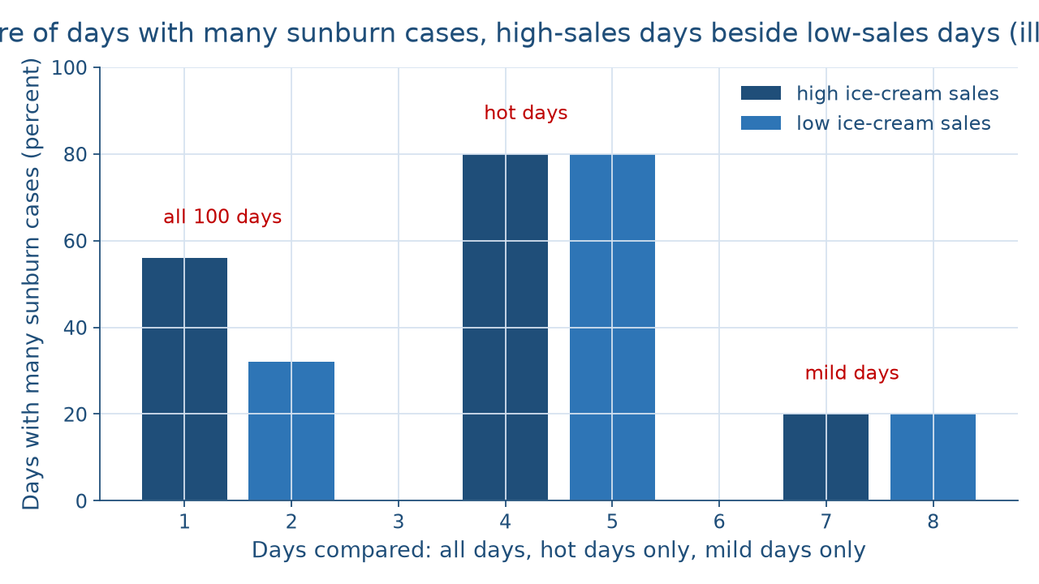
Watch the gap vanish
WORKED EXAMPLE · HOLD TEMPERATURE FIXED
What else could explain it?
Week 10
7
Notes:
This chart draws the table in three pairs of bars. In each pair, the left bar is high ice-cream-sales days and the right bar is low-sales days, and each bar's height is the percent of those days with many sunburn cases. Across all 100 days the left bar stands at 56 percent and the right at 32 percent, so the left is taller. Among hot days only, both bars stand at 80 percent. Among mild days only, both stand at 20 percent. The gap that appears across all days disappears inside each temperature group. DO: point out each pair in words, left bar then right bar, and ask what changed between the first pair and the other two. Vetted answer: only days alike in temperature are compared, so temperature can no longer make a difference.

Slide 8
Hot days vs. mild days
WORKED EXAMPLE · LIKE WITH LIKE
Hot: 24 ÷ 30 and 8 ÷ 10
Both 80 percent
Mild: 4 ÷ 20 and 8 ÷ 40
Both 20 percent
What else could explain it?
Week 10
8
Notes:
On the left, the hot days held fixed. High-sales hot days are 24 + 6 = 30, and 24 ÷ 30 × 100 = 80 percent had many sunburn cases. Low-sales hot days are 8 + 2 = 10, and 8 ÷ 10 × 100 = 80 percent did. On the right, the mild days held fixed. High-sales mild days are 4 + 16 = 20, and 4 ÷ 20 × 100 = 20 percent had many sunburn cases. Low-sales mild days are 8 + 32 = 40, and 8 ÷ 40 × 100 = 20 percent did. Why did the overall gap appear? 30 of the 50 high-sales days were hot, 60 percent, while 10 of the 50 low-sales days were hot, 20 percent. DO: ask whether the table contains a counting error. Vetted answer: no; every count is accurate, and hot weather is the confounding factor behind both.

Slide 9
Flip the arrow; count cases
CONCEPT 3 OF 7 · THE OTHER RIVALS
Reverse: fit people pick the app
Grade-minded students pick the front row
Coincidence: 3 wins with a mascot
Too few games to rule out chance
What else could explain it?
Week 10
9
Notes:
On the left, reverse causation. The fitness app's ad says its users are fitter, but people who are already fit, or already training, are the ones who download a workout app, so the arrow could run from fitness to the app. Students who sit in the front row may earn higher grades because students who already care about grades choose the front row. On the right, coincidence. A city softball team wins all 3 games a new mascot attends, and a fan credits the mascot. This is Week 9's lesson in a new setting: a sample of 3 games is too small to rule out a lucky run. DO: ask pairs to name the rival in each case and say what evidence would test it. Vetted answers: reverse causation, tested by comparing people who started alike; coincidence, tested by many more games.

Slide 10
First is not because
CONCEPT 4 OF 7 · THE FALLACY SET
Passage: lucky socks, then a pass
Only support: the socks came first
Post hoc; the premise is true
What else could explain it?
Week 10
10
Notes:
After this, therefore because of this (post hoc) is the fallacy of concluding that one event caused another only because it came first, with no comparison that rules out the other explanations. The passage is illustrative: I wore my lucky socks to the exam and passed, so the socks helped me pass. The only support is that the socks came first, so the passage commits after this, therefore because of this (post hoc). Studying, sleep, and the exam's difficulty also came first. Use Week 7's distinction here: a fallacy is a flaw in the reasoning, not a false premise, and this premise is true. DO: ask whether the verdict says the friend failed. Vetted answer: no; it says only that order alone does not show a cause. Then ask what comparison would.

Slide 11
Coffee slope vs. bus route
CONCEPT 5 OF 7 · CHECK EACH LINK
Coffee to grills: no link backed
Unsupported slippery slope
Bus route: each link counted
A reasonable slope
What else could explain it?
Week 10
11
Notes:
A slippery slope predicts that one step leads through a chain of further steps to a bad outcome. It is reasonable when each link is backed by evidence and a fallacy when the links are not. On the left, the illustrative coffee passage: let students bring coffee into the library, next full meals, then grills, and soon the building burns down. No link from coffee to meals to grills to fire is backed by evidence, so it commits the unsupported slippery slope. On the right, the contrast, discussed and never keyed: cutting the late-night bus route leaves late-shift workers without a ride, so some drive and late-night traffic rises, each step backed by the city's own ridership counts. The tally: 1 + 1 = 2 Week 10 passages, 17 + 2 = 19 keyed, and 20 − 19 = 1 still to come. DO: have pairs list each slope's links and mark which are backed.

Slide 12
Agreement vs. difference
CONCEPT 6 OF 7 · MILL'S METHODS
Agreement: what every case shares
Potluck: everyone sick ate potato salad
Difference: the one factor that differs
Wilting plant above a heating vent
What else could explain it?
Week 10
12
Notes:
Mill (1843), A System of Logic, Book III, Chapter 8, names five methods for finding causes: agreement, difference, residues, concomitant variation, and a joint method. The course works and grades the first two. On the left, the method of agreement looks for the one factor every case of an effect shares while the cases differ in other factors: the sick potluck guests ate different dishes, but every one ate the potato salad. On the right, the method of difference compares a case with the effect and a case without it, alike in every factor but one: two plants share soil, water, and kind, and only the wilting one sits above a heating vent. DO: give a fresh case aloud, two loaves from one recipe where only the yeast packet differs, and ask which method it is. Vetted answer: difference.

Slide 13
Let chance pick groups
CONCEPT 7 OF 7 · THE FAIR TEST
Hold what you can fixed
Assign by lottery
Hidden factors split evenly
What else could explain it?
Week 10
13
Notes:
A controlled comparison holds other factors fixed, or spreads them evenly by random assignment, so that a difference in outcome can be traced to the one factor that differs. Random assignment means deciding by chance which cases get a factor, so that other factors, including ones no one thought to measure, end up spread evenly. Picture a tutoring center whose evening review sessions seem to raise grades, though the students who chose to attend may be the most motivated. The fix: one course, one exam, the same material, and a lottery to decide who attends now and who attends later. This goes past Mill's methods, which work only on the factors you thought to list. DO: ask whether comparing far more self-chosen students would fix it. Vetted answer: no; size cannot fix how the groups formed.

Slide 14
Audit the chatbot
THIS ACTIVITY · CHECK THE MACHINE
Paste the table's overall rates
Watch for: ice cream causes sunburn
Check: the gap vanishes by temperature
The tool drafts; you check
What else could explain it?
Week 10
14
Notes:
This audit is for this activity only. Open one approved chatbot, such as Claude or Gemini, and paste this prompt: over 100 summer days, 56 percent of high-ice-cream-sales days had many sunburn cases at a beach clinic, against 32 percent of low-sales days; does ice cream raise sunburn risk? A common slip is to report the correlation as a cause, or to add a vague caution without naming the confounding factor. The correct reading: within hot days the rates are 80 and 80, and within mild days 20 and 20, so hot weather drives both. DO: have each pair paste the prompt, then paste the hot and mild rows, mark whether the reply names the confounding factor, and correct any slip by hand. Close on the rule for this activity: the tool drafts; you check.

Slide 15
Ask what else explains it
Three rivals: confounder, reverse, chance
56 vs. 32 becomes 80 and 80, 20 and 20
First is not because; test each link
Next: Numbers in the News
BEFORE NEXT CLASS
15
Notes:
Let me pull it together. A correlation is a pattern, and a causal claim says one thing makes another happen. Check every correlation against a confounding factor, reverse causation, and coincidence. In the hot-weather table, 56 percent against 32 percent became 80 and 80 on hot days and 20 and 20 on mild days, so hot weather, not ice cream, is behind the sunburns. Post hoc infers a cause from order alone. A slippery slope is a causal chain, a fallacy only when its links lack support. Agreement finds what cases share, difference finds what a pair does not, and random assignment splits hidden factors evenly. Next week, Numbers in the News states these claims in risks and base rates. DO: return to the three claims on the board and have each student name the rival that most threatens one of them.

