Slide 1
What does this number say?
WEEK 11 · READ THE NUMBERS
Week 11
1
Notes:
Welcome to Week 11. For two weeks you tested the evidence behind claims: Week 9 checked who was in a sample, and Week 10 checked whether a pattern shows a cause. This week the evidence arrives as numbers: a percent that rose, a risk that doubled, a screening result, a bar graph in an ad. Each one can be true and still leave you with the wrong picture. By the end of the week you will run one four-question numbers check on any figure in a claim and say in words how much it can carry. For course policy on how this week's work is graded and submitted, the current syllabus is the place to look. Let's start with three numbers you have probably scrolled past.

Slide 2
Three big-sounding numbers
01
THE QUESTION BEHIND THIS WEEK
2
Notes:
Picture three numbers crossing a phone screen in one evening, all illustrative. A campus post says support for overnight library hours jumped 20 percent. A store sign says sales are up 100 percent. A health alert says a risk rose by half. Each sounds big, and none of them tells you yet how big. Up 100 percent can mean 2 sales became 4. DO: read the three numbers aloud, then ask the room to write one question they would ask about each before believing it. Collect a few. You are listening for out of how many, compared with what, and from where to where. Those are this week's four questions in rough form, and the deck sharpens them one at a time.

Slide 3
Four cases, one check
02
OUR EXAMPLES THIS WEEK
3
Notes:
This week's shared examples are all illustrative except one. First, the running question's random sample: 200 of 400 students in favor last year, 50 percent, and 240 of 400 this year, 60 percent. Second, the risk pair: 2 in 1,000 rising to 3 in 1,000, and 4 in 1,000 falling to 3 in 1,000. Third, the screening table: a condition that affects 1 in 100, a test given to 1,000 people, and 108 positive results. Fourth, an ad's bar graph: ratings of 50 and 55 on an axis that starts at 45. The real case, taught in words and never quizzed, is the National Cancer Institute's explanation of a lung-screening trial. Every number on later slides comes from these.

Slide 4
Find the "so" first
CONCEPT 1 OF 7 · FIND THE CLAIM
A number is often a premise
Find the conclusion it supports
Some passages only report
What does this number say?
Week 11
4
Notes:
Week 1's test returns. An argument offers premises as reasons for a conclusion, and a report tells what happened and offers nothing as a reason. A number can sit in either one. The illustrative campus post reads: support for overnight hours jumped 20 percent in one year, so the library should open around the clock. The word so marks the conclusion, the library should open around the clock, and the number is the premise. Compare: this year's random survey found 60 percent of students in favor. That only reports. DO: show both sentences and ask the room to label each argument or report, then name the conclusion in the first. Answers: the post argues, the survey sentence reports.

Slide 5
Points vs. percent
CONCEPT 2 OF 7 · POINTS VS. PERCENT
60 − 50 = 10 percentage points
The plain gap
A 20 percent change
Gap divided by the start
What does this number say?
Week 11
5
Notes:
The random sample found 200 of 400 in favor last year, and 200 ÷ 400 × 100 = 50 percent. This year it found 240 of 400, and 240 ÷ 400 × 100 = 60 percent. On the left, percentage points are the plain difference between two percents: 60 − 50 = 10 percentage points. On the right, a percent change is the difference divided by the starting value, times 100: (60 − 50) ÷ 50 × 100 = 20 percent. Support rose 10 percentage points, which is a 20 percent increase, and a fair report gives both. DO: work the two lines live on the board, pausing before each result for predictions. Then ask what a reader pictures on hearing jumped 20 percent; the usual reply is 50 to 70, which did not happen.

Slide 6
Small base, big percent
WORKED EXAMPLE · GAPS AND TINY BASES
Doorway gap: 15 percentage points
Store: 2 to 4 units
Up 100 percent, 2 more units
What does this number say?
Week 11
6
Notes:
Week 9's two surveys come back with a new question. The doorway sample read 75 percent, and the random sample read 60 percent. The gap is 75 − 60 = 15 percentage points, and 15 ÷ 60 × 100 = 25 percent higher. Week 9 already told you why: the doorway sample was biased, so neither number shows a rise in support, and a correct calculation does not rescue a bad sample. Next, an illustrative store sign says sales are up 100 percent. Sales went from 2 units to 4 units; 4 − 2 = 2 more units, and (4 − 2) ÷ 2 × 100 = 100 percent. DO: ask the room what single number they would want before trusting any percent change. Answer: the starting count.

Slide 7
Relative vs. absolute
CONCEPT 3 OF 7 · NAME THE BASE
2 to 3 in 1,000
+50 percent; 1 more per 1,000
4 to 3 in 1,000
−25 percent; 1 fewer per 1,000
What does this number say?
Week 11
7
Notes:
Absolute risk is the chance of an outcome stated as a count out of a named base, such as 2 in 1,000 people. Relative risk compares one risk with another as a ratio or a percent change. On the left, a risk rises from 2 in 1,000 to 3 in 1,000: the absolute change is 3 − 2 = 1 more case per 1,000 people, and the relative change is (3 − 2) ÷ 2 × 100 = 50 percent. On the right, a risk falls from 4 in 1,000 to 3 in 1,000: 4 − 3 = 1 fewer case per 1,000, and (4 − 3) ÷ 4 × 100 = 25 percent. DO: ask why two changes of 1 case per 1,000 get different percents. Answer: the relative number depends on the starting risk.

Slide 8
Both numbers are true
CONCEPT 4 OF 7 · A REAL CASE
20 percent relative decrease
About 0.4 percent absolute
Taught in words, never quizzed
What does this number say?
Week 11
8
Notes:
This is the week's one real case, taught in words from a federal health agency. The National Cancer Institute explains that in a large lung-screening trial a 20 percent decrease in the relative risk of dying of lung cancer translated to an absolute reduction of about 0.4 percent. The relative number compares the risk with screening against the risk without it. The absolute number is the plain difference in risk. Both are real, and they answer different questions. A report with only the 20 percent sounds larger than the result, and one with only the 0.4 percent can sound like nothing happened. DO: ask the room which number a fair report leaves out. Answer: neither; it gives both. This is not screening advice.

Slide 9
Count 1,000 people
WORKED EXAMPLE · NATURAL FREQUENCIES
10 have it; test finds 9
990 do not; 99 flagged anyway
9 of the 108 positives
What does this number say?
Week 11
9
Notes:
Natural frequencies set a problem out as counts of people in a group of round size, and Gigerenzer and Hoffrage (1995) found that people reason about such problems more easily in counts. The base rate is 1 in 100. Of 1,000 people tested, 1,000 ÷ 100 = 10 have the condition; the test detects 9 and misses 1, a false negative. Then 1,000 − 10 = 990 do not have it, and 990 × 10 ÷ 100 = 99 test positive anyway, false positives, while 891 test negative. In all, 9 + 99 = 108 test positive, and 9 of the 108 people who test positive have the condition, 1 in 12. DO: build the four counts on the board one at a time, asking the room for each before you write it.

Slide 10
Test row vs. positive column
THE TRAP EVERYONE FALLS FOR
Row: catches 9 of 10
True, but not your question
Column: 9 of 108 positives
What a positive result means
What does this number say?
Week 11
10
Notes:
The misreading to cure is base-rate neglect: judging a positive result from the test's accuracy alone while ignoring how rare the condition is. On the left is the row reading. The test catches 9 of the 10 people who have the condition, and that is true. On the right is the column reading, the one a person holding a positive result belongs to: only 9 of the 108 people who test positive have the condition. The 99 false positives from the 990 people without it crowd that column. DO: read aloud a friend's claim, the test catches 9 of every 10 cases so I almost surely have it, and ask pairs to correct it using the column. Answer: 9 of 108.

Slide 11
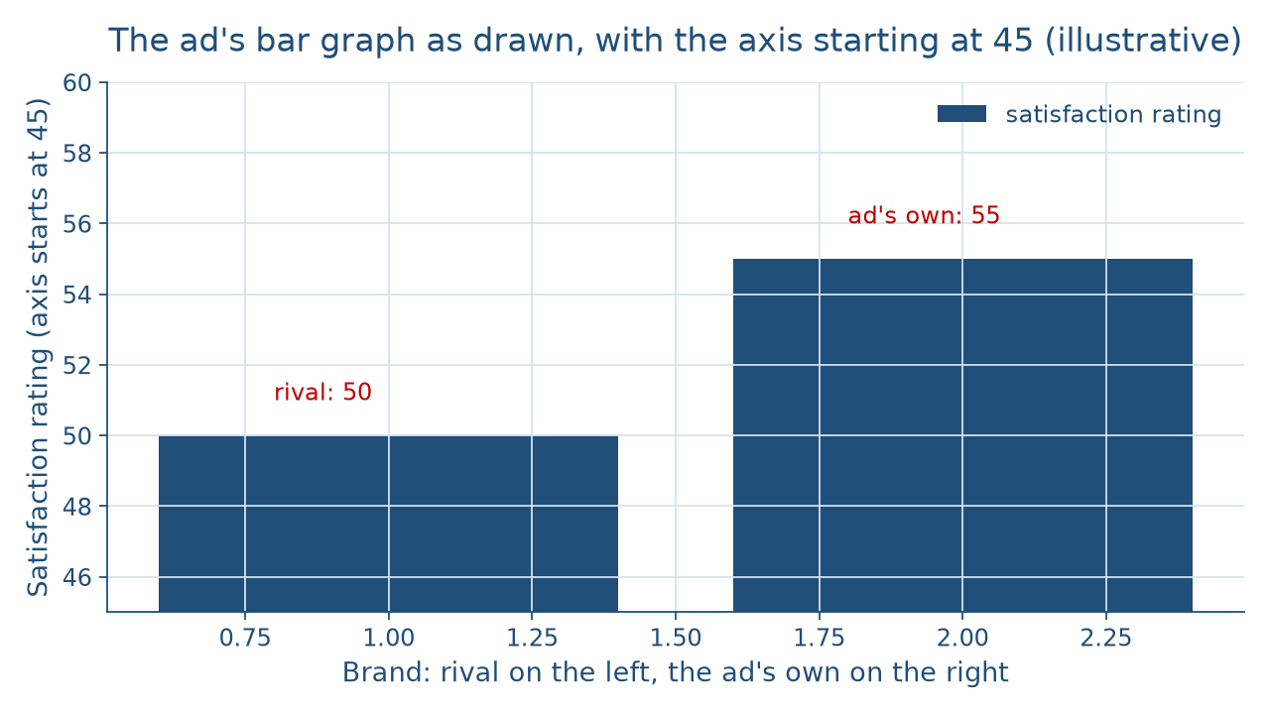
One bar looks double
CONCEPT 6 OF 7 · CHECK THE AXIS
What does this number say?
Week 11
11
Notes:
This is the illustrative ad's bar graph as drawn. The rival brand's satisfaction rating is 50 and the ad's own is 55, and the vertical axis starts at 45. The bars are drawn 50 − 45 = 5 units and 55 − 45 = 10 units tall, and 10 ÷ 5 = 2, so one bar looks twice the other. That is a truncated axis: an axis that starts above zero, which makes bar heights stop matching the values they stand for. DO: before naming the trick, ask the room how much better the ad's brand looks. Collect answers such as twice as good. Then point to where the axis starts, read its number aloud, and compute the real gap together on the next slide.

Slide 12
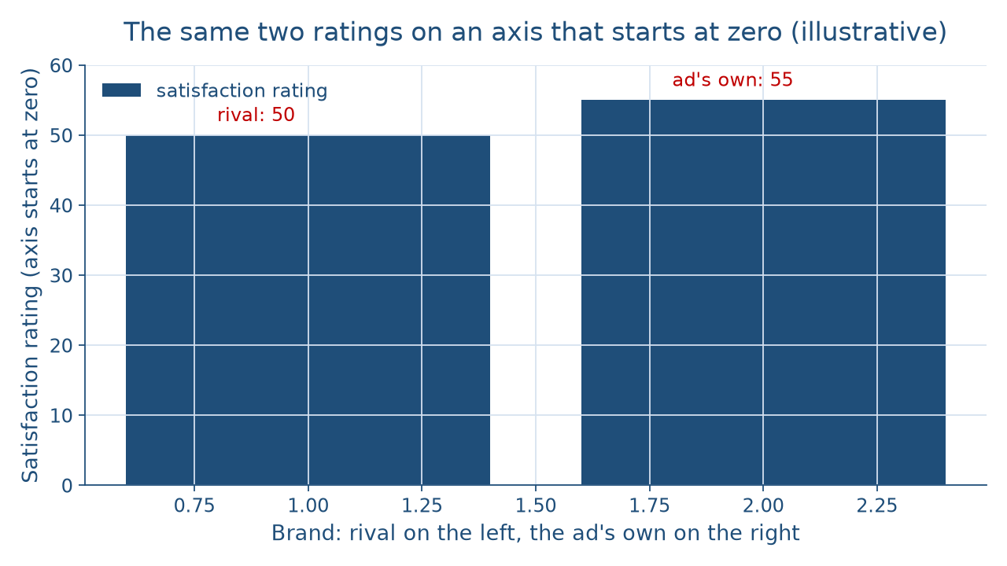
Same data from zero
THE SAME NUMBERS, HONESTLY DRAWN
What does this number say?
Week 11
12
Notes:
Here are the same two ratings, 50 and 55, on an axis that starts at zero. Now the bars are drawn 50 and 55 units tall, and they look nearly the same height. The real gap is 55 − 50 = 5, and 5 ÷ 50 × 100 = 10 percent. So the ad's taller bar on the last slide showed a 10 percent gap, not a doubling. A limitation worth naming: an axis above zero is not always a trick, as on a line graph of body temperature. The question is whether the drawing makes a difference look bigger than the numbers say. DO: ask pairs to write one sentence a fair ad could say about these ratings. Accept versions of higher by 5, or 10 percent.

Slide 13
Scale and window
CONCEPT 6 OF 7 · TWO MORE TRICKS
Stretched scale: a gentle rise looks steep
Cherry-picked window: one unusual month
Read axis and time range first
What does this number say?
Week 11
13
Notes:
Two more graph tricks need no arithmetic. A stretched scale is an axis drawn so tall or so narrow that a small change spreads over most of the graph and looks steep. Picture an illustrative city's monthly bus ridership rising a little over a year, drawn on an axis that runs only from the lowest month to the highest, so the line climbs like a cliff. A cherry-picked time window is a stretch of time chosen because it shows the pattern the speaker wants. Picture a crime map showing one unusual month and leaving out the months around it. DO: ask the room what they would request to check each graph. Answers: the full axis, and the months before and after.

Slide 14
Audit the chatbot
THIS ACTIVITY · CHECK THE MACHINE
Paste the 50 and 60 survey
Watch for: "rose 10 percent"
Check: points and percent both
The tool drafts; you check
What does this number say?
Week 11
14
Notes:
This audit is for this activity only. Open one approved chatbot, such as Claude or Gemini, and paste this prompt: a random sample of 400 students found 50 percent in favor of overnight library hours last year and 60 percent this year; describe the change in one sentence. A common slip is to write that support rose 10 percent, which writes a percentage-point change as a percent. The vetted reading is that support rose 10 percentage points, a 20 percent increase. If the reply gets it right, ask it to state the change as a risk in natural frequencies and watch for a missing base. DO: have pairs paste the prompt, mark any slip, and correct it by hand in one sentence.

Slide 15
Four questions, one card
Points or percent: say both
Relative or absolute: name the base
9 of the 108 positives
Next: Evaluating Sources and Evidence
BEFORE NEXT CLASS
15
Notes:
Let me pull it together. A number in a claim is often a premise, so find the conclusion first. Support rose 10 percentage points, a 20 percent increase, and a fair report gives both. A risk from 2 in 1,000 to 3 in 1,000 is a 50 percent relative rise and 1 more case per 1,000 people. Only 9 of the 108 people who test positive have the condition. The ad's taller bar shows a 10 percent gap, not a doubling. DO: have everyone write the four questions on one card, points, base, positives, axis, and run them on one number from a real ad they have seen. Next week, in Evaluating Sources and Evidence, the check turns from the number to its source.

