Slide 1
What would test it?
WEEK 13 · SCIENCE AND EXPLANATION
Week 13 · Science and Explanation
1
Notes:
Welcome to Week 13. This week has one orienting question: what would test a claim about how the world works? Last week you asked where a claim comes from and whether its source deserves trust. This week you ask what kind of evidence could count for or against a claim, and how to tell a real test from a page of stories. You will work an illustrative smoke alarm, an illustrative supplement trial, an illustrative car that will not start, and an illustrative energy-bracelet ad, and you will key the last passage in the course's fallacy set. For course policy, the current syllabus is the place to check. Keep a pencil ready: every slide this week ends in a verdict you say in words, and the next slide opens on three claims you have probably met.

Slide 2
Three claims, one question
01
THE QUESTION BEHIND THIS WEEK
2
Notes:
Open on three illustrative claims. An ad for a cold supplement fills its page with 12 happy customers' stories. A seller says an energy bracelet works and that no test can measure its effect. A friend says the old dorm must be haunted, since no one has ever proven it is not. Each one asks the listener to believe something about how the world works, and each comes with something that feels like evidence. DO: read the three claims aloud, then ask the room to vote on which one has the best evidence behind it and to name what that evidence is. Collect the reasons on the board. Return to the vote at the closing slide, once the room can say which claim was never tested, which was tested and failed, and which was never evidence at all.

Slide 3
Four cases, one fallacy
02
OUR EXAMPLES THIS WEEK
3
Notes:
Name the week's illustrative cases so students can track them. First, a kitchen smoke alarm that chirps, used to read a failed and a passed prediction. Second, a cold-supplement ad with 12 testimonials and a blinded trial of 120 adults, 60 on the supplement and 60 on a placebo; 51 of 60 in each group feel better within a week, which is 85 percent in both. Third, a car that will not start, with 3 clues and 3 rival hypotheses. Fourth, an energy-bracelet ad that shows 3 of the 5 warning signs of pseudoscience. Then one keyed passage, the haunted dorm, which closes the fallacy set at 20 passages keyed through Week 13. Week 7 began that set, and this week finishes it. Every case is illustrative and attributed to no real person, product, or company.

Slide 4
A real test could fail
CONCEPT 1 OF 8 · TESTABILITY
Hypothesis: a proposed explanation still being tested
Prediction: what you should observe if true
Testable: some observation could show it wrong
What would test it?
Week 13
4
Notes:
Start with a laptop fan that starts roaring. You guess a browser tab is running something heavy; that guess is a hypothesis, a proposed explanation still being tested. You predict that closing the browser will quiet the fan; a prediction is what you should observe if the hypothesis is true, stated before you look. It was a real test because the fan might have kept roaring. A testable claim is one that some possible observation could show to be wrong. Now the bracelet: the seller says no test can measure its effect, so every possible observation is ruled out in advance. The claim is untestable as stated, and an untestable claim is not a proven one. DO: ask pairs to write one prediction the bracelet's seller could have made, then ask what result would have counted against it.

Slide 5
Falsifiability: one proposal
CONCEPT 1 OF 8 · A FAMOUS PROPOSAL
Popper: science makes falsifiable claims
Logik der Forschung, mid-1930s; English edition 1959
Critics: many pseudosciences were tested and failed
What would test it?
Week 13
5
Notes:
Popper built a famous proposal on this idea, falsifiability: making predictions that some possible observation could show to be false. He proposed it as the test that separates science from non-science, in Logik der Forschung, first published in German in Vienna in the mid-1930s, and in his English edition, The Logic of Scientific Discovery, in 1959. Those dates are taught in words and never quizzed. Teach the honesty note next: falsifiability is one influential proposal, not a settled test. Philosophers of science have criticized it, noting that many pseudosciences have been tested and shown false rather than being untestable. So the question what would show this wrong is a strong first check, not a machine that sorts all of science. The misconception to name: unfalsifiable does not mean proven. It means the claim avoided the test.

Slide 6
Misses refute; hits support
CONCEPT 2 OF 8 · THE LOGIC OF A TEST
Chirping goes on: not the battery
Modus tollens: valid
Chirping stops: so the battery?
Affirming the consequent: invalid
What would test it?
Week 13
6
Notes:
This is Week 4's pair of forms at work. Every test rests on a conditional: if the hypothesis is true, then the prediction comes true. Hypothesis: the smoke alarm chirps because its battery is low. Prediction: a new battery will stop the chirping. Left column: the chirping goes on, so the battery is not the cause. That is if P, then Q; not Q; so not P, modus tollens, a valid form. Right column: the chirping stops, and someone concludes the battery was low. That is if P, then Q; Q; so P, affirming the consequent, an invalid form, because taking the alarm down may have reset it. DO: give the room both versions, ask for a show of hands on which is valid, then reveal: the left is valid, the right is not, so a passed test supports without proving.

Slide 7
Testimonials versus a control
WORKED EXAMPLE · THE SUPPLEMENT TRIAL
Ad: 12 testimonials, no comparison group
Trial: 120 adults, 60 and 60, blinded
51 of 60 better in each group: 85 percent
What would test it?
Week 13
7
Notes:
Run the worked example from the outline. The ad prints 12 customer testimonials; each is an uncontrolled observation, with no comparison group. The trial randomly assigns 120 adults with colds, 60 to the supplement and 60 to a placebo pill that looks the same. A control group is a comparison group that does not get the treatment; a placebo is a look-alike treatment with no active ingredient; blinding means neither the adults nor the staff who check symptoms know who got which. Within a week, 51 of 60 in the supplement group feel better, and 51 ÷ 60 × 100 = 85 percent. In the placebo group, 51 of 60 feel better, also 85 percent. Week 10's controlled comparison is the backbone here. DO: before revealing the placebo row, ask the room to predict it, then reveal 85 percent and ask what the 12 testimonials now show.

Slide 8
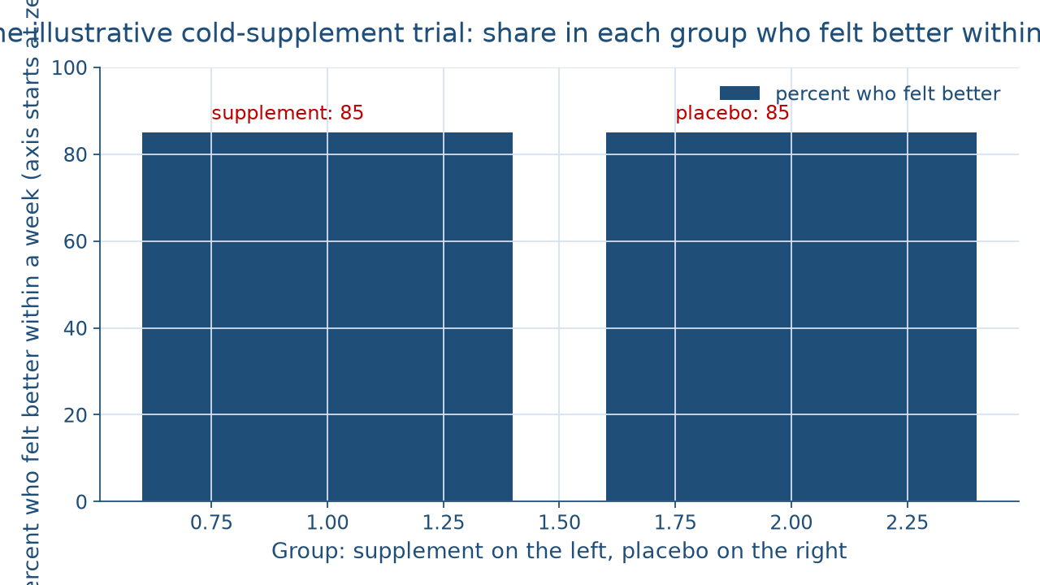
Two bars, one height
CONCEPT 3 OF 8 · COMPARE WITH A CONTROL
What would test it?
Week 13
8
Notes:
Describe the figure in words for everyone. It is a bar chart with two bars on an axis that starts at zero and runs to 100 percent. The left bar is the supplement group, 51 of 60 adults, 85 percent. The right bar is the placebo group, 51 of 60 adults, also 85 percent. The two bars are exactly level. The verdict in words: 85 percent recovered in both groups, so the supplement group did no better than the placebo group. The 51 placebo takers who recovered could have written testimonials too, so the ad's 12 stories show that colds end, not that the supplement ends them. DO: ask one student to explain, without the word placebo, why the level bars matter, then ask another to say what a trial like this cannot settle, such as a different dose or a different illness.

Slide 9
Three rivals, three clues
CONCEPT 4 OF 8 · BEST EXPLANATION
Clues: clicking, dim lights, headlights left on
Dead battery explains 3 of the 3
Starter explains 1; empty tank, none
What would test it?
Week 13
9
Notes:
Inference to the best explanation is reasoning from the evidence to the hypothesis that would best explain it, judged by fit with the evidence, simplicity, scope, and consistency with what else is known. Peirce called a related form abduction, and Harman (1965), The Inference to the Best Explanation, in The Philosophical Review, named the modern form. The car will not start. There are 3 clues: the engine only clicks, the dashboard lights are dim, and the headlights were left on overnight; the fuel gauge reads half full. A dead battery explains 3 of the 3 clues and fits the gauge. A failed starter explains 1 of the 3, the clicking. An empty tank explains none, and the gauge counts against it. DO: have pairs fill a three-by-three grid of rival and clue, then reveal that the dead battery wins on all 4 criteria and still needs a jump-start test.

Slide 10
Theory vs. guess
CONCEPT 5 OF 8 · THEORY VS. GUESS
Theory: well tested, broad
Earned by passing tests
Guess: untested hunch
Hypothesis: still being tested
What would test it?
Week 13
10
Notes:
A friend says of a well-supported idea, it's only a theory. In everyday talk a theory is a hunch; in science it means nearly the opposite. Left column: a scientific theory is a well-tested, broad explanation of many observations, and it earns that name by passing tests. Right column: a guess is an untested hunch, and a hypothesis is a proposed explanation still being tested. The ladder runs from guess, to hypothesis, to theory, and each rung is earned by a test that could have failed. Name the misconception plainly: students often hear only a theory as a fair dismissal, because everyday speech uses the word loosely. The cure is the ladder. DO: give three sentences, one using each word, and ask the room to place each on the ladder before you confirm.

Slide 11
Three of five signs
CONCEPT 5 OF 8 · WARNING SIGNS
No test can measure its effect
Customer stories, no controlled test
Big labs want to hide the truth
What would test it?
Week 13
11
Notes:
Pseudoscience is a claim or practice presented with the look of science that lacks the testing science requires. The five warning signs are: no possible result could count against the claim, testimonials stand in for controlled tests, methods and data are kept secret, persecution is claimed in place of evidence, and the claim never changes despite contrary evidence. The bracelet's ad says no test can measure its effect, fills its page with customer stories, and claims big labs want to hide the truth: 3 of the 5 signs. The ad says nothing either way about secret data or about change over time. Three signs are a strong reason to investigate, not a proof that the bracelet fails. The list is a classroom tool, not a machine that settles a case. DO: have pairs match each bullet to its sign, then ask which two signs a single ad cannot show.

Slide 12
Who carries the burden?
CONCEPT 6 OF 8 · BURDEN OF PROOF
Haunted dorm: appeal to ignorance
Burden lies with the person claiming
Careful search: a reasonable neighbor
What would test it?
Week 13
12
Notes:
Read the passage: No one has ever proven that the old dorm is not haunted, so it must be haunted. The only support offered is a lack of disproof, so the passage commits the appeal to ignorance, ad ignorantiam: concluding a claim is true because no one has shown it false. Locke (1690) named the ad ignorantiam argument, in the same work Week 7 met for the appeal to authority. The burden of proof lies with the person claiming the dorm is haunted. The tally closes here: 19 passages keyed through Week 12 plus 1 is 20 passages keyed through Week 13, the whole fallacy set of 20. The neighbor: an inspector checks every beam for termite damage, finds none, and reasonably concludes there are probably no termites. DO: read both aloud and ask which one searched where the evidence would be.

Slide 13
Why trust tomorrow?
CONCEPT 7 OF 8 · HUME'S QUESTION
Problem of induction: why expect the future to resemble the past?
Treatise, 1739 to 1740; Enquiry, 1748
Strong arguments still beat weak ones
What would test it?
Week 13
13
Notes:
Every morning you expect the floor to hold and your coffee to taste like coffee, though you have never checked tomorrow. The problem of induction is Hume's question of what justifies expecting the future to resemble the past. Hume raised it in A Treatise of Human Nature, 1739 to 1740, and in shorter form in An Enquiry Concerning Human Understanding, 1748; those dates are taught in words and never quizzed. Every passed test, every sample from Week 9, and every best explanation leans on that expectation. The misconception to name: if induction cannot be proven, it is worthless. The cure: Hume asks why induction works, not whether some inductive arguments beat others. A controlled trial still beats one story. Philosophers still disagree about the best reply, and this course takes no side on it.

Slide 14
Audit the chatbot
THIS ACTIVITY · CHECK THE MACHINE
Paste the smoke-alarm test
Watch for: "the test proves it"
Check: affirming the consequent
The tool drafts; you check
What would test it?
Week 13
14
Notes:
This audit is for this activity only. Open one approved chatbot, such as Claude or Gemini, and paste this prompt: My smoke alarm chirped. I guessed the battery was low, so I put in a new battery, and the chirping stopped. Does that prove the battery was low? Answer yes or no and name the argument form. A common slip is to answer yes, which affirms the consequent and treats a passed test as proof. The vetted reading is no: the passed test supports the battery hypothesis, but another cause, such as a reset when the alarm came down, could explain it. If the reply gets it right, ask it whether a lack of disproof shows the old dorm is haunted, and watch for false balance. DO: have pairs paste the prompt, mark any slip, and correct it by hand in one sentence.

Slide 15
Four questions, one card
Predict: could any observation show it wrong?
Compare: control, placebo, blinding
Rivals: which explanation fits best?
Next: Bias and Decision-Making
BEFORE NEXT CLASS
15
Notes:
Recap the science check in four questions. Predict: what does the claim predict, and could any observation show it wrong? The bracelet's claim is untestable as stated. Compare: was there a control group, a placebo, and blinding? The trial's 85 percent in both groups shows the supplement did no better than a placebo. Rivals: which explanation fits the evidence best? The dead battery is the best of 3 rival explanations of the car's 3 clues. And burden: who must support the claim? The haunted-dorm passage commits the appeal to ignorance. DO: return to the opening vote, ask the room to re-sort the three claims, and have each student write one sentence naming which claim was never tested. Next week, in Bias and Decision-Making, these outward tests turn inward on your own reasoning.

