Slide 1
Who checks the checker?
WEEK 14 · BIAS AND DECISION-MAKING
Week 14 · Bias and Decision-Making
1
Notes:
Welcome to Week 14. This week has one orienting question: where does your own reasoning go wrong? For most of this course you have tested other people's arguments, their form, their words, their samples, their numbers, and their sources. This week you turn the same tests on yourself. You will work Wason's rule-discovery task and an illustrative player's run of it, an illustrative student's evidence list on the running question, and illustrative cases of motivated reasoning, overconfidence, availability, and anchoring. Then you will practice four debiasing habits and one bias check. For course policy, the current syllabus is the place to check. Keep a pencil ready: the next slide opens on three moments you may have lived, and by the end you will know what tilted each one.

Slide 2
Three moments, one tilt
01
THE QUESTION BEHIND THIS WEEK
2
Notes:
Open on three illustrative moments. First, you search for reasons your side of an argument is right, and you find plenty. Second, a jacket's tag reads was 200 dollars, now 120, and you feel you have found a bargain before asking what the jacket is worth. Third, your group promises a project in 6 days and needs 9. None of these is a bad argument from someone else; each is your own judgment, tilted. DO: read the three moments aloud and ask each student to write which one they have lived most recently and what they believed at the time. Collect a show of hands for each moment. Keep the tally on the board, because the closing slide returns to it once the room can name the bias behind each one.

Slide 3
One task, five cases
02
OUR EXAMPLES THIS WEEK
3
Notes:
Name the week's cases so students can track them. First, Wason's rule-discovery task, a real experiment from 1960, and an illustrative player who tests 3 triples that fit the guess and then 1 that breaks it. Second, an illustrative student's evidence list on the running question: 10 sources from a first search, 8 favoring overnight hours and 2 supporting the objection, then 10 more from a disconfirming search, for 11 and 9 on a list of 20. Third, two single-story posts. Fourth, a team of 4 that plans 6 days against a record averaging 9. Fifth, a plane-crash story, a price tag reading was 200 dollars, now 120, and a classroom demonstration with anchors of 300 and 30 dollars. Every case except Wason's task is illustrative, and every number in them is made for this week.

Slide 4
Wason's 2, 4, 6
CONCEPT 1 OF 7 · CONFIRMATION BIAS
Told: the triple 2, 4, 6 fits a rule
The rule: any ascending sequence
Most tested triples that fit their guess
Who checks the checker?
Week 14
4
Notes:
Confirmation bias is the habit of seeking and favoring evidence that fits what one already believes, while overlooking or discounting evidence that could show it wrong. A cognitive bias is a steady tilt in how people gather or weigh evidence. The classic experiment is Wason (1960), On the failure to eliminate hypotheses in a conceptual task, in the Quarterly Journal of Experimental Psychology. Participants were told that the triple 2, 4, 6 fits a rule and asked to find the rule by proposing triples. The rule was any ascending sequence. Most participants proposed triples that fit their own guess rather than triples that could disprove it. Teach the caveat: Wason's paper is the classic experiment later read as showing confirmation bias, not the paper that coined the phrase. Name the misconception: confirmation bias is other people's problem. Wason's participants were trying hard, so the cure is to assume the tilt is in you too.

Slide 5
Confirming vs. disconfirming tests
CONCEPT 2 OF 7 · THE DISCONFIRMING TEST
8, 10, 12 · 20, 22, 24 · 1, 3, 5
All 3 fit the guess: yes
1, 5, 20 breaks the guess: yes
So add 2 is wrong
Who checks the checker?
Week 14
5
Notes:
Run the outline's player. The player guesses add 2 each time. Left column: the player tests 3 triples that fit the guess, 8, 10, 12; 20, 22, 24; and 1, 3, 5. All 3 get a yes, and the player announces add 2. Every triple that fits add 2 also fits any ascending sequence, so none of the 3 tests could have shown the guess wrong. Right column: the player tries 1, 5, 20, a triple that breaks the guess. It gets a yes, so add 2 is wrong. Then 6, 4, 2 gets a no, which points toward the real rule. This is Week 13's logic of a test turned on your own guess: a passed prediction supports, a failed one counts against. DO: before revealing the right column, ask pairs to propose one triple that could prove add 2 wrong; collect three, then reveal 1, 5, 20. Verdict: 1 test that could fail taught more than 3 that could not.

Slide 6
Your search makes the lean
WORKED EXAMPLE · THE EVIDENCE AUDIT
First search: 3 phrases, all one side
10 sources: 8 for, 2 against
Disconfirming search: 10 more, 3 and 7
Full list: 20 sources, 11 and 9
Who checks the checker?
Week 14
6
Notes:
An evidence audit lists the evidence one gathered, with the searches that found it, and checks which side it favors and whether the search produced the lean. The illustrative student favors overnight hours and lists the 10 sources found with 3 search phrases, each asking about the benefits of late-night study. Of the 10, 8 favor overnight hours and 2 support the objection. The 3 phrases all pointed one way, so the lean of 8 to 2 tells you more about the search than about the question. Then the student runs 2 phrases about the harms of all-night studying and finds 10 more sources: 3 favor overnight hours and 7 support the objection. The full list is 10 + 10 = 20 sources, with 8 + 3 = 11 and 2 + 7 = 9. DO: ask the room whether 11 beats 9; the vetted reply is no, a count of sources is not a verdict, so each source gets Week 12's source check.

Slide 7
State the objection fairly
CONCEPT 3 OF 7 · CONSIDER THE OPPOSITE
O1: overnight hours encourage all-night studying
O2: losing sleep can hurt exam performance
OC: overnight hours help students harm themselves
Map: an arrow marked against, at C
Who checks the checker?
Week 14
7
Notes:
Consider the opposite: state the strongest case against your own view, fairly and in full, before deciding how much your own case is worth. This is Week 2's standard form and principle of charity, turned on the side you do not hold. The student writes the running question's strongest objection. O1: Overnight hours encourage all-night studying. O2: Losing sleep can hurt exam performance. So, OC: Keeping the library open overnight would help students harm themselves. On the map, O1 and O2 work together to support OC, and the objection is an arrow marked against pointing at C, the running question's conclusion. Name the misconception: considering the opposite means giving up your view. It does not; the student still favors overnight hours. DO: have each student write the objection in standard form without looking, then compare with a partner and repair any premise that became a straw man.

Slide 8
Would I accept it reversed?
CONCEPT 4 OF 7 · MOTIVATED REASONING
Two posts, one story each
Friendly post accepted; unfriendly one dismissed
Same-standard test: same low weight
Who checks the checker?
Week 14
8
Notes:
Motivated reasoning is evaluating evidence more leniently when it supports a conclusion one wants and more strictly when it does not. The same-standard test asks whether you would accept a piece of evidence if it pointed the other way. The illustrative case: two posts each rest on one student's story. One says overnight study helped a student's grades, and the other says an all-nighter hurt a student's exam. The student who favors overnight hours accepts the first and dismisses the second as only one story. The complaint is fair, and it applies to both. Both are single anecdotes, so the same-standard test gives both the same low weight. This is Week 9's generalization from one vivid anecdote, cutting both ways. DO: give pairs one minute to write a sentence that weighs both posts by one standard, then read two aloud and check that neither post gets more weight than the other.

Slide 9
Plan 6, record 9
CONCEPT 4 OF 7 · OVERCONFIDENCE
Team of 4 is sure: 6 days
Last 3 projects: 9, 10, 8 days
Average 9 days: 3 days over plan
Who checks the checker?
Week 14
9
Notes:
Overconfidence is holding a belief or a prediction with more certainty than the evidence supports. The illustrative team of 4 says it is sure a group project will take 6 days. Its last 3 projects took 9, 10, and 8 days. Work it on the board: (9 + 10 + 8) ÷ 3 = 27 ÷ 3 = 9 days, and 9 − 6 = 3 days longer than the plan. All 3 of the 3 past projects ran past 6 days. Name the misconception: knowing about a bias protects you from it. The team could define overconfidence and still plan 6 days. The cure is a habit, checking the plan against the record before committing. DO: ask students to predict the average before you compute it, write their guesses down, then reveal 9 and ask how many guessed under it. Keep those written guesses, because writing a prediction first is one of the four habits on a later slide.

Slide 10
Vivid isn't frequent
CONCEPT 5 OF 7 · TWO HEURISTICS
Availability: easy to recall
Plane-crash story: drive instead
Anchoring: pulled to a start
Was 200 dollars, now 120
Who checks the checker?
Week 14
10
Notes:
A heuristic is a mental shortcut for making a judgment quickly, which often works and sometimes misleads. Tversky and Kahneman (1974), Judgment under Uncertainty: Heuristics and Biases, in Science, described availability and anchoring, along with a third heuristic, representativeness. Left column: the availability heuristic judges how common something is by how easily examples come to mind. After a news story about a plane crash, an illustrative traveler drives instead; ease of recall is not frequency, and the base rate from Week 11 is the missing number. Right column: anchoring is the pull of a starting number on an estimate. The tag reads was 200 dollars, now 120: 200 − 120 = 80 dollars, and 80 ÷ 200 × 100 = 40 percent off. The 200 is the anchor; whether 120 is fair is a separate question. DO: ask what each traveler and shopper should ask next, and collect: how many flights, and what do other stores charge.

Slide 11
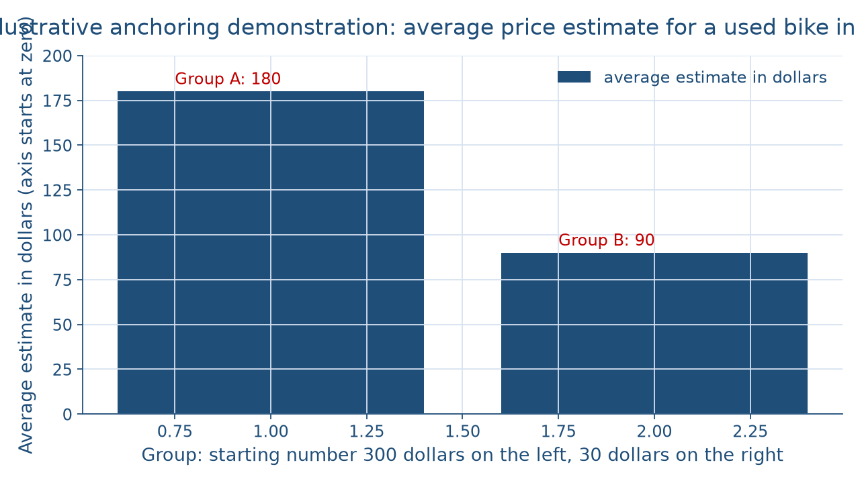
Same bike, two anchors
CONCEPT 5 OF 7 · ANCHORING, SHOWN
Who checks the checker?
Week 14
11
Notes:
Describe the figure in words for everyone. It is a bar chart with two bars on an axis that starts at zero dollars. The illustrative class of 40 was split into 2 groups of 20. Group A was asked whether a used bike costs more or less than 300 dollars; Group B whether it costs more or less than 30 dollars. Then every student estimated the price. The left bar, Group A, averages 180 dollars; the right bar, Group B, averages 90 dollars. The gap is 180 − 90 = 90 dollars, from an arbitrary starting number. The same pull works on an opening salary offer. These numbers are illustrative, never the original study's figures. Name the misconception: a heuristic is always wrong. It is a shortcut that often works. DO: ask one student to explain the gap without the word anchor, then ask another where an arbitrary number met them this week.

Slide 12
Four habits you do
CONCEPT 6 OF 7 · FOUR HABITS
Consider the opposite
Look for the disconfirming case
Write the prediction down first
Decide what would change your mind
Who checks the checker?
Week 14
12
Notes:
The debiasing habits are four practices that reduce bias in one's own reasoning: consider the opposite, look for the case that would disprove one's view, write the prediction down before seeing the result, and decide in advance what evidence would change one's mind. Walk the illustrative student through all four. The student considered the opposite with O1, O2, and OC. The student looked for the disconfirming case with 2 search phrases aimed at the other side. The student wrote a guess about the new sources before reading them. And the student wrote what would change their mind: evidence that the library's sleep reminders and quiet rest floor do not reduce all-night studying would give the objection more weight. DO: have each student write their own change-my-mind sentence for their position on the running question, then trade with a partner who checks that it names evidence, not a feeling.

Slide 13
Five questions, yourself first
CONCEPT 7 OF 7 · THE BIAS CHECK
What did I search for?
Would I accept it reversed?
What number or story steers me?
What did I predict? What changes my mind?
Who checks the checker?
Week 14
13
Notes:
The bias check is the set of questions for auditing one's own reasoning: what was searched for and which side it favored, whether the evidence would be accepted if it pointed the other way, what number or vivid story is steering the judgment, what was predicted beforehand, and what would change one's mind. Run it on the week. The player's 3 confirming tests could not catch the wrong guess while 1 disconfirming test did. The student's 8 to 2 lean came from the search phrases, and a search for the other side changed the list to 11 and 9. The posts, the plane crash, the price tag, the bike estimates, and the project plan each show a bias steering a judgment. None of these checks decides the running question. DO: ask which question would have caught each case, then name the misconception: finding a bias does not prove a conclusion false.

Slide 14
Audit the chatbot
THIS ACTIVITY · CHECK THE MACHINE
Paste the add-2 test
Watch for: confirmed
Check: one triple that breaks it
The tool drafts; you check
Who checks the checker?
Week 14
14
Notes:
This audit is for this activity only. Open one approved chatbot, such as Claude or Gemini, and paste this prompt: I think the rule behind the numbers 2, 4, 6 is add 2 each time. I tested 8, 10, 12 and 20, 22, 24, and both fit the rule. Is my rule confirmed? Suggest one next triple to test. A common slip is to call the rule confirmed, or to suggest another triple that also fits add 2, which is a confirming test that cannot fail. The vetted reading: the rule is not confirmed, because both triples fit any ascending sequence too, and the useful next test breaks the guess, such as 1, 5, 20. DO: have pairs paste the prompt, mark any slip, and correct it by hand in one sentence that names the disconfirming test.

Slide 15
Test yourself first
Disconfirm: aim where your guess breaks
Audit: your search makes the lean
Same standard; check the record
Next: Reasoning About Values and the Course Synthesis
BEFORE NEXT CLASS
15
Notes:
Recap the week in four moves. Disconfirm: the player's 3 confirming tests could not catch the wrong guess, while 1 disconfirming test did. Audit: the student's 8 to 2 lean came from the search phrases, and a search for the other side changed the list to 11 and 9. Same standard: two single stories get the same low weight, and a plan of 6 days meets a record averaging 9. Shortcuts: vivid is not frequent, and the 200-dollar anchor does not make 120 dollars fair. DO: return to the opening tally of three moments, ask each student to name the bias behind the moment they chose and the habit that would have caught it, and collect one written sentence each. Next week, in Reasoning About Values and the Course Synthesis, considering the opposite grows into stating the other side at its strongest.

