Slide 1
What ought we to do?
WEEK 15 · VALUES AND THE SYNTHESIS
Week 15 · Reasoning About Values and the Course Synthesis
1
Notes:
Welcome to Week 15, the last teaching week of the course. This week has one orienting question: how do you reason well about what ought to be done, and not only about what is so? You will take moral arguments apart into a value premise and a factual premise, meet three ethical frameworks as tools, practice stating the other side at its strongest, and then build the running question in full, with its strongest objection and a reply. The week ends by putting every test from the course together in one table. For course policy, the current syllabus is the place to check. Keep a pencil ready: the next slide opens on three choices you may face in one week, and every slide after it ends with a verdict you can say in words.

Slide 2
Three choices, one question
01
THE QUESTION BEHIND THIS WEEK
2
Notes:
Open on three illustrative choices. A friend asks to copy your lab report. Your club of 5 wins a 600-dollar prize and has to decide how to split it. A coworker proposes a plan at a team meeting, and you think it will not work. None of these asks what is so; each asks what you ought to do. People often say questions like these are only opinion, so there is nothing to argue about. This week shows otherwise: a moral claim has reasons, and reasons can be strong or weak. DO: read the three choices aloud and ask the room to vote on which one has a right answer and which is only opinion. Record the vote on the board. Return to it at the closing slide, once the room can separate the factual question from the value question in each.

Slide 3
One argument, built in full
02
OUR EXAMPLES THIS WEEK
3
Notes:
Name the week's cases so students can track them. First and most important, the running question argued all course: should the campus library stay open around the clock during finals week? It has P1 to P4 and C, with P3 supplied, and P4's cost of 1,600 dollars rests on 2 staff × 8 hours × 5 nights × 20 dollars an hour. Its strongest objection has premises O1, O2, and O3, with O3 supplied, and a pinned reply. Second, an illustrative club of 5 splitting a 600-dollar prize, either 120 dollars each or by the 50 hours on its sign-in log. Third, an illustrative coworker who proposes moving the team's weekly meeting online. Every case is illustrative and attributed to no real person, club, or company. Week 1 introduced the running question; this week it is finished.

Slide 4
Every ought needs an is
CONCEPT 1 OF 8 · VALUE AND FACT
Value premise: what is good, right, or required
Factual premise: what the situation is
Each premise needs its own support
What ought we to do?
Week 15
4
Notes:
A moral argument is an argument whose conclusion says what someone ought to do or what is good, right, or required. It usually joins a value premise, a claim about what is good, right, or required, to a factual premise, a claim about what the situation is. Each premise needs its own support: evidence for the factual one, reasons and principles for the value one. Take the illustrative lab report. Copying it would count as cheating under the course's rules; that is factual, checked by reading the rules. A student should not help another student cheat; that is the value premise, supplied the way Week 2 taught you to supply an unstated premise. The misconception to name: a moral claim is only opinion. The cure: an opinion is a claim someone holds, and its reasons can be strong or weak. DO: ask the room which half of the lab-report reason a rule book could settle, then confirm: the factual half.

Slide 5
One value, three facts
CONCEPT 2 OF 8 · THE RUNNING QUESTION
P3 (supplied): value premise
Campus should provide, at modest cost
P1, P2, P4: factual premises
P4: 1,600 dollars
What ought we to do?
Week 15
5
Notes:
Split the running question into value and fact. Left column: P3 (supplied) says the campus should provide study space students need during finals when it can do so at modest cost. It says what the campus should do, so it is the value premise. Right column: P1, P2, and P4 say what the situation is, so they are the 3 factual premises. P1 is the need for a quiet, safe place late at night; P2 is that the library is the only such space large enough; P4 is the cost. Check P4 live: 2 staff × 8 hours × 5 nights × 20 dollars an hour = 1,600 dollars, so P4 matches the inputs it rests on. That is 1 value premise and 3 factual premises, 4 premises in all. DO: have pairs label each premise value or factual, then reveal the split and check the cost arithmetic together.

Slide 6
Shared values, split facts
CONCEPT 2 OF 8 · WHERE THE DISPUTE LIES
O1, O2: factual; O3 (supplied): value
Both sides can accept P3 and O3
The real dispute: O1, a factual claim
What ought we to do?
Week 15
6
Notes:
Now put the strongest objection in standard form. O1: overnight hours encourage all-night studying. O2: losing sleep can hurt exam performance. O3 (supplied): the campus should not provide a service that helps students harm themselves. So, OC: the campus library should not stay open around the clock during finals week. O1 and O2 are the 2 factual premises, and O3 is the 1 value premise. Here is the surprise: a reader can accept both P3 and O3 at once. The sides part ways on O1, a factual claim about whether an open library adds all-night studying or only moves it to a less safe place, and evidence about where students study can settle that. Week 10's causal check is the tool for O1. DO: ask the room whether they accept P3 and O3 together, then ask which premise is left in dispute: O1.

Slide 7
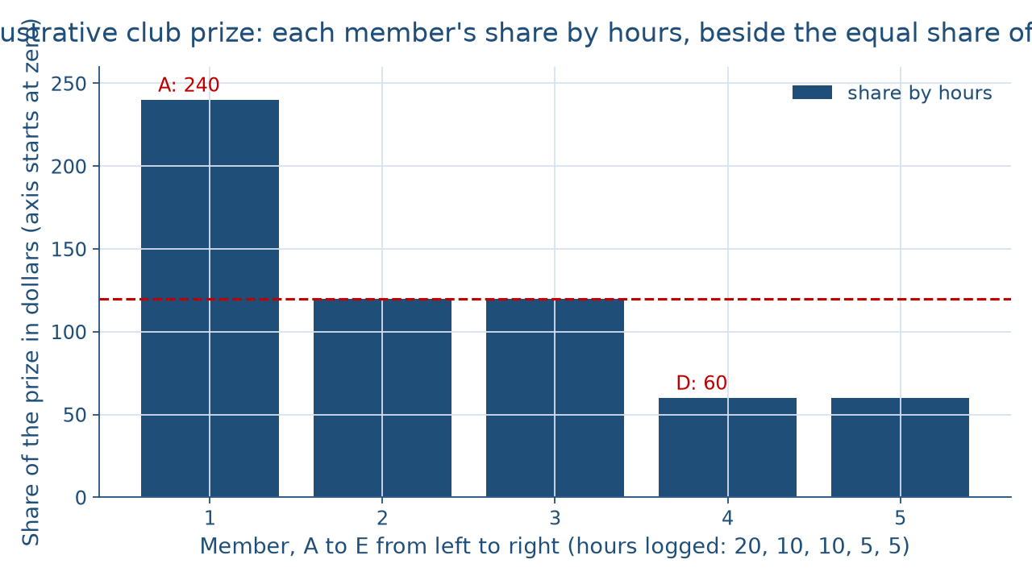
Two rules, one prize
CONCEPT 3 OF 8 · THE CLUB PRIZE
What ought we to do?
Week 15
7
Notes:
Describe the figure in words for everyone. It is a bar chart of five members' shares of a 600-dollar prize split by hours, on an axis that starts at zero. Member A, with 20 hours, has the tallest bar at 240 dollars; Members B and C, with 10 hours each, sit at 120 dollars; Members D and E, with 5 hours each, sit at 60 dollars. A level line at 120 dollars marks the equal share, 600 ÷ 5 = 120. The log's hours total 20 + 10 + 10 + 5 + 5 = 50, and 600 ÷ 50 = 12 dollars an hour. Whether equal shares or shares by hours is fair is the value question; whether the log's 50 hours are accurate is the factual question. DO: ask one student to name the value question and another the factual one, then ask what kind of objection a member who disputes the log is making: a factual one.

Slide 8
Three lenses, no verdict
CONCEPT 4 OF 8 · THREE FRAMEWORKS
Consequence-based: judge by outcomes
Duty-based: judge by duties or rules
Character-based: what a good person would do
What ought we to do?
Week 15
8
Notes:
There are 3 frameworks, presented as tools, not verdicts. A consequence-based framework judges an act by its outcomes; its strongest case is that outcomes for everyone affected matter, and its standard objections are that outcomes are hard to predict and that it can seem to allow harming a few for a gain to many. A duty-based framework judges it by whether it keeps duties or rules, some holding regardless of outcomes; its strongest case is that some things should not be done to people even for good outcomes, and its standard objections are that duties can conflict and that keeping a rule can lead to a bad outcome. A character-based framework judges it by what a person of good character would do; its strongest case is that it looks at the whole person, and its standard objection is that it can give little specific guidance in a hard case. DO: give the coworker's plan and ask which framework each of three reasons comes from.

Slide 9
Each lens argues both sides
CONCEPT 5 OF 8 · BOTH SIDES
Outcomes: safe study space vs. lost sleep
Duties: provide what is needed vs. no harm
Character: caring vs. valuing rest
What ought we to do?
Week 15
9
Notes:
Run the running question through each framework. Consequence-based: the case for C weighs a quiet, safe place for many students against a cost of 1,600 dollars, while the objection weighs the harm of lost sleep. Duty-based: the case for C rests on a duty to provide what students need at modest cost, while the objection rests on a duty not to help people harm themselves. Character-based: the case for C asks what a caring campus would do, while the objection asks what a campus that values rest and moderation would do. Each framework supports a version of both sides, so no framework decides the question here. The misconception to name: a framework decides the case. The cure: a framework says what to weigh, and a consequence-based case still needs evidence about sleep. DO: assign each third of the room one framework and have them state both sides before you reveal the pinned versions.

Slide 10
Straw man vs. steelman
CONCEPT 6 OF 8 · STEELMAN THE OTHER SIDE
Straw man: a dorm, not a library
Answers a claim no premise makes
Steelman: O1, O2, O3 at full strength
Holders would accept the wording
What ought we to do?
Week 15
10
Notes:
Steelmanning is stating the opposing view in its strongest form, ideally in terms its holders would accept, before replying to it. Left column: Week 7's straw man, they want the library to be a dorm, answers a claim no premise makes, so knocking it down leaves the objection untouched. Right column: the steelman is O1, O2, and O3 stated in terms the objection's holders would accept, so a reply to it answers the real objection. Now the workplace case. A coworker proposes moving the weekly meeting online. The straw man is they don't care about the team. The steelman is that an online meeting saves each member's travel time, and the team can keep one in-person meeting a month for planning. The misconception: steelmanning means agreeing. It does not. DO: have pairs write a straw man and a steelman of one class rule, then swap and test which one the other side would sign.

Slide 11
Map, object, reply, weak link
CONCEPT 7 OF 8 · BUILD AND DEFEND
P1, P2, P3 linked; P4 supports modest cost
Objection and reply: arrows marked against
Weakest point: the reply's factual claim
What ought we to do?
Week 15
11
Notes:
Build the running question in full and describe the map in words. P1, P2, and P3 are linked, working together to support C; P4 supports P3's modest cost condition; the objection is an arrow marked against pointing at C; and the reply is an arrow marked against pointing at the objection. The reply: students who stay up will study somewhere; the question is whether that place is quiet and safe, and the library can post sleep reminders and set aside one quiet floor for rest without closing the building. Notice that the reply targets O1, the factual premise, and accepts O3. Where the argument is weakest: the reply rests on the factual claim that closing the library would move all-night studying rather than end it, and that claim needs evidence. This course takes no side; a student arguing the other way does the same work. DO: have each student sketch the map on paper and say aloud where it is weakest.

Slide 12
Name the claim, then test
CONCEPT 8 OF 8 · THE COURSE SYNTHESIS
11 kinds of argument, 11 matched tests
Must follow: counterexample; causal: confounding check
Ought: the value-and-fact split
What ought we to do?
Week 15
12
Notes:
The course synthesis matches each kind of argument with the test that fits it, and there are 11 kinds. A claim that must follow gets the counterexample method from Weeks 3 and 4; an all or some claim gets a Venn diagram from Week 5; a claim that hangs on a key word gets a precise definition from Week 6; a reply aimed at a person or a distorted view gets the fallacy check; a claim about a group from a sample gets the sampling check; a causal claim gets the confounding check; a claim in numbers gets percentage points and natural frequencies; a claim from a source gets the source check; an explanation offered as true gets testability and the best-explanation test; your own reasoning gets the bias check; and a claim about what ought to be gets the value-and-fact split. DO: run it on the library: P4's 1,600 dollars by arithmetic, P2's only by the source check, O1 by the confounding check, P3 and O3 by the frameworks.

Slide 13
Audit the chatbot
THIS ACTIVITY · CHECK THE MACHINE
Paste the library objection
Watch for: a straw man or a verdict
Check: steelman wording, no side taken
The tool drafts; you check
What ought we to do?
Week 15
13
Notes:
This audit is for this activity only. Open one approved chatbot, such as Claude or Gemini, and paste this prompt: Here is an argument that a campus library should stay open around the clock during finals week, and an objection that overnight hours encourage all-night studying and losing sleep can hurt exam performance. Summarize the objection fairly, then tell me which framework settles the question. Two slips are common. The summary may turn the objection into a straw man, such as saying its holders want to punish students. Or the reply may name a framework that supposedly settles the question, a neutral-sounding summary that quietly takes a side. The vetted reading: the steelman is O1, O2, and O3, and each framework supports a version of both sides. DO: have pairs paste the prompt, mark any slip, and correct it by hand in one sentence.

Slide 14
Value, fact, and the test
Split value premise from factual premise
Frameworks are lenses, not judges
Steelman, reply, name the weak link
Next: the cumulative final
BEFORE THE FINAL
14
Notes:
Recap the week in four moves. First, split every moral argument into its value premise and its factual premise; in the running question, P3 is the value premise and the dispute is mostly about O1, a factual claim. Second, the consequence-based, duty-based, and character-based frameworks are lenses, not judges, and each supports a version of both sides. Third, steelman the objection, reply to it, and name where your own argument is weakest. Fourth, name the kind of claim, then pick the test from the 11 in the course synthesis. DO: return to the opening vote on the three choices, and have each student write one sentence separating the factual question from the value question in one of them. This is the last teaching week; the cumulative final comes next, and the synthesis table is the map to review with.

