Slide 1
Who grew your dinner?
WEEK 5 · HOW PEOPLE FEED THEMSELVES
Week 5 · Making a Living: Subsistence Strategies
1
Notes:
Welcome to Week 5, which opens a new unit on how people make a living. Before anything else, point students to the current syllabus as the authoritative source for how the course runs, then keep this opening on the ideas. The week's orienting question: how does a group get its food, and what does that choice do to the size and shape of the places people live? Preview the path. We will name five subsistence strategies as a model, trace the shift to food production, read the illustrative subsistence comparison table and divide our way through its ratios, link food to settlement and surplus, weigh the debate over foragers' working hours, and finish at the course's market. Remind students that Week 4 listened to the market's words; this week asks where its food comes from. Then move to the hook.

Slide 2
A cart nobody grew
01
THE HOOK · A WEEKLY GROCERY RUN
2
Notes:
Open with a family's weekly grocery run, an illustrative scene. One adult pushes a cart, a teenager grabs cereal, a card pays at the register, and the family drives home with a week of dinners. Almost nothing in the cart was grown, caught, or raised by anyone the family knows. Make it strange the way Week 2's Nacirema exercise did: describe the trip as if it were a foreign custom. DO: ask the room to name three foods from their last meal and, for each, say who produced it and how the student got it. Write the answers in two columns on the board, who produced it and how it was gotten. Expected answers: a farm or a fishing boat in the first column, a store or a paycheck in the second. Hold the board; it becomes the first sorting exercise when the five strategies arrive.

Slide 3
Four models, one market
02
DATASET D AND DATASET A · MODEL AND MARKET
3
Notes:
Introduce this week's shared data by name. Dataset D is the illustrative subsistence comparison table: four illustrative communities, one per strategy, with engineered whole-number values, a model and not a description of any real people. Dataset A is the running fieldwork site, the illustrative, unnamed weekly neighborhood farmers' market constructed for this course. The values to remember: densities of 1, 4, 20, and 200 people per square kilometre; 60, 40, 2, and 0 settlement moves per decade; typical local groups of 30, 60, 150, and 3,000. The settled results: 20 ÷ 1 = 20, 200 ÷ 20 = 10, and 200 ÷ 1 = 200 for density; 6 and 4 moves a year; about once every 5 years for the village; and 3,000 ÷ 150 = 20 for group size. The market has 24 stalls and runs 4 hours. Each value returns in a worked example.

Slide 4
Five ways to eat
CONCEPT 1 OF 6 · THE MODEL
Foraging: hunt, gather, fish
Horticulture: hand tools, resting fields
Pastoralism: herds, seasonal moves
Intensive agriculture; wage economies
Who grew your dinner?
Week 05
4
Notes:
Subsistence strategies are the ways a group gets its food, taught in this course as a model of five strategies; real communities mix strategies. Foraging is getting food by hunting, gathering, and fishing, without domesticated plants or animals. Horticulture is gardening with hand tools, with fields often left to rest and recover before they are planted again. Pastoralism is making a living mainly by herding domesticated animals, often moving with the seasons. Intensive agriculture is farming with plows, irrigation, draft animals or machines, and permanent fields worked year after year. Industrial and postindustrial economies are economies in which most people buy their food and work for wages, increasingly in services and information. DO: return to the hook's board and tag each food's route with a strategy; expected answers: the store and paycheck column is the wage pattern, and the producer column holds intensive agriculture and fishing.

Slide 5
A map versus a ladder
CONCEPT 1 OF 6 · THE TRAP
Map: compare side by side
No top, no bottom
Ladder: everyone climbs upward
Rejected by the discipline
Who grew your dinner?
Week 05
5
Notes:
Name the classic wrong turn before it settles in. On the left, the model as a map: the five strategies sit side by side as different ways of making a living, with no top and no bottom. On the right, the ladder: the old habit of reading the list as stages every society climbs, from foraging up to industry, a view the discipline rejected. Real communities mix strategies and change in many directions. Use the community garden example: a household that buys its food with wages also tends a hand-tool garden bed that rests each year, so one household uses two strategies at once. Call back to Week 1, which said anthropology compares and never ranks. DO: ask whether the garden household is moving down a ladder when it plants; expected answer: no, it is mixing strategies, which is why the course says map, not ladder.

Slide 6
Several starts, not one
CONCEPT 2 OF 6 · FOOD PRODUCTION BEGINS
Domestication: wild into dependent kinds
Independent, in several world regions
After the last ice age
No date keyed
Who grew your dinner?
Week 05
6
Notes:
Domestication is people shaping wild plants and animals, over many generations, into kinds that depend on human care; it began independently in several world regions after the end of the last ice age. The shift to food production is the change from getting food only by foraging to also growing plants and raising animals, which happened independently in several world regions rather than as one invention in one place. Stress two words: independently and several. This is one of the few places the cultural course borrows from archaeology, the subfield from Week 1 that studies past ways of life through what people left behind. The course names the shift in words and keys no date, because the timing differed by region. DO: read the claim that farming was invented once and copied everywhere, and ask which two words of the definition refute it; expected answer: independently and several.

Slide 7
20, 10, and 200
WORKED EXAMPLE · DENSITY RATIOS
Densities: 1, 4, 20, 200 per square kilometre
20 ÷ 1 = 20
200 ÷ 20 = 10
200 ÷ 1 = 200
Who grew your dinner?
Week 05
7
Notes:
Work the canonical example from Dataset D. Population density is the number of people living on each square kilometre of land. The foraging community has 1 person per square kilometre, the pastoral 4, the horticultural 20, and the intensive agricultural 200. Divide the horticultural density by the foraging density: 20 ÷ 1 = 20, so 20 times as many people live on each square kilometre. The intensive agricultural density is 200 ÷ 20 = 10 times the horticultural density and 200 ÷ 1 = 200 times the foraging density. Say the honesty note every time: this is a model with engineered numbers, and real foraging densities are often well under 1 person per square kilometre. DO: show only the four densities, have pairs compute the three ratios, then collect and reveal 20, 10, and 200; ask what permanent fields have to do with the largest jump.

Slide 8
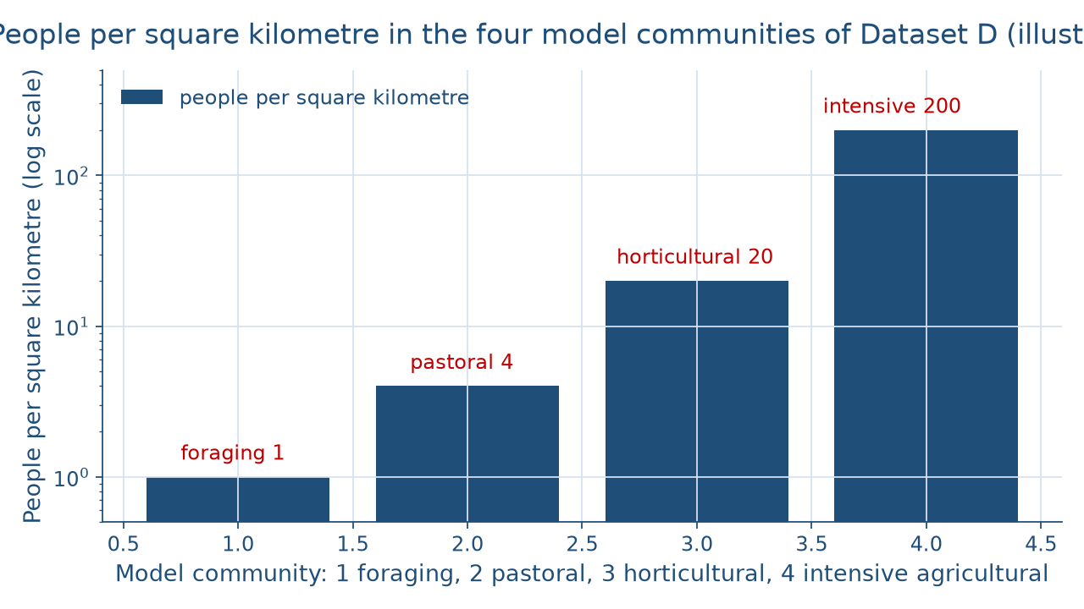
Density in the model
WORKED EXAMPLE · SEEING THE GAP
Who grew your dinner?
Week 05
8
Notes:
The figure draws Dataset D's four densities as bars on a logarithmic scale, so each step up the axis multiplies rather than adds; without that scale the foraging bar would vanish beside the intensive agricultural bar. Left to right: foraging at 1 person per square kilometre, pastoral at 4, horticultural at 20, and intensive agricultural at 200. Read the gaps aloud: horticultural is 20 times foraging, and intensive agricultural is 10 times horticultural and 200 times foraging. Warn students that the left-to-right order is the table's order, not a ranking; the bars measure crowding, not progress. DO: before revealing the labels, ask students to predict which bar is tallest and by how many times it beats the shortest; collect guesses, reveal 200, and ask what would let 200 people live on land where the model's foragers number 1.

Slide 9
Moving 6 times a year
WORKED EXAMPLE · MOVES PER YEAR
A decade is 10 years
Foraging: 60 ÷ 10 = 6 a year
Pastoral: 40 ÷ 10 = 4 a year
Village: about once every 10 ÷ 2 = 5 years
Who grew your dinner?
Week 05
9
Notes:
Settlement mobility is how often a community moves its homes, for example several times a year, once every few years, or not at all. Dataset D gives moves per decade, and a decade is 10 years. The foraging group moves 60 ÷ 10 = 6 times a year, and the pastoral group moves 40 ÷ 10 = 4 times a year, with the seasons. The horticultural village moves 2 times a decade, so it moves about once every 10 ÷ 2 = 5 years, as its fields need rest. The intensive agricultural town makes 0 moves and stays put. DO: give pairs the four moves-per-decade values and ask them to restate each as moves per year or years between moves; collect answers, reveal 6, 4, about once every 5 years, and none, then ask what each group would have to carry. Expected answers: little for the foragers, herds for the pastoralists.

Slide 10
3,000 versus 150
WORKED EXAMPLE · GROUP SIZE
Town 3,000 ÷ village 150
= 20 times
Pastoral 60 ÷ foraging 30
= 2 times
Who grew your dinner?
Week 05
10
Notes:
Typical local-group size is how many people usually live together in one camp, village, or town. On the left, the intensive agricultural town's typical local group of 3,000 is 3,000 ÷ 150 = 20 times the horticultural village's group of 150. On the right, the pastoral group of 60 is 60 ÷ 30 = 2 times the foraging group of 30. Point out what size does to daily life: a village elder can know every face in a group of 150, while a town of 3,000 needs other ways to organize, which is a thread Week 7 picks up. Keep the caveat: these are engineered model values, not counts of any real people. DO: ask the room to compute both ratios before revealing them, then ask which column shows the bigger jump and why permanent fields allow it; expected answer: the left column, because food grows where the town lives.

Slide 11
Surplus lets people stay
CONCEPT 4 OF 6 · FOOD AND SETTLEMENT
Surplus: food beyond immediate need
Stored, traded, or feeds non-producers
Permanent fields: stay, store, grow
Foraging, herding: small groups move
Who grew your dinner?
Week 05
11
Notes:
A surplus is food produced beyond what the producers need right away, which can be stored, traded, or used to feed people who do not produce food. Read Dataset D as a chain of causes. The intensive agricultural town works permanent fields, so its food grows where it lives; it makes 0 moves; it holds 200 people per square kilometre in groups of 3,000; and permanent fields with storage make a surplus possible. At the other end, the foraging group follows its food, moves 6 times a year, and lives in a group of 30. Add a fresh case: an illustrative fishing town smokes and salts the spring run's extra fish and lives on it in the quiet months, so it stays in one harbor. DO: ask students to name one thing their household stores and how storage changes their routine; then cure the trap that a small foraging group is an earlier stage of anyone's society.

Slide 12
Shorter hours versus longer
CONCEPT 5 OF 6 · A DEBATE, NO VERDICT
Sahlins (1972): fewer food-getting hours
Than farmers; needs met
Critics: add processing, tools, household
Hours longer
Who grew your dinner?
Week 05
12
Notes:
In the 1960s, Ju/'hoansi foragers in the Kalahari region, an older outsiders' label for them being !Kung, were the subject of studies of work, food sharing, and mobility. On the left, Sahlins (1972), Stone Age Economics, a title quoted as published: many foragers met their needs with fewer hours of food-getting work than farmers. On the right, later critics counted food processing, tool-making, and household work and found the hours longer. The original affluent society debate is a disagreement about which tasks count as work, so the course gives both sides their strongest case and keys no verdict. Keep the past tense and the decade; the Ju/'hoansi have changed since then and speak for themselves. DO: have students count a household's food hours twice, shopping only and then with cooking and cleanup, and ask which count each side resembles; expected answer: the first is Sahlins's, the second the critics'.

Slide 13
Two strategies, one stall
CONCEPT 6 OF 6 · BACK AT THE MARKET
24 stalls; 12 − 8 = 4 hours
Entry 6: three generations at work
Farm, permanent fields: intensive agriculture
Buyers live by wages
Who grew your dinner?
Week 05
13
Notes:
Return to Dataset A, the illustrative market with 24 stalls, open once a week from 8:00 a.m. to noon, so 12 − 8 = 4 hours. Field-note entry 6, 8:50 a.m., family-run stall, records an older woman who directs a man and a teenager who restock the bins while a younger woman runs the card reader; the stall may be run by one family across three generations. Read it as Week 3 taught: observation first, interpretation second. The stall sells from the family's own farm, with permanent fields, which is intensive agriculture. Its buyers mostly live by wages and buy their food, the industrial and postindustrial pattern. State the reading in one plain sentence: the family-run stall is intensive agriculture meeting buyers who live by wages, two strategies mixing in one place, not two rungs on a ladder. DO: ask pairs to name each side's strategy before revealing it; expected answers: intensive agriculture and the wage economy.

Slide 14
Audit the chatbot
THIS WEEK'S AUDIT · CHECK THE MACHINE
Paste the Dataset D prompt
Check: ranking or ladder language?
Check: present tense, verdict, invented hours?
The tool drafts; you check
Who grew your dinner?
Week 05
14
Notes:
This activity puts a chatbot from the approved list, such as Claude, Gemini, or ChatGPT, to work on this week's material. DO: paste this exact prompt: Here is an illustrative model table of four communities: foraging at 1 person per square kilometre, pastoral at 4, horticultural at 20, and intensive agricultural at 200. Explain what the table shows, and say what the 1960s Ju/'hoansi studies found about foragers' work. Compare the response with the vetted reading: the table is a model for comparing, density rises 200-fold with permanent fields, and the working-hours question is a debate with no verdict. Name the likely errors first: ranking the strategies as stages or calling foragers "primitive", describing the Ju/'hoansi in the present tense with no decade, declaring a winner in the debate, or inventing an hours figure. Have students mark each and correct it by hand. The judgment rule: the tool drafts; you check.

Slide 15
A map, not a ladder
Five strategies, a model
Density 200 times; 6 moves a year
Hours debate: no verdict
Next: Exchange and Economic Systems
BEFORE NEXT WEEK
15
Notes:
Recap in the order taught. Subsistence strategies are the ways a group gets its food, and the five strategies are a model for comparing, not a ladder. Domestication began independently in several world regions after the end of the last ice age, with no date keyed. In Dataset D, density runs 1, 4, 20, and 200 people per square kilometre, so the intensive agricultural density is 200 times the foraging; the foraging group moves 6 times a year and the town stays put; and the town's group of 3,000 is 20 times the village's 150. A surplus lets a settlement stay and grow. The original affluent society debate is about which tasks count as work. The market's family-run stall is intensive agriculture meeting a wage economy. Next week, Exchange and Economic Systems asks how people share and trade what they produce. DO: have each student write one place where two strategies meet in their own town, and collect them as exit tickets.

