Slide 1
How do goods move?
WEEK 6 · HOW GOODS MOVE
Week 6 · Exchange and Economic Systems
1
Notes:
Welcome to Week 6, the second week of the unit on making a living, exchanging, and governing. Before anything else, point students to the current syllabus as the authoritative source for how the course runs, then keep this opening on the ideas. The week's orienting question: once people have goods, how do they share, swap, pool, and sell them, and what tie does each exchange leave behind? Preview the path. We will name three forms of exchange as a model, split reciprocity into three kinds, key the illustrative exchange set, read the kula and the gift's three obligations, read the potlatch and state Canada's potlatch ban plainly, sort two kinds of money, and finish with the market's coded tally of 50 exchanges. Remind students that Week 5 asked how people get their food; this week asks what happens to it next. Then move to the hook.

Slide 2
Gifts with no price
01
THE HOOK · A FAMILY GIFT EXCHANGE
2
Notes:
Open with a holiday gift exchange among cousins, an illustrative scene from the chapter. 8 cousins draw names from a bowl, each buys 1 gift, and the family sets a limit of 25 dollars a gift. Nobody sends a bill and nobody pays at the door, yet everyone notices who gave what, and one cousin plans a better gift for next year. Make it strange the way Week 2's Nacirema exercise did: describe the evening as if it were a foreign custom with hidden rules. DO: ask the room to list two things that moved at the party besides the gifts themselves. Write the answers on the board in two columns, goods and feelings or debts. Expected answers: gratitude, a sense of owing, a plan to give back. Hold the board; it returns when the gift's three obligations arrive.

Slide 3
12 transactions, 50 exchanges
02
DATASETS C AND A · THIS WEEK
3
Notes:
Introduce this week's shared data by name. Dataset C is the illustrative exchange set: 12 everyday transactions constructed for this course, each with one pinned key, plus three borderline cases discussed and never keyed. Dataset A is the running fieldwork site, the illustrative, unnamed weekly neighborhood farmers' market of 24 stalls. Its coded tally counts 50 exchanges from one two-hour visit. The values to remember: the set keys 3 generalized, 3 balanced, 2 negative, 2 redistribution, and 2 market, so 3 + 3 + 2 + 2 + 2 = 12. The tally counts 33 market exchange, 8 generalized reciprocity, 5 balanced reciprocity, 4 redistribution, and 0 negative reciprocity. The settled results are 66, 16, 10, and 8 percent, a gap of 66 − 16 = 50 percentage points, and 26 percent for all reciprocity together. Each value returns in a worked example later in the deck.

Slide 4
Three paths for goods
CONCEPT 1 OF 7 · THE MODEL
Reciprocity: back and forth between equals
Redistribution: into a center, back out
Market exchange: prices from supply and demand
How do goods move?
Week 06
4
Notes:
The model comes from Polanyi, named in words from The Great Transformation. Reciprocity is exchange between social equals, in which goods or help pass back and forth between people rather than through a center or a market. Redistribution is exchange in which goods are collected by a central person or office and then given out again. Market exchange is buying and selling at prices set by supply and demand, usually with money and with no lasting tie expected. Name the trap: students often treat market exchange as natural or universal. It is one form among three, and real economies mix all three every day. DO: give three sandwich paths, a parent's lunch, a club's dues-funded meeting, and a deli sale, and have pairs label each; expected answers: reciprocity, redistribution, and market exchange.

Slide 5
How closely you count
CONCEPT 2 OF 7 · KEEPING COUNT
Generalized: no count kept
Balanced: equal return, known time
Negative: try to get more
How do goods move?
Week 06
5
Notes:
Sahlins (1965), "On the Sociology of Primitive Exchange", a title quoted as published in the period's wording, split reciprocity into three kinds by how closely the giver keeps track. Generalized reciprocity is giving with no count kept and no set time for a return, usual among close kin and close friends. Balanced reciprocity is exchange in which each side expects a return of about equal value within a known time, and both sides keep rough track. Negative reciprocity is exchange in which one side tries to get more than it gives, including hard haggling with strangers. The closer the tie, the less anyone counts. Cure the trap that reciprocity is always an equal trade: only the balanced kind expects that. DO: read three favors, a sister's car, a coworker's shift swap, and a garage-sale lamp, and collect a label for each; expected answers: generalized, balanced, negative.

Slide 6
Keying the exchange set
WORKED EXAMPLE · KEYING DATASET C
3 generalized, 3 balanced
2 negative, 2 redistribution, 2 market
3 + 3 + 2 + 2 + 2 = 12
Reciprocity keys: 8 of 12
How do goods move?
Week 06
6
Notes:
Work the canonical example from Dataset C, the illustrative exchange set. Parents who feed a toddler with no count kept, a grandparent who buys school supplies, and a friend's 5 a.m. airport ride are the 3 generalized keys. Roommates taking turns at groceries, neighbors trading eggs for tomatoes, and coworkers swapping a weekend shift are the 3 balanced keys. The overpriced flea-market lamp and the hidden-pillar concert tickets are the 2 negative keys. The club's dues dinner and the food bank are the 2 redistribution keys. The phone charger and the used bike are the 2 market keys. Check the total: 3 + 3 + 2 + 2 + 2 = 12. Group the reciprocities: 3 + 3 + 2 = 8 of the 12. DO: hand out the 12 transactions unlabeled, have pairs key them, then reveal the counts and debrief any transaction that split the room.

Slide 7
Keyed versus borderline
CONCEPT 2 OF 7 · THE HONEST LIMIT
12 keyed transactions
One pinned key each
3 borderline cases
Discussed, never keyed
How do goods move?
Week 06
7
Notes:
On the left, the 12 keyed transactions of Dataset C, each with one pinned key. On the right, the 3 borderline cases the course discusses and never keys. Birthday gifts among a group of friends could be generalized, or balanced if everyone keeps track. A tip at a restaurant could be market exchange, or a gift. A wedding gift registry could be a gift, or a purchase list. This is the honesty note for any model: real exchanges can carry two meanings at once, so a good answer names both readings and the evidence that would decide between them. Call back to Week 3, where field notes kept observation apart from interpretation; a borderline case is an interpretation the notes cannot settle yet. DO: assign each table one borderline case, ask for both readings plus one piece of deciding evidence, and collect them without declaring a winner.

Slide 8
Shells for fame, not profit
CONCEPT 3 OF 7 · A DOCUMENTED CASE
1910s Trobriand Islands, Malinowski (1922)
Soulava (Kilivila): necklaces, clockwise
Mwali (Kilivila): armbands, counterclockwise
Held a while, then passed on
How do goods move?
Week 06
8
Notes:
The kula was an exchange in which, in the 1910s, Trobriand Islanders and their neighbors carried shell necklaces clockwise and shell armbands counterclockwise around a ring of islands. The necklaces were soulava and the armbands were mwali, both Kilivila words. Each valuable was held a while, then passed on, for prestige and lasting partnerships rather than profit. The account comes from Malinowski (1922), Argonauts of the Western Pacific, the same fieldwork Week 3 used to introduce participant observation. Keep the past tense and the decade: this describes what Malinowski recorded in the 1910s, and Trobriand Islanders have changed since then and speak for themselves. Cure the trap that the kula was trade for profit. DO: compare a team trophy passed from champion to champion and ask what each holder keeps at the end; expected answer: a name and a partner, not money.

Slide 9
Three obligations of gifts
CONCEPT 4 OF 7 · NO FREE GIFT
To give
To receive
To give back
From Mauss's essay on the gift
How do goods move?
Week 06
9
Notes:
Mauss's essay on the gift, Essai sur le don, first published in French in the 1920s, argues that a gift carries three obligations: to give, to receive, and to give back. Those are the three obligations of the gift. The course states the essay's date in words and keys no year. Return to the hook's board. Each cousin gave, because skipping the exchange would be noticed. Each cousin received, even a gift they did not love, because refusing would insult the giver. And the cousin who got a thoughtful gift plans a better one for next year, which is giving back. Cure the trap that a gift is free of obligation: a gift is a tie, not a free thing. DO: ask students to recall one gift they felt they could not refuse and one they felt they had to return, then match each to an obligation; expected answers: to receive and to give back.

Slide 10
Giving that confirms rank
CONCEPT 5 OF 7 · THE POTLATCH
Kwakwaka'wakw and Northwest Coast peoples
Hosts give goods before witnesses
Validates names, rank, and rights
How do goods move?
Week 06
10
Notes:
The potlatch is a ceremonial feast of the Kwakwaka'wakw and other Northwest Coast peoples, at which hosts give away goods to validate names, rank, and rights before invited witnesses. Name the older outsiders' label, Kwakiutl, once, and then use only the people's own name, Kwakwaka'wakw. Read the potlatch with the gift's three obligations. Hosts gave, which showed they could support the name or rank they claimed. Witnesses received, and by accepting they recognized the claim. The gifts they accepted called for a return, the third obligation; the course pins no detail of how that return was made. Cure the trap that the potlatch was waste: counted only in goods it can look like loss, but counted in witness and standing it secured something real. DO: compare a large wedding where guests serve as witnesses, and ask what the guests' presence confirms; expected answer: the new marriage, before the whole community.

Slide 11
A law, not a debate
CONCEPT 5 OF 7 · DOCUMENTED HISTORY
Banned under the Indian Act from 1885
Law dropped in 1951
1921: arrests, ceremonial objects seized
How do goods move?
Week 06
11
Notes:
State this history plainly, as documented fact. Canada banned the potlatch under the Indian Act, as law from 1885, and the ban was dropped in 1951. After a potlatch held in 1921, people were arrested and ceremonial objects were seized and sent to museums. The start of the ban is said in words; the year the law was dropped, 1951, is the date the course asks students to know. Cure the second trap of this beat: the ban is not a debated policy with two sides, it was a law in force from 1885 to 1951. Save the both-sides format for contested questions such as how to code a borderline exchange. Tell students that Week 15 returns to what happened to the seized objects. DO: ask one student to state the ban's end year and one to state what happened after the 1921 potlatch; expected answers: 1951, and arrests and seized objects.

Slide 12
Any exchange versus some
CONCEPT 6 OF 7 · TWO KINDS OF MONEY
General-purpose money
Buys nearly anything
Special-purpose money
Some exchanges only
How do goods move?
Week 06
12
Notes:
On the left, general-purpose money: money that can be used for nearly any exchange, such as one national currency that buys groceries, pays rent, and settles debts. It buys nearly anything. On the right, special-purpose money: money or tokens that are valid for some exchanges only, such as tickets that buy food at one fair and nothing else. A campus laundry card and a gift card for one store work the same way. Add consumption: what people buy, use, and display, studied by anthropologists as a way people show identity as well as meet needs. A hometown team jersey keeps a student warm and also tells new classmates where the student comes from. DO: ask students to pull out one card or token and say which column it belongs in; expected answers: a debit card on the left, a transit or laundry card on the right.

Slide 13
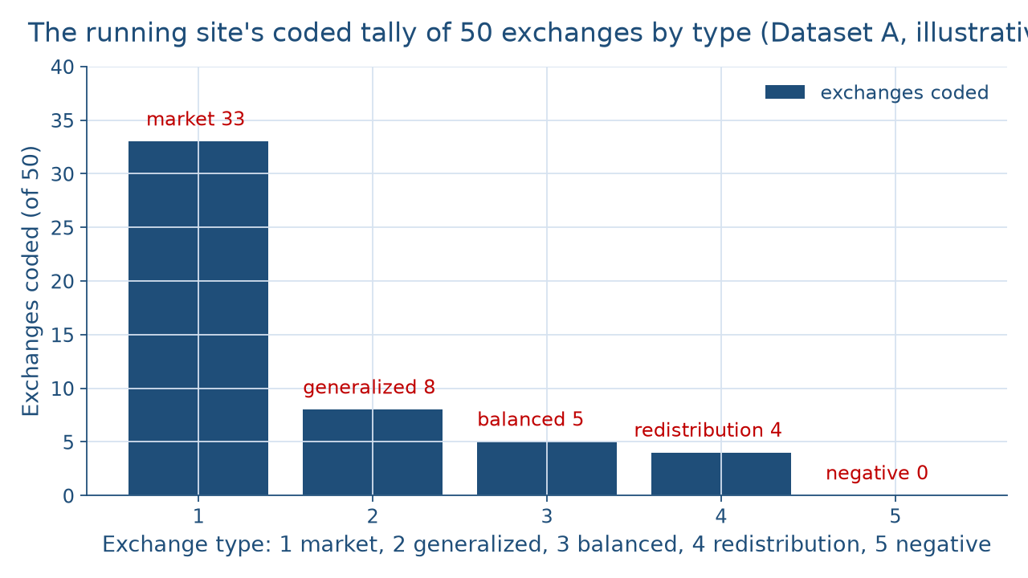
Where 50 exchanges went
WORKED EXAMPLE · SEEING THE TALLY
How do goods move?
Week 06
13
Notes:
The figure draws the running site's coded tally from Dataset A as five bars, one per exchange type, out of 50 exchanges coded on one two-hour visit. Left to right: market exchange at 33, generalized reciprocity at 8, balanced reciprocity at 5, redistribution at 4, and negative reciprocity at 0, an empty bar. The market exchange bar towers over the other four, yet the shorter bars show vendors sharing, swapping, and pooling. Warn students that the order of the bars is the table's order, not a ranking of better and worse ways to exchange. DO: before revealing the labels, ask students to predict which type is tallest and which bar is empty; collect guesses, reveal market exchange at 33 and negative reciprocity at 0, and ask why vendors who see each other every week might never haggle hard with one another.

Slide 14
From counts to percentages
WORKED EXAMPLE · COUNTS TO PERCENTAGES
33 ÷ 50 × 100 = 66 percent
8 ÷ 50 × 100 = 16 percent
66 − 16 = 50 percentage points
All reciprocity: 13, or 26 percent
How do goods move?
Week 06
14
Notes:
Work the canonical example. A percent is a share of a total, out of 100. Market exchange share: 33 ÷ 50 × 100 = 66 percent. Generalized reciprocity share: 8 ÷ 50 × 100 = 16 percent. Balanced reciprocity is 5 ÷ 50 × 100 = 10 percent, and redistribution is 4 ÷ 50 × 100 = 8 percent, and the shares check: 66 + 16 + 10 + 8 + 0 = 100 percent. A difference between two percentages is in percentage points, so the gap is 66 − 16 = 50 percentage points. All reciprocity together is 8 + 5 + 0 = 13 exchanges, or 13 ÷ 50 × 100 = 26 percent. Name the 3 set-aside cases: free samples at the cheese stall, the free plum handed to a toddler, and a hard haggle with a first-time buyer. DO: have pairs compute the four shares, then reveal and ask why the gap is not called 50 percent.

Slide 15
Audit the chatbot
THIS WEEK'S AUDIT · CHECK THE MACHINE
Paste the coded-tally prompt
Check: gift called free?
Check: kula as profit, present tense?
The tool drafts; you check
How do goods move?
Week 06
15
Notes:
This activity puts a chatbot from the approved list, such as Claude, Gemini, or ChatGPT, to work on this week's material. DO: paste this exact prompt: An illustrative market tallied 50 exchanges: 33 purchases at posted prices, 8 shared with no count kept, 5 vendor swaps of matched value, 4 pooled for a pantry, and 0 hard haggles. Name each exchange type, compare the market with the kula, and explain whether a vendor's free plum is a gift. Compare the response with the vetted reading: 66 percent market exchange, 16 percent generalized, a gap of 50 percentage points, the kula in the 1910s for prestige and partnership, and the plum left as a borderline case. Name the likely errors first: calling a gift free of obligation, calling the kula trade for profit, describing Trobriand Islanders in the present tense, or forcing the plum into one box. The judgment rule: the tool drafts; you check.

Slide 16
A gift is a tie
Three forms, three reciprocities
Kula, the gift, the potlatch
Tally: 66 percent market exchange
Next: Political Organization, Power, and Inequality
BEFORE NEXT WEEK
16
Notes:
Recap in the order taught. Reciprocity, redistribution, and market exchange are three forms of exchange in a model, and real economies mix all three. The three reciprocities, generalized, balanced, and negative, differ by how closely the giver keeps count. Dataset C keys 3 generalized, 3 balanced, 2 negative, 2 redistribution, and 2 market. In the 1910s, the kula moved valuables for prestige and partnership, not profit. A gift carries three obligations, to give, to receive, and to give back, and the potlatch validated names, rank, and rights before witnesses; Canada's ban on it was dropped in 1951. Special-purpose money buys only some things. The market's tally showed 66 percent market exchange, a gap of 50 percentage points over generalized reciprocity. Next week, Political Organization, Power, and Inequality asks who has the authority to collect and give out goods. DO: have each student write one exchange from their own week and its type as an exit ticket.

