Slide 1
Who counts as family?
WEEK 9 · WHO COUNTS AS FAMILY
Week 9 · Kinship and Descent
1
Notes:
Welcome to Week 9, which opens the unit on kinship, marriage, gender, and the categories of difference. Point students to the current syllabus as the authoritative source for how the course runs, then keep this opening on the ideas. The week's orienting question: who counts as family, and who decides? Preview the path. We will set kin by birth beside kin by marriage, learn to draw a kinship diagram and write kin-type strings, trace patrilineal and matrilineal descent, meet two documented matrilineal cases, sort cousins under three terminology types, widen the circle to chosen and fictive kin, and finish by drawing the market's family-run stall with roles, not names. Remind students that Week 3's genealogical method collected kin ties person by person; this week gives them the tools to draw what that method collects.

Slide 2
Fourteen guests, one cake
01
THE HOOK · A BIRTHDAY PARTY
2
Notes:
Open with the chapter's illustrative birthday party for a girl turning 9. There are 14 guests from 3 generations around one cake. Her stepsister lights the 9 candles, her half-brother hands out plates, her grandmother's new husband takes the photos, and a neighbor everyone calls Auntie brought the cake. Ask the room the anthropologist's question: who in that room is family, and who decides? Some guests share a parent with the girl, some joined through a marriage, and Auntie shares neither, yet leaving her off the guest list would hurt. DO: ask students to sort the four named guests into by birth, by marriage, or neither on a scrap of paper; collect a show of hands for each, then reveal half-brother by birth, stepsister and the grandmother's husband by marriage, and Auntie neither, and use the split to set up the first concept.

Slide 3
21 positions, one stall
02
DATASET B AND DATASET A · THIS WEEK
3
Notes:
Introduce this week's shared data by name. Dataset B is the illustrative kinship set, constructed for this course: a three-generation diagram centred on ego, with 4 grandparents, 10 positions in the parents' generation, and 7 in ego's generation, so 4 + 10 + 7 = 21 positions, and every answer is pinned. Dataset A is still the running fieldwork site, the illustrative, unnamed weekly neighborhood farmers' market of 24 stalls, and this week we draw its family-run stall: 2 + 4 + 2 = 8 roles across 3 generations, with 3 married couples. Say plainly that both are illustrative and describe no real family. Every kinship diagram in this course is also described in words, generation by generation, so a student who cannot see a drawing still gets every tie. That rule carries through the whole week.

Slide 4
Birth versus marriage
CONCEPT 1 OF 7 · THE KEY DISTINCTION
Consanguineal kin
Related by birth
Affinal kin
Related by marriage
Who counts as family?
Week 09
4
Notes:
Start with the frame. Kinship is the ties a society recognizes as family, built from birth, marriage, and other bonds; every society decides which ties count, what they are called, and what rights and duties they carry, so kinship is cultural as well as biological. On the left, consanguineal kin: relatives connected by birth, such as a parent, a sibling, a grandparent, or a cousin. On the right, affinal kin: relatives connected by marriage, such as a spouse, a parent-in-law, or an aunt's husband. Back at the party, the half-brother is consanguineal kin, and the stepsister and the grandmother's new husband are affinal kin. Name the wrong turn: students often think kinship is only biology. The cure is Auntie, who is neither by birth nor by marriage and still counts. DO: ask for one more example of each column from students' own families, written as a relationship, never a name.

Slide 5
Shapes, lines, and letters
CONCEPT 2 OF 7 · THE DRAWING TOOLS
Triangle man, circle woman, = marriage
Vertical line descent, horizontal line siblings
F M B Z S D H W, read from ego
MB mother's brother; FZD father's sister's daughter
Who counts as family?
Week 09
5
Notes:
A kinship diagram is a drawing of family ties that uses a triangle for a man, a circle for a woman, an equals sign for marriage, a vertical line for descent, and a horizontal line joining siblings, centred on a marked ego and always described in words as well. Ego is the person the diagram is centred on. Kin-type notation writes F for father, M for mother, B for brother, Z for sister, S for son, D for daughter, H for husband, and W for wife, read outward from ego: MB is mother's brother, and FZD is father's sister's daughter. Z stands for sister because S is already taken by son. Name the wrong turn: reading a string from the far end, so FZD becomes daughter's sister's father. DO: have students read FZD and MBW aloud one step at a time, finger on ego, then check: father's sister's daughter, and mother's brother's wife.

Slide 6
Three generations, 21 positions
WORKED EXAMPLE · THE KINSHIP SET IN WORDS
Grandparents: FF, FM, MF, MM = 4
Parents' generation: F, FB, FZ, M, MB, MZ, spouses = 10
Ego's generation: ego, B, Z, four cousins = 7
4 + 10 + 7 = 21 positions
Who counts as family?
Week 09
6
Notes:
Walk Dataset B generation by generation, as the course rule requires. The grandparents' generation: FF, FM, MF, and MM, 4 positions. The parents' generation: ego's father F, his brother FB and sister FZ, each married, FBW and FZH; ego's mother M, her brother MB and sister MZ, each married, MBW and MZH; that is 10 positions. Ego's generation: ego, ego's brother B and sister Z, and four cousins, FBS, FZD, MBD, and MZS; that is 7 positions. The total is 4 + 10 + 7 = 21 positions. DO: sketch the diagram on the board one generation at a time, shading ego, joining each couple with an equals sign, and dropping a vertical line to each sibling line; pause before the bottom row and ask students to name the four cousin strings before you write them.

Slide 7
Patrilineal versus matrilineal
CONCEPT 3 OF 7 · TWO DESCENT RULES
Patrilineal
Sons and daughters in; sons pass on
Matrilineal
Daughters and sons in; daughters pass on
Who counts as family?
Week 09
7
Notes:
Descent is a rule that places a person in a group through a parent. On the left, patrilineal descent: descent traced through men, so sons and daughters belong to their father's group, and only sons pass membership on to their children. On the right, matrilineal descent: descent traced through women, so daughters and sons belong to their mother's group, and only daughters pass membership on. Add the third pattern in words: bilateral kinship traces relatives equally through both parents and forms no descent groups. Then lineage versus clan: a lineage can trace each step back to a known common ancestor; a clan claims a common ancestor, often legendary, without every step known. Name two wrong turns: patrilineal descent does not shut daughters out, and lineage and clan are not synonyms. DO: ask which column a daughter belongs to under each rule, then ask which column lets her pass membership on.

Slide 8
Two lists, 13 people
WORKED EXAMPLE · EGO'S TWO LINEAGES
Patrilineage: FF, F, FB, FZ, ego, B, Z, FBS = 8
Matrilineage: MM, M, MB, MZ, ego, B, Z, MZS = 8
In both: ego, B, Z = 3
Either list: 8 + 8 − 3 = 13
Who counts as family?
Week 09
8
Notes:
Work the canonical example from Dataset B. If the society were patrilineal, ego's patrilineage is FF, F, FB, FZ, ego, B, Z, and FBS, 8 people. FZ belongs but does not pass membership on, so FZD belongs to her father's, FZH's, patrilineage. If the society were matrilineal, ego's matrilineage is MM, M, MB, MZ, ego, B, Z, and MZS, 8 people; MB belongs but does not pass it on, so MBD belongs to her mother's, MBW's, matrilineage. Ego, B, and Z are in both lists, 3 people, so the lists together name 8 + 8 − 3 = 13 people, and 21 − 13 = 8 positions fall in neither: FM, MF, FBW, FZH, MBW, MZH, FZD, and MBD. DO: run it live; pause before each list, collect predictions, then reveal 8, 8, 13, and 8, and ask why the two cross cousins land in neither list.

Slide 9
Descent is not rule
CONCEPT 4 OF 7 · DOCUMENTED CASES
Haudenosaunee: clan membership through women
Clan mothers held recognized roles
Trobriand, 1910s: heir was sister's son
Matrilineal is not matriarchal
Who counts as family?
Week 09
9
Notes:
Set two documented cases beside the model. The Haudenosaunee, with the older outsiders' label Iroquois given once, are a documented matrilineal case: clan membership passed through women, and clan mothers held recognized roles, including in choosing chiefs. They are living nations who speak for themselves. From Malinowski's fieldwork, in the 1910s Trobriand Islanders traced descent matrilineally, and a man's heir was his sister's son, his ZS. Ask two questions apart: how did membership pass, and who held the role? Membership passed through women; the role went from a man to his sister's son. Name the wrong turn: reading matrilineal as matriarchal. Matrilineal means descent is traced through women; it does not mean that women rule, and in many matrilineal societies men of the group, such as a mother's brother, have held authority over its affairs. Keep both cases in the past tense.

Slide 10
Three ways to say cousin
CONCEPT 5 OF 7 · NAMING THE COUSINS
Parallel cousins: FBS, MZS
Cross cousins: FZD, MBD
Lineal, generational, bifurcate merging
Older labels name types, not peoples
Who counts as family?
Week 09
10
Notes:
Kinship terminology is the set of words a language uses for relatives. Parallel cousins are the children of a parent's same-sex sibling, so in Dataset B they are FBS and MZS. Cross cousins are the children of a parent's opposite-sex sibling, FZD and MBD. That is 2 + 2 = 4 cousins, and parallel cousins are 2 ÷ 4 × 100 = 50 percent of them. Under lineal terminology, older label Eskimo, ego uses separate words for siblings and cousins. Under generational terminology, older label Hawaiian, ego calls everyone in their generation brother or sister. Under bifurcate merging terminology, older label Iroquois, ego calls parallel cousins brother or sister and cross cousins by a different term. The older labels name terminology types, not any present-day people's practice. Morgan's Systems of Consanguinity and Affinity of the Human Family was a pioneering comparison of kin terms, its date said in words.

Slide 11
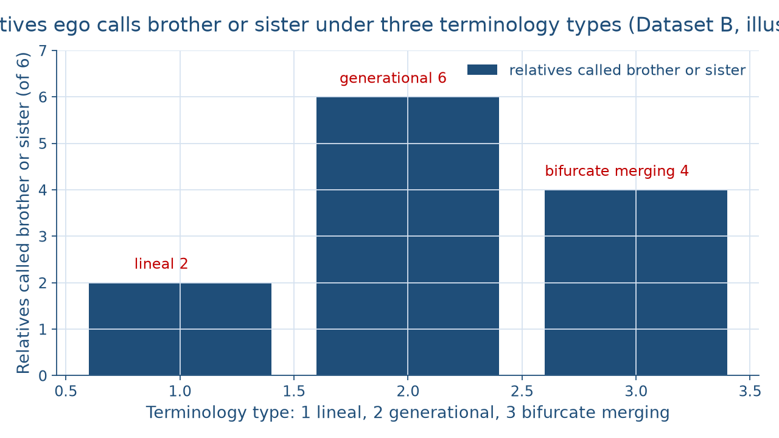
Same relatives, three counts
WORKED EXAMPLE · COUNTING BROTHERS AND SISTERS
Who counts as family?
Week 09
11
Notes:
The figure draws who ego calls brother or sister among the six relatives in ego's generation of Dataset B: B, Z, FBS, FZD, MBD, and MZS. Left to right: lineal terminology at 2, only B and Z; generational terminology at 6, all of them; bifurcate merging terminology at 4, B, Z, FBS, and MZS, with FZD and MBD called by a separate cross-cousin term. Read the gaps aloud: generational minus bifurcate merging is 6 − 4 = 2, the two cross cousins, and bifurcate merging minus lineal is 4 − 2 = 2, the two parallel cousins. The order is the order taught, not a ranking. Name the wrong turn: a cousin term read as the same in every society. DO: before revealing the bars, ask students to predict each count; collect guesses, reveal 2, 6, and 4, and ask which two relatives explain each gap.

Slide 12
Chosen and fictive kin
CONCEPT 6 OF 7 · BEYOND BIRTH AND MARRIAGE
Godparent at a naming: fictive kin
Coach Dad on a youth team: fictive kin
A club that calls itself family: chosen kin
No birth or marriage, real duties
Who counts as family?
Week 09
12
Notes:
Fictive kin are people treated as relatives without ties of birth or marriage, such as godparents or a coach the players call family. Chosen kin are people who choose to be family to one another and take on the duties of family without ties of birth or marriage. Walk the chapter's three illustrative ties. A godparent at a naming promises to guide the child through life: fictive kin. A youth soccer coach the players call Coach Dad drives players home and checks on their grades: fictive kin. A college club whose members call each other family shows up for one another's hard days: chosen kin. None rests on birth or marriage, yet each carries real duties, which is Week 2's point that culture is learned, now applied to family. Name the wrong turn: fictive kin read as not real kin. DO: ask students to name one fictive or chosen tie in their lives and the duty it carries, as a role, never a name.

Slide 13
Eight roles, three generations
WORKED EXAMPLE · THE FAMILY-RUN STALL
Founding grower and late husband
Son and wife; daughter and husband
Son's daughter; daughter's son
2 + 4 + 2 = 8 roles, 3 couples
Who counts as family?
Week 09
13
Notes:
Work the stall from Dataset A. Field-note entry 6, 8:50 a.m., records an older woman directing a man and a teenager who restock the bins while a younger woman runs the card reader, and entry 10, 9:25 a.m., records her saying the farm came from my husband's side. Week 3's rule holds: roles, never names. First generation: the founding grower and her late husband, whose family's farm the stall sells from. Second: their son, who drives and restocks, and his wife at the card reader; their daughter, who keeps the books, and her husband, who does not work at the stall. Third: the son's daughter, a teenager who restocks and weighs produce, and the daughter's son, a college student on online orders. That is 2 + 4 + 2 = 8 roles across 3 generations, with 3 married couples. DO: draw it live, then ask which 2 people are affinal kin to the founding grower: the son's wife and the daughter's husband.

Slide 14
Audit the chatbot
THIS WEEK'S AUDIT · CHECK THE MACHINE
Paste the kinship-set prompt
Check: is FZD put in ego's patrilineage?
Check: matrilineal called matriarchal?
The tool drafts; you check
Who counts as family?
Week 09
14
Notes:
This activity puts a chatbot from the approved list, such as Claude, Gemini, or ChatGPT, to work on this week's material. DO: paste this exact prompt: In an illustrative three-generation kinship set centred on ego, list ego's patrilineage if the society were patrilineal, say whether FZD, the father's sister's daughter, belongs to it, and explain what matrilineal descent among Trobriand Islanders in the 1910s meant for who ruled. Compare the response with the vetted reading: ego's patrilineage is FF, F, FB, FZ, ego, B, Z, and FBS, 8 people; FZD belongs to her father's patrilineage, because FZ does not pass membership on; and matrilineal describes how membership passed, not that women ruled. The likely errors are placing FZD in ego's patrilineage through her mother, calling the Trobriand case matriarchal, or writing it in the present tense. Correct it by hand. Judgment rule for this audit: the tool drafts; you check.

Slide 15
Culture draws the family
Birth, marriage, and choice
Descent through one parent's line
2, 6, or 4 brothers and sisters
Next: Marriage, Family, and Households
BEFORE NEXT WEEK
15
Notes:
Recap in the order taught. Kinship is cultural: every society decides which ties count, and consanguineal kin are related by birth while affinal kin are related by marriage. A kinship diagram draws those ties, kin-type notation names them from ego outward, and every diagram is described in words. Patrilineal and matrilineal descent keep both sons and daughters, and only one sex passes membership on; in Dataset B each lineage has 8 people and 21 − 13 = 8 positions fall in neither. Matrilineal is not matriarchal. Lineal, generational, and bifurcate merging terminology give ego 2, 6, or 4 brothers and sisters. Chosen and fictive kin carry real duties, and the stall's 8 roles are drawn by role alone. Next week, Week 10, Marriage, Family, and Households, reads marriage payments and residence through these descent groups. DO: have each student write one kin-type string for a relative of their own and read it aloud to a neighbor.

