Slide 1
Who decided who does what?
WEEK 11 · WHO DOES WHICH JOB
Week 11 · Sex, Gender, and Sexuality
1
Notes:
Welcome to Week 11, the third week of the unit on kinship, marriage, gender, and the categories of difference. Point students to the current syllabus as the authoritative source for how the course runs, then keep this opening on the ideas. The week's orienting question: who decided which person does which task, and did biology decide it or did a family or a society? Preview the path. We will keep sex, gender, and sexuality apart, see gender roles as learned and changing, test the classic foraging model and a debate the course keeps open, meet documented gender diversity in communities' own terms, weigh Mead's 1935 study and its critics, ask who moves at marriage, and finish by reading the market's family-run stall by gender and by generation. Remind students that Week 10 asked where a couple lives; this week asks which partner moves and who does which work.

Slide 2
One dinner, many jobs
01
THE HOOK · A HOLIDAY DINNER
2
Notes:
Open with the chapter's illustrative holiday dinner. One relative always carves. A cousin always washes the dishes. The youngest guests are sent to set the table before anyone sits down. Nobody wrote these jobs down, yet the whole family knows them, and a newcomer who grabs the carving knife will hear about it. Ask the anthropologist's question: who decided which person does which task? In some families the split follows age, in others it follows who is a man and who is a woman, and in others it follows who cooks best. DO: ask students to write down one task at their own family's holiday table and what decides who does it: age, gender, skill, or something else. Collect a show of hands for each reason, then point out that if biology set the split, every family would split it the same way.

Slide 3
Six jobs, five couples
02
DATASET A AND DATASET B · THIS WEEK
3
Notes:
Introduce this week's shared data by name. Dataset A is still the running fieldwork site, the illustrative farmers' market of 24 stalls, and this week we read who does which job at its family-run stall: 1 + 3 + 2 = 6 working roles across 3 generations, held by 4 women and 2 men. Dataset B is the illustrative kinship set from Week 9, constructed for this course, with 21 positions. This week we look at its parents' generation: 10 positions drawn as 5 triangles and 5 circles, so 10 ÷ 2 = 5 married couples, with 4 in-married spouses, 2 women and 2 men. Say plainly that both are illustrative and describe no real family. DO: ask students to predict which split will explain more of the stall's jobs, gender or generation, and keep the guesses on the board until the worked example.

Slide 4
Three words, three questions
CONCEPT 1 OF 7 · KEEP THREE APART
Sex: chromosomes, hormones, anatomy
Gender: roles, behaviors, identities a culture organizes
Sexuality: attraction and the cultural rules around it
Each answers a different question
Who decided who does what?
Week 11
4
Notes:
Sex is biological traits, such as chromosomes, hormones, and anatomy, that are kept distinct from gender and from sexuality. Gender is the roles, behaviors, and identities a culture organizes around sex; what it includes differs across societies and changes over time. Sexuality is patterns of attraction and the cultural rules around them, kept distinct from both sex and gender. Each answers a different question: what are the body's traits, what does a culture expect of a person in light of them, and what rules surround attraction. Walk the chapter's illustrative statements: a study of runners' hormones is about sex; a family expecting the oldest daughter to host is about gender; a club whose members agree not to date each other is about sexuality. DO: read a team's coed rule aloud and have students call out which word fits; confirm gender, because a league wrote it and could rewrite it.

Slide 5
Sex versus gender
CONCEPT 1 OF 7 · THE KEY DISTINCTION
Sex
The body's biological traits
Gender
What a culture builds around sex
Who decided who does what?
Week 11
5
Notes:
On the left, sex: the body's biological traits, chromosomes, hormones, and anatomy. On the right, gender: the roles, behaviors, and identities a culture organizes around sex, which differ across societies and change over time. Name the wrong turn: sex and gender used as synonyms, as if gender were a polite word for the body. It is tempting, because everyday speech swaps them all the time. The cure is one question asked every time: is this about the body, or about what a culture expects? Tie it to the holiday dinner: a relative's body did not hand them the carving knife; the family did. DO: give students three phrases, hormone levels, the oldest daughter hosts, and the team's coed rule, and ask them to place each on the left or the right; reveal hormone levels on the left and the other two on the right.

Slide 6
Rules people rewrite
CONCEPT 2 OF 7 · GENDER ROLES
Men's or women's work differs and changes
Learned, shared but never uniform, changing
A coed league writes its own rules
Dress code: 2 lists rewritten as 1
Who decided who does what?
Week 11
6
Notes:
Gender is culturally organized: what counts as men's work or women's work differs across societies and changes over time. Gender roles are the tasks, behaviors, and expectations a culture assigns to people by gender; they are learned, differ across societies, and change over time. This is Week 2's culture concept applied to gender: culture is learned, shared but never uniform, and changing. Walk the two illustrative cases. A youth sports league writes its coed rules, and another league writes them differently. A workplace's dress code once had 2 lists, one for men and one for women, and the managers rewrote it as 1 list for everyone: staff learned it, argued over it, and changed it. Name the wrong turn: gender roles read as the same everywhere. DO: ask students for one gender rule at a school, team, or job that has changed, and collect three examples.

Slide 7
A model with exceptions
CONCEPT 3 OF 7 · DIVISION OF LABOR
Tasks assigned by gender
Man-the-hunter: men hunted, women gathered
Many documented exceptions
A model, never a rule for all
Who decided who does what?
Week 11
7
Notes:
The gendered division of labor is the way a society assigns tasks to people by gender, such as who does which job in a household, a workplace, or a family business. The most famous model of it comes from foraging societies, which Week 5 taught as people living by hunting, gathering, and fishing without domesticated plants or animals. The man-the-hunter model is the classic foraging model holding that big-game hunting was done mainly by men and gathering mainly by women; it is a model with many documented exceptions, not a description of every foraging society. Name the wrong turn: the model read as a description of every foraging society. The cure is to call it the classic model and name the exceptions. DO: write the sentence in every foraging society, only men hunted on the board, ask students to fix it, and collect two fair rewrites.

Slide 8
Two cases, no verdict
THE DEBATE · HOW OFTEN WOMEN HUNTED
The classic model
A widely recorded pattern
Its critics
Exceptions, and who observed
Who decided who does what?
Week 11
8
Notes:
How often women hunted in foraging societies is debated, and the course keys no verdict. On the left, the case for the classic model: many recorded foraging societies did divide labor this way, so the model sums up a real, widely recorded pattern, and a model that fits many cases is a useful tool for comparison. On the right, the case against reading it as the rule: there are many documented exceptions in which women hunted, and Week 3's reflexivity says an observer's own position, including gender, shapes what they record, so older accounts may have missed women's hunting. Compare it with Week 5's original affluent society debate, which also stays open. DO: split the room in half, give each half one side to argue in two sentences, and collect the strongest line from each; close by saying the course states both and chooses neither.

Slide 9
In their own terms
CONCEPT 4 OF 7 · GENDER DIVERSITY
Two-Spirit: English umbrella term, adopted 1990
Hijra: Hindi and Urdu, South Asia
Fa'afafine: Samoan, Samoa
Describe first; no policy argued
Who decided who does what?
Week 11
9
Notes:
Cross-cultural gender diversity is the documented range of ways societies recognize and organize gender beyond one fixed pattern, described in each community's own terms. Two-Spirit is an English umbrella term adopted by Indigenous people at a gathering near Winnipeg in the summer of 1990 to describe a range of gender and sexual identities within their own nations' traditions. Hijra is a Hindi and Urdu term for documented communities in South Asia, and fa'afafine is a Samoan term for a documented case in Samoa. Add no detail a source has not given. This is Week 2's cultural relativism as a method: describe before judging, and the course argues no policy question about gender. Name the wrong turn: Two-Spirit read as an ancient word in one Indigenous language. DO: ask students for the term's language, year, and who chose it; confirm English, 1990, and Indigenous people.

Slide 10
Mead versus her critics
CONCEPT 5 OF 7 · A CLASSIC STUDY
Mead (1935)
Temperament linked to sex is learned
Later critics
Contrasts drawn too sharply
Who decided who does what?
Week 11
10
Notes:
Mead (1935), Sex and Temperament in Three Primitive Societies, a title quoted as published in the period's wording, compared three societies she studied. On the left, Mead's argument: temperament linked to sex differs across societies, so much of what a society calls a masculine or feminine temperament is learned. Her strongest case: if three societies paired temperament and sex in different ways, sex alone cannot fix temperament. On the right, later critics argued that her contrasts among the three societies were drawn too sharply. Their strongest case reuses Week 2: culture is shared but never uniform, so neat contrasts can flatten the variety inside each society. The course teaches both at full strength and keys no verdict. DO: ask half the room for Mead's best sentence and half for the critics' best sentence, read one of each aloud, and leave the verdict open.

Slide 11
Who moves at marriage?
CONCEPT 6 OF 7 · WORKED EXAMPLE
5 + 5 = 10 positions; 10 ÷ 2 = 5 couples
4 in-married: 2 women, 2 men
Patrilocal: 5 women move
Matrilocal: 5 men move
Who decided who does what?
Week 11
11
Notes:
First, the callback from Week 9: matrilineal is not matriarchal. The Haudenosaunee are a documented matrilineal case: clan membership passed through women, and clan mothers held recognized roles, including in choosing chiefs. In the 1910s, Trobriand Islanders traced descent matrilineally, and a man's heir was his sister's son. Now ask a gender question of Week 10's residence rules on Dataset B. The parents' generation has 10 positions, 5 triangles (F, FB, FZH, MB, MZH) and 5 circles (M, FZ, FBW, MZ, MBW), so 10 ÷ 2 = 5 married couples. FBW, FZH, MBW, and MZH are 4 in-married spouses, 2 women and 2 men. Under patrilocal residence the wife moves in each couple, so 5 women move, and M would live near FF and FM; under matrilocal residence, 5 men move. DO: run it live; name each rule, pause, collect who moves, then reveal.

Slide 12
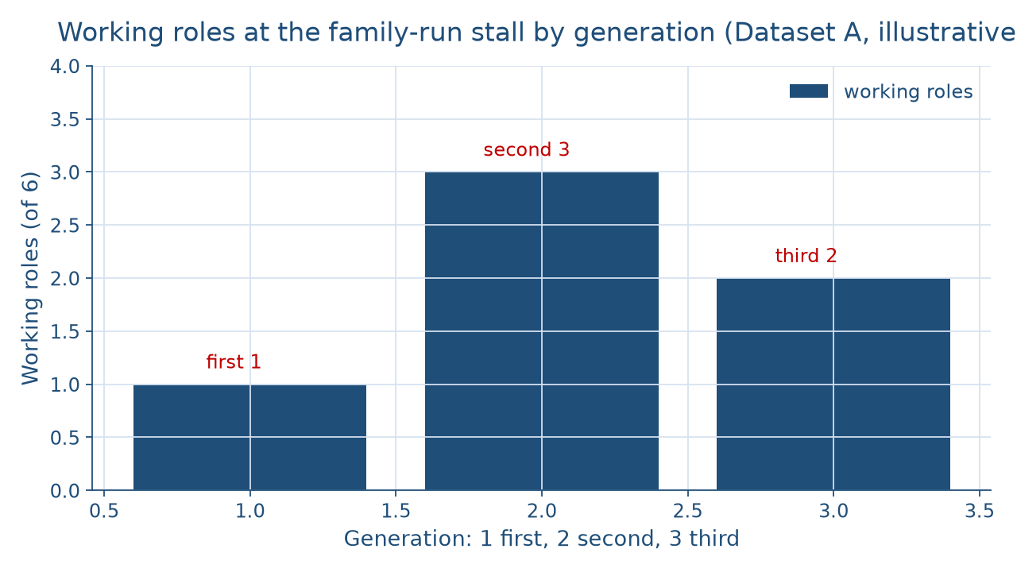
Roles by generation
WORKED EXAMPLE · THE FAMILY-RUN STALL
Who decided who does what?
Week 11
12
Notes:
This chart shows the family-run stall's working roles by generation, from Dataset A, illustrative. The first generation holds 1 working role, the founding grower, who directs the stall. The second generation holds 3: the son, who drives the truck and restocks; his wife, who runs the card reader; and the daughter, who keeps the books. The third generation holds 2: the granddaughter, who restocks and weighs produce, and the grandson, who handles online orders. So 1 + 3 + 2 = 6 working roles, and the second generation's bar is the tallest. DO: before naming the bars, ask students which generation holds the most working roles; collect guesses, then reveal the second generation, with 3 of the 6. Then ask which split the earlier board guesses predicted, gender or generation, and carry the answer to the next slide.

Slide 13
Six roles, two splits
WORKED EXAMPLE · GENDER AND GENERATION
1 + 3 + 2 = 6; 8 − 2 = 6
4 + 2 = 6; 4 − 2 = 2
3 ÷ 6 × 100 = 50 percent
Restocking: 1 + 1 = 2, across the line
Who decided who does what?
Week 11
13
Notes:
Work the stall from Dataset A. Field-note entry 6, 8:50 a.m., records an older woman directing a man and a teenager who restock the bins while a younger woman runs the card reader. By generation, 1 + 3 + 2 = 6 working roles. The stall family has 8 roles, and the founding grower's late husband and the daughter's husband do no stall work, so 8 − 2 = 6. By gender, 4 women, the founding grower, the son's wife, the daughter, and the granddaughter, and 2 men, the son and the grandson: 4 + 2 = 6, and 4 − 2 = 2 more women than men. The second generation holds 3 ÷ 6 × 100 = 50 percent. The son and the granddaughter both restock, 1 + 1 = 2 people across the gender line. Add the honesty note: the notes record who does each job, not why. DO: ask students to state the reading in one sentence, then compare.

Slide 14
Audit the chatbot
THIS WEEK'S AUDIT · CHECK THE MACHINE
Paste the stall prompt
Check: sex and gender swapped?
Check: one family read as a rule?
The tool drafts; you check
Who decided who does what?
Week 11
14
Notes:
This activity puts a chatbot from the approved list, such as Claude, Gemini, or ChatGPT, to work on this week's material. DO: paste this exact prompt: At an illustrative family farm stall, a grandmother directs, her son drives and restocks, his wife runs the card reader, her daughter keeps the books, her teenage granddaughter restocks and weighs produce, and her grandson handles online orders. Explain the difference between sex and gender, describe this division of labor, and say what gender rule this family follows. Compare the response with the vetted reading: 6 working roles, 4 women and 2 men, divided by generation as much as by gender, with restocking crossing the gender line. The likely errors are using sex and gender as synonyms, or declaring a family gender rule from one stall. Correct it by hand. Judgment rule for this audit: the tool drafts; you check.

Slide 15
Bodies are not job descriptions
Sex, gender, sexuality: three questions
Man-the-hunter: a model with exceptions
A residence rule decides who moves
Next: Race, Ethnicity, and Human Variation
BEFORE NEXT WEEK
15
Notes:
Recap in the order taught. Sex is the body's biological traits, gender is the roles and identities a culture organizes around sex, and sexuality is attraction and the rules around it. Gender roles are learned, differ across societies, and change over time. The man-the-hunter model is a model with many exceptions, and how often women hunted stays an open debate. Two-Spirit, hijra, and fa'afafine are documented cases, each in the community's own terms. Mead argued that temperament linked to sex is learned, and her critics said her contrasts were too sharp. In Dataset B, the same 5 couples send 5 women under patrilocal residence and 5 men under matrilocal residence. At the stall, 3 ÷ 6 × 100 = 50 percent of the working roles sit in the second generation. Next week, Week 12, Race, Ethnicity, and Human Variation. DO: have each student name one rule from the week and tell a neighbor.

