Slide 1
Is race in the body?
WEEK 12 · VARIATION AND ITS CATEGORIES
Week 12 · Race, Ethnicity, and Human Variation
1
Notes:
Welcome to Week 12, the last week of the unit on kinship, marriage, gender, and the categories of difference. Send students to the current syllabus as the authoritative source for how the course runs, then keep this opening on the ideas. The week's orienting question: when a form asks about race and ethnicity, do the boxes describe how human bodies vary, or what a society decided to call those differences? Preview the path. We will see human variation as a gradient, ask where most variation lies with two attributed figures, weigh Boas's 1912 study, define race as a social classification with real effects, set ethnicity apart from race and name nationalism, and finish by reading the 2024 census categories as the issuing body's own. Remind students that Week 11 taught a category organized around the body, gender; this week teaches a second one.

Slide 2
One label, every skin
01
THE HOOK · A SUNSCREEN LABEL
2
Notes:
Open with the chapter's illustrative sunscreen label. It tells everyone to guard their skin against ultraviolet light, the invisible part of sunlight that burns, and it does not offer one bottle for each skin color. It gives one warning, because the sun reaches every body. Then turn to a form students have filled in, a job application or a clinic intake sheet, that asks about race and ethnicity with the words check all that apply. Ask the anthropologist's two questions at once: what does biology show about how people vary, and what did a society, or a government office, decide to call those differences? DO: ask students to recall the last form that asked about race or ethnicity, and to write one word for how it felt to choose a box: easy, unsure, or stuck. Collect a show of hands for each word, then say that the pause is where this week begins.

Slide 3
Seven boxes, two figures
02
DATASET G · THIS WEEK'S REAL FIGURES
3
Notes:
Introduce this week's shared data by name. Dataset G is the course's set of sourced real figures, and unlike the running market it is real, so it always carries its issuing body. This week it gives the Office of Management and Budget's 2024 standard: 1 combined race-and-ethnicity question with 7 minimum categories. It also gives the Census Bureau's statement that its race categories reflect a social definition of race. Beside it sit two attributed figures for where variation lies: about 85 percent within populations, from Lewontin in 1972, and about 94 percent within so-called racial groups, from the Statement on Race in 1998. Say plainly that the two figures are stated with their sources and never keyed. DO: ask students to guess how many minimum categories the 2024 standard has, write the guesses on the board, and hold them until the worked example.

Slide 4
A gradient, not boxes
CONCEPT 1 OF 6 · CONTINUOUS VARIATION
Traits shade gradually across geography
Skin color tracks ancestral ultraviolet light
Skin color predicts no other trait
Is race in the body?
Week 12
4
Notes:
Human variation is the biological differences among people, such as skin color and body form; it is continuous and lies mostly within groups rather than between them. Continuous variation is variation in which a trait such as skin color changes gradually across geography rather than falling into separate boxes. Skin color varies mainly with ancestral exposure to ultraviolet light and does not predict other traits. So skin color is an adaptation that tracks the ultraviolet light a person's ancestors met, and it carries no information about intelligence, character, or any other trait. Name the wrong turn: skin color read as predicting other traits. DO: read three illustrative claims aloud and have students call fit or no fit: skin color tracks ancestral ultraviolet light, fit; you can tell other traits from skin color, no fit; skin color changes gradually from place to place, fit. Two of the three fit.

Slide 5
Boxes versus gradient
CONCEPT 1 OF 6 · THE KEY DISTINCTION
Boxes
Separate groups, sharp edges
Gradient
Gradual change across geography
Is race in the body?
Week 12
5
Notes:
On the left, the boxes picture: people fall into a few separate groups with sharp edges between them. On the right, the gradient picture, which is the one the evidence supports: traits such as skin color change gradually across geography rather than falling into separate boxes. Use the chapter's image of walking slowly across a continent and meeting people town by town; you would see skin color shift, but you would never find a line where one color stops and another starts. Week 1 named biological anthropology as the subfield that studies human evolution and human variation, and this is one of its findings that the cultural course uses. DO: sketch a long bar on the board that shades from light to dark with no breaks, ask a volunteer to draw where the boxes would go, and then ask the room what evidence would justify each line they drew.

Slide 6
Most variation is within
CONCEPT 2 OF 6 · WITHIN-GROUP VARIATION
Lewontin (1972): about 85 percent within
Statement on Race (1998): about 94 percent
Different analyses; neither is keyed
Is race in the body?
Week 12
6
Notes:
Within-group variation is the finding that most human variation lies within groups rather than between them; the figures for it come from different analyses and are stated with attribution, never as one settled number. Lewontin (1972), The Apportionment of Human Diversity, in Evolutionary Biology, quantified the idea, with a figure of about 85 percent within populations. The American Anthropological Association's Statement on Race (1998) states about 94 percent within so-called racial groups. Anchor it in the chapter's family reunion: cousins differ in height, eye color, and build, and the differences inside one family can be as large as those between two families. Name the wrong turn: the within-groups percentage read as one settled number. DO: ask students what the two figures agree on before anyone does arithmetic, and collect the answer that both say most variation lies within groups.

Slide 7
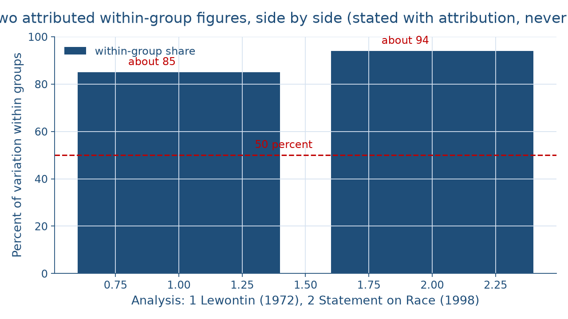
Two figures, one idea
WORKED EXAMPLE · SIDE BY SIDE
Is race in the body?
Week 12
7
Notes:
This chart sets the two attributed figures side by side. The left bar is Lewontin's 1972 figure, about 85 percent of variation within populations, so 100 − 85 = 15 percent lies outside them. The right bar is the Statement on Race figure from 1998, about 94 percent within so-called racial groups, so 100 − 94 = 6 percent lies outside them. A dashed line marks 50 percent, and both bars rise well above it. The right bar is 94 − 85 = 9 percentage points taller, and the gap is in percentage points because it is the difference between two percentages, the same rule Week 6 used for the market tally. DO: before naming the bars, ask which side of the 50 percent line each one sits on; collect answers, then reveal that both are above it, so both say most variation lies within groups, while the gap of 9 percentage points shows the number is not one number.

Slide 8
A trait that moved
CONCEPT 3 OF 6 · BOAS (1912)
Immigrant parents and United States-born children
Children's head form differed
Supposedly fixed traits respond to environment
Is race in the body?
Week 12
8
Notes:
Boas (1912), Changes in the Bodily Form of Descendants of Immigrants, in American Anthropologist, found that children born in the United States to immigrant parents differed in head form from their parents. That was evidence that traits once treated as fixed racial markers respond to environment. Walk the shape of the argument: the assumption tested was that head form was a fixed racial marker; the comparison was immigrant parents and their children born in the new country; the finding was a difference in head form; the conclusion was that a trait called fixed responds to environment. This is Week 8's Boas again, whose approach was later labelled historical particularism. DO: ask students to name the two groups Boas compared and the trait he measured, then collect answers and confirm parents and their United States-born children, and head form.

Slide 9
Boas versus caution
THE DEBATE · REANALYSES, NO VERDICT
Boas's case
A fixed trait changed
The cautious case
One measure settles little
Is race in the body?
Week 12
9
Notes:
Later researchers reanalyzed Boas's data, and the course mentions those reanalyses in words and keys no figure from them. On the left, Boas's strongest case: a trait that was called fixed changed within one generation, in a new environment, and that is enough to show it is not a fixed racial marker. On the right, the cautious case: one measure in one study cannot settle how much every trait responds to environment, so a careful reader keeps the size of the change an open question. The course states both at full strength and chooses neither. This mirrors Week 11's treatment of Mead and her critics. DO: split the room in half, give each half one side to argue in two sentences, collect the strongest line from each, and close by saying the course keys the 1912 finding but no verdict on the reanalyses.

Slide 10
Made, and real
CONCEPT 4 OF 6 · RACE DEFINED
A society makes the categories
Categories differ by place and time
The inequality built around them is real
Is race in the body?
Week 12
10
Notes:
Race is a social classification of people into groups that a society makes; the categories differ across places and times, and the inequality built around them has real effects, so race is not a set of natural biological groups. The Statement on Race describes race in the United States as a social mechanism invented during the eighteenth century. Now use Week 7's tools. In Fried's scheme a stratified society is one in which people have unequal access to basic resources, and a category tied to land, jobs, or schooling becomes part of that stratification. Power and authority ask who wrote the rule and whether people accepted it as rightful. Walk the chapter's illustrative town whose old housing records kept some families out of one neighborhood by category. DO: ask who made that category and whether it had real effects; collect the two answers, the town did, and yes.

Slide 11
Two opposite wrong turns
CONCEPT 4 OF 6 · THE TRAP
Natural groups
Drops: made by a society
No real effects
Drops: real in its effects
Is race in the body?
Week 12
11
Notes:
Name both wrong turns side by side. On the left, race read as a set of natural biological groups, which is tempting because visible traits feel natural. On the right, the phrase race is a social construct read as race has no real effects, which is tempting because constructed can sound like imaginary. Each wrong turn keeps one half of the definition and drops the other. The cure is to say both halves every time: made by a society, and real in its effects. Tie this to Week 2's cultural relativism, which is a method and not anything goes; here too, the anthropologist's description does not erase real harm. DO: read the sentence race is a social construct, so it does not affect anyone's life, ask students to name which half it drops, and collect two fair rewrites that keep both halves.

Slide 12
Heritage, not skin
CONCEPT 5 OF 6 · ETHNICITY
Shared ancestry, language, religion, customs
Ethnic identity: how people claim it
Ethnicity is not race
Is race in the body?
Week 12
12
Notes:
Ethnicity is a shared identity based on ancestry, language, religion, or customs; it is not the same as race. Ethnic identity is how people claim and display their ethnicity, for example through food, music, language, dress, or a heritage festival. Use the chapter's illustrative neighborhood festival: stalls sell a heritage's foods, a stage hosts its music, and signs use two languages. What is on show is not skin color but ancestry, language, food, music, and custom. Race sorts people by a society's reading of bodies; ethnicity gathers people around a shared heritage they learn and display. Name the wrong turn: ethnicity read as the same as race. DO: read the family speaks its grandparents' language at home and the old law sorted residents by a reading of their skin color, ask students to label each, and confirm ethnicity for the first and race for the second.

Slide 13
Nation, nationalism, nation-state
CONCEPT 5 OF 6 · A LARGER FRAME
Nation: a people sharing history, identity
Nationalism: a nation should govern itself
Nation-state: a state claiming one nation
Is race in the body?
Week 12
13
Notes:
Picture a crowd standing for a national anthem before a game: strangers acting as one people for a few minutes. A nation is a people who see themselves as sharing a history and an identity, often tied to a homeland. Nationalism is the idea and feeling that a nation should govern itself, together with loyalty to that nation. A nation-state is a state whose government claims to stand for one nation. Call back Week 7: in Service's model a state is a society with a central government that has the power to tax, make law, and enforce it. A nation-state adds a claim that the government stands for one people, and it is a claim, not a description, because most states hold people of many ethnicities. The course names these ideas and argues no current political question. DO: ask students to define nation-state in their own words and compare with a neighbor.

Slide 14
Whose boxes are these?
CONCEPT 6 OF 6 · WORKED EXAMPLE
1 question, 7 minimum categories
7 − 1 = 6 not newly added
1 person, 2 boxes, still 1 person
Is race in the body?
Week 12
14
Notes:
Work the outline's example on Dataset G. The Office of Management and Budget's 2024 revision uses 1 combined race-and-ethnicity question with 7 minimum categories: American Indian or Alaska Native; Asian; Black or African American; Hispanic or Latino; Middle Eastern or North African; Native Hawaiian or Pacific Islander; and White. Middle Eastern or North African is 1 of the 7, so 7 − 1 = 6 categories were not newly added in 2024. The office describes the 7 categories as socio-political constructs, and the Census Bureau states that its race categories reflect a social definition of race, not a biological, anthropological, or genetic one. The Census Bureau also states that people may report more than one race, so 1 person who checks 2 boxes is still 1 person, and a tally of checked boxes can run higher than the count of people. DO: check the board's guesses, then run each step live.

Slide 15
Audit the chatbot
THIS WEEK'S AUDIT · CHECK THE MACHINE
Paste the census prompt
Check: race as natural groups?
Check: one unsourced within-group number?
The tool drafts; you check
Is race in the body?
Week 12
15
Notes:
This activity puts a chatbot from the approved list, such as Claude, Gemini, or ChatGPT, to work on this week's material. DO: paste this exact prompt: A form asks about race and ethnicity using the 2024 federal standard. Explain what the categories describe, say whether they are biological groups, and say how much human variation lies within groups. Compare the response with the vetted reading: 7 minimum categories that the Office of Management and Budget calls socio-political constructs, human variation that is continuous, and two attributed within-group figures, about 85 percent and about 94 percent, from different analyses. The likely errors are presenting race as natural biological groups, or giving one within-group number with no source as if it were settled. Correct it by hand, citing the issuing body. Judgment rule for this audit: the tool drafts; you check.

Slide 16
Made boxes, continuous bodies
Variation is continuous; most lies within groups
Race: made by societies, real in effects
7 minimum categories, the issuing body's own
Next: Religion, Ritual, and Worldview
BEFORE NEXT WEEK
16
Notes:
Recap in the order taught. Human variation is continuous, and skin color tracks ancestral ultraviolet light without predicting other traits. Most variation lies within groups: about 85 percent from Lewontin and about 94 percent from the Statement on Race, 9 percentage points apart because they come from different analyses. Boas found in 1912 that immigrants' children differed in head form from their parents. Race is a social classification made by societies and real in its effects; ethnicity is a shared heritage and not the same as race; a nation-state is a state whose government claims to stand for one nation. The 2024 standard has 7 minimum categories, its issuing body's own. Next week, Week 13, Religion, Ritual, and Worldview, turns from social categories to meaning. DO: have each student write one sentence that keeps both halves of the race definition and read it to a neighbor.

