Slide 1
What do rituals do?
WEEK 13 · MEANING, RITUAL, AND PASSAGE
Week 13 · Religion, Ritual, and Worldview
1
Notes:
Welcome to Week 13, which opens the unit on meaning, ritual, and healing. Send students to the current syllabus as the authoritative source for how the course runs, then keep this opening on the ideas. The week's orienting question: when people mark a big change in life, face danger, or explain bad luck, what are their rituals doing for them? Preview the path. We will define religion two ways, read a rite of passage in three phases with the course's rites set, name the strange middle of a rite, look at magic and uncertainty, read witchcraft as an explanation for misfortune, meet revitalization movements, and finish at the running market with its opening bell. Remind students that Week 10 met the wedding in the rites set as a marriage; this week reads it again as a rite.

Slide 2
A dinner with rules
01
THE HOOK · A NEW YEAR'S EVE DINNER
2
Notes:
Open with the chapter's illustrative family on New Year's Eve. There is a special meal nobody cooks at any other time of year, a countdown at 10 seconds to midnight, and a grandparent who tells the same story every year about why the family eats the dish, until the youngest child can recite it too. Nobody would call the evening a religion, yet it has a set order of acts, a story about how the custom began, and a feeling that the year goes better if it is done right. It also marks a line in time. DO: ask students to write down one custom from their own family, team, or workplace that has a fixed order of steps, and one word for what it does: luck, belonging, or marking time. Collect a show of hands for each word and keep the list for the end of class.

Slide 3
Six rites, three phases
02
DATASET E · THIS WEEK'S SHARED DATA
3
Notes:
Introduce this week's shared data by name. Dataset E, the rites-of-passage set, is illustrative: it was made up for this course and describes no real people. It holds 6 rites, a graduation, a naming ceremony, a military recruit's basic training, a wedding, a coming-of-age ceremony, and a retirement, each with 3 pinned phases, so 6 × 3 = 18 pinned phase entries. Beside it this week sits Dataset A, the running market, also illustrative, with its opening routine: the hush, the bell at 8:00 a.m., the call Bell's rung!, and the first sale. The 10 pinned field notes from Visit 1 return too. DO: ask students to guess how many phase entries the rites set holds before you show the arithmetic, write the guesses on the board, and settle them at the worked example.

Slide 4
Two ways to define religion
CONCEPT 1 OF 6 · DEFINITIONS
Tylor (1871): belief in spiritual beings
He called it animism
Geertz (1966): a system of symbols
What do rituals do?
Week 13
4
Notes:
Tylor (1871), Primitive Culture, offered a minimum definition of religion: belief in spiritual beings, which he called animism. Animism is Tylor's name for that belief. Geertz (1966), Religion as a Cultural System, defines religion as a system of symbols that shapes people's moods and motivations and their sense of the order of existence; the course paraphrases it and quotes none of it. Put them together for the course's working definition: religion is a system of beliefs and practices about spiritual beings and the order of the world. This is Week 2's symbol at a larger scale: something that stands for something else by convention, now organized into a whole system. DO: read the New Year's dinner against each definition. Ask whether Tylor's test calls it religion, and collect no, because it names no spiritual being; then ask what Geertz's lens picks up, and collect the dish, the countdown, and the story.

Slide 5
A myth is not false
CONCEPT 1 OF 6 · MYTH, WORLDVIEW, RITUAL
Myth: a sacred story of origins
Worldview: how the world is ordered
Ritual: patterned acts that carry meaning
What do rituals do?
Week 13
5
Notes:
A myth is a sacred story that explains how things came to be, told and retold by the people who hold it. In everyday English, myth means a false belief; in anthropology it does not, because the term names what a story does for the people who tell it, not whether an outsider believes it. A myth is language at work, spoken and passed on, as Week 4 said every language is learned. A worldview is a people's broad sense of how the world is ordered and what it means, which religion and ritual help shape. A ritual is a patterned, repeated sequence of acts that people perform because it carries meaning for them. Name the wrong turn: myth read as a false story. DO: ask students to rewrite the sentence their myth is only a story so that it uses the term the course's way, and collect two rewrites.

Slide 6
Three phases of passage
CONCEPT 2 OF 6 · VAN GENNEP (1909)
Separation: set apart from the old status
Transition: between old and new
Incorporation: welcomed back, new status
What do rituals do?
Week 13
6
Notes:
A rite of passage is a ritual that moves a person from one social status to another, such as a graduation, a wedding, or a retirement; it need not be religious. Van Gennep (1909), Les rites de passage, identified three phases, and the English translation appeared in 1960, so 1960 − 1909 = 51 years passed before English readers had it. Separation is the first phase, when a person is set apart from their old status. Transition is the middle phase, when a person has left the old status but not yet entered the new one. Incorporation is the last, when a person is welcomed back into the community in a new status. Teach the phases as a model for comparison, not a law: real rites can stretch or blur a phase. DO: have students name the three phases of a team tryout aloud, one phase per volunteer.

Slide 7
The graduation, phase by phase
CONCEPT 2 OF 6 · WORKED EXAMPLE
Caps, gowns, lined up apart
Waiting to be called
Tassel turned, welcomed back
6 × 3 = 18; 18 − 6 = 12
What do rituals do?
Week 13
7
Notes:
Work the outline's example on Dataset E. Separation: graduates leave family seats, put on caps and gowns, and line up apart. Transition: the procession and ceremony, waiting to be called, no longer students and not yet graduates. Incorporation: name read, diploma handed over, tassel turned, and welcomed back by family as graduates. Then count the whole set: 6 rites, each with 3 pinned phases, so 6 × 3 = 18 pinned phase entries. Each rite has 1 transition phase, so 6 of the 18 entries are liminal, and 18 − 6 = 12 entries are separation or incorporation. Name the wrong turn: a rite of passage read as always religious. The graduation and the retirement name no spiritual being and still follow the three phases. DO: check the board's guesses against 18, then run each phase live, pausing for a prediction before each reveal.

Slide 8
Liminality versus communitas
CONCEPT 3 OF 6 · TURNER'S TWO IDEAS
Liminality
The in-between state
Communitas
The bond it builds
What do rituals do?
Week 13
8
Notes:
On the left, liminality: the in-between state of the transition phase, when a person is no longer in the old status and not yet in the new one. Turner (1967), Betwixt and Between, in The Forest of Symbols, developed it in an essay first presented in 1964. On the right, communitas: the intense bond among people who share that liminal state together, set out in Turner (1969), The Ritual Process. Read the recruit's basic training from Dataset E. Separation: recruits leave home, hand in civilian clothes, and get the same haircut. Transition: basic training, where recruits are equal, stripped of former status, and bonded, which is liminality with communitas. Incorporation: the graduation parade, where the recruit returns as a soldier with a rank. Name the wrong turn: ritual read as meaningless repetition. DO: ask where in that row each idea sits, and collect the transition phase for both.

Slide 9
Magic goes where risk is
CONCEPT 4 OF 6 · MALINOWSKI'S FISHING CONTRAST
Open sea: dangerous, magic used
Lagoon: safe, no magic
Magic where outcomes are uncertain
What do rituals do?
Week 13
9
Notes:
Magic is ritual action that people use to try to bring about a result directly, such as a good catch or a safe voyage. Malinowski observed that, in the 1910s, Trobriand Islanders used magic for dangerous open-sea fishing but not for safe lagoon fishing, and argued that magic is used where outcomes are uncertain. His essay Magic, Science and Religion was first published in 1925 and collected after his death in 1948. This is the same Malinowski whose fieldwork in the Trobriand Islands Week 3 used to teach participant observation. Stress the contrast: same fishermen, same skills, and the magic went where the danger did. Set it beside the chapter's illustrative basketball player, who practices free throws for hours and keeps a pregame routine for the part she cannot control. DO: ask students to name one routine they use before an uncertain event and say whether it fits Malinowski's argument.

Slide 10
Magic versus religion
CONCEPT 4 OF 6 · THE KEY DISTINCTION
Magic
Ritual aimed at one result
Religion
A system of belief, order
What do rituals do?
Week 13
10
Notes:
On the left, magic: a ritual aimed at one specific result, treated as working directly, used in Malinowski's account where outcomes are uncertain. On the right, religion: a wider system of beliefs and practices about spiritual beings and the order of the world, in Tylor's and Geertz's senses. Name the wrong turn: magic and religion read as the same. It is tempting because both use ritual and both may involve unseen forces. The cure is one question: is this ritual aimed at one result, or does it express a whole sense of how the world is ordered? A person can hold a religion and also use magic, so the two are not rival boxes. DO: read two illustrative cases, a lucky sweatshirt worn only to a final exam, and a weekly service that tells how the world began; ask students to label each, and confirm magic for the first and religion for the second.

Slide 11
Why them, why now?
CONCEPT 5 OF 6 · EVANS-PRITCHARD (1937)
Termites weakened the granary
Witchcraft explained the timing
Shamans, priests, diviners
What do rituals do?
Week 13
11
Notes:
Evans-Pritchard (1937), Witchcraft, Oracles and Magic Among the Azande, came from fieldwork in the late 1920s. In the late 1920s, Azande accepted that termites weakened a granary's supports, but asked why it fell at the moment particular people sat beneath it, and witchcraft answered the why them, why now. Witchcraft, in his account, explained why a misfortune struck particular people at a particular moment, alongside knowledge of natural causes. Name the wrong turn: witchcraft belief read as ignorance of natural causes; the Azande knew about termites. Then name religious specialists: a shaman is a part-time specialist who contacts the spirit world on behalf of others, a priest is a full-time official of an organized religion, and a diviner seeks hidden knowledge, such as a misfortune's cause, through set procedures. DO: ask students to split the illustrative commuter's snapped bike chain into a how question and a why-her question.

Slide 12
Rebuilding a culture deliberately
CONCEPT 6 OF 6 · WALLACE (1956)
Deliberate and organized
Led by the society's own members
A more satisfying culture, under stress
What do rituals do?
Week 13
12
Notes:
Wallace (1956), Revitalization Movements, in American Anthropologist, describes a revitalization movement as a deliberate, organized effort by members of a society to build a more satisfying culture in a time of stress. The Ghost Dance movement of 1889 to 1890 is a commonly taught example; name it in words and describe none of its practices, because its meaning belongs to the communities who took part and their descendants. Walk the chapter's three illustrative cases with the definition's four parts. A town whose mill closed organizes its own residents to revive its old language classes and harvest festival: it fits. A clothing style that spreads among teenagers by chance is not deliberate. A company's heritage ad campaign is not led by the society's members. DO: read the three cases, collect a fit or no fit for each, and confirm that 1 of the 3 fits.

Slide 13
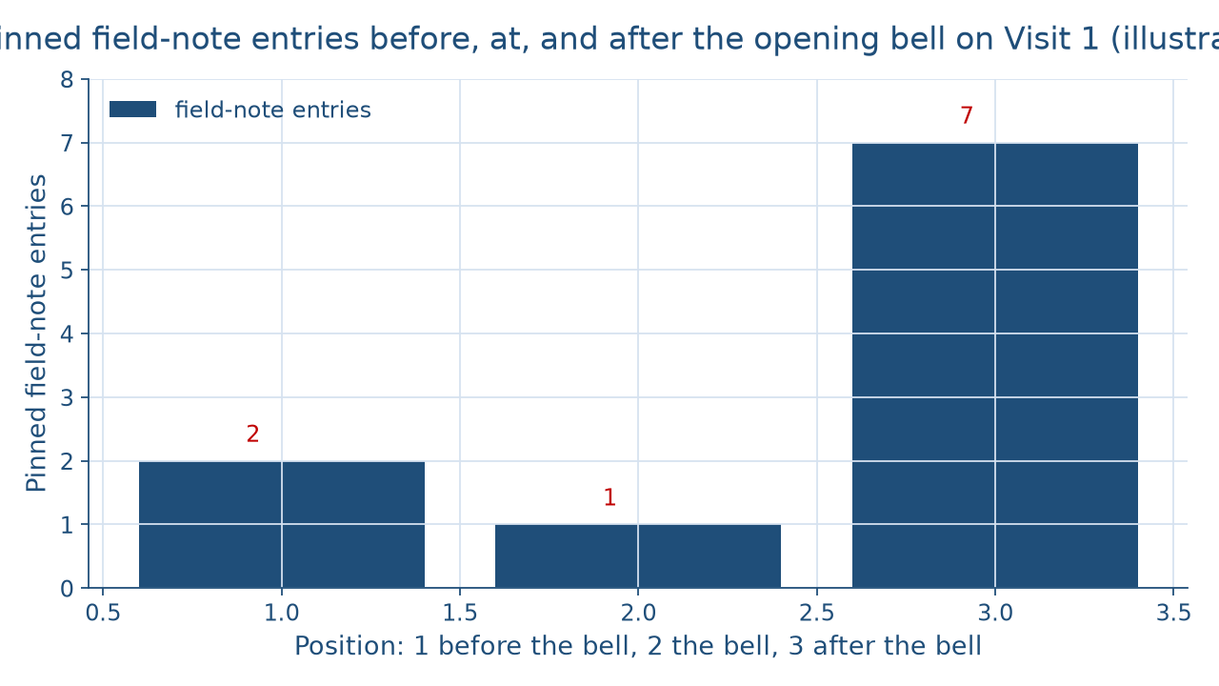
The bell in the notes
CONCEPT 6 OF 6 · THE RUNNING SITE
What do rituals do?
Week 13
13
Notes:
This chart counts the 10 pinned field notes from Visit 1 at the running market, which is illustrative. The left bar shows the 2 entries before the bell, at 7:40 a.m. and 7:55 a.m. The middle bar shows the 1 entry that records the bell at 8:00 a.m. The right bar, the tallest, shows the 7 entries after it, from 8:20 a.m. to 9:25 a.m. So 2 + 1 + 7 = 10 pinned entries. Visit 1 ran from 7:30 a.m. to 9:30 a.m., so from 7:30 to 8:00 is 30 minutes into the visit. Week 3 recorded these notes in two columns, and Week 7 read the bell as the manager's authority. DO: before naming the bars, ask which part of the morning the observer saw most of, collect answers, and reveal the 7 entries after the bell.

Slide 14
It marks time, not people
CONCEPT 6 OF 6 · WORKED EXAMPLE
Hush, ring, first sale: 3 parts
Moves the market, not a person
A calendrical ritual
What do rituals do?
Week 13
14
Notes:
Read the routine against the rites set. The hush, the ring with the call Bell's rung!, and the first sale within a minute make a 3-part sequence, like the 3 phases, but the routine moves the market from setting up to selling once each market day and moves no person to a new status. A calendrical ritual is a ritual performed at a regular point in time, such as each week, season, or year, that marks the passing of time for a group rather than moving one person to a new status. Use Week 4's tools on its language: the hush is nonverbal communication, and the bell is the vendors' own emic term. The reading: the opening bell is a small calendrical ritual, not a rite of passage, because it marks the same line in time each market day. DO: ask whose status changes when the bell rings, and collect nobody's.

Slide 15
Audit the chatbot
THIS WEEK'S AUDIT · CHECK THE MACHINE
Paste the bell and granary prompt
Check: bell called a rite of passage?
Check: Azande in present tense, no decade?
The tool drafts; you check
What do rituals do?
Week 13
15
Notes:
This activity puts a chatbot from the approved list, such as Claude, Gemini, or ChatGPT, to work on this week's material. DO: paste this exact prompt: An illustrative farmers' market rings a bell each market day before selling begins. Is that a rite of passage? Then explain how the Azande used witchcraft to explain a granary that fell. Compare the response with the vetted reading: the bell is a calendrical ritual, because it moves no one to a new status, and in the late 1920s Azande accepted that termites weakened the granary while witchcraft answered why them, why now. The likely errors are calling the bell a rite of passage because it has three parts, or describing the Azande in the present tense with no fieldwork decade, as if they did not know natural causes. Correct it by hand, citing Evans-Pritchard (1937). Judgment rule for this audit: the tool drafts; you check.

Slide 16
Rites move, bells mark
Separation, transition, incorporation
Magic where outcomes are uncertain
Witchcraft answered why them, why now
Next: Health, Illness, and Healing
BEFORE NEXT WEEK
16
Notes:
Recap in the order taught. Tylor defined religion as belief in spiritual beings, which he called animism, and Geertz described it as a system of symbols. A rite of passage moves a person through separation, transition, and incorporation; the 6 rites in Dataset E give 18 pinned phase entries. Liminality is the in-between state, and communitas is the bond it can build. Magic goes where outcomes are uncertain, as in Trobriand open-sea fishing in the 1910s. Azande witchcraft answered why them, why now, alongside knowledge of termites. A revitalization movement deliberately rebuilds a culture under stress, and the market's bell is a calendrical ritual. Next week, Week 14, Health, Illness, and Healing, reads an illness explained by witchcraft through the explanatory model. DO: return to the hook's list of customs and have each student label theirs as a rite of passage, a calendrical ritual, or magic, and say why to a neighbor.

