Slide 1
What does being sick mean?
WEEK 14 · MEANING, ILLNESS, AND HEALING
Week 14 · Health, Illness, and Healing
1
Notes:
Welcome to Week 14, the second week of the unit on meaning, ritual, and healing. Send students to the current syllabus as the authoritative source for how the course runs, then keep this opening on the ideas. The week's orienting question: when a person is sick or hurt, how much of what happens is about the body, and how much is about meaning, explanation, and the way life is arranged? Preview the moves in order: tell disease from illness, ask the five explanatory-model questions, map the ways people heal, describe shared ways of talking about suffering, name harm that comes from arrangements, and read one vendor's back strain at the running market with every tool. Tell students that every case in this deck is either pinned by the course or labelled illustrative. Transition: start with one bad night before an exam.

Slide 2
One night, two stories
01
THE HOOK · A MIGRAINE NIGHT
2
Notes:
Open with the chapter's illustrative student on the night before a big exam. Around 9 p.m., a migraine starts: a pounding headache, light that hurts, and a wave of nausea. The next morning, a clinic note sums it up in one line. But the student lived a lost study night, a dark room with a cold cloth, a roommate who said it was stress and too much coffee, a parent who said it runs in the family, and a worry about being believed. DO: ask the room to list everything the clinic note leaves out, and write the list on the board in two columns without naming the columns yet. Collect four or five items. Then reveal that the left column will be called disease and the right column illness, and move every item where it belongs. That sorting is the week's first move.

Slide 3
One vendor, one back strain
02
DATASETS F AND A · THIS WEEK'S SHARED DATA
3
Notes:
Introduce this week's shared data by name. Dataset F, the interview excerpt, is illustrative: an unnamed vendor who has sold at the running market for 20 years, made up for this course and describing no real person. The interviewer asks 5 questions; the first 4 replies carry the 4 emic terms students met in Week 3 and Week 4, regulars, seconds, the swap, and the bell, and the 5th reply carries the back strain, so 4 + 1 = 5 replies. In that reply, the vendor's wife says it is the cold mornings, and the vendor's doctor says it is the lifting. Dataset A, the running market, is also illustrative: 24 stalls, a first-aid kit in the market office, and one vendor who brings ginger tea for anyone with a cold. Every worked example this week reads from these two datasets.

Slide 4
Disease versus illness
CONCEPT 1 OF 6 · KLEINMAN (1980)
Disease
The body's malfunction
Illness
The lived experience and meaning
What does being sick mean?
Week 14
4
Notes:
On the left, disease: a biological malfunction of the body as a biomedical practitioner defines it, such as a strained muscle or an infection. On the right, illness: the person's and community's experience and meaning of being unwell, including how it feels, what it disrupts, and what people say about it. Kleinman (1980), Patients and Healers in the Context of Culture, developed the distinction. The two usually travel together but can come apart: high blood pressure that nobody has noticed is disease with no illness yet, and weeks of feeling awful with tests that find nothing is illness with no disease the tests can name. Name the misconception: students use disease and illness as synonyms. The cure is one question for any account of sickness: is this about the body, or about what it is like and what it means?

Slide 5
The migraine, read twice
CONCEPT 1 OF 6 · WORKED EXAMPLE
Body: headache, light, nausea
Meaning: lost night, worry about belief
Two explanations: stress, family
What does being sick mean?
Week 14
5
Notes:
Work the chapter's illustrative migraine in the course's order. What was observed: a headache that started around 9 p.m., light that hurt, nausea, a lost study night, two explanations from the people around the student, and a worry about being believed. The body side, which is disease: the headache, the light, and the nausea, the things a clinician records and treats. The meaning side, which is illness: the lost night, the dark room, the roommate's stress, the parent's runs in the family, and the worry about belief. DO: read each item aloud and have the room call out disease or illness; the vetted sort is headache, light, and nausea on the disease side, and everything else on the illness side. Close with the reading: one disease recorded in the body, one illness lived as a lost night.

Slide 6
Five open questions
CONCEPT 2 OF 6 · EXPLANATORY MODELS
Cause and timing
What it does to the body
How serious; what treatment
Asked openly, no single right reply
What does being sick mean?
Week 14
6
Notes:
An explanatory model is a person's account of an illness: what caused it, why it started when it did, what it does to the body, how serious it is, and what treatment it needs. Kleinman developed the idea in the same 1980 work. The five questions are a classroom model: they organize listening, and a real conversation rarely follows them in order. They are asked as open questions, with no single right reply to mark. This is Week 3's method returning: an open-ended interview asks the five questions, the person's own words are an emic account, and explanatory model is the analyst's etic term for what those words add up to. Name the misconception: students read an explanatory model as a quiz and treat the doctor's model as the true one. The cure: record every account a person reports, and ask what each one leads people to do.

Slide 7
Two models, one back
CONCEPT 2 OF 6 · WORKED EXAMPLE
Wife: the cold mornings
Doctor: the lifting
2 accounts of the cause, 1 condition
5 − 1 = 4 questions open
What does being sick mean?
Week 14
7
Notes:
Work the outline's example on Dataset F, which is illustrative. The vendor says, My back's not what it was, after twenty years of crates; that is the illness side, the vendor's own experience. The vendor's wife says it is the cold mornings, and the vendor's doctor says it is the lifting, so there are 2 accounts of the cause of 1 condition. The doctor's account names a bodily cause, the lifting, which is how a biomedical practitioner frames the problem, the disease side. The five questions are cause, timing, what it does to the body, how serious it is, and what treatment it needs; the excerpt touches only the cause question, so 5 − 1 = 4 questions stay open for a follow-up interview. DO: ask which of the two models is right; the vetted reply is that the course keys neither, because both are data about how people explain a back strain.

Slide 8
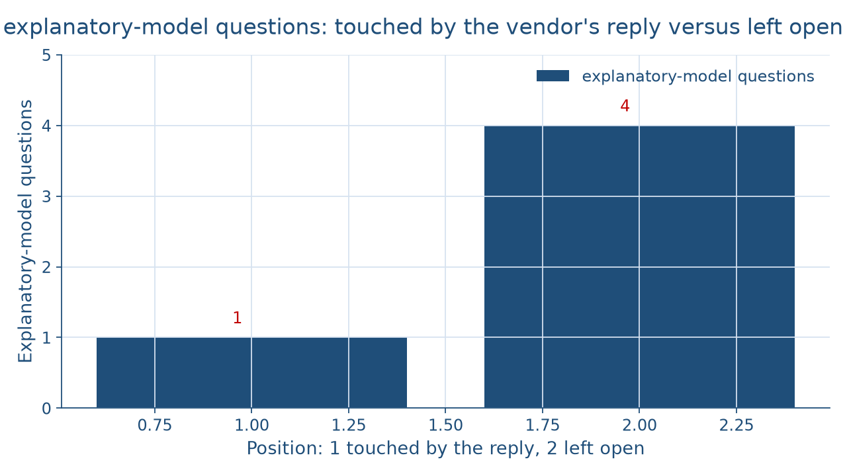
Four questions still waiting
CONCEPT 2 OF 6 · WHAT THE REPLY LEAVES OPEN
What does being sick mean?
Week 14
8
Notes:
This chart counts the five explanatory-model questions against the vendor's reply in the illustrative interview. The left bar, questions the reply touches, is 1: the cause, answered two ways by the wife and the doctor. The right bar, the taller one, is 4: timing, what it does to the body, how serious it is, and what treatment it needs. Together the bars make 5 questions, so 5 − 1 = 4 questions stay open. DO: give pairs one minute to write one open follow-up question for each of the 4 open questions, then collect a question for timing and one for treatment and check that each is open, such as, when did you first notice it, rather than closed, such as, was it the lifting. Remind the room that any follow-up starts with the course's consent script from Week 3 and offers no diagnosis.

Slide 9
Many systems, one household
CONCEPT 3 OF 6 · MANY WAYS TO HEAL
Ethnomedicine: a culture's own healing system
Biomedicine: one system among many
Medical pluralism: more than one at once
What does being sick mean?
Week 14
9
Notes:
Open with the chapter's illustrative family when the youngest child catches a cold: soup with extra garlic, a grandparent's scarf and early bedtime, cold medicine from the pharmacy, and a clinic visit if the fever lasts. Ethnomedicine is a culture's own system of health and healing, including its ideas about what makes people sick and the remedies and healers it relies on. Biomedicine is the system of medicine based on biology and laboratory science, taught in medical schools and practiced in clinics and hospitals; anthropologists treat it as one healing system among many. Medical pluralism is the use of more than one system at once, such as a clinic and a family remedy. Be careful to say that one system among many makes no claim that every remedy works equally well; that is a question for medical research, and the course makes no such claim.

Slide 10
Two kinds of care
CONCEPT 3 OF 6 · WORKED EXAMPLE
First-aid kit in the market office
Ginger tea for anyone with a cold
1 market, 24 stalls, 2 kinds of care
What does being sick mean?
Week 14
10
Notes:
Work the outline's example on Dataset A, the illustrative running market. The market office keeps a first-aid kit, and one vendor brings ginger tea for anyone with a cold, so 1 market of 24 stalls holds 2 kinds of care at once. The kit is there for cuts, scrapes, and emergencies; the tea is a vendor's way of looking after the people around the stall. DO: ask the room which concept names the pattern; the vetted reply is medical pluralism, more than one system of health and healing in one place. Then name the misconception: students read ethnomedicine as superstition set against biomedicine. The cure is Week 2's cultural relativism used as a method: describe each system in the terms of the people who use it before judging it.

Slide 11
A shared word for suffering
CONCEPT 4 OF 6 · CULTURAL CONCEPTS OF DISTRESS
An illustrative dorm floor feels fried
Shared meaning, cause, and remedy
Described in words, never a diagnosis
What does being sick mean?
Week 14
11
Notes:
Cultural concepts of distress are ways of experiencing and talking about suffering that are shared within a cultural group. Use the chapter's illustrative dorm floor in exam weeks: students say they feel fried, and the whole floor knows what it means, too little sleep, a short temper, and a head that will not hold one more fact, along with what brings it on and what helps. Anthropologists have documented many such shared ways of naming suffering in communities around the world; this course names none of them, describes the idea in words, and diagnoses no one. DO: walk the four moves aloud, observed, meaning to the people involved, the concept, and a comparison, and for the comparison call back Week 13's Azande granary: the word fried carries its own why, exam weeks, and its own plan.

Slide 12
Harm built into arrangements
CONCEPT 5 OF 6 · STRUCTURAL VIOLENCE
Same injury, different job arrangements
Galtung (1969) coined the term
Farmer (2004) brought it into anthropology
2004 − 1969 = 35 years
What does being sick mean?
Week 14
12
Notes:
Open with the chapter's two illustrative warehouse workers who hurt their backs the same way: one has sick leave and a health plan and rests, the other has a temporary contract with neither and is back lifting boxes in two days. Structural violence is harm done by social arrangements, rather than by a person's blow, that put some people in the way of illness and injury. Galtung (1969), Violence, Peace, and Peace Research, in the Journal of Peace Research, coined the term. Farmer (2004), An Anthropology of Structural Violence, in Current Anthropology, brought it into anthropology. Galtung coined it in 1969 and Farmer's article came in 2004, so 2004 − 1969 = 35 years passed between them. The social distribution of illness is the uneven way illness and injury fall across a society, taught in words with no figure keyed.

Slide 13
A blow versus an arrangement
CONCEPT 5 OF 6 · TWO WRONG TURNS
Not a fight
Harm with no single attacker
Not Farmer's coinage
Galtung coined it
What does being sick mean?
Week 14
13
Notes:
Name the two misconceptions the week is built to cure. On the left: students read structural violence as physical violence by a person, a fight or an assault. It is not a fight; it is harm with no single attacker, done by the way work, money, or care is arranged. On the right: students credit the term to Farmer as its coiner. It is not Farmer's coinage; Galtung coined it in 1969, and Farmer brought it into anthropology in 2004. DO: read two sentences aloud and have the room fix each one. First: the warehouse supervisor committed structural violence by shouting at a worker; the vetted fix is that shouting is a person's act, while structural violence is the arrangement that sent the injured worker back early. Second: Farmer coined structural violence; the vetted fix credits Galtung in 1969.

Slide 14
One back strain, every tool
CONCEPT 6 OF 6 · WORKED EXAMPLE
Disease: the lifting; illness: not what it was
2 models; 4 questions open
Kit and tea: medical pluralism
Arrangements: a question for fieldwork
What does being sick mean?
Week 14
14
Notes:
Read the vendor's back strain with every tool of the week, from Datasets F and A, both illustrative. Disease and illness: the doctor's account, the lifting, names a bodily cause, the disease side, while My back's not what it was is the illness side. Explanatory models: 2 accounts of the cause of 1 condition, the cold mornings and the lifting, and 5 − 1 = 4 questions stay open. Medical pluralism: in 1 market of 24 stalls, the first-aid kit and the ginger tea are 2 kinds of care at once. Structural violence: what arrangements put a vendor in the way of 20 years of lifting crates? The excerpt does not say, so the question stays open for fieldwork. DO: have students write the reading in one plain sentence, then compare with the outline's: one condition read through 2 explanatory models, and an anthropologist asks the open questions before calling any one account the right one.

Slide 15
Audit the chatbot
THIS WEEK'S AUDIT · CHECK THE MACHINE
Paste the back-strain prompt
Check: did it crown one model right?
Check: did it credit Farmer as coiner?
The tool drafts; you check
What does being sick mean?
Week 14
15
Notes:
This activity puts a chatbot from the approved list, such as Claude, Gemini, or ChatGPT, to work on this week's material. DO: paste this exact prompt: An illustrative farmers' market vendor says the back is not what it was after 20 years of lifting crates. The vendor's wife says it is the cold mornings, and the vendor's doctor says it is the lifting. Which explanation is correct, and who coined the term structural violence? Expect two slips. The tool often names the doctor's model the correct one; the vetted reading is that both are explanatory models and the course keys neither. The tool may also credit Farmer as the coiner; Galtung coined it in 1969, and Farmer brought it into anthropology in 2004. Have pairs mark each slip and correct it by hand. For this activity, the rule holds: the tool drafts; you check.

Slide 16
The body, and its meaning
Disease versus illness
Five open questions, no single right reply
Structural violence: Galtung (1969), Farmer (2004)
Next: Globalization, Colonialism, and Applied Anthropology
BEFORE NEXT WEEK
16
Notes:
Recap in the order taught. Disease is the body's malfunction and illness is the lived experience and meaning; Kleinman (1980) set them apart. An explanatory model answers five open questions, cause, timing, what it does to the body, how serious it is, and what treatment it needs, with no single right reply. Ethnomedicine is a culture's own healing system, biomedicine is one system among many, and medical pluralism is using more than one at once. Cultural concepts of distress are described in words and never used to diagnose. Structural violence is harm done by arrangements: Galtung coined it in 1969 and Farmer brought it into anthropology in 2004. DO: exit ticket, one sentence each: name the disease side and the illness side of the vendor's back strain. Next week, Globalization, Colonialism, and Applied Anthropology, and the Course Synthesis, reads the running market through every week's lens.

