Slide 1
One place, many ties
WEEK 15 · GLOBAL TIES AND THE SYNTHESIS
Week 15 · Globalization, Colonialism, and Applied Anthropology, and the Course Synthesis
1
Notes:
Welcome to Week 15, the last module of new material in the course; its theme is one place, many ties. Send students to the current syllabus as the authoritative source for how the course runs, then keep this opening on the ideas. The week's orienting question: how is one small place tied to the rest of the world, and since when? Preview the path. We will define globalization, state the history of colonialism plainly, use the world-system as a model, work the UN's 2024 migration figures, meet heritage and repatriation, put applied and public anthropology to work, and close by reading the running market through every lens the course has taught. Remind students that Week 6 met the potlatch as exchange; this week it returns as a colonial law and as a story of return.

Slide 2
One cup, many hands
01
THE HOOK · A CUP OF COFFEE
2
Notes:
Open with the chapter's illustrative cup of coffee, bought on the way to class. The beans were grown on a farm in one region of the world, shipped across an ocean, roasted in another country, and poured by a worker near you. No student has met the grower, the shipper, or the roaster, yet every morning cup depends on all of them. That chain of many hands is where this week starts. DO: ask students to write down one thing they used this morning, such as a phone, a shirt, or a breakfast food, and list every place it might have passed through. Collect two or three routes aloud, note which steps nobody knows, and keep the list for the synthesis at the end of class.

Slide 3
Three datasets, one synthesis
02
DATASETS G, H, AND A · SHARED DATA
3
Notes:
Name the week's three shared datasets. Dataset G is real: the UN Department of Economic and Social Affairs counted about 304 million international migrants in 2024, 3.7 percent of the world's population, against an estimated 154 million in 1990. The World Bank's remittance estimate is taught in words and never tested. Dataset H is real too: the potlatch ban dropped in 1951, the Native American Graves Protection and Repatriation Act signed in 1990, and UNESCO's convention adopted in 2003. Dataset A is the illustrative running market of 24 stalls, read this week through every lens, from the 10 field-note entries to the two vendors who send money to relatives in another country every month. Every real figure carries its issuing body and year; the market stays labelled illustrative, and all three feed the closing synthesis.

Slide 4
Old flows, still intensifying
CONCEPT 1 OF 7 · GLOBALIZATION
Goods, people, money, ideas
A long, often colonial history
Not the same everywhere
One place, many ties
Week 15
4
Notes:
Globalization is the intensifying flow of goods, people, money, and ideas across the world. It has a long history, often colonial, and it does not make every culture the same; global goods are remade locally, so the world is not the same everywhere. Stress the word intensifying: these are old flows, still intensifying, and what keeps growing is their reach. Walk the coffee in four moves, the order Week 3 taught for every reading. What was observed: beans grown, shipped, roasted, and poured across borders. What it might mean to the people involved: income to a grower, a product to a roaster, a habit to a buyer. What the concept calls it: globalization. What a comparison adds: a loaf from the market's bread stall travels a few miles. DO: ask whether globalization began with the internet, collect answers, and correct it with the word intensifying.

Slide 5
Colonialism, stated plainly
CONCEPT 2 OF 7 · COLONIALISM
Rule over another society
Land, labor, and resources
After 1492: crops, animals, diseases
One place, many ties
Week 15
5
Notes:
Colonialism is one society's rule over another and the use of its land, labor, and resources. Its legacies include borders, languages, economies, and inequalities that continue in the present. After 1492, crops, animals, and diseases moved between the Americas and the rest of the world, changing diets, economies, and populations on every continent. The course describes that movement in plain words, and colonialism is stated plainly. Name the wrong turn: reading colonialism as a debate about whether harm occurred. The course presents real scholarly debates with each side at full strength, but documented harms are stated as documented history. DO: ask students for one legacy they can name, such as a border, a language, or a crop grown far from where it began, and sort the answers into those four legacy types on the board.

Slide 6
The potlatch ban was law
CONCEPT 2 OF 7 · WORKED EXAMPLE
Banned 1885 until 1951
Under Canada's Indian Act
Documented harm, not a debate
One place, many ties
Week 15
6
Notes:
Call back Week 6, where the potlatch was read as exchange: a feast at which hosts give away goods to validate names, rank, and rights before witnesses. Canada banned the potlatch under Canada's Indian Act from 1885 until 1951. The Canadian Museum for Human Rights describes the ban as part of an effort to destroy Indigenous culture and religion. Read it in four moves. What was observed: a national government made a feast illegal for decades. What it meant: because the potlatch validated names, rank, and rights, the ban reached into how those rights were recognized. What the concept calls it: colonialism in law. What a comparison adds: Week 6's exchange case now shows a state using law against a people's own institutions. DO: ask whether the class should give both sides of whether the ban caused harm; collect votes, then answer no: it is a documented harm, not a debate.

Slide 7
Core versus periphery
CONCEPT 3 OF 7 · THE WORLD-SYSTEM MODEL
Core: draws wealth in
Roasts and sells the beans
Periphery: land and labor drawn on
Grows the beans
One place, many ties
Week 15
7
Notes:
Wallerstein's world-system idea, from The Modern World-System, 1974, named in words, describes a world economy, core versus periphery, in which the core, the regions that gain, draws on the periphery, the regions drawn on, through unequal exchange. The core draws wealth in from other regions; the periphery has its land and labor drawn on. On the illustrative coffee route, the growing region sits in the periphery because it grows the beans, and the roasting country sits in the core because it roasts and sells the beans as a branded product. If most of the price stays with the roaster, the exchange is unequal. Call back Week 6: reciprocity is exchange between social equals, so unequal exchange is not reciprocity. DO: have pairs place two products they buy on the model, then name what they would check before trusting the guess.

Slide 8
Never outside history
CONCEPT 3 OF 7 · WOLF AND MINTZ
A model, not a verdict
Wolf: peoples always in history
Mintz: sugar, plantations, diets
One place, many ties
Week 15
8
Notes:
The world-system is a model and a classroom tool, not a verdict on any real place; real places can mix roles. Two anthropologists carried this thinking into the discipline's own cases, named in words. Wolf's Europe and the People Without History, 1982, argued that the peoples anthropologists studied were never outside history: peoples were always in history, tied into trade, war, and empire. Mintz's Sweetness and Power, 1985, traced how sugar linked plantation labor to European diets, so sugar, plantations, and diets belong to one story. Connect Wolf to a course rule from Week 1 and every week since: each ethnographic account is written in the past tense with its fieldwork decade, so no people is frozen in a timeless present. DO: read a one-line description of a people in the present tense with no date, ask what Wolf would object to, and rewrite it together in the past tense with a decade.

Slide 9
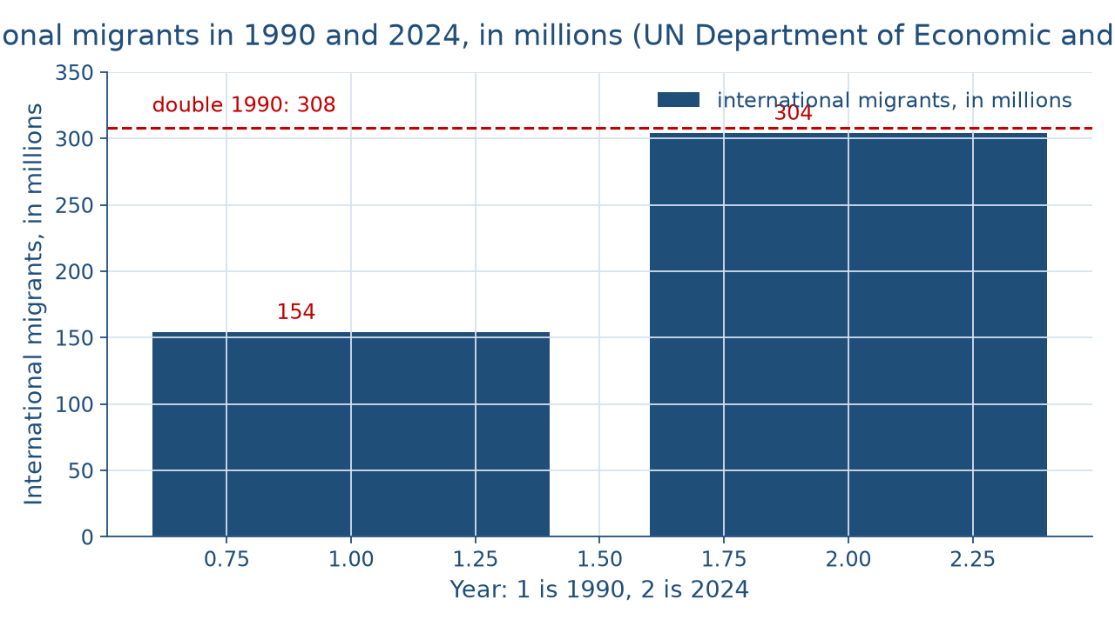
Nearly double since 1990
CONCEPT 4 OF 7 · DATASET G
One place, many ties
Week 15
9
Notes:
This bar chart shows the UN Department of Economic and Social Affairs' count of international migrants, in millions. The left bar, for 1990, is an estimated 154 million. The right bar, for 2024, is about 304 million, and it is nearly twice as tall: nearly double since 1990. A thin line marks double the 1990 count, 2 × 154 = 308 million, and the 2024 bar stops 308 − 304 = 4 million short of it. So 304 − 154 = 150 million more migrants in 2024 than in 1990. Migration is the movement of people from one place to live in another, including across national borders. DO: before naming the bars, ask students to guess whether the count rose by about half, nearly doubled, or tripled; collect a show of hands for each, then reveal nearly double, 4 million short.

Slide 10
Percent versus percentage points
CONCEPT 4 OF 7 · WORKED EXAMPLE
2024: 3.7 percent of the world
1990: 2.9 percent
Change: 0.8 percentage points
One place, many ties
Week 15
10
Notes:
Work the share. International migrants were 3.7 percent of the world's population in 2024 and 2.9 percent in 1990, so 3.7 − 2.9 = 0.8 percentage points: percent versus percentage points. A share of a total is a percent; the gap between two shares is in percentage points, the same rule Week 6 used when market exchange at 66 percent and generalized reciprocity at 16 percent gave a gap of 50 percentage points. Point out why the count nearly doubled while the share rose by less than one point: the world's population grew too. The course argues no current immigration policy; it studies how people move and the ties they keep. DO: write the sentence the share grew 0.8 percent on the board, ask what is wrong, and collect the fix: 0.8 percentage points.

Slide 11
Ties that cross borders
CONCEPT 4 OF 7 · TRANSNATIONAL TIES
Calls, visits, money home
Remittances: estimate taught in words
Read with Week 6's reciprocities
One place, many ties
Week 15
11
Notes:
Transnational ties are the family, economic, and cultural links that migrants keep across borders, such as remittances, regular calls, and return visits: calls, visits, money home. Remittances are money that migrants send to family and communities at home. The World Bank estimated that remittances to low- and middle-income countries would reach about 685 billion dollars in 2024; the estimate is taught in words and never tested. Read a remittance with Week 6's reciprocities: money sent to a parent with no count kept looks like generalized reciprocity, and money cousins expect back looks like balanced reciprocity, but a real family's meaning is a question for fieldwork. Call back Week 2's acculturation through the chapter's illustrative family group chat spanning three countries. DO: ask pairs which reciprocity fits each of two illustrative transfers and what they would need to ask the family.

Slide 12
Return is the law
CONCEPT 5 OF 7 · HERITAGE AND REPATRIATION
UNESCO convention: 2003
NAGPRA: 1990; ban dropped 1951
1921 seizure; centres 1979, 1980
One place, many ties
Week 15
12
Notes:
Cultural heritage is the practices, places, objects, and knowledge a community recognizes as its own. UNESCO's convention on intangible cultural heritage was adopted in Paris in 2003. Repatriation is the return of human remains and cultural objects to the communities they came from. NAGPRA, the Native American Graves Protection and Repatriation Act, signed in 1990, requires federal agencies and federally funded institutions to return Native American human remains, funerary objects, sacred objects, and objects of cultural patrimony. After the 1921 potlatch, authorities charged 45 participants and seized about 750 ceremonial objects; they began returning to community centres opened in 1979 and 1980, and 1979 − 1921 = 58 years after the seizure. On one line: 1990 − 1951 = 39, 2003 − 1990 = 13, and 39 + 13 = 52 years since the ban dropped. DO: ask whether a funded museum's return is goodwill or law, and collect law.

Slide 13
Applied work, remade goods
CONCEPT 6 OF 7 · ANTHROPOLOGY AT WORK
Applied: methods on practical problems
Public: wide audiences, public debates
Homogenization: everything the same
Found instead: remade locally
One place, many ties
Week 15
13
Notes:
Applied anthropology, from Week 1, uses methods on practical problems. Public anthropology brings anthropological work to wide audiences and public debates. The chapter's illustrative museum label rewritten with a community is both, and it is Week 3's emic and etic at work: the old labels gave an outsider's account, and the new ones add the insiders' terms. On the right column, homogenization is the idea that global flows make everything the same, every culture alike. What anthropologists have found instead is that global goods and media are remade locally, as in the illustrative neighborhood restaurant that tops a far-traveled dish with its families' own herbs. Name the two wrong turns: applied work read as separate from real anthropology, and globalization read as homogenization. DO: ask for one global song, app, or food students' families use their own way, and name what was changed.

Slide 14
Ten lenses, one market
CONCEPT 7 OF 7 · WORKED EXAMPLE
Market exchange: 33 of 50, 66 percent
Reciprocity: 13 of 50, 26 percent
Monthly remittances: outside the tally
One place, many ties
Week 15
14
Notes:
Read the illustrative running market of 24 stalls through every lens: the 10 field-note entries, the 4 emic terms, the family stall's intensive agriculture, the coded tally, the manager's authority, the 3-generation diagram and its households, the division of labor, the 8:00 a.m. bell, the first-aid kit and the ginger tea, and the two vendors' monthly transfers; that makes ten lenses on 1 market, one market read whole. Of the 50 coded exchanges, 33 were market exchange, so 33 ÷ 50 × 100 = 66 percent; reciprocity of all kinds was 8 + 5 + 0 = 13, so 13 ÷ 50 × 100 = 26 percent; redistribution was 4 ÷ 50 × 100 = 8 percent. The monthly remittances happen outside the two-hour visit, so they sit outside the tally. DO: ask which lens changed the market most for each student, then state the reading: a small local way of life and a knot in a global web at once.

Slide 15
Audit the chatbot
THIS WEEK'S AUDIT · CHECK THE MACHINE
Paste the potlatch and repatriation prompt
Check: ban called a debate?
Check: return called goodwill?
The tool drafts; you check
One place, many ties
Week 15
15
Notes:
This activity puts a chatbot from the approved list, such as Claude, Gemini, or ChatGPT, to work on this week's material. DO: paste this exact prompt: Summarize Canada's potlatch ban and the return of the regalia seized after the 1921 potlatch, and say whether a federally funded United States museum has to return a Native American sacred object a tribe requests. Compare the response with the vetted reading: the ban was law from 1885 until 1951, a documented harm, and under the 1990 Native American Graves Protection and Repatriation Act a covered institution is required to return such an object. The likely errors are the ban called a debate with two sides, or the return called optional goodwill. Correct the slip by hand, citing the issuing body. Judgment rule for this audit: the tool drafts; you check.

Slide 16
One market, many ties
Colonialism: documented, stated plainly
304 million migrants in 2024
Repatriation is law, not goodwill
Ten lenses, one market
BEFORE YOU GO
16
Notes:
Recap in the order taught. Globalization is an old, intensifying flow, much of it colonial. Colonialism is documented and stated plainly, as Canada's potlatch ban from 1885 until 1951 shows. The world-system is a model of core and periphery joined by unequal exchange. The UN counted about 304 million international migrants in 2024, 3.7 percent of the world's population, and transnational ties carry money and calls across borders. Repatriation is law, not goodwill, for covered institutions in the United States under the 1990 act. Applied and public anthropology put the discipline to work, and people remake what arrives. Ten lenses read one market, many ties, as local and global at once. The finals week follows, with no new material. DO: return to the hook's routes and have each student name three lenses from the course they would use on their own item, then share one with a neighbor.

