Slide 1
Same helmets, three costs
WEEK 7 · INVENTORY COSTING
Week 7
1
Notes:
Welcome to Week 7. This week has one orienting question: when a store buys the same item at different costs, which cost belongs to the goods it sold? You will answer it with the bicycle shop's helmets, an illustrative example we built for this course. You will cost them three ways, compare the results by their effects, and meet two rules from outside bodies. Before we start, a reminder about course policy: the current syllabus is the place to check how this week's work is weighted and submitted, so keep it open beside this deck. Everything on these slides is about the helmets and the methods. Let's begin with the shelf itself, where the question shows up.

Slide 2
Which helmets were sold?
01
THE HOOK
2
Notes:
Picture the helmet shelf at the bicycle shop. It started the period with 20 helmets that cost 30 dollars each. It bought 40 more at 33 dollars, and later 40 more at 36 dollars. Then it sold 70 helmets at 50 dollars each, and 30 are still on the shelf. Every helmet looks the same, and nobody wrote a price inside any of them. So what did the 70 helmets that were sold cost? If they were the cheap ones, profit looks bigger; if they were the costly ones, it looks smaller. The shop paid the same total either way. DO: ask the room to guess the cost of the 70 helmets sold, write three or four guesses on the board, and keep them for the FIFO and LIFO slides.

Slide 3
Dataset D: the helmet layers
02
THE SHARED DATASET
3
Notes:
This week's shared dataset is Dataset D, the helmet layers, and it is illustrative: it describes no real business. The shop uses a periodic system, the one from Week 6 that finds cost of goods sold from a count at the end of the period. There are three layers. Beginning inventory is 20 helmets at 30 dollars. Purchase 1 is 40 helmets at 33 dollars. Purchase 2 is 40 helmets at 36 dollars. The shop sells 70 helmets at 50 dollars each, so sales are 3,500 dollars, and 30 helmets remain. Each unit cost is higher than the one before, so costs are rising. Every slide from here uses these same numbers, and so do the tutorial, the quiz, and the Accounting Workshop.

Slide 4
Available: 100 helmets, 3,360
CONCEPT 1 · WHAT COULD BE SOLD
Layers: 600, 1,320, and 1,440
Available: 600 + 1,320 + 1,440 = 3,360
Every method splits the same 3,360
Inventory costing: three methods
Week 07
4
Notes:
The cost of goods available for sale is the total cost of all the goods a business could have sold in a period: the cost of its beginning inventory plus the cost of its purchases. Each group bought at one unit cost is an inventory layer. Multiply each layer: 20 × 30 = 600, 40 × 33 = 1,320, and 40 × 36 = 1,440. Add them: 600 + 1,320 + 1,440 = 3,360 dollars for 100 helmets. Every method this week splits that same 3,360 into cost of goods sold for the 70 helmets sold and ending inventory for the 30 left. DO: have pairs compute the three layer costs before you show the total, then write the check on the board: cost of goods sold plus ending inventory equals 3,360.

Slide 5
Costs move, not helmets
CONCEPT 2 · THE RULE BEHIND IT
Cost flow assumption: which costs count as sold
Need not match the physical flow
Four methods: specific identification, FIFO, LIFO, average
Inventory costing: three methods
Week 07
5
Notes:
A cost flow assumption is a rule for deciding which unit costs move to cost of goods sold and which stay in ending inventory. It need not match the order in which the goods physically leave. Think of a grocery co-op's bulk rice bin, refilled from the top: the scoop takes the newest rice, yet the co-op can still count its oldest costs as sold first. U.S. GAAP allows several assumptions, and this week covers four: specific identification, FIFO, LIFO, and weighted average. The trap to name now is reading FIFO and LIFO as a description of which boxes leave the shelf. DO: ask, a shop sells its oldest helmets first, so must it use FIFO? Collect answers, then show that the method describes costs, never boxes.

Slide 6
Tracked cost vs. assumed cost
CONCEPT 3 · TRACKING EACH UNIT
Specific identification: actual unit cost
Few, costly, unique goods
Assumption: a stated rule
Many identical units
Inventory costing: three methods
Week 07
6
Notes:
Specific identification is a costing method that tracks the actual cost of each unit sold, used for goods that are few, costly, and easy to tell apart. A hand-built bicycle frame with its own serial number fits it, and so does a used guitar. The helmets do not: there are 100 of them, they are identical, and writing a cost inside each one would take more effort than the information is worth. So the right column is where the shop lives. It uses an assumption, a stated rule applied to many identical units. Neither choice is more honest than the other; each method follows a rule U.S. GAAP allows. That is why the next three slides cost the same helmets under three different rules.

Slide 7
FIFO: oldest costs first
WORKED EXAMPLE · FIFO
COGS: 600 + 1,320 + 360 = 2,280
Ending: 30 × 36 = 1,080
Gross profit: 3,500 − 2,280 = 1,220
Inventory costing: three methods
Week 07
7
Notes:
First-in, first-out, or FIFO, is a cost flow assumption under which the oldest unit costs are counted as sold first, so ending inventory carries the newest costs. Count 70 helmets from the oldest layer up: all 20 at 30, all 40 at 33, then 10 at 36. That is 20 × 30 + 40 × 33 + 10 × 36 = 600 + 1,320 + 360 = 2,280 dollars of cost of goods sold. Ending inventory is the 30 helmets left from Purchase 2: 30 × 36 = 1,080. The check holds: 2,280 + 1,080 = 3,360. Gross profit is 3,500 − 2,280 = 1,220. DO: run the three steps live, pausing before each layer to ask how many helmets are still needed, then compare 2,280 with the room's guesses from the hook.

Slide 8
LIFO: newest costs first
WORKED EXAMPLE · LIFO
COGS: 40 × 36 + 30 × 33 = 2,430
Ending: 20 × 30 + 10 × 33 = 930
Gross profit: 3,500 − 2,430 = 1,070
Inventory costing: three methods
Week 07
8
Notes:
Last-in, first-out, or LIFO, is a cost flow assumption under which the newest unit costs are counted as sold first, so ending inventory carries the oldest costs. Count 70 helmets from the newest layer down: all 40 at 36, then 30 at 33. That is 40 × 36 + 30 × 33 = 1,440 + 990 = 2,430 dollars of cost of goods sold. Ending inventory is all 20 beginning helmets and 10 from Purchase 1: 20 × 30 + 10 × 33 = 600 + 330 = 930. The check holds: 2,430 + 930 = 3,360. Gross profit is 3,500 − 2,430 = 1,070. DO: before revealing the total, ask whether LIFO's cost of goods sold will be higher or lower than FIFO's 2,280, and name the trap: when costs rise, LIFO gives the higher figure.

Slide 9
Average cost: 33.60 each
WORKED EXAMPLE · WEIGHTED AVERAGE
Unit cost: 3,360 ÷ 100 = 33.60
COGS: 70 × 33.60 = 2,352; ending 1,008
Gross profit: 3,500 − 2,352 = 1,148
Inventory costing: three methods
Week 07
9
Notes:
Weighted average is a cost flow assumption that gives every unit the same average cost, found by dividing the cost of goods available for sale by the units available. For the helmets, 3,360 ÷ 100 = 33.60 dollars a helmet. Cost of goods sold is 70 × 33.60 = 2,352, and ending inventory is 30 × 33.60 = 1,008. The check holds: 2,352 + 1,008 = 3,360. Gross profit is 3,500 − 2,352 = 1,148. The word weighted matters: averaging the three prices, 30, 33, and 36, would treat the 20-helmet layer as if it were as big as a 40-helmet layer. DO: ask a volunteer to average the three prices the wrong way, then show why dividing total cost by total units gives every helmet an equal say.

Slide 10
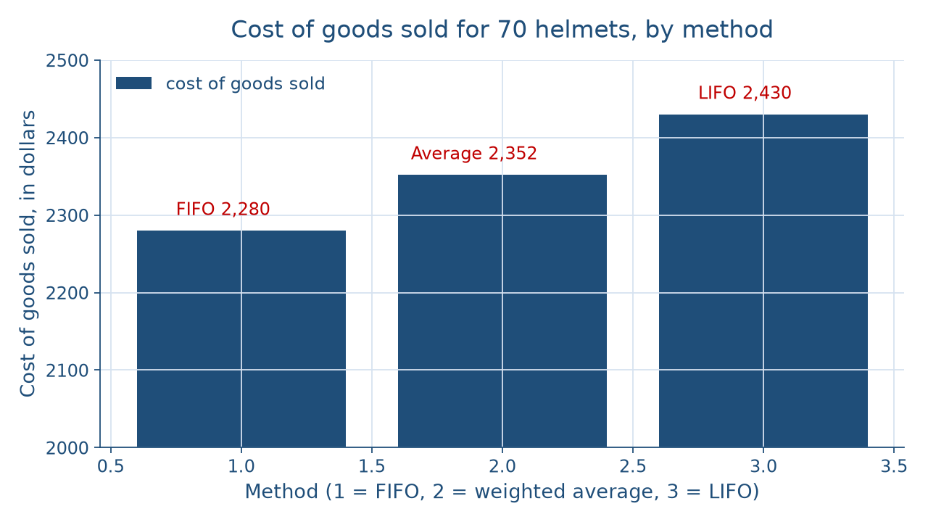
Three methods, one pool
THE THREE RESULTS
Inventory costing: three methods
Week 07
10
Notes:
This chart shows cost of goods sold for the 70 helmets under each method, in dollars. The first bar is FIFO at 2,280, the middle bar is weighted average at 2,352, and the third bar is LIFO at 2,430. The bars rise from left to right, and the LIFO bar stands 150 dollars taller than the FIFO bar. The ending inventory figures move the opposite way, 1,080 under FIFO, 1,008 under weighted average, and 930 under LIFO, because every method splits the same 3,360. DO: before you name the bars, ask the room to predict which method gives the tallest bar and why; then point out that the average sits between the oldest and newest costs.

Slide 11
FIFO vs. LIFO, rising costs
CONCEPT 4 · EFFECTS, NOT VERDICTS
FIFO: lowest COGS, highest gross profit
Ending inventory near recent costs
LIFO: COGS near current costs
150 more COGS than FIFO
Inventory costing: three methods
Week 07
11
Notes:
When costs are rising, as they did for the helmets, FIFO gives the lowest cost of goods sold and the highest ending inventory and gross profit. LIFO gives cost of goods sold closer to current costs, and weighted average falls between the two. Under LIFO the shop reports 150 dollars more cost of goods sold than under FIFO, because the newest, costliest helmets are counted as sold first: 2,430 − 2,280 = 150, and gross profit differs by 1,220 − 1,070 = 150. Notice the sentence does not say which method is better. Week 1 compared GAAP and IFRS without ranking them, and this course treats allowed methods the same way. DO: have pairs write one plain sentence for each column, then read two aloud and remove any word that ranks.

Slide 12
Pick one, keep it
CONCEPT 5 · A STANDING CHOICE
Same method every period
Disclose the method to readers
A method change is not costless
Inventory costing: three methods
Week 07
12
Notes:
Consistency is the practice of applying the same accounting method from period to period so a business's statements can be compared, with the method disclosed to readers. A lender comparing this year's gross profit with last year's needs to know one rule produced both. That is why a change of method is not costless: this year's figures and last year's would come from different rules, and a reader could mistake the switch for a change in the business. Week 5's classified balance sheet sorts the current assets, and Inventory is one of them, so the method decides the amount that sits there. DO: pose the friend who says, I will switch to whichever method makes this year look best, and ask two students to answer in one sentence each.

Slide 13
Two rules, two sources
CONCEPT 6 · RULES FROM THEIR SOURCES
IFRS does not allow LIFO (SEC, 2008)
Net realizable value: 30 × 34 = 1,020
FIFO write-down: 1,080 − 1,020 = 60
Inventory costing: three methods
Week 07
13
Notes:
First rule: IFRS does not allow LIFO, as the SEC stated in 2008 in Release No. 33-8982; U.S. GAAP permits it. That is a documented rule, not a debate. Second rule: under the FASB's Accounting Standards Update No. 2015-11, inventory measured by FIFO or average cost is reported at the lower of its cost and its net realizable value, the amount the business expects to receive for the goods, less the costs to finish and sell them. LIFO and the retail method stay under the earlier lower-of-cost-or-market guidance, named in words only. At 34 dollars a helmet, 30 × 34 = 1,020, so FIFO ending inventory of 1,080 is written down by 1,080 − 1,020 = 60. DO: ask whether weighted average's 1,008 needs a write-down; it does not, because 1,008 is below 1,020.

Slide 14
One error, two years
CONCEPT 7 · AN ERROR'S ECHO
Year 1: ending inventory high, net income high
Year 2: beginning inventory high, net income low
Two-year total right; each year wrong
Inventory costing: three methods
Week 07
14
Notes:
An inventory error is a mistake in the amount of ending inventory, and it reaches two years. Say a year-end count includes boxes that were already sold, so ending inventory is overstated. That year, cost of goods sold is understated and net income is overstated. The same overstated figure becomes next year's beginning inventory, so next year's cost of goods sold is overstated and its net income is understated. Over the two years the errors offset, yet each year's statements are wrong, and a lender reading only the first year sees profit that was never earned. This is the same lesson as Week 3's trial balance: a total can come out right while the parts are wrong. DO: have pairs trace an understated count through both years.

Slide 15
Check the chatbot's costing
AUDIT THE AI
Paste the helmet layers and the IFRS question
Watch for LIFO allowed under IFRS
The tool drafts; you check every figure
Inventory costing: three methods
Week 07
15
Notes:
This is an audit exercise for this activity only. Open one of the approved chatbots, such as Claude, and paste this prompt: The shop has 20 helmets at 30 dollars, buys 40 at 33 and 40 at 36, and sells 70 at 50 each in a periodic system. Compute cost of goods sold, ending inventory, and gross profit under FIFO, LIFO, and weighted average, and say whether a company reporting under IFRS may use LIFO. Then check every figure against Dataset D. Watch for a common slip: the tool may say IFRS permits LIFO, or it may give LIFO the lower cost of goods sold. The correct statements are that IFRS does not allow LIFO and that LIFO's cost of goods sold here is 2,430. DO: have each pair report one error they caught. The tool drafts; you check.

Slide 16
Same helmets, three costs
FIFO 2,280; LIFO 2,430; average 2,352
IFRS does not allow LIFO; write-down 60
Next: midterm review and internal control
BEFORE NEXT WEEK
16
Notes:
Let's pull the week together. The helmets' cost of goods available for sale is 3,360, and every method splits it. FIFO gave cost of goods sold of 2,280, LIFO gave 2,430, and weighted average gave 2,352. When costs rise, FIFO shows the lowest cost of goods sold and LIFO's sits closer to current costs, and the course describes those effects without ranking them. A business keeps its method and discloses it. IFRS does not allow LIFO, and FIFO's 1,080 of ending inventory was written down by 60 to 1,020. Next week, Midterm Review & Exam, reviews Weeks 1 to 7 and adds internal control. DO: ask each student to write the one-sentence reading for LIFO versus FIFO on a card and hand it in on the way out.

