Slide 1
How much will arrive?
WEEK 10 · OWED VERSUS COLLECTED
Week 10 · Receivables
1
Notes:
Welcome to Week 10. For how the course runs, point students to the current syllabus; this deck stays with this week's ideas. The orienting question is one every business that sells on account meets at the end of a year: of everything customers owe us, how much will really arrive? This week students tell accounts receivable from notes receivable, compare the direct write-off method and the allowance method by their effects, estimate the allowance with an aging schedule, record bad debt expense, write off an account and record a recovery, and compute the simple interest on a note. They finish by reading receivables on the balance sheet at net realizable value. Transition: start with three businesses that let customers pay later.

Slide 2
Owed is not collected
01
START WITH THREE UNPAID BILLS
2
Notes:
Open with three places. A landscaping company mows office parks all month and bills each client at the end. A tutoring business bills families for the month's sessions. And the bicycle shop, now in Year 3, repairs and sells bicycles on account to businesses and groups. Every one of them is owed money, and every one knows some of it will never arrive. The question this week is how the books stay honest about that part. DO: ask the room for a time they waited on money someone owed them, and how their confidence changed as the weeks went by. Collect two or three answers, then name the pattern: the older a debt, the less likely it is to be paid. That pattern drives the whole week.

Slide 3
Meet Dataset G
02
THE DATASET WE USE THIS WEEK
3
Notes:
Dataset G is the bicycle shop's receivables at the end of Year 3, the year after the Year 2 statements, and it is illustrative. Customers owe the shop $40,000 in Accounts Receivable, sorted into four age groups: $28,000 not yet due, $7,000 that are 1 to 30 days past due, $3,000 that are 31 to 60 days past due, and $2,000 over 60 days past due. The allowance already has a $260 credit balance. Later, one customer's $350 account is written off. Separately, a youth cycling program signs a $6,000, 6 percent, 3-month note. Every number on the coming slides comes from this set. DO: have students copy the four age groups and their balances into their notes now, so they can check each step as the deck builds it.

Slide 4
Account vs. note
CONCEPT 1 · TWO KINDS OF RECEIVABLE
Accounts receivable: owed on account
Usually weeks, usually no interest
Notes receivable: a written promise
Face, rate, and time
How much will arrive?
Week 10
4
Notes:
Accounts receivable are amounts customers owe on account. They come from ordinary sales on account, are usually collected within weeks, and usually carry no interest. Notes receivable are written promises to pay a sum, often with interest. A note spells out its face, its rate, and its time. Both are assets, and both are claims on cash the business has not received yet. For the shop, the $40,000 owed on account is Accounts Receivable, and the youth cycling program's $6,000 note is Notes Receivable. Callback: Week 2 met Accounts Receivable as an asset, and Week 9's NSF check went back into it, because the customer owed the shop again. Cure the wrong turn early: a receivable is a claim, not cash, and the shop cannot pay rent with it.

Slide 5
Direct write-off vs. allowance
CONCEPT 2 · TWO WAYS TO RECORD
Direct write-off: expense at the write-off
Not GAAP when bad debts are material
Allowance: estimate at each period's end
Credit Allowance for Doubtful Accounts
How much will arrive?
Week 10
5
Notes:
The direct write-off method records bad debt expense only when the business gives up on a specific account and writes it off. The direct write-off method is not acceptable under GAAP when bad debts are material. The allowance method estimates the uncollectible accounts at the end of each period and records bad debt expense with a credit to Allowance for Doubtful Accounts. Callback: Week 4's expense recognition puts an expense in the period whose revenue it helped earn, and the allowance method does that for bad debts, because this year's losses come from this year's credit sales. Present the two by their effects, not as a ranking: they put the same loss in different periods. DO: ask which method lets the expense land in a later year than the sale, and confirm it is the direct write-off method.

Slide 6
A contra asset for doubt
CONCEPT 3 · A SECOND CONTRA ACCOUNT
Allowance: a contra asset, credit balance
Accounts Receivable keeps full customer balances
Net realizable value: receivables minus allowance
How much will arrive?
Week 10
6
Notes:
Allowance for Doubtful Accounts is a contra asset account with a credit balance that holds the estimate of the receivables the business does not expect to collect. Callback: Week 3 introduced the contra account with Accumulated Depreciation, and this is the receivables' version of the same idea. The shop does not yet know which customers will fail to pay, so it cannot cross out any one balance. Accounts Receivable keeps every customer's full balance, and the allowance sits beside it and reduces it. Net realizable value of receivables is Accounts Receivable minus Allowance for Doubtful Accounts, the amount the business expects to collect. Name the trap: the credit balance does not make the allowance a liability. The shop owes nobody this amount. DO: ask where on the balance sheet the allowance sits, and confirm the asset side, under Accounts Receivable.

Slide 7
Age the receivables
WORKED EXAMPLE · THE AGING SCHEDULE
28,000 × 0.01 = $280
7,000 × 0.04 = $280
3,000 × 0.10 = $300
2,000 × 0.30 = $600
How much will arrive?
Week 10
7
Notes:
An aging schedule groups receivables by how long they are past due and applies a higher estimated uncollectible percentage to older groups; its total is the balance the allowance should have. Walk Dataset G's four groups. Not yet due: 1 percent of $28,000 is 28,000 × 0.01 = $280. One to 30 days past due: 4 percent of $7,000 is 7,000 × 0.04 = $280. Thirty-one to 60 days past due: 10 percent of $3,000 is 3,000 × 0.10 = $300. Over 60 days past due: 30 percent of $2,000 is 2,000 × 0.30 = $600. The balances foot to 28,000 + 7,000 + 3,000 + 2,000 = $40,000, and the estimates to 280 + 280 + 300 + 600 = $1,460. DO: run the four multiplications live, pausing before each so students predict the estimate, then reveal it and foot the column together.

Slide 8
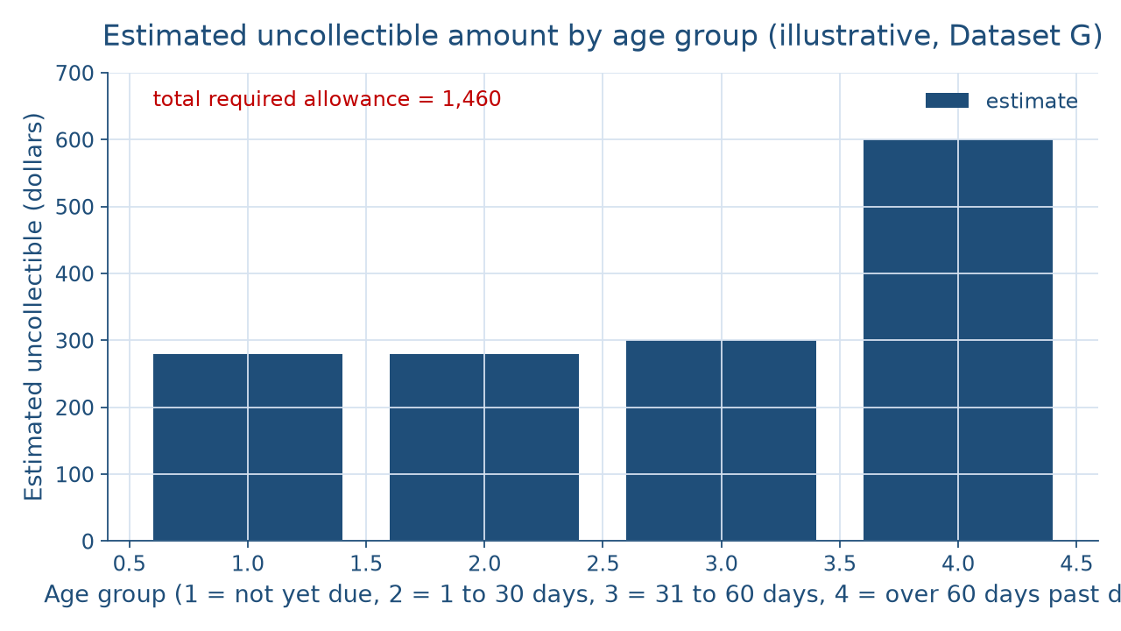
Older bills carry more doubt
THE PICTURE OF THE AGING SCHEDULE
How much will arrive?
Week 10
8
Notes:
This bar chart shows the four estimates from the aging schedule, from the newest bills on the left to the oldest on the right. The first two bars are equal at $280, the third is a little taller at $300, and the last bar, for the receivables over 60 days past due, stands at $600, about twice as tall as any other. That oldest group holds only $2,000 of the shop's $40,000, the smallest balance of the four, yet it supplies the largest estimate. The newest group holds $28,000 and supplies only $280. Together the four bars add to the $1,460 the allowance should hold. DO: before naming the pattern, ask students which bar surprises them and why; then state the lesson: age, not size, drives the estimate.

Slide 9
Fill the allowance up
WORKED EXAMPLE · THE YEAR-END ADJUSTMENT
Required $1,460; already holds $260
Bad Debt Expense 1,200 / Allowance 1,200
Net realizable value: 40,000 − 1,460 = $38,540
How much will arrive?
Week 10
9
Notes:
Bad debt expense is the amount that brings the allowance to its required balance. Think of filling a tank to a line: you pour in only the difference. The aging schedule requires $1,460, and the allowance already has a $260 credit balance, so bad debt expense is 1,460 − 260 = $1,200. The entry at the end of Year 3 debits Bad Debt Expense 1,200 and credits Allowance for Doubtful Accounts 1,200; debits equal credits. The allowance becomes 260 + 1,200 = $1,460, and net realizable value is 40,000 − 1,460 = $38,540. Callback: like every Week 4 adjustment, it touches one income statement account and one balance sheet account and never Cash. DO: ask why the expense is not $1,460, and confirm that $260 is already in the account.

Slide 10
Write off $350
WORKED EXAMPLE · THE WRITE-OFF
Allowance 350 / Accounts Receivable 350
Receivables $39,650; allowance $1,110
Net realizable value stays $38,540
How much will arrive?
Week 10
10
Notes:
Later, the shop gives up on one customer's $350 balance. A write-off is the entry that removes a specific customer's balance the business no longer expects to collect. Under the allowance method it debits Allowance for Doubtful Accounts 350 and credits Accounts Receivable 350, and debits equal credits. Accounts Receivable falls to 40,000 − 350 = $39,650, the allowance falls to 1,460 − 350 = $1,110, and net realizable value is 39,650 − 1,110 = $38,540, unchanged. Cure the two classic wrong turns here: a write-off is not an expense under the allowance method, and it does not reduce net realizable value. The expense was recorded with the Year 3 estimate. DO: have students compute net realizable value before and after on paper, then compare: both show $38,540.

Slide 11
Same $350, two methods
THE SAME ACCOUNT, TWO METHODS
Direct: Bad Debt Expense 350 at write-off
Receivables shown at the full $40,000
Allowance: expense in Year 3's estimate
No expense at the write-off
How much will arrive?
Week 10
11
Notes:
Put the two methods side by side on that one $350 account, and describe the effects without ranking them. Under the direct write-off method, the entry at the write-off debits Bad Debt Expense 350 and credits Accounts Receivable 350, so the expense lands in the period of the write-off, and until then the receivables appear at the full $40,000. Under the allowance method, the expense was already part of Year 3's $1,200 estimate, so the write-off itself records no expense; it moves amounts between Accounts Receivable and its contra account. The loss is the same $350 either way; the period it lands in differs. DO: ask pairs to say, in one plain sentence each, what a reader of Year 3's income statement would see under each method, then share two sentences.

Slide 12
Recovering a written-off account
WHEN A LOST ACCOUNT PAYS
Reverse: Accounts Receivable 350 / Allowance 350
Collect: Cash 350 / Accounts Receivable 350
Allowance returns to $1,460
How much will arrive?
Week 10
12
Notes:
A recovery is the collection of an account that was written off. Suppose the customer whose $350 was written off later pays it in full. The shop records two entries. First it reverses the write-off: debit Accounts Receivable 350, credit Allowance for Doubtful Accounts 350, which puts the customer's balance back on the books. Then it records the collection: debit Cash 350, credit Accounts Receivable 350. Each entry balances, and the allowance returns to 1,110 + 350 = $1,460. Why two entries instead of one? The first restores the customer's history, so the file shows that this customer did pay in the end, which matters the next time the customer asks to buy on account. DO: have students write both entries and check that each one balances before moving on.

Slide 13
Interest for three months
WORKED EXAMPLE · THE NOTE
6,000 × 0.06 × 3⁄12 = $90
Maturity value: $6,090
Not a full year's $360
How much will arrive?
Week 10
13
Notes:
Simple interest is interest figured on the face of a note alone: Interest = Face × Rate × Time, where Time is the note's term as a fraction of a year. The face is the principal amount a note promises to pay, before interest. For the youth cycling program's note, Interest = 6,000 × 0.06 × 3⁄12 = $90. The maturity value is the face of a note plus its interest: 6,000 + 90 = $6,090. At maturity the shop debits Cash 6,090 and credits Notes Receivable 6,000 and Interest Revenue 90, and 6,000 + 90 = 6,090 balances the entry. Name the wrong turn: a 3-month note does not earn a full year's 6,000 × 0.06 = $360. DO: ask the room for the interest before revealing it, and debrief anyone who said $360.

Slide 14
Three lines, one picture
CONCEPT 4 · WHAT A LENDER READS
Accounts Receivable $40,000
Less allowance (1,460)
Net realizable value $38,540
How much will arrive?
Week 10
14
Notes:
On the balance sheet, receivables take three lines in current assets. Accounts Receivable, $40,000. Less Allowance for Doubtful Accounts, (1,460). Net realizable value of receivables, $38,540, because 40,000 − 1,460 = 38,540. A lender reading before a loan decision sees the full amount owed, the estimate of what will not arrive, and what the shop expects to collect. Why show all three and not only the net figure? The middle line carries news: a fast rise in the allowance from one year to the next is a warning a lender wants to see, and a single net figure would hide it. DO: ask students which line answers the lender's question about cash to come, and confirm the net realizable value line.

Slide 15
Check the chatbot's write-off
THIS ACTIVITY · AUDIT THE CHATBOT
Paste Dataset G's facts into one chatbot
Watch for a write-off booked as expense
The tool drafts; you check every entry
How much will arrive?
Week 10
15
Notes:
For this activity, students open one approved chatbot, such as Claude or ChatGPT, and paste this prompt: The bicycle shop uses the allowance method. Its aging schedule requires a $1,460 allowance, the allowance has a $260 credit balance, and Accounts Receivable is $40,000. Record the year-end bad debt entry, then the later write-off of a $350 account, and give net realizable value after each. A common error on this material is treating the write-off as an expense: the tool debits Bad Debt Expense 350 and reports net realizable value falling by $350. Another is booking the full $1,460 as the expense. The vetted entries are Bad Debt Expense 1,200 / Allowance 1,200, then Allowance 350 / Accounts Receivable 350, with net realizable value at $38,540 both times. DO: have pairs mark each line against Dataset G and correct it by hand. The tool drafts; you check.

Slide 16
Estimate early, write off later
Allowance $1,460; expense $1,200; value $38,540
Write-off changes neither expense nor value
Next: long-lived assets and depreciation
BEFORE NEXT WEEK
16
Notes:
Recap the week's key numbers. The aging schedule set the required allowance at $1,460, so bad debt expense was 1,460 − 260 = $1,200, and net realizable value was $38,540. The $350 write-off moved amounts between Accounts Receivable and the allowance and left net realizable value at $38,540. The note earned $90 for its three months, a maturity value of $6,090. The one-sentence reading: the allowance method puts $1,200 of bad debt expense in Year 3, the year of the sales, and shows receivables at what the shop expects to collect. Next week, in Long-Lived Assets, the shop's van is depreciated by three methods. DO: give a one-minute exit ticket: write the write-off entry and say why net realizable value did not change; collect and review two answers aloud.

