Slide 1
Spreading a van's cost
WEEK 11 · COST SPREAD OVER YEARS
Week 11 · Long-Lived Assets
1
Notes:
Welcome to Week 11. For how the course runs, point students to the current syllabus; this deck stays with this week's ideas. The orienting question is one every business meets the day it buys something it will use for years: what did the asset cost, and how much of that cost belongs to each year? This week students name the three groups of long-lived assets, measure an asset's cost, compute depreciation three ways, compare the methods by their effects without ranking them, record the sale of an asset with its gain or loss, and meet intangible assets and natural resources in words. Everything runs on one illustrative delivery van. Transition: start with something students already own.

Slide 2
Bought once, used for years
01
START WITH A LAPTOP
2
Notes:
Open with a laptop a student buys for $1,200 and plans to use for all 4 years of study. Ask whether it cost $1,200 in the first year and nothing afterward. Most people say no: it is fairer to say it cost $300 a year, because it is used every year. That instinct is depreciation. Then widen the frame: a coffee roaster buys a roasting machine, a small software firm buys a patent, and the bicycle shop buys a delivery van it will drive for 5 years. Each asks the same two questions. DO: ask the room to name one thing they own and expect to use for several years, collect three examples, and ask how many years each will last.

Slide 3
Meet Dataset H
02
THE DATASET WE USE THIS WEEK
3
Notes:
Dataset H is the bicycle shop's delivery van, and it is illustrative. The van's price is $28,000, freight to deliver it is $1,500, and setup so it can carry bicycles is $500. The shop expects a residual value of $3,000 and a useful life of 5 years or 90,000 miles. In its first year the van drives 20,000 miles. At the end of Year 3 the shop sells it for $12,500. Every number on the coming slides comes from this set, and the methods turn these inputs into three different schedules. DO: have students copy the six inputs (price, freight, setup, residual value, years, miles) onto one line of their notes so they can check every result against them.

Slide 4
Three kinds of lasting asset
CONCEPT 1 · THREE GROUPS
Property, plant, and equipment: the van
Intangible assets: a patent
Natural resources: timber, a quarry
Spreading a van's cost
Week 11
4
Notes:
Long-lived assets are the assets a business uses in its operations for more than one year and does not hold for sale. They come in three groups. Property, plant, and equipment is the physical group: the van, the work stands, a building. Intangible assets have no physical form but give the business rights or advantages, such as a patent. Natural resources are taken from the earth or grown on it, such as timber or a quarry's stone. Callback: Week 5 placed property, plant, and equipment below the current assets on the classified balance sheet, and this week fills that section in. DO: name four items (the van, bicycles for sale, a patent, shop supplies) and have students sort each; the van and the patent are long-lived, the bicycles are inventory, and the supplies are a current asset.

Slide 5
What the van cost
WORKED EXAMPLE · THE VAN'S COST
28,000 + 1,500 + 500 = $30,000
Delivery Van 30,000 / Cash 30,000
Freight is cost, not expense
Spreading a van's cost
Week 11
5
Notes:
The cost of a long-lived asset is everything needed to acquire it and get it ready for use, such as the price, freight, and setup. Recording that cost in an asset account is called capitalizing it. For the van: price $28,000 + freight $1,500 + setup $500 = 28,000 + 1,500 + 500 = $30,000. The shop pays cash, an illustrative detail, so the entry debits Delivery Van 30,000 and credits Cash 30,000; debits equal credits. The cure for the classic wrong turn: the $1,500 delivery charge is not an expense of the month, because the van could not work until it arrived. DO: show the three amounts, ask students to vote expense or asset for the $1,500, then reveal that all three are capitalized into the $30,000 cost.

Slide 6
Allocation, not market value
CONCEPT 2 · WHAT DEPRECIATION IS
Depreciation: cost spread over years
Not cash, not market value
Residual $3,000; life 5 years
Depreciable cost: $27,000
Spreading a van's cost
Week 11
6
Notes:
Depreciation is the allocation of a long-lived asset's cost to the periods that use it. It is not a measure of market value, and it is not a cash payment. Every method needs three estimates. Residual value is what the business expects to receive when it stops using the asset: $3,000 for the van. Useful life is how long it expects to use the asset: 5 years or 90,000 miles. Depreciable cost is cost minus residual value: 30,000 − 3,000 = $27,000. Callback: Week 4 recorded the shop's first depreciation, $200 a month on $12,000 of equipment, and warned that depreciation is not a fall in market value; the same warning holds here. DO: ask whether a rise in used-van prices would change this year's depreciation, and confirm that it would not, because depreciation tracks cost.

Slide 7
Straight-line: even years
WORKED EXAMPLE · METHOD ONE
(30,000 − 3,000) ÷ 5 = $5,400 a year
Depreciation Expense 5,400 / Accumulated Depreciation 5,400
Book value after Year 1: $24,600
Spreading a van's cost
Week 11
7
Notes:
The straight-line method records the same depreciation in each full year: (cost − residual value) ÷ useful life. For the van, (30,000 − 3,000) ÷ 5 = 27,000 ÷ 5 = $5,400 a year, a straight-line rate of 20 percent. Each year-end adjusting entry debits Depreciation Expense 5,400 and credits Accumulated Depreciation 5,400, and it never touches Cash. The depreciation schedule lists each year's depreciation and the book value that follows: $24,600 after Year 1, then $19,200, $13,800, $8,400, and $3,000 after Year 5, the residual value. Five years of $5,400 total $27,000. DO: build the schedule live; pause before each book value, have students subtract $5,400 aloud, and stop at $3,000 to point out that it equals the residual value.

Slide 8
Units-of-production: per mile
WORKED EXAMPLE · METHOD TWO
27,000 ÷ 90,000 miles = $0.30 a mile
20,000 miles × $0.30 = $6,000
More miles, more depreciation
Spreading a van's cost
Week 11
8
Notes:
The units-of-production method ties depreciation to use: (cost − residual value) ÷ total expected units × units used. The van's units are miles. Its rate is 27,000 ÷ 90,000 miles = $0.30 a mile. In a 20,000-mile first year, depreciation is 20,000 × $0.30 = $6,000, and book value is 30,000 − 6,000 = $24,000. A year with more miles gets more depreciation, and a year with fewer miles gets less, yet over all 90,000 miles the method still moves the full $27,000 into expense. DO: ask why the rate is not $30,000 ÷ 90,000; take two answers, then confirm that the $3,000 residual value is never used up, so only the $27,000 depreciable cost is spread over the miles.

Slide 9
Double-declining: heavy early
WORKED EXAMPLE · METHOD THREE
Rate: 2 × 20 percent = 40 percent
Year 1: 30,000 × 0.40 = $12,000
Year 5 stops at $888
Spreading a van's cost
Week 11
9
Notes:
The double-declining-balance method is an accelerated method: it multiplies book value at the start of each year by twice the straight-line rate, and it stops when book value reaches residual value. The rate is 2 × 20 percent = 40 percent. Residual value is not subtracted at the start. Year 1 is 30,000 × 0.40 = $12,000, leaving $18,000. Year 2 is $7,200, leaving $10,800. Year 3 is $4,320, leaving $6,480. Year 4 is $2,592, leaving $3,888. In Year 5, 3,888 × 0.40 = $1,555.20 would leave $2,332.80, below the $3,000 residual value, so Year 5 is 3,888 − 3,000 = $888. The total is $27,000. DO: run the five years as a chain; at Year 5 ask the room for the depreciation, and confirm $888, not $1,555.20.

Slide 10
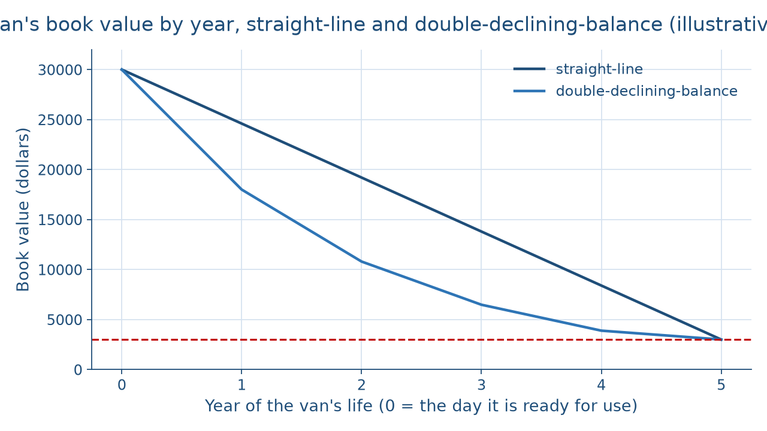
Two paths to $3,000
THE PICTURE OF TWO METHODS
Spreading a van's cost
Week 11
10
Notes:
This line chart shows the van's book value from the day it is ready for use to the end of Year 5 under two methods. Both lines start at $30,000 and end at the $3,000 residual value. The straight-line line drops by the same $5,400 every year, so it is a straight diagonal: $24,600, $19,200, $13,800, $8,400, $3,000. The double-declining-balance line drops steeply at first, to $18,000 after Year 1, then flattens: $10,800, $6,480, $3,888, and $3,000. In every year between the start and the end, it sits below the straight-line line. DO: before naming the lines, ask students which one front-loads the expense, and why both must land on the same $3,000.

Slide 11
Same total, different timing
CONCEPT 3 · EFFECTS, NEVER A RANKING
Straight-line Year 1: $5,400
Total over 5 years: $27,000
Double-declining Year 1: $12,000
Total over 5 years: $27,000
Spreading a van's cost
Week 11
11
Notes:
Compare the methods by their effects, never as a ranking. In Year 1 the van's depreciation is $5,400 under straight-line, $6,000 under units-of-production in a 20,000-mile year, and $12,000 under double-declining-balance, which is 12,000 − 5,400 = $6,600 more than straight-line. Yet straight-line and double-declining-balance both total $27,000 over the 5 years. A method that records more depreciation early shows lower net income and a lower book value in the early years, and higher net income later. GAAP allows each method; a business picks one that fits how it expects to use the asset and applies it consistently. Callback: Week 7 compared FIFO and LIFO the same way, by effect, never by verdict. DO: ask which method a lender should prefer, then redirect: the lender should ask which method is used.

Slide 12
A sale, not a gain
WORKED EXAMPLE · SELLING THE VAN
Book value: 30,000 − 16,200 = $13,800
12,500 − 13,800: a $1,300 loss
Debits 12,500 + 16,200 + 1,300 = 30,000
Spreading a van's cost
Week 11
12
Notes:
The gain or loss on disposal is the cash received minus the asset's book value on the date of sale. The shop uses straight-line and sells the van at the end of Year 3 for $12,500. Accumulated Depreciation is 5,400 × 3 = $16,200, and book value is 30,000 − 16,200 = $13,800. Cash received minus book value is 12,500 − 13,800, a loss of $1,300. The entry debits Cash 12,500, Accumulated Depreciation 16,200, and Loss on Sale of Delivery Van 1,300, and credits Delivery Van 30,000; debits 12,500 + 16,200 + 1,300 = 30,000 = credits. Under double-declining-balance, book value would be $6,480 and the same sale a $6,020 gain, yet the three-year total is $17,500 either way. DO: ask whether the shop gained $12,500, then walk the comparison to the $1,300 loss.

Slide 13
Patents, goodwill, and quarries
CONCEPT 4 · ASSETS YOU CANNOT DRIVE
Patent: amortized over its useful life
Goodwill: not amortized, general GAAP rule
Quarry: depleted by the tons removed
Spreading a van's cost
Week 11
13
Notes:
This beat is taught in words. Amortization of an intangible asset is the allocation of the cost of an intangible asset with a finite life, such as a patent a small software firm buys, to the periods of its useful life; it does for a patent what depreciation does for a van. Goodwill is the amount a buyer pays for a whole business beyond the value of its identifiable assets minus its liabilities. Under the general GAAP rule, goodwill is not amortized; private companies and not-for-profit entities may elect to amortize it. Depletion is the allocation of a natural resource's cost to the periods in which its units are taken out, such as the tons of stone a quarry removes. DO: read three items aloud (a patent, goodwill, a quarry) and have students call out amortized, not amortized, or depleted.

Slide 14
Check the chatbot's schedule
THIS ACTIVITY · AUDIT THE CHATBOT
Paste Dataset H's facts into one chatbot
Watch Year 5 against the $3,000 floor
The tool drafts; you check every figure
Spreading a van's cost
Week 11
14
Notes:
For this activity, students open one approved chatbot, such as Claude or ChatGPT, and paste this prompt: A delivery van cost $30,000, including $1,500 of freight and $500 of setup. Its residual value is $3,000 and its useful life is 5 years. Build its straight-line and double-declining-balance schedules, and record its sale at the end of Year 3 for $12,500 under straight-line. A common error on this material is applying 40 percent in Year 5 and leaving book value at $2,332.80, below the $3,000 residual value; another is calling the $12,500 a gain. The correct Year 5 figure is $888, and the sale is a $1,300 loss. DO: have pairs compare the chatbot's two schedules line by line against the outline's figures and mark each mismatch. The judgment rule for this activity: the tool drafts; you check.

Slide 15
Spread cost, not price
Cost $30,000; depreciable cost $27,000
$5,400, $0.30 a mile, or $12,000 first
Next: current liabilities and payroll
BEFORE NEXT WEEK
15
Notes:
Recap the week's key numbers. The van cost $30,000, freight and setup included, and its depreciable cost is $27,000. Straight-line gives $5,400 a year, units-of-production $0.30 a mile or $6,000 in a 20,000-mile year, and double-declining-balance starts at $12,000 and stops at the $3,000 residual value with $888 in Year 5. Every method moves the same $27,000 into expense, in different years. Selling the van for $12,500 at a $13,800 book value records a $1,300 loss, not a gain. Next week, Current Liabilities and Payroll turns to what the shop owes within a year. DO: ask each student to write the week's one plain sentence from memory, then have two volunteers read theirs and check each figure against Dataset H.

