Slide 1
Why lenders pay less
WEEK 13 · BORROWING FOR YEARS
Week 13 · Long-Term Liabilities
1
Notes:
Welcome to Week 13. For how the course runs, point students to the current syllabus; this deck stays with this week's ideas. The orienting question comes from a business that needs more money, for longer, than one lender will give: how does it borrow for years, and why would lenders pay less, or more, than they will get back? This week students read a bond's terms, price a bond by its present value, and record bonds issued at face, at a discount, and at a premium. They follow each period's cash interest, straight-line amortization, interest expense, and carrying value to maturity. They meet the effective-interest method and installment notes in words, and they place the debt on the balance sheet. Transition: start with three borrowers who cannot pay out of one year's cash.

Slide 2
Borrowing for years
01
START WITH THREE BORROWERS
2
Notes:
Open with three borrowers. A repair shop wants to expand. A farm cooperative needs a new harvester. A city wants a new school. None of them can pay out of one year's cash, and none of them wants one lender to carry the whole amount. So each one borrows for years, and two of them do it by selling bonds to many lenders at once. The question for the week is what that debt costs and how the books record it. DO: ask the room for one big purchase that people or groups they know paid for over years instead of all at once, such as a car, a home, or a community building. Collect two or three answers, then name the pattern: a long debt is repaid in pieces, and each piece carries interest.

Slide 3
Meet Dataset J
02
THE DATASET WE USE THIS WEEK
3
Notes:
Dataset J is the bicycle shop's bond issue, and it is illustrative. After a later expansion, the shop issues $100,000 of 5-year, 6 percent bonds that pay interest semiannually. That is 10 periods of $3,000 cash interest, because 100,000 × 6% ÷ 2 = 3,000. The dataset tries the same bonds three ways: issued at face for $100,000, at a discount for $96,000, and at a premium for $104,000. Straight-line amortization gives $400 a period in both the discount and premium cases. Every number on the coming slides comes from this set. DO: have students copy the face, the stated rate, the 10 periods, and the three issue prices into their notes now, so they can check each step as the deck builds it.

Slide 4
A bond is a long-term note
CONCEPT 1 · WHAT A BOND IS
Sold to many bondholders at once
Interest each period, face at maturity
Recorded in Bonds Payable, a long-term liability
Why lenders pay less
Week 13
4
Notes:
A bond is a long-term note that a business or a government issues to many lenders at once, promising interest every period and the face value at maturity. The lenders are the bondholders. The borrower records the promise in Bonds Payable, the long-term liability for the face value of the bonds it has issued. This is Week 12's note payable at a larger size and a longer term: Week 12's program owed its note for three months, while the shop owes its bonds for five years, which is why they sit with the long-term liabilities Week 5 defined. Cure the wrong turn early: a bondholder is a lender, not an owner. DO: ask whether a bondholder gets a vote or a dividend; confirm that the shop owes bondholders interest and their money back, and nothing more.

Slide 5
Stated rate vs. market rate
CONCEPT 2 · THE TWO RATES
Stated rate: printed on the bond
Sets the cash: $3,000 a period
Market rate: what investors require
Sets the price on the day of sale
Why lenders pay less
Week 13
5
Notes:
Read the bond's terms. The face value, also called par value, is the $100,000 the shop repays at maturity. The stated rate, also called the contract rate, is 6 percent a year, and it sets the cash interest: 100,000 × 6% ÷ 2 = $3,000 each period, for 5 × 2 = 10 periods. The maturity date is the day the face is due, at the end of the 10th period. The market rate is the return investors require on bonds like these on the day they are sold, and it sets the price. The carry line for the week fits on one breath: the stated rate sets the cash; the market rate sets the price. DO: ask whether the $3,000 changes if the bonds sell for $96,000; confirm that it does not, because cash interest always comes from face times stated rate.

Slide 6
Discount each cash flow
WORKED EXAMPLE · THE PRESENT VALUE
One payment: 3,000 ÷ 1.03 = $2,912.62
Face: 100,000 ÷ 1.03¹⁰ = $74,409.39
74,409.39 + 25,590.61 = $100,000.00
Why lenders pay less
Week 13
6
Notes:
Present value is what an amount due in the future is worth today at a given rate, and a bond's price is the present value of its cash flows at the market rate. Check it when the market rate equals the stated rate: 6% ÷ 2 = 3% a period. One $3,000 payment due in one period is worth 3,000 ÷ 1.03 = $2,912.62 today. The $100,000 face, due in 10 periods, is worth 100,000 ÷ 1.03¹⁰ = $74,409.39. The 10 interest payments together are worth $25,590.61. The total is 74,409.39 + 25,590.61 = $100,000.00, the face. A higher market rate divides by a larger number and the price falls; a lower one raises it. DO: run the steps live; pause before the total, collect predictions, then reveal $100,000.00.

Slide 7
Issued at face: $100,000
WORKED EXAMPLE · ISSUED AT FACE
Cash 100,000 / Bonds Payable 100,000
Interest Expense 3,000 / Cash 3,000
Total interest: 10 × 3,000 = $30,000
Why lenders pay less
Week 13
7
Notes:
When the market rate equals the stated rate, the bonds are issued at face. Walk it the usual way. The shop receives $100,000 of cash, an asset going up, and owes $100,000, a liability going up: debit Cash 100,000; credit Bonds Payable 100,000. Each period it pays the cash interest: debit Interest Expense 3,000; credit Cash 3,000. Both entries balance. Over 10 periods the interest expense totals 10 × 3,000 = $30,000. At face, each period's expense is exactly the cash paid, because there is no discount or premium to spread. Cure a wrong turn here: the $100,000 is not revenue, because the shop must repay every dollar. DO: have students write both entries before you reveal them, then check that debits equal credits in each.

Slide 8
Issued for $96,000
WORKED EXAMPLE · ISSUED AT A DISCOUNT
Discount: 100,000 − 96,000 = $4,000
Cash 96,000 + Discount 4,000 / Bonds Payable 100,000
Carrying value starts at $96,000
Why lenders pay less
Week 13
8
Notes:
Now investors want more than 6 percent, so they pay $96,000, a discount of 100,000 − 96,000 = $4,000. The entry: debit Cash 96,000 and Discount on Bonds Payable 4,000; credit Bonds Payable 100,000. Debits 96,000 + 4,000 = 100,000 = credits 100,000. Discount on Bonds Payable is a contra liability, with a debit balance, subtracted from Bonds Payable, the way Week 4's Accumulated Depreciation is subtracted from an asset. The carrying value, Bonds Payable minus any discount or plus any premium, starts at 100,000 − 4,000 = $96,000. Cure the wrong turn: a discount is not a gain or a loss. The shop borrows $96,000 and repays $100,000, so the $4,000 is extra interest. DO: ask what the balance sheet shows on the day of issue; confirm $96,000.

Slide 9
$400 a period, evenly
WORKED EXAMPLE · STRAIGHT-LINE AMORTIZATION
4,000 ÷ 10 = $400 a period
Expense: 3,000 + 400 = $3,400
Carrying value: 96,000 + 400 = $96,400
Why lenders pay less
Week 13
9
Notes:
To amortize the discount is to spread it over the bond's life as extra interest expense. Straight-line amortization spreads it evenly, the same move as Week 11's straight-line depreciation of the van: 4,000 ÷ 10 = $400 a period. Interest expense each period is 3,000 + 400 = $3,400. The entry: debit Interest Expense 3,400; credit Discount on Bonds Payable 400 and Cash 3,000. After the first period, the carrying value is 96,000 + 400 = $96,400; after 10 periods, 96,000 + 10 × 400 = $100,000. Total interest expense is 10 × 3,400 = $34,000, equal to the $130,000 paid minus the $96,000 received. Investors who paid $96,000 earn more than the 6 percent stated rate. DO: have pairs foot the entry, then say how much the carrying value grows each period; confirm $400, so it reaches $100,000 after 10 periods.

Slide 10
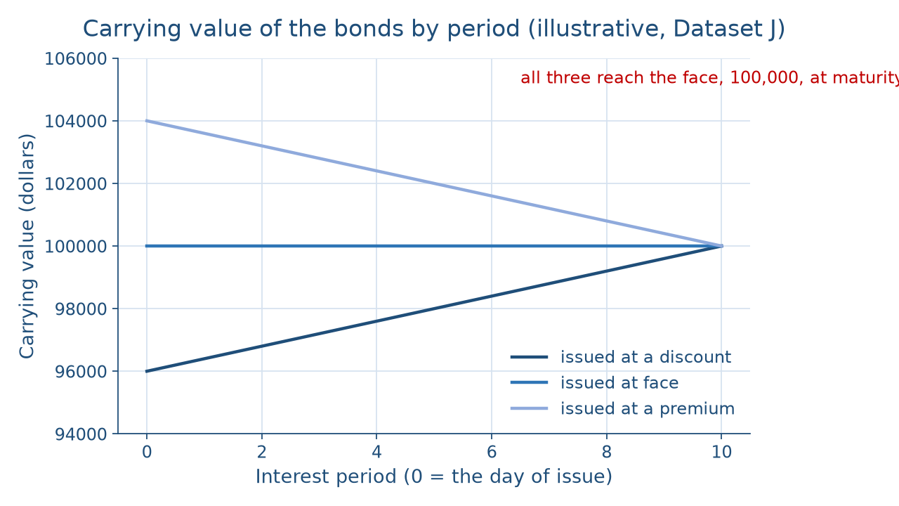
Three paths to one face
THE PICTURE OF THE CARRYING VALUES
Why lenders pay less
Week 13
10
Notes:
This line chart shows the carrying value of the shop's bonds over 10 periods, starting on the day of issue at the left. The discount line starts lowest, at $96,000, and climbs by $400 every period. The premium line starts highest, at $104,000, and falls by $400 every period. The face line stays flat at $100,000. At period 10, the maturity date, all three lines meet at $100,000. The lesson is that amortization does one job in both directions: it walks the carrying value to the face, so the shop's books show exactly what it repays on the last day. DO: before naming the pattern, ask students which line rises and which falls, and by how much each period; confirm $400 each way, ending at the $100,000 face.

Slide 11
Issued for $104,000
WORKED EXAMPLE · ISSUED AT A PREMIUM
Premium: 104,000 − 100,000 = $4,000
Expense: 3,000 − 400 = $2,600
Carrying value: 104,000 − 400 = $103,600
Why lenders pay less
Week 13
11
Notes:
Flip the story: investors want less than 6 percent, so they pay $104,000, a premium of 104,000 − 100,000 = $4,000. The entry: debit Cash 104,000; credit Bonds Payable 100,000 and Premium on Bonds Payable 4,000. Premium on Bonds Payable carries a credit balance and is added to Bonds Payable, so the carrying value starts at $104,000. Amortization is 4,000 ÷ 10 = $400 a period, and it reduces interest expense: 3,000 − 400 = $2,600. Each period: debit Interest Expense 2,600 and Premium on Bonds Payable 400; credit Cash 3,000. After the first period the carrying value is 104,000 − 400 = $103,600. Total interest expense is 10 × 2,600 = $26,000. DO: ask whether a premium adds to the expense; confirm that it lowers it.

Slide 12
Discount vs. premium
SAME BONDS, TWO DIRECTIONS
Discount: market rate higher
Expense $3,400; total $34,000
Premium: market rate lower
Expense $2,600; total $26,000
Why lenders pay less
Week 13
12
Notes:
Put the two cases side by side. Both pay the same $3,000 of cash interest every period, because the stated rate and the face never change. A discount, $4,000, is extra interest the shop pays at maturity, so it adds $400 a period, for interest expense of $3,400. A premium, also $4,000, is money the shop received and does not repay, so it subtracts $400 a period, for interest expense of $2,600. Cure the classic wrong turn: a premium is not extra interest expense. Read the totals: $34,000 at a discount and $26,000 at a premium, against $30,000 at face. That is Week 11's lesson in a new setting: the method or price changes how a cost lands, and the reading names the effect. DO: have students state each case's total in one sentence.

Slide 13
Effective interest, in words
CONCEPT 3 · GAAP'S METHOD, IN WORDS
Expense = carrying value × market rate
Same $4,000 total; same face at maturity
Straight-line acceptable when not materially different
Why lenders pay less
Week 13
13
Notes:
The effective-interest method is the method GAAP calls for, and straight-line is acceptable when its results are not materially different. Under the effective-interest method, each period's interest expense is the carrying value at the start of the period times the market rate for one period, and the amortization is the difference between that expense and the cash interest. In the discount case, the carrying value grows, so the expense starts a little below $3,400 and ends a little above it. Both methods amortize the same $4,000 and reach the $100,000 face at maturity, and on that day the shop debits Bonds Payable 100,000 and credits Cash 100,000. This course computes straight-line and describes the effective-interest method in words. DO: ask whether total interest differs between the methods; confirm that it does not.

Slide 14
Installment notes, in words
CONCEPT 4 · EQUAL PAYMENTS OVER YEARS
Equal payments over the term
Each pays interest, then principal
Early mostly interest; late mostly principal
Why lenders pay less
Week 13
14
Notes:
An installment note is a loan repaid in a series of payments over its term; when the payments are equal, each covers that period's interest and the rest reduces the principal. Picture a farm cooperative paying off a new harvester. At the start, the balance owed is largest, so most of each payment is interest. As the balance shrinks, the interest shrinks with it, and more of the same payment goes to principal; near the end, almost all of it is principal. This slide carries no figures, because the course describes installment notes in words. The part of the principal due within the next year is Week 12's current portion of long-term debt. DO: sketch a bar split into interest and principal at the start and at the end, and ask which part grows.

Slide 15
Debt on the balance sheet
CONCEPT 5 · WHAT A LENDER READS
Bonds Payable $100,000
Less discount (3,600)
Carrying value $96,400
Why lenders pay less
Week 13
15
Notes:
Bonds Payable is reported in the long-term liabilities section at its carrying value. After the first period, the discounted bonds show Bonds Payable $100,000, less Discount on Bonds Payable (3,600), for a carrying value of 100,000 − 3,600 = $96,400, since 4,000 − 400 = $3,600 of discount remains. For the premium case, the remaining premium is added instead. When the bonds come within one year of maturity, they move to current liabilities, the same current-versus-long-term line Week 5 drew on the classified balance sheet. The debt does not change; only its classification does. A lender reads the carrying value, not the face, because it shows what the shop's debt is on the books at that moment. DO: ask which figure the balance sheet reports after one period; confirm $96,400.

Slide 16
Check the chatbot's premium
THIS ACTIVITY · AUDIT THE CHATBOT
Paste Dataset J's premium case into one chatbot
Watch for a premium added to expense
The tool drafts; you check every entry
Why lenders pay less
Week 13
16
Notes:
For this activity, students open one approved chatbot, such as Claude or ChatGPT, and paste this prompt: The bicycle shop issues $100,000 of 5-year, 6 percent bonds that pay interest semiannually, for $104,000. Using straight-line amortization, give the issue entry, one period's interest entry, the interest expense per period, and the carrying value after the first period. A common error on this material is adding the premium to interest expense, so the tool reports $3,400 instead of $2,600. Another is figuring the cash interest on the $104,000 price instead of the $100,000 face. The vetted figures are cash interest $3,000, amortization $400, interest expense $2,600, and carrying value $103,600. DO: have pairs mark each line against Dataset J and correct it by hand. The tool drafts; you check.

Slide 17
Same face, three costs
Cash interest $3,000 a period, always
Expense: $3,000, $3,400, or $2,600
Next: stockholders' equity and stock
BEFORE NEXT WEEK
17
Notes:
Recap the week's key numbers. The bonds pay $3,000 of cash interest a period, because 100,000 × 6% ÷ 2 = 3,000. At face, interest expense is $3,000 a period and $30,000 in all. At a discount, $400 of amortization raises it to $3,400 and $34,000, and the carrying value climbs from $96,000 to $100,000. At a premium, it falls to $2,600 and $26,000, and the carrying value falls from $104,000 to $100,000. The one-sentence reading: the same $100,000 face and the same $3,000 a period cost the shop $30,000, $34,000, or $26,000, because it received $100,000, $96,000, or $104,000 at issue. Next week, in Stockholders' Equity, the shop raises money from owners instead. DO: give a one-minute exit ticket: write the discount case's interest entry; review two answers aloud.

