Slide 1
Who owns the claim?
WEEK 14 · OWNERS IN, OWNERS OUT
Week 14 · Stockholders' Equity
1
Notes:
Welcome to Week 14. For how the course runs, point students to the current syllabus; this deck stays with this week's ideas. The orienting question is one every corporation meets as it grows: when owners put money in, or the business hands money back to them, how do the books show it? This week students describe the corporate form, count authorized, issued, and outstanding shares, record a stock issue above par, meet preferred stock, record a cash dividend on its three dates, explain stock dividends and splits in words, record treasury stock at cost, prepare the equity statements, and compute basic earnings per share. Every figure comes from the bicycle shop's second year. Transition: start with three groups of owners.

Slide 2
Owners in, owners out
01
START WITH THREE GROUPS OF OWNERS
2
Notes:
Open with three places. A few friends start a small software firm and sell shares to their families to get going. Neighbors at a cooperative grocery each buy a member share, a type of ownership we only name. And the bicycle shop, now in Year 2, wants $45,000 to grow without borrowing it the way Week 13's bonds did. In every case owners put money in, and sooner or later the business hands some back. DO: ask the room to name one way an owner gets money back from a business they own. Collect two or three ideas, such as a dividend or selling the shares to someone else, and say that this week records each move with a balanced entry.

Slide 3
Meet Dataset K
02
THE DATASET WE USE THIS WEEK
3
Notes:
Dataset K is the bicycle shop's Year 2 stockholders' equity, and it is illustrative. The charter authorizes 100,000 shares of $1-par common stock. From Dataset A, the founders already hold 30,000 shares, bought for $30,000 in Month 1. On the first day of Year 2 the shop sells 5,000 more shares at $9. In Month 5 it declares a $0.20 cash dividend on 35,000 shares, $7,000, and pays it in Month 6. At the end of Month 6 it buys back 1,000 shares at $10. Retained earnings start the year at $13,000, and net income is $69,000. DO: have students copy these seven facts into their notes now, so they can check each slide as the deck builds the equity section.

Slide 4
Two features, two tax types
CONCEPT 1 · THE CORPORATE FORM
Limited liability and transferable shares
C corporation: taxed separately
S corporation: income passes through
Who owns the claim?
Week 14
4
Notes:
The corporate form rests on two features. Limited liability, from Week 1, means shareholders cannot lose more than they invested. Transferable shares means an owner can sell or give shares to someone else without the business closing or changing. Picture two partners running a food truck: if one wants out, the partnership may end. A corporation keeps going. There is a tax side, stated as fact and never as advice. A C corporation is taxed separately under the federal corporate income tax. An S corporation's income passes through to its shareholders for federal income tax. DO: ask students what happens to the bicycle shop when a founder sells shares to a new owner, and confirm that the shop stays the same business, because its shares are transferable.

Slide 5
Three counts of shares
CONCEPT 2 · COUNTING SHARES THREE WAYS
Authorized: 100,000
Issued: 35,000
Outstanding: 34,000
Who owns the claim?
Week 14
5
Notes:
Ask how many shares the shop has, and there are three honest replies. Authorized shares are the largest number the charter allows: 100,000. Issued shares are the shares sold to owners so far: the founders' 30,000 plus the 5,000 sold in Year 2, which is 30,000 + 5,000 = 35,000. Outstanding shares are the issued shares still held by owners. After the shop buys back 1,000 shares at the end of Month 6, outstanding shares are 35,000 − 1,000 = 34,000, while issued shares stay at 35,000. Outstanding is the count that matters for dividends and for earnings per share. DO: ask students which of the three counts falls when a corporation buys back shares, and confirm that only the outstanding count falls.

Slide 6
Par vs. market value
THE TRAP IN A PRICE PER SHARE
Par value: $1
A legal amount in the charter
Market value: $9
What a buyer pays
Who owns the claim?
Week 14
6
Notes:
Here is the week's first trap. Students often read par value as market value, because both are a price per share. Par value is a legal amount per share printed in the charter: for the shop, $1. It sets how much of each share's price goes to Common Stock, and it rarely changes. Market value is what a buyer pays: in Year 2 the shop's shares sell for $9. Recall Dataset A. On Day 1 of Month 1 the founders paid $30,000 for 30,000 shares, or 30,000 ÷ 30,000 = $1 a share, exactly par, so Common Stock got the whole $30,000 and Additional Paid-in Capital was $0. That is the Week 2 Common Stock balance you already know. DO: ask what changes in Year 2, when the price is $9 but par stays $1, and set up the next slide.

Slide 7
Split the $45,000
WORKED EXAMPLE · THE YEAR 2 ISSUE
5,000 × $9 = $45,000
Common Stock 5,000 × $1 = $5,000
Additional Paid-in Capital $40,000
Who owns the claim?
Week 14
7
Notes:
Walk the entry the usual way. What happened: on the first day of Year 2 the shop sells 5,000 shares at $9, so 5,000 × 9 = $45,000 comes in. Which accounts change: Cash rises, and two equity accounts rise. Common Stock is credited only for par, 5,000 × 1 = $5,000. Additional Paid-in Capital is credited for the rest, 45,000 − 5,000 = $40,000, the same as 5,000 × (9 − 1) = $40,000. The entry: debit Cash 45,000; credit Common Stock 5,000 and Additional Paid-in Capital 40,000. Debits 45,000 = credits 5,000 + 40,000 = 45,000. Issued shares are now 30,000 + 5,000 = 35,000. DO: run it live; pause before the split and ask how much belongs to Common Stock, collect guesses, then reveal $5,000 and the reason: Common Stock holds only par.

Slide 8
Preferred vs. common
CONCEPT 3 · A SECOND CLASS OF SHARES
Preferred: paid first
Usually no vote
Common: paid after preferred
Votes; keeps the rest
Who owns the claim?
Week 14
8
Notes:
Preferred stock is a second class of shares with priority over common stock for dividends and in liquidation, usually without voting rights. Priority means order, not size. When the board pays a dividend, preferred shareholders are paid first; common shareholders are paid after them. If the corporation closes, preferred owners are repaid before common owners too. Preferred owners usually give up a vote, while common owners vote and keep whatever the business earns beyond the preferred dividend. Picture a ferry company whose preferred stock is owed $3,000 when the board pays $10,000 in all: the preferred owners get their $3,000 first and the common owners share the $7,000 left. The bicycle shop issues no preferred stock, so its preferred dividends are $0, which matters when we reach earnings per share.

Slide 9
Three dates, two entries
WORKED EXAMPLE · THE CASH DIVIDEND
Declaration, Month 5: Dividends / Dividends Payable
Record date, Month 5: no entry
Payment, Month 6: Dividends Payable / Cash
Who owns the claim?
Week 14
9
Notes:
The board declares $0.20 a share on 35,000 outstanding shares: 35,000 × 0.20 = $7,000. On the declaration date, in Month 5, the liability is recorded: debit Dividends 7,000; credit Dividends Payable 7,000. Dividends Payable is a current liability, like the ones you listed in Week 12. On the record date, also in Month 5, no entry is made; the date fixes who receives the dividend. On the payment date, in Month 6, the liability is paid: debit Dividends Payable 7,000; credit Cash 7,000. At year end, as in Week 5, Dividends closes to Retained Earnings. And Week 2's rule holds: a dividend is a distribution to owners, never an expense. DO: ask which date gets no entry and why; confirm the record date, which moves no money and creates no debt.

Slide 10
More slices, same cake
CONCEPT 4 · MORE PIECES, SAME CLAIM
Stock dividend: shares instead of cash
2-for-1 split: twice the shares, half the par
Total stockholders' equity: unchanged
Who owns the claim?
Week 14
10
Notes:
Think about a cake cut into eight pieces instead of four: more pieces, no more cake. A stock dividend hands owners additional shares instead of cash and moves an amount from retained earnings to paid-in capital. A stock split increases the number of shares and reduces par value per share in proportion; in a 2-for-1 split, each share becomes two, each with half the par value. The course teaches both in words and keys one point: neither one changes total stockholders' equity, because no asset leaves the corporation and no owner pays anything in. Students often think a split makes owners richer because they hold more shares. DO: ask the room whether equity doubles after a 2-for-1 split, collect votes, and confirm it stays the same.

Slide 11
Buy back 1,000 shares
WORKED EXAMPLE · THE BUYBACK
1,000 × $10 = $10,000
Debit Treasury Stock; credit Cash
Issued 35,000; outstanding 34,000
Who owns the claim?
Week 14
11
Notes:
Treasury stock is a corporation's own shares that it has reacquired and not retired; under the cost method it is recorded at cost and reported as a deduction from stockholders' equity. At the end of Month 6 the shop buys back 1,000 shares at $10: 1,000 × 10 = $10,000. The entry: debit Treasury Stock 10,000; credit Cash 10,000. Debits 10,000 = credits 10,000. Shares outstanding fall to 35,000 − 1,000 = 34,000, and shares issued stay at 35,000. The trap: students list treasury stock as an asset because the shop paid cash for it. A corporation cannot own a claim on itself, so the $10,000 reduces equity. DO: ask where Treasury Stock goes on the balance sheet, collect answers, and confirm it is subtracted in the equity section.

Slide 12
Foot the equity section
WORKED EXAMPLE · THE EQUITY SECTION
Retained earnings 13,000 + 69,000 − 7,000 = $75,000
35,000 + 40,000 + 75,000 − 10,000
Total stockholders' equity $140,000
Who owns the claim?
Week 14
12
Notes:
First the statement of retained earnings, the Week 5 statement you know. Retained Earnings starts Year 2 at $13,000, adds net income of $69,000, and subtracts $7,000 of dividends: 13,000 + 69,000 − 7,000 = $75,000. Then the stockholders' equity section. Common Stock, $1 par, 100,000 shares authorized, 35,000 issued, 34,000 outstanding: $35,000. Additional Paid-in Capital: $40,000. Retained Earnings: $75,000. Less Treasury Stock, 1,000 shares at cost: (10,000). Total stockholders' equity is 35,000 + 40,000 + 75,000 − 10,000 = $140,000. Notice that Common Stock equals 35,000 issued shares × $1 par. DO: have pairs foot the section line by line in their notes, then check that the $69,000 of net income landed in Retained Earnings and not in paid-in capital.

Slide 13
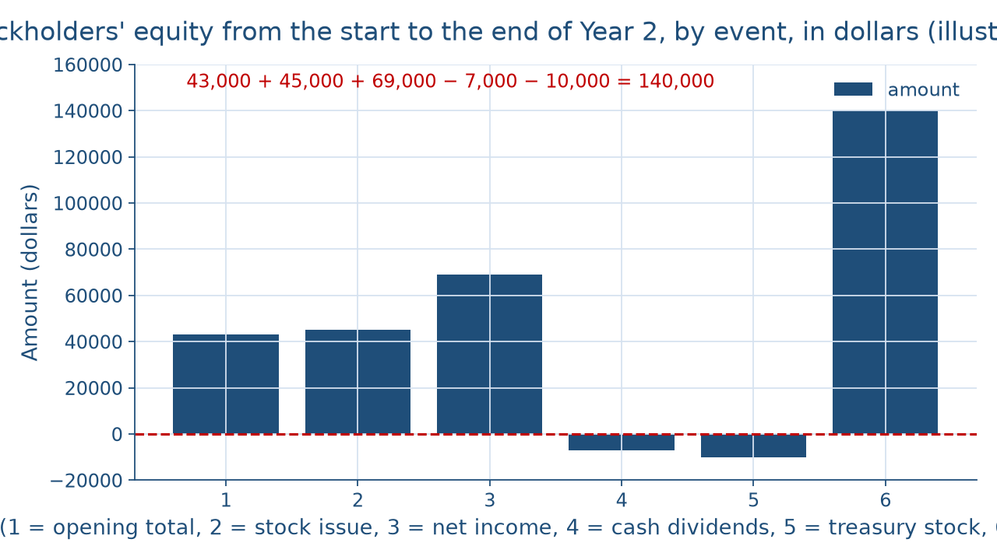
Four events, one total
THE YEAR IN ONE PICTURE
Who owns the claim?
Week 14
13
Notes:
This picture is the statement of stockholders' equity as bars, in order. The first bar is the opening total, $43,000: Common Stock 30,000 + Additional Paid-in Capital 0 + Retained Earnings 13,000 + Treasury Stock 0. Then come the year's four events: the stock issue adds $45,000, net income adds $69,000, the cash dividends subtract $7,000, and the treasury stock subtracts $10,000, so those two bars point below zero. The last bar is the closing total: 43,000 + 45,000 + 69,000 − 7,000 − 10,000 = $140,000, the same total as the equity section, so the two statements tie. DO: before naming the closing bar, ask students to add the four events to $43,000 in their heads, collect the sums, and confirm $140,000.

Slide 14
Average the shares first
WORKED EXAMPLE · EARNINGS PER SHARE
35,000 × 6⁄12 + 34,000 × 6⁄12 = 34,500
(69,000 − 0) ÷ 34,500 = $2.00
Preferred dividends: $0
Who owns the claim?
Week 14
14
Notes:
Basic earnings per share is net income minus preferred dividends, divided by the weighted-average common shares outstanding. The shop had 35,000 shares outstanding for the first 6 months and 34,000 for the last 6, after the buyback. Weighted average: 35,000 × 6⁄12 + 34,000 × 6⁄12 = 17,500 + 17,000 = 34,500. The shop has no preferred stock, so preferred dividends are $0. Basic earnings per share is (69,000 − 0) ÷ 34,500 = $2.00. The trap is dividing by the year-end 34,000 shares; the 1,000 treasury shares were outstanding for half the year, and the weighted average counts that half. DO: work it live; pause after the two halves, collect the total, then reveal 34,500 and $2.00 and say it in words: each average outstanding share earned $2.00.

Slide 15
Check the chatbot's equity
THIS ACTIVITY · AUDIT THE CHATBOT
Paste Dataset K's facts into one chatbot
Watch for treasury stock listed as an asset
The tool drafts; you check every line
Who owns the claim?
Week 14
15
Notes:
For this activity, students open one approved chatbot, such as Claude or ChatGPT, and paste this prompt: A corporation has 30,000 shares of $1-par common stock. It issues 5,000 more at $9, declares and pays a $0.20 cash dividend on 35,000 shares, and buys back 1,000 shares at $10. Retained earnings began at $13,000 and net income was $69,000. Record each entry and prepare the stockholders' equity section. Common errors on this material: crediting the whole $45,000 to Common Stock, recording the dividend as an expense, or listing treasury stock as an asset. The vetted section shows Common Stock $35,000, Additional Paid-in Capital $40,000, Retained Earnings $75,000, less Treasury Stock (10,000), total $140,000. DO: have pairs mark each line against Dataset K and correct it by hand. The tool drafts; you check.

Slide 16
Paid in, earned, handed back
Common Stock $35,000; paid-in capital $40,000
Total equity $140,000; earnings per share $2.00
Next: the statement of cash flows
BEFORE NEXT WEEK
16
Notes:
Recap the week's key numbers. The 5,000-share issue at $9 sent $5,000 to Common Stock and $40,000 to Additional Paid-in Capital, so Common Stock ends at $35,000. The $7,000 dividend was recorded when declared and paid in Month 6. The $10,000 buyback cut outstanding shares to 34,000 and reduced equity. Retained earnings ended at $75,000, total stockholders' equity at $140,000, and basic earnings per share at $2.00. The one-sentence reading: the owners put in $45,000, the shop earned $69,000, paid its owners $7,000, and bought back $10,000 of its shares, so equity grew from $43,000 to $140,000. Next week, the statement of cash flows shows these moves as financing activities. DO: give a one-minute exit ticket: write the treasury stock entry and say why it is not an asset; review two answers aloud.

