Slide 1
Where did the cash go?
WEEK 15 · WHERE DID THE CASH GO?
Week 15 · The Statement of Cash Flows, Analysis, and the Course Synthesis
1
Notes:
Welcome to Week 15, the course's final teaching week. For how the course runs, point students to the current syllabus; this deck stays with this week's ideas. The orienting question is one every owner and lender asks: a business earned a profit, so why did its cash change by a different amount? This week students sort cash into operating, investing, and financing activities, build the operating section by the indirect method, tie the statement of cash flows to the change in cash, compute four ratios, open a public company's annual report on EDGAR, and read the bicycle shop's whole story from Month 1 to Year 2. Every keyed figure comes from the shop's illustrative datasets. Transition: start with a food truck's bank app.

Slide 2
Profit, but where's the cash?
01
START WITH A PROFIT AND A BANK BALANCE
2
Notes:
Open with a picture. A food truck owner checks the bank app at the end of a busy month. The income statement shows a profit, yet the bank balance is tight, because the owner bought a grill and stocked up on ingredients. Both reports are telling the truth: earning and having cash happen on different schedules. The bicycle shop shows the same gap at a bigger size. In Year 2 it earned net income of $69,000, while its cash grew from $22,000 to $71,000, an increase of 71,000 − 22,000 = $49,000. DO: ask the room for two reasons a business's cash could change by a different amount than its profit. Collect three ideas, such as buying equipment or customers paying late, and say that this week's statement explains each one.

Slide 3
Meet Dataset L
02
THE DATASET WE USE THIS WEEK
3
Notes:
Dataset L is the bicycle shop's Year 2 statement of cash flows and ratios, and it is illustrative. Net income was $69,000 and depreciation expense $12,000. The shop sold equipment for $7,000 at a $2,000 gain and bought new equipment for $40,000. Accounts receivable rose $3,000, inventory rose $5,000, prepaid expenses fell $1,000, and accounts payable rose $2,000. Financing lines come from Week 14's Dataset K: the $45,000 stock issue, the $10,000 treasury stock purchase, and the $7,000 dividend, plus a $20,000 note repayment. Cash went from $22,000 to $71,000. Year-end figures: current assets $100,000, current liabilities $40,000, total assets $200,000, net sales $690,000, gross profit $276,000. DO: have students copy these facts into their notes so they can check every slide against them.

Slide 4
Running vs. buying and funding
CONCEPT 1 · THREE KINDS OF CASH
Operating: running the business
Day-to-day cash in and out
Investing (33,000); financing $8,000
Assets bought; owners and lenders
Where did the cash go?
Week 15
4
Notes:
Cash sorts into three sections. Operating activities are the cash effects of running the business day to day, such as collecting from customers and paying suppliers, employees, and rent. Investing activities report cash paid to buy long-lived assets and cash received from selling them. Financing activities report cash received from and paid to the owners and lenders. For the shop, investing is the purchase of equipment, (40,000), plus the sale of equipment, 7,000, for net cash used by investing activities of (33,000). Financing is 45,000 − 10,000 − 7,000 − 20,000 = $8,000. The trap: students put the $7,000 dividend in operating because cash went out. Week 2 settled it: a dividend is a distribution to owners, never an expense, so it is financing. DO: read four events aloud, a customer payment, an equipment purchase, a dividend, and a loan repayment, and have the room call out each section.

Slide 5
Begin at $69,000
WORKED EXAMPLE · START FROM NET INCOME
Net income $69,000
Add back depreciation 12,000
Subtract the gain (2,000)
Where did the cash go?
Week 15
5
Notes:
The indirect method is a way of reporting operating activities that starts with net income and adjusts it to cash. Start at the shop's Year 2 net income, $69,000. Add back depreciation expense, 12,000: it was subtracted to reach net income, but no cash left the shop for it. Subtract the gain on sale of equipment, (2,000), because the sale's whole $7,000 of cash already appears in investing activities. Recall Week 11: a gain is cash received minus book value, so the equipment's book value was 7,000 − 2,000 = $5,000. The trap: students call the depreciation add-back a source of cash. Adding it back only undoes a subtraction that used no cash. DO: ask the room whether more depreciation would mean more cash; collect votes, then confirm that cash would not change.

Slide 6
Four changes, one total
WORKED EXAMPLE · THE WORKING PIECES
Receivables (3,000); inventory (5,000)
Prepaid expenses 1,000; payables 2,000
Operating cash $74,000
Where did the cash go?
Week 15
6
Notes:
Next adjust for current operating assets and current operating liabilities. An increase in a current operating asset ties up cash, so subtract it: accounts receivable rose (3,000) and inventory rose (5,000). A decrease in a current operating asset frees cash, so add it: prepaid expenses fell 1,000. An increase in a current operating liability means cash has not yet been paid for something expensed, so add it: accounts payable rose 2,000. Net cash provided by operating activities is 69,000 + 12,000 − 2,000 − 3,000 − 5,000 + 1,000 + 2,000 = $74,000. In words: running the shop brought in $5,000 more cash than its net income. DO: run it live; pause before each change, ask for its sign, collect the calls, then reveal the sign and its reason and foot the total to $74,000.

Slide 7
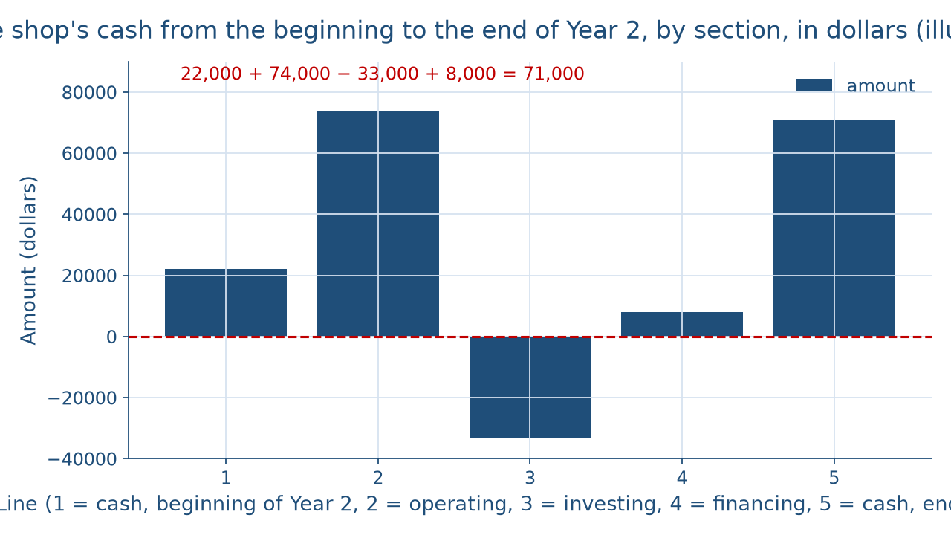
$22,000 becomes $71,000
THE YEAR IN ONE PICTURE
Where did the cash go?
Week 15
7
Notes:
This picture walks the shop's cash through Year 2, one bar per line. The first bar is cash at the beginning of Year 2, $22,000. The second bar, the tallest, is operating activities, $74,000. The third bar points below zero: investing activities, minus $33,000, mostly the new equipment. The fourth bar is financing activities, a short $8,000. The last bar is cash at the end of Year 2, $71,000. Read left to right, the bars add up: 22,000 + 74,000 − 33,000 + 8,000 = 71,000. DO: before naming the last bar, ask students to add the three sections to $22,000 in their heads, collect the sums, and confirm $71,000, the cash on the balance sheet.

Slide 8
The statement checks itself
WORKED EXAMPLE · TIE IT TO CASH
74,000 − 33,000 + 8,000 = $49,000
22,000 + 49,000 = $71,000
Ties to the balance sheet's cash
Where did the cash go?
Week 15
8
Notes:
The total of the three sections is the net increase in cash, which equals the change in cash during the period. For the shop, 74,000 − 33,000 + 8,000 = $49,000. Add the beginning cash: 22,000 + 49,000 = $71,000, which is the cash on the end-of-Year-2 balance sheet. The statement reconciles, so every dollar of the change from $22,000 to $71,000 has a line that explains it. This is the Week 3 habit in a new place: a trial balance checks that debits equal credits, and this statement checks that the sections equal the change in cash. DO: have pairs foot the full statement in their notes, section by section, then check that their ending cash matches $71,000 before moving on.

Slide 9
Net income vs. cash
THE TRAP IN A PROFITABLE YEAR
Net income $69,000
Earned, by accrual
Operating cash $74,000
Cash moved; total up $49,000
Where did the cash go?
Week 15
9
Notes:
Here is the week's central distinction, the one Week 5 first named. Students often read net income as the cash a business made. Set three numbers side by side. Net income was $69,000. Net cash provided by operating activities was $74,000. Total cash grew by $49,000. They differ because accrual accounting records revenues and expenses when earned and incurred, not when cash moves, and because investing and financing cash never touch net income at all. In another year the gap can run the other way: a profitable business can run short of cash when customers pay slowly or inventory piles up. DO: ask a volunteer to explain the $5,000 gap between $69,000 and $74,000 in one sentence, using the four working changes.

Slide 10
2.5 and 30 percent
WORKED EXAMPLE · BALANCE SHEET RATIOS
Current ratio 100,000 ÷ 40,000 = 2.5
Total liabilities $60,000; assets $200,000
Debt to total assets 30 percent
Where did the cash go?
Week 15
10
Notes:
A financial ratio is one amount from the statements divided by another, read in one plain sentence to describe the business, never as good or bad on its own. The current ratio is current assets divided by current liabilities: 100,000 ÷ 40,000 = 2.5. In words, the shop holds $2.50 of current assets for each $1 of current liabilities. Debt to total assets is total liabilities divided by total assets. Total liabilities are 40,000 + 20,000 = $60,000, the current liabilities plus a long-term note. Total assets are 60,000 + 140,000 = $200,000, using Week 14's stockholders' equity. Debt to total assets is 60,000 ÷ 200,000 = 0.30, or 30 percent. DO: compute both live; pause before each division, collect the results, then say each ratio aloud as one plain sentence.

Slide 11
Month 1 vs. Year 2
THE TRAP IN A HIGH RATIO
Month 1: about 12.9
A new shop holding cash
Year 2: 2.5
A busy shop using cash
Where did the cash go?
Week 15
11
Notes:
Students often think a higher current ratio is always better. Look at the shop's own history. At the end of Month 1, from Dataset B, its current assets were $20,700 and its current liabilities $1,600, so its current ratio was 20,700 ÷ 1,600, or about 12.9. At the end of Year 2 it was 2.5. The Month 1 figure was high because a brand-new shop was holding most of its founders' cash before spending it. A very high ratio can mean cash sitting unused or customers slow to pay, so a ratio is always read beside the business's own story. DO: ask the room which year looks safer and why, collect two answers, and close by saying that the ratios describe two different moments, not a better and a worse shop.

Slide 12
40 cents and 10 cents
WORKED EXAMPLE · TWO MARGINS
Gross margin 276,000 ÷ 690,000 = 40 percent
Profit margin 69,000 ÷ 690,000 = 10 percent
Describe, never advise
Where did the cash go?
Week 15
12
Notes:
Gross margin, from Week 6, is gross profit divided by sales revenue. The shop's Year 2 net sales were $690,000 and its gross profit $276,000, so gross margin is 276,000 ÷ 690,000 = 0.40, or 40 percent, and cost of goods sold was 690,000 − 276,000 = $414,000. Profit margin is net income divided by net sales: 69,000 ÷ 690,000 = 0.10, or 10 percent. In words, of each sales dollar the shop kept 40 cents after the cost of its goods and 10 cents after every expense. Week 6's first bicycle sale had a gross margin of 50 percent; a whole year of many products gives a different figure, and neither is good or bad. No ratio is investment advice. DO: ask which margin uses net income, and confirm profit margin.

Slide 13
Open a real 10‑K
CONCEPT 5 · A REAL ANNUAL REPORT
Form 10‑K: the annual report
Public on the SEC's EDGAR website
Read for structure; no figure keyed
Where did the cash go?
Week 15
13
Notes:
Most U.S. public companies file a Form 10‑K with the SEC each year, and every filed 10‑K is public on the SEC's EDGAR website. A Form 10‑K is the annual report most U.S. public companies file with the SEC, containing their financial statements; EDGAR is the SEC's public website of company filings. A student picks a company whose products they use, opens a filing marked 10‑K, and finds its statement of cash flows. They find the same three sections the shop uses, with far bigger numbers. The limit matters: the course reads a real filing for its structure only, and no real company's figure is ever keyed. DO: if a projector is available, open one 10‑K live on EDGAR, scroll to the statement of cash flows, and have the room name each of its three sections aloud.

Slide 14
Month 1 to Year 2
WORKED EXAMPLE · THE COURSE SYNTHESIS
Month 1: earned $1,400; operations used $400
Year 2: earned $69,000; operations provided $74,000
Net income and cash flow differ
Where did the cash go?
Week 15
14
Notes:
Now read the shop's whole story. In Month 1, Dataset A, it recorded twelve transactions and reached total assets of $33,200; after Dataset B's six adjustments, its net income was $1,400 and its cash $17,100. Sort Month 1's cash: operating receipts 1,200 + 3,500 + 1,000 = $5,700 minus payments 2,400 + 1,500 + 600 + 1,600 = $6,100 give operating cash of (400). Investing is (12,000) for equipment, and financing is 30,000 − 500 = $29,500. The total, −400 − 12,000 + 29,500 = $17,100, is all of Month 1's cash. The indirect method agrees: 1,400 + 200 − 1,050 − 350 − 2,200 + 300 + 400 + 900 = (400). By the end of Year 2 the shop held $71,000 of cash and $200,000 of total assets. DO: have pairs sort the twelve transactions into sections, then compare totals.

Slide 15
Check the chatbot's cash
THIS ACTIVITY · AUDIT THE CHATBOT
Paste Dataset L's operating facts
Watch for a gain added back
The tool drafts; you check every sign
Where did the cash go?
Week 15
15
Notes:
For this activity, students open one approved chatbot, such as Claude or Gemini, and paste this prompt: A business had net income of $69,000, depreciation of $12,000, a $2,000 gain on selling equipment for $7,000, accounts receivable up $3,000, inventory up $5,000, prepaid expenses down $1,000, and accounts payable up $2,000. Prepare the operating section by the indirect method. Common errors on this material: adding the gain instead of subtracting it, adding the increase in receivables, or calling depreciation a source of cash. The vetted total is $74,000. DO: have pairs mark each line against Dataset L, fix any reversed sign by hand, and explain the fix in one sentence. The tool drafts; you check.

Slide 16
Earned, then where it went
Operating cash $74,000; cash up $49,000
Current ratio 2.5; debt to total assets 30 percent
Next: the cumulative final
BEFORE THE FINAL
16
Notes:
Recap the week's key numbers. Cash sorts into operating, investing, and financing activities, and a dividend is financing. The indirect method took net income of $69,000 to operating cash of $74,000. Investing used $33,000, financing provided $8,000, and cash rose $49,000, from $22,000 to $71,000. The current ratio was 2.5, debt to total assets 30 percent, gross margin 40 percent, and profit margin 10 percent, each read as a description. A 10‑K on EDGAR has the same shape, and no real figure is keyed. The course's one sentence: in Month 1 the shop earned $1,400 while its operations used $400, and in Year 2 it earned $69,000 while its operations provided $74,000. Next week, the cumulative final draws on every week. DO: give a one-minute exit ticket: name the section for a dividend and the sign for a gain.

