Slide 1
Where buyers and sellers meet
WEEK 2 · THE MARKET IT SELLS INTO
Week 2 · The market it sells into
1
Notes:
Welcome to Week 2. This week asks one orienting question: what market does a business sell into, and what forces in the wider economy push on it? You will compare four economic systems by who owns resources and who decides what gets produced, each with its strongest case and its critics. You will read one illustrative strawberry schedule to find where a price settles, what a shortage and a surplus are, and what one shift of demand does. Then you will sort markets into four structures and place the coffee cart among them, and you will name the economy's health signs and who steers each kind of policy. For how the course runs, including how work is graded, the current syllabus is the place to look. DO: ask students to name one thing they wanted that sold out, and keep the list for the hook.

Slide 2
Why did berries sell out?
01
THE QUESTION BEHIND THIS WEEK
2
Notes:
DO: describe an illustrative strawberry stand at a summer farmers' market. On one day the sign says 4 dollars a pint, the line is long, and the berries are gone before lunch. On another day the sign says 6 dollars, the line is short, and flats of berries sit in the sun all afternoon. Ask for a show of hands: did the growers plan badly on the first day? Collect answers, then name the idea the week builds toward: the price on the sign was below the price where buyers and sellers agree, so buyers wanted more than sellers offered. Tell the room that the same stand will show us an equilibrium, a shortage, a surplus, and a shift, all from one schedule. Use the sold-out list from the title slide as more examples of the same pattern.

Slide 3
Meet the strawberry schedule
02
OUR DATASET THIS WEEK
3
Notes:
Introduce the dataset by name: the farmers'-market strawberry schedule. It is illustrative, constructed for this course and not real data. Prices run 2, 3, 4, 5, 6, and 7 dollars a pint. At those prices buyers want 700, 600, 500, 400, 300, and 200 pints on one market day, and sellers offer 100, 200, 300, 400, 500, and 600 pints. A summer festival later adds 200 pints of demand at every price, so buyers want 900, 800, 700, 600, 500, and 400 pints. Tell students the deck walks this one table from its equilibrium of 5 dollars and 400 pints, through a shortage and a surplus of 200 pints each, to a new equilibrium of 6 dollars and 500 pints. The same schedule returns in the tutorial, the quiz, and the Business Case Workshop.

Slide 4
Four systems, two questions
CONCEPT 1 OF 6 · WHO OWNS, WHO DECIDES
Market: owners and prices decide
Command: central planners decide
Socialism: government runs key industries
Mixed: nearly every country
Where buyers and sellers meet
Week 02
4
Notes:
An economic system is the way a society answers two questions about its economy: who owns the productive resources, and who decides what gets produced. Left column: in a market economy private individuals and businesses own the resources and prices are set by buyers and sellers, so owners and prices decide; in a command economy central planners decide what gets produced, how much of it, and how resources are used. Right column: under socialism the government owns or closely directs key industries, so government runs key industries; a mixed economy combines private ownership and market prices with a government role, and nearly every country runs one. DO: walk an illustrative neighborhood bakery through all four. Ask who decides how many loaves to bake under each system, then confirm: the owner, the plan, a government-run flour supply, and the owner within government rules.

Slide 5
Each system's strongest case
CONCEPT 1 OF 6 · POSITIONS, NOT A VERDICT
Markets: prices carry information
Planning: steers resources toward set goals
Critics on each side, no verdict
Where buyers and sellers meet
Week 02
5
Notes:
Each system has serious defenders and serious critics, and this course picks no winner. Defenders of markets say prices carry information from countless everyday choices and reward new ideas; critics say markets can leave people without basics and ignore harms such as pollution. Defenders of command planning say it steers resources toward set goals, such as equal access to basics; critics say planners lack the information prices carry, so shortages and waste follow. Defenders of socialism say key industries can serve public need rather than profit; critics point to weaker rewards for new ideas. So there are critics on each side, and no verdict. Smith (1776), Wealth of Nations, is the classic case for markets; name it and do not quote it. DO: have pairs write the strongest case for the system each finds less convincing, then share two.

Slide 6
Where 400 meets 400
CONCEPT 2 OF 6 · WORKED EXAMPLE
At 5 dollars: 400 wanted, 400 offered
Buyers want less as price climbs
Sellers offer more as price climbs
Where buyers and sellers meet
Week 02
6
Notes:
Demand is the amount of a good that buyers want to purchase at each possible price; supply is the amount sellers want to offer at each possible price. Equilibrium is the price at which the two amounts match. DO: read the strawberry schedule row by row. Buyers want less as price climbs: 700, 600, 500, 400, 300, and 200 pints as the price goes from 2 to 7 dollars. Sellers offer more as price climbs: 100, 200, 300, 400, 500, and 600 pints. Ask the room to call out the row where the two columns agree. At 5 dollars, 400 wanted and 400 offered; 400 = 400, so the equilibrium is 5 dollars and 400 pints. Say it in words: on a normal market day strawberries settle at 5 dollars a pint, and 400 pints change hands. The schedule is a classroom model.

Slide 7
Shortage vs. surplus
CONCEPT 3 OF 6 · WORKED EXAMPLE
At 4 dollars: 500 − 300
Shortage of 200 pints
At 6 dollars: 500 − 300
Surplus of 200 pints
Where buyers and sellers meet
Week 02
7
Notes:
A shortage is the gap at a price below equilibrium, when buyers want more than sellers offer; it pushes the price up. A surplus is the gap at a price above equilibrium, when sellers offer more than buyers want; it pushes the price down. Left column: at 4 dollars buyers want 500 pints and sellers offer 300, so shortage = 500 − 300, a shortage of 200 pints. Right column: at 6 dollars sellers offer 500 and buyers want 300, so surplus = 500 − 300, a surplus of 200 pints. DO: put both prices on the board and ask which way each pushes the price, then confirm that both move back toward 5 dollars. Callback: in Week 1 a not-for-profit's surplus was money left over after expenses; a market surplus is a pile of unsold goods. Same word, two ideas.

Slide 8
Add 200 at every price
CONCEPT 4 OF 6 · WORKED EXAMPLE
Buyers want 900, 800, 700, 600, 500, 400
At 5 dollars: 600 − 400 = 200 short
New equilibrium: 6 dollars, 500 pints
Where buyers and sellers meet
Week 02
8
Notes:
A shift of demand is a change in the amount buyers want at every price at once, caused by something other than the good's own price. DO: run the festival shift live. Add 200 to each amount buyers want: 700 + 200 = 900, 600 + 200 = 800, 500 + 200 = 700, 400 + 200 = 600, 300 + 200 = 500, and 200 + 200 = 400. So buyers want 900, 800, 700, 600, 500, 400 pints. Check the old price first: at 5 dollars, 600 − 400 = 200 short, so the old price no longer holds. Then find the new match: at 6 dollars buyers want 500 and sellers offer 500, so the new equilibrium is 6 dollars, 500 pints. The price rose 6 − 5 = 1 dollar and the amount sold rose 500 − 400 = 100 pints. The sellers' column never changed.

Slide 9
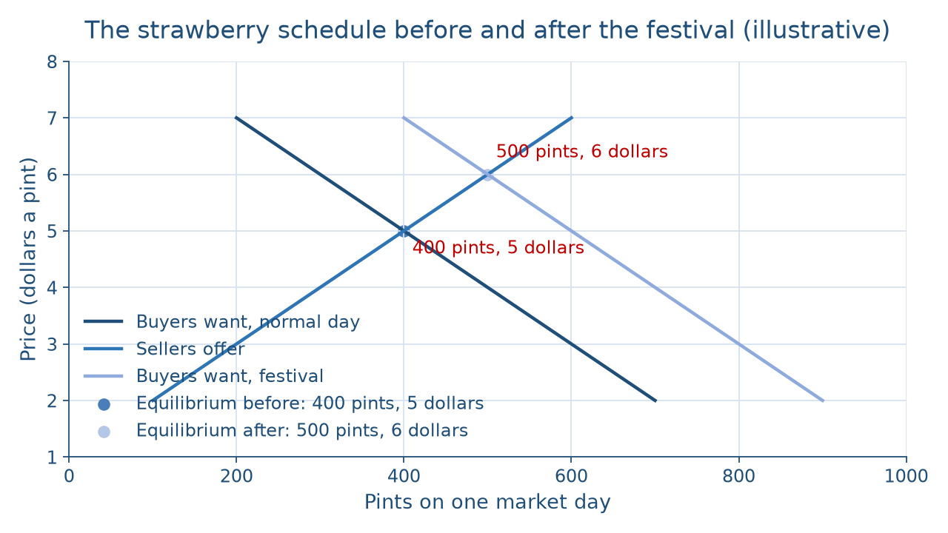
One shift, one new crossing
READ THE PICTURE
Where buyers and sellers meet
Week 02
9
Notes:
Describe the picture in words for everyone. The horizontal axis is pints on one market day; the vertical axis is price in dollars a pint. The normal-day buyers line falls from 700 pints at 2 dollars to 200 pints at 7 dollars. The sellers line rises from 100 pints at 2 dollars to 600 pints at 7 dollars, and the two cross at 400 pints and 5 dollars. The festival buyers line sits 200 pints to the right at every price, from 900 pints at 2 dollars to 400 pints at 7 dollars, and crosses the same sellers line at 500 pints and 6 dollars. DO: before naming anything, ask which line moved and which stayed put. The vetted answer: the buyers line shifted right, the sellers line did not move, and the crossing climbed along the sellers line, so price and amount both rose.

Slide 10
Along vs. shift
THE TRAP EVERYONE FALLS FOR
Higher price alone: less wanted
Same schedule, smaller amount
Festival: more wanted at every price
Higher price is the result
Where buyers and sellers meet
Week 02
10
Notes:
Left column: a higher price alone means less wanted. Buyers slide along the same schedule to a smaller amount, so going from 5 dollars to 6 dollars on the normal-day schedule drops the amount wanted from 400 to 300 pints. Right column: the festival means more wanted at every price, and the higher 6-dollar price is the result, not the cause. Students often say a higher price means more demand, and that reverses the story. DO: read three statements and have tables call each one a movement along or a shift: the price of berries rises from 5 to 6 dollars on a normal day (along); a festival brings crowds (shift); a rival stand closes and its shoppers come over (shift). Debrief any table that called the price change a shift. The line to keep: a price change moves you along the schedule; a shift moves the whole schedule.

Slide 11
Four structures, four businesses
CONCEPT 5 OF 6 · COUNT THE SELLERS
Wheat farm: perfect competition
Nail salon: monopolistic competition
Wireless carrier: oligopoly
Water utility: monopoly
Where buyers and sellers meet
Week 02
11
Notes:
A market structure sorts markets by how many sellers there are, how alike their products are, and how easily a new seller can enter. A wheat farm sits in perfect competition: very many sellers of an identical product, none of whom can set the price. A nail salon sits in monopolistic competition: many sellers of slightly different products, with easy entry. A wireless carrier sits in an oligopoly: a handful of large sellers with steep barriers that keep new sellers out. A city water utility is a monopoly: a single seller protected by high barriers to entry. Every example is illustrative. DO: give each table one business near campus, such as a pizza place or a bus line, and ask them to place it with three questions: how many sellers, how alike the products, how easy the entry. Collect placements and debrief one disputed case.

Slide 12
Monopolistic, not a monopoly
CONCEPT 5 OF 6 · WORKED EXAMPLE
Cart: many sellers, different drinks
Easy entry for a new cart
Sherman Act (1890)
Antitrust law polices monopoly
Where buyers and sellers meet
Week 02
12
Notes:
Left column: place the running venture. The illustrative coffee cart faces many sellers, including other carts, cafés, and the chain café opening nearby, so the cart has many sellers and different drinks, each a little different. There is easy entry for a new cart with modest equipment and a permit. So the cart sits in monopolistic competition. Callback: the chain café was a threat in the Week 1 SWOT; now we can name the market it competes in. Right column: an antitrust law is a federal law that polices monopoly and limits on competition, and the Sherman Act (1890) is the first of the three core federal antitrust laws. DO: ask whether monopolistic competition is a kind of monopoly. The vetted answer is no: the cart sits near the crowded end, with many rivals and no protection from new ones. Name these laws as general education only.

Slide 13
Three signs to watch
CONCEPT 6 OF 6 · THE ECONOMY'S HEALTH
Growth, measured by GDP
Employment
Price stability
Where buyers and sellers meet
Week 02
13
Notes:
Picture an illustrative family-run hardware store. When the economy grows, people build decks and the store sells more lumber; growth is measured by GDP, the total value of the final goods and services an economy produces in a year, which we name and never compute. When a big local employer cuts jobs, fewer families take on projects; that is employment, how many people who want work have it. When prices across the economy climb fast, the store's own costs jump; that is price stability. Callback: in Week 1 the PESTEL scan named prices rising across the economy as an economic force on a campus bookstore; these three signs are how economists read that force. DO: read three headlines and have the room name the sign each one is about: the economy grew last year; a plant announces layoffs; prices are climbing quickly.

Slide 14
Fiscal vs. monetary
CONCEPT 6 OF 6 · WHO STEERS
Fiscal: spending and taxes
Congress and the President
Monetary: the Federal Reserve
Maximum employment, stable prices
Where buyers and sellers meet
Week 02
14
Notes:
Left column: fiscal policy is government spending and taxation, so fiscal means spending and taxes, set in the United States by Congress and the President. Right column: monetary policy is run by the Federal Reserve toward the goals Congress assigned it, maximum employment and stable prices. How the Federal Reserve does its work comes later in the course. Students often hand taxes to the Federal Reserve because it is the economic agency they hear about most; the cure is to ask whether the news is about the government's budget or about the Federal Reserve. Whether any particular policy is wise is argued terrain, and this deck names who holds each lever and stops there. DO: read two headlines, a tax cut passed by lawmakers and a Federal Reserve announcement, and have students label each fiscal or monetary.

Slide 15
Audit the chatbot
THIS WEEK'S AUDIT · CHECK THE MACHINE
Paste the schedule into Claude or ChatGPT
Check: did the price cause the demand?
The tool drafts; you check
Where buyers and sellers meet
Week 02
15
Notes:
This activity puts a chatbot from the approved list, such as Claude or ChatGPT, to work on this week's material. DO: paste this exact prompt: At 2, 3, 4, 5, 6, and 7 dollars a pint, buyers want 700, 600, 500, 400, 300, and 200 pints of strawberries and sellers offer 100, 200, 300, 400, 500, and 600 pints. Find the equilibrium and the gap at 4 dollars. A festival then adds 200 pints of demand at every price; find the new equilibrium and explain why the price rose. Compare the reply with the vetted answers: 5 dollars and 400 pints, a shortage of 200 pints, then 6 dollars and 500 pints. Name the likely error first: chatbots often say the higher price increased demand, which reverses cause and result. The judgment rule for this activity: the tool drafts; you check.

Slide 16
Systems, prices, structures, signs
Equilibrium: 5 dollars, 400 pints
Festival shift: 6 dollars, 500 pints
Cart: monopolistic competition
Next: From Idea to Plan
BEFORE NEXT CLASS
16
Notes:
Recap the week in the order it was taught. Economic systems differ on who owns and who decides, each has a strong case and strong critics, and nearly every country runs a mixed economy. On the strawberry schedule the equilibrium is 5 dollars, 400 pints; at 4 dollars there is a shortage of 200 pints and at 6 dollars a surplus of 200 pints. The festival shift adds 200 pints at every price and moves the market to 6 dollars, 500 pints. The cart sits in monopolistic competition, and the Sherman Act (1890) polices monopoly. Growth, employment, and price stability are the health signs; Congress and the President set fiscal policy, and the Federal Reserve runs monetary policy. DO: have each student write one movement along a schedule and one shift for a product they buy. Next: From Idea to Plan, where the five forces model reads the cart's industry.

