Slide 1
Make, check, protect it
WEEK 6 · MAKING THE PRODUCT
Week 6 · Operations, quality, and information systems
1
Notes:
Welcome to Week 6, which opens a new part of the course: making the product and selling it. This week asks one orienting question: how does a business make what it sells, and what limits how much it can make? You will follow inputs becoming outputs, sort the ways things get made, and plan the coffee cart's opening month with a Gantt chart. Then you will find the cart's slowest step and compute how many drinks it can make in an hour. Last, you will see how firms build quality into their work and how a small business keeps its information safe. For how the course runs, including how work is graded, the current syllabus is the place to look. DO: ask each student to name the slowest line they have waited in lately and what held it up. Keep three answers for the hook.

Slide 2
Stuck behind one machine?
01
THE QUESTION BEHIND THIS WEEK
2
Notes:
DO: read back two or three of the slow lines from the title slide, then ask what they had in common. Most rooms land on the same answer: the cashier was fine, but everyone waited at one oven, one machine, or one person. Tell the room the coffee cart has the same problem. Taking an order takes 1 minute, but making the drink takes 2 minutes on the cart's one espresso machine, so the cart can make at most 30 drinks an hour however fast the counter works. Name the idea in plain words before the term: the slowest step sets the pace, and speed anywhere else is wasted. Promise the room they will compute that limit themselves in a few slides. That sets up the dataset slide, where the cart's process map is laid out.

Slide 3
Meet the cart's process map
02
OUR DATASET THIS WEEK
3
Notes:
Introduce the dataset by name: the coffee cart's process map and capacity. It is illustrative, constructed for this course and not real data. The counter step, taking the order and payment, takes 1 minute per drink. The drink-preparation step takes 2 minutes per drink on the one espresso machine. The settled results: capacity with one machine is 60 ÷ 2 = 30 drinks an hour, and 30 × 4 = 120 drinks in a four-hour morning rush. With a second machine and a second person, preparation runs at an effective 1 minute, and the counter caps capacity at 60 ÷ 1 = 60 drinks an hour. Callback: Week 3's start-up list already paid 20,000 dollars for the cart and its equipment; this week we watch that machine work. DO: ask students to guess the hourly capacity before you reveal it.

Slide 4
Inputs in, outputs out
CONCEPT 1 OF 6 · IN, THROUGH, OUT
Farm: seed and labor in, vegetables out
Transit: buses and drivers in, rides out
Goods and services both run operations
Making the product
Week 06
4
Notes:
Operations management is the work of planning, running, and improving the process that turns a business's inputs, such as materials, labor, and equipment, into the goods or services it sells. The production process is the set of steps that does it. First bullet: an illustrative family farm takes in seed, soil, water, and a crew's labor, and sends out boxes of vegetables, which are goods. Second bullet: an illustrative city transit agency takes in buses, drivers, and fuel, and sends out rides, which are a service. Third bullet: both need operations. Callback: Week 1 named the factors of production, and operations is where those factors get put to work. Name the trap: operations happens only in factories. DO: ask pairs to name one input and the output for a bus route; vetted answer, buses or drivers in and rides out.

Slide 5
Same, choices, or one-off
CONCEPT 2 OF 6 · HOW ALIKE?
Mass production: identical sandwich loaves
Mass customization: standard cake, buyer's choices
Customization: one cake from scratch
Making the product
Week 06
5
Notes:
Use an illustrative neighborhood bakery. Mass production is making large numbers of identical items the same way every time, so each one costs less to make: the sandwich loaves. Mass customization is making items from standard parts and steps while letting each buyer choose some features, so many buyers get a personalized item at close to the cost of mass production: birthday cakes from the standard sponge with the buyer's flavor and message. Customization is making each item from scratch to one buyer's own wishes, one at a time: a wedding cake designed with the couple. Name the trap: mass customization does not mean building every item from scratch, because every order starts from the same base. DO: ask the room to sort a made-to-order sandwich from a set menu; the vetted answer is mass customization.

Slide 6
Continuous vs. intermittent
CONCEPT 2 OF 6 · RUNNING OR RESETTING
Continuous: runs without stopping
The bread line
Intermittent: stops and resets
The cake bench
Making the product
Week 06
6
Notes:
A second way to sort production asks whether the process keeps running. Left column: a continuous process is a production process that runs for long stretches without stopping, making the same output the whole time. The bakery's bread line is the example, turning out the same loaf tray after tray. Right column: an intermittent process is a production process that stops and resets to make different outputs, in short runs or one order at a time. The cake bench is the example, because each birthday cake or wedding cake needs its own setup. Point out that one small bakery runs both kinds. DO: ask students whether a bike-repair bench is continuous or intermittent, and why; vetted answer, intermittent, because each bike that comes in needs a different job. Then move to planning the cart's first month.

Slide 7
Plan the bars, watch them
CONCEPT 3 OF 6 · PLAN THE MONTH
Location: go where customers are
Resource planning: inventory, suppliers, schedule
Gantt chart: tasks as bars over time
Production control: correct when work slips
Making the product
Week 06
7
Notes:
A location decision is the choice of where a business makes or delivers its product, weighing nearness to customers, suppliers, and workers against cost. Callback: Week 1's SWOT gave the cart a strength, it can move to where the customers are, such as the office building two blocks away or the weekend farmers' market. Resource planning gets inventory, suppliers, and the schedule ready; the start-up list set aside 2,000 dollars of opening inventory, and Week 3 showed the bean supplier's bargaining power. A Gantt chart shows each task as a horizontal bar against a timeline. Production control tracks the work against the plan and corrects course. DO: sketch the opening month left to right: permit first, beans and helper training side by side, menu testing after both, opening last. Ask what slides if the beans run late; vetted answer, testing and opening.

Slide 8
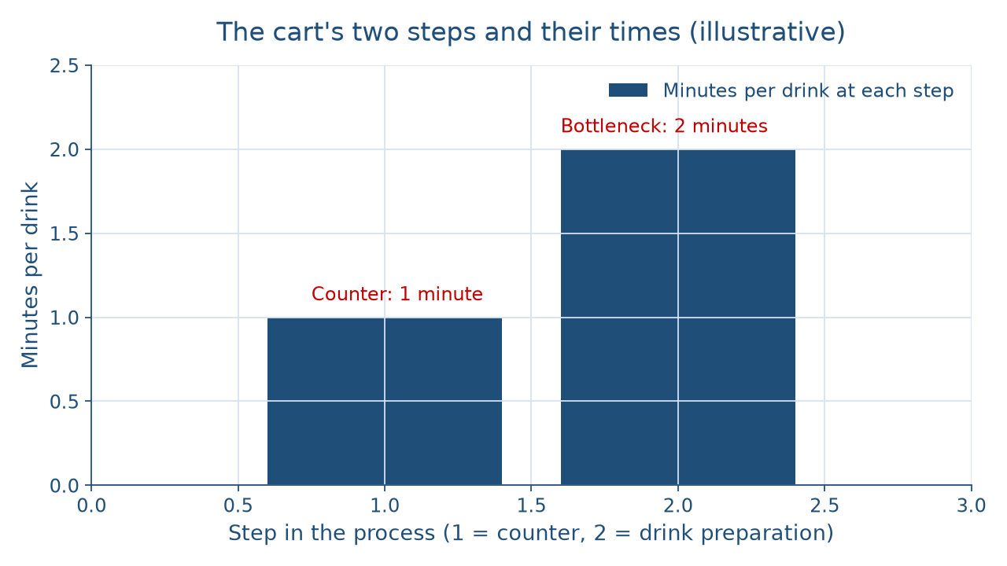
Find the tallest bar
CONCEPT 4 OF 6 · READ THE PICTURE
Making the product
Week 06
8
Notes:
Describe the picture in words for everyone. The horizontal axis numbers the cart's two steps in order: step 1 is the counter, where the order and payment are taken, and step 2 is drink preparation on the one espresso machine. The vertical axis is minutes per drink. The counter bar reaches 1 minute. The preparation bar reaches 2 minutes, twice as tall. A process map is a step-by-step list or drawing of how a product moves from start to finish, with the time each step takes, and this picture is the cart's process map drawn as bars. DO: before naming anything, ask which step decides how many drinks the cart can make. The vetted answer: drink preparation, the tallest bar. A bottleneck is the slowest step in a process, the one that limits how much the whole process can produce.

Slide 9
30 an hour, not 60
CONCEPT 4 OF 6 · WORKED EXAMPLE
60 ÷ 2 = 30 drinks an hour
30 × 4 = 120 in the rush
Second machine: 60 ÷ 1 = 60
Making the product
Week 06
9
Notes:
Capacity is the most output a process can produce in a given time, set by its slowest step. DO: run the outline's worked example live, pausing before each step for predictions. Counter step: 1 minute per drink. Drink-preparation step: 2 minutes on the one machine. Bottleneck: preparation, at 2 minutes. Capacity with one machine: 60 ÷ 2 = 30 drinks an hour. Morning rush with one machine: 30 × 4 = 120 drinks in a four-hour rush. With a second machine and a second person, preparation runs at an effective 1 minute, both steps take 1 minute, and the counter caps capacity at 60 ÷ 1 = 60 drinks an hour. The change: 60 ÷ 30 = 2, so capacity doubles. Say it in words: every drink waits its turn at the machine, so the next equipment dollar belongs at the bottleneck.

Slide 10
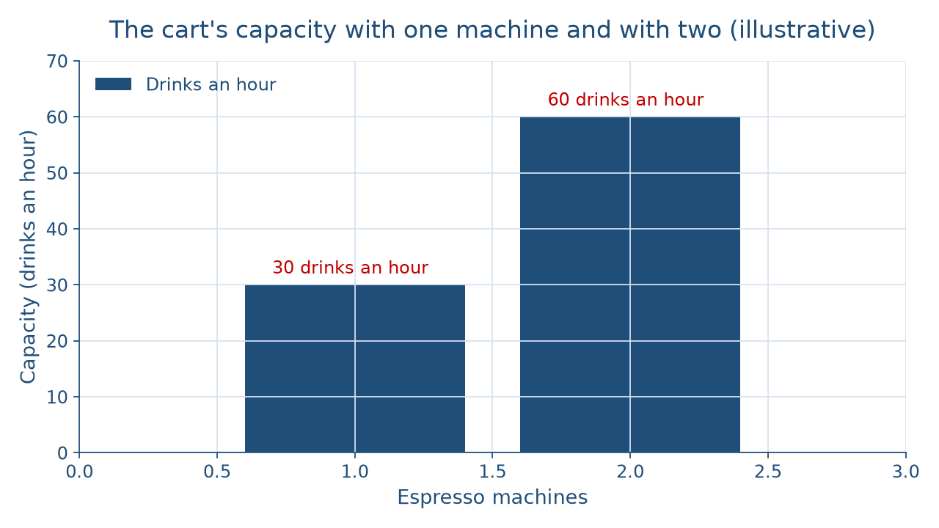
One machine vs. two
CONCEPT 4 OF 6 · ONE VS. TWO
Making the product
Week 06
10
Notes:
Describe the picture in words. The horizontal axis is the number of espresso machines, 1 or 2. The vertical axis is drinks an hour. With 1 machine the bar reaches 30 drinks an hour, because the 2-minute preparation step is the limit. With 2 machines and a second person the bar reaches 60 drinks an hour, twice as tall, and the 1-minute counter becomes the new limit. Add the caveat: this process map is a model that assumes every drink takes the same time and customers arrive steadily, so capacity is a ceiling, not a promise. DO: ask the room what the owner would have to change next to go past 60 drinks an hour. The vetted answer: the counter, because once both steps take 1 minute, a faster machine alone no longer helps.

Slide 11
Fastest step? No, slowest
THE TRAP EVERYONE FALLS FOR
Wrong: the counter sets the pace
Right: the machine sets the pace
Capacity = 60 ÷ bottleneck's step time
Making the product
Week 06
11
Notes:
Students often think a process runs as fast as its fastest step, so a 1-minute counter means 60 drinks an hour even with one machine. That is tempting, because the counter is the step customers see. But every drink must also pass through the machine, and the machine finishes only one drink every 2 minutes, so capacity is 30 drinks an hour. The cure is to find the slowest step first: capacity is minutes in an hour divided by the bottleneck's step time, which is the formula on the third bullet. DO: write two claims on the board, the counter sets the pace and the machine sets the pace, and have students vote. Reveal the vetted answer, the machine, and ask one student to explain why a faster card reader would not raise capacity at all.

Slide 12
Five ways to build quality
CONCEPT 5 OF 6 · BUILD QUALITY IN
Total quality management: everyone, every process
Six Sigma: 3.4 defects per 1,000,000
Lean: cut steps with no value
JIT: small stock, timed deliveries
Making the product
Week 06
12
Notes:
Total quality management is a quality approach in which everyone in a firm works to improve every process continuously. Six Sigma is a quality program, introduced at Motorola in 1986, that aims for no more than 3.4 defects per 1,000,000 opportunities and works through define, measure, analyze, improve, and control. Lean production removes every step that adds no value for the customer. JIT inventory has materials arrive as they are needed, so a business keeps a small, steady stock. The fifth, ISO 9000, is a family of international standards for quality management, named so students recognize it. DO: tell the illustrative bike shop story, where mechanics log the brake repairs that come back, write one standard method, and drop a test ride that caught nothing. Ask which approaches that used; vetted answer, total quality management and lean.

Slide 13
Inspect late vs. build in
CONCEPT 5 OF 6 · THE TRAP
End inspection: catches mistakes late
Mistake already made and paid
Built in: fix the step
Kitchen checklist at hand-off
Making the product
Week 06
13
Notes:
Students often think quality means inspecting products at the end and throwing out the bad ones. Left column: an end inspection catches a mistake only after it is made and paid for. Right column: building quality in fixes the step where the mistake is born. DO: walk the illustrative hospital kitchen through the five Six Sigma steps. Define: a wrong item on a tray for someone on a special diet. Measure: count the wrong trays each week. Analyze: most errors happen at the shift change. Improve: two cooks read a short checklist together at the hand-off. Control: keep counting to see whether the fix holds. Then name the second trap: JIT does not mean no inventory ever. The cart gets milk as it is needed but keeps a small stock for the morning.

Slide 14
Everyone guards the data
CONCEPT 6 OF 6 · PROTECT THE DATA
Data: sales, customers, suppliers, payroll
Threats: phishing, ransomware, lost devices
Protections: passwords, multifactor, updates, backups
Not only the IT department's job
Making the product
Week 06
14
Notes:
An information system is the people, devices, software, and records a business uses to collect, store, and use its data, such as sales, customers, suppliers, and payroll. Cybersecurity is protecting those devices, accounts, and data. The common threats are phishing, malicious software such as ransomware, unauthorized access to accounts, and lost or stolen devices. The protections are habits: recognize and report phishing, strong passwords with a password manager, multifactor authentication, prompt software updates, and regular backups. DO: present the illustrative community food bank, whose coordinator gets a message asking for a fresh sign-in to the donation site. Ask pairs to name the threat and two protections. Vetted answer: phishing; do not click, report it, and rely on multifactor authentication. Cure the trap: a small business may have no IT department, so security is everyone's job.

Slide 15
Audit the chatbot
THIS WEEK'S AUDIT · CHECK THE MACHINE
Paste the cart's process into Claude or ChatGPT
Check: 30 an hour, 120 in the rush?
Check: 60 an hour with two machines?
Making the product
Week 06
15
Notes:
This activity puts a chatbot from the approved list, such as Claude or ChatGPT, to work on this week's material. DO: paste this prompt: A coffee cart takes 1 minute at the counter and 2 minutes to make each drink on one espresso machine. How many drinks can it make in an hour, and in a four-hour rush? What if it adds a second machine and a second person? Compare the reply with the vetted answers: 60 ÷ 2 = 30 drinks an hour, 30 × 4 = 120 in the rush, and 60 an hour with two machines. Name the likely errors first: chatbots often add the two step times together, or base capacity on the fastest step instead of the slowest. The judgment rule for this audit: the tool drafts; you recompute from the bottleneck before you trust it.

Slide 16
Slowest step sets pace
In, through, out
Same, choices, or one-off
30 an hour; 60 with two machines
Next: who buys, at what price
BEFORE NEXT CLASS
16
Notes:
Recap the week in the order it was taught. Operations management turns inputs into outputs, for a bus ride as much as a loaf of bread. Mass production repeats one item, mass customization adds choices to a standard base, and customization starts over; a process either runs continuously or stops and resets. The cart plans its location, inventory, and a Gantt chart, and production control keeps the work on plan. With one machine the cart makes at most 30 drinks an hour, 120 in a four-hour rush, and a second machine lifts that to 60. Quality is built in, not inspected in, and data protection is everyone's job. Next: Week 7, Who Buys and at What Price: Marketing, Products & Pricing. DO: have each student write the cart's bottleneck and one way to lift it.

