Slide 1
Who buys, at what price
WEEK 7 · MARKETING AND PRICING
Week 7 · Marketing, products, and pricing
1
Notes:
Welcome to Week 7, the second half of the unit on making the product and selling it. The orienting question is short: who buys, and at what price does the business cover its costs? You will start with the customer, choose a target market, and build the coffee cart's marketing mix with the four Ps. You will tell a product from a service and follow a product through its life cycle. Then you will run the cart's numbers: its break-even, its markup and margin, and what a lower launch price does. For how the course runs, including how work is graded, the current syllabus is the place to look. DO: ask each student to name one price that made them stop and change what they bought. Keep three answers for the hook.

Slide 2
What made you stop?
01
THE QUESTION BEHIND THIS WEEK
2
Notes:
DO: read back two or three of the prices from the title slide, then ask what each one changed: did the buyer switch, buy less, or pay anyway? Most rooms find a mix, and that mix is the week's second half in miniature. Tell the room the coffee cart faces the same choice from the seller's side. It charges 5 dollars a drink, each drink costs it 2 dollars in cups, lids, beans, and milk, and its fixed costs come to 36,000 dollars a year. Put the plain question on the board: how many drinks before the cart earns a single dollar of profit? Promise the room they will compute it themselves, and warn them that the quick answer of 36,000 divided by 5 is wrong. That sets up the dataset slide.

Slide 3
Meet the cart's price
02
OUR DATASET THIS WEEK
3
Notes:
Introduce the dataset by name: the coffee cart's price and break-even. It is illustrative, constructed for this course and not real data. The price is 5 dollars a drink. The variable cost is 2 dollars a drink, for the cup, lid, beans, and milk. Fixed costs are 36,000 dollars a year: the plan's 35,000 dollars of operating expenses plus 1,000 dollars of loan interest. Callback: Week 3's funding plan took a 10,000-dollar equipment loan at 10 percent a year, and that 1,000 dollars of first-year interest is now a fixed cost. The settled results: 12,000 drinks a year to break even, 48 a day over 250 operating days, and 60,000 dollars of revenue; a 150 percent markup and a 60 percent margin; and 18,000 drinks at a 4-dollar price. DO: ask students to guess the break-even before you reveal it.

Slide 4
Listen first, sell second
CONCEPT 1 OF 8 · THE MARKETING CONCEPT
Bike shop asks riders what they need
Adds early repairs before any ad
Want, beat rivals, stay profitable
Who buys, at what price
Week 07
4
Notes:
The marketing concept is the idea that a business should find out what customers want and deliver it better than its rivals do, while still earning a profit. First bullet: an illustrative neighborhood bike shop with a slow month asks its riders what they need, and commuters say repairs only happen while they are at work. Second bullet: the shop adds early-morning repair hours two days a week before it spends anything on ads. Third bullet: the concept's three tests are what customers want, better than rivals, and at a profit. Name the trap: marketing read as advertising. Ads are one piece, and they come after the offer is right. DO: ask pairs whether the new hours were a marketing decision; the vetted answer is yes, because the change started from what customers wanted and beat rivals at a profit.

Slide 5
Split, then choose
CONCEPT 2 OF 8 · TARGET MARKETS
Geographic: where buyers live or work
Demographic: age, life stage, income
Psychographic: lifestyle, values, interests
Behavioral: how and how often they use it
Who buys, at what price
Week 07
5
Notes:
A target market is the particular group of buyers a business decides to serve. Market segmentation splits a whole market into smaller groups who share a trait. Walk the four bases with an illustrative community gym. Geographic: people who live or work within a short drive. Demographic: retirees, a life stage. Psychographic: people who want exercise to feel social, a value. Behavioral: members who come at the same early hour every day, before work. The gym picks retirees who want a social midday class and builds a class around them. Then buyer behavior in brief: a buyer notices a need, compares options, buys, and judges the purchase afterward, like a shopper choosing a gift in an illustrative bookstore. Name the trap: aiming at everyone. DO: read out the early-hour members and ask which base; vetted answer, behavioral.

Slide 6
Four Ps, one cart
CONCEPT 3 OF 8 · THE FOUR PS
Product: drinks made to order
Price: 5 dollars a drink
Place: office weekdays, market weekends
Promotion: how the word gets out
Who buys, at what price
Week 07
6
Notes:
The marketing mix is the set of decisions a business controls in bringing an offer to market, organized as the four Ps, the framework McCarthy (1960), Basic Marketing, set out. Some courses add people, process, and physical evidence for services; only the four are keyed here. Left column: the product is espresso drinks made to order, and the price is 5 dollars a drink. Right column: place is the cart at the office building two blocks away on weekdays and the farmers' market on weekends; promotion is how the word gets out, met in depth in Week 9. Callback: Week 1's SWOT listed the strength that the cart can move to where the customers are; that is a place advantage. Name the trap: place read as only a store's address. DO: ask which P covers the weekend move; vetted answer, place.

Slide 7
Shelf vs. no shelf
CONCEPT 4 OF 8 · GOODS AND SERVICES
Good: beans wait on a shelf
Made ahead, stored, sold later
Service: the ride happens once
Produced and used together
Who buys, at what price
Week 07
7
Notes:
Left column: a market stall roasts coffee beans on a slow afternoon, and the bags wait on a shelf until buyers come; a good can be made ahead, stored, and sold later. Right column: an illustrative ride-share driver crosses town with an empty back seat, and that seat cannot be saved for the evening rush. A service is an offer that is produced and used at the same moment, such as a haircut or a ride, so it cannot be made ahead and stored. Callback: Week 6's capacity of 30 drinks an hour cannot be stored either, so an empty hour at the cart's machine is lost like the empty seat. Name the trap: a product and a service treated as interchangeable. DO: ask whether a haircut or a bag of beans is the service; vetted answer, the haircut, because it cannot sit on a shelf.

Slide 8
Four stages, one model
CONCEPT 5 OF 8 · A CLASSROOM MODEL
Introduction: new, few buyers, low sales
Growth: sales climb, rivals appear
Maturity: sales level off, price fights
Decline: buyers move on, sales fall
Who buys, at what price
Week 07
8
Notes:
The product life cycle is a classroom model of a product's sales over time in four stages: introduction, growth, maturity, and decline. Introduction: the product is new, few buyers know it, and sales are low. Growth: sales climb fast and rivals appear. Maturity: most buyers who want it have it, sales level off, and rivals fight on price. Decline: buyers move to something newer and sales fall. Use an illustrative charging case made for one phone model: growth a year after launch, decline once the phone is replaced. An illustrative streaming plan that most households already have is in maturity. Add the honesty note: this is a model, not a timetable; some products stay mature for decades. DO: ask which stage the case is in when sales climb and rivals arrive; vetted answer, growth.

Slide 9
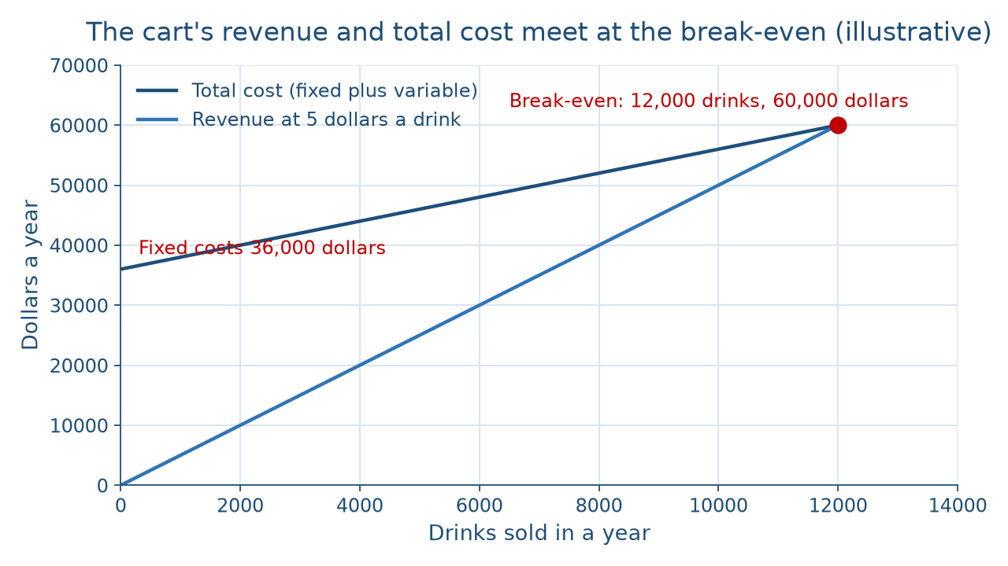
Where the lines cross
CONCEPT 6 OF 8 · READ THE PICTURE
Who buys, at what price
Week 07
9
Notes:
Describe the picture in words for everyone. The horizontal axis is drinks sold in a year, from zero to 12,000. The vertical axis is dollars a year. The total-cost line starts at 36,000 dollars at zero drinks, because the fixed costs are owed before any sale, and rises slowly, 2 dollars a drink. The revenue line starts at zero and rises faster, 5 dollars a drink. They meet at 12,000 drinks and 60,000 dollars. A fixed cost stays the same however many units are sold; a variable cost rises with every unit. DO: before naming the meeting point, ask what is true to its left; the vetted answer is that cost is above revenue, a loss. Then name it: the break-even point is the number of units a business must sell to cover all its costs.

Slide 10
Break even at 12,000
CONCEPT 6 OF 8 · WORKED EXAMPLE
Per-unit margin: 5 − 2 = 3 dollars
36,000 ÷ (5 − 2) = 12,000 drinks
12,000 ÷ 250 = 48 a day
12,000 × 5 = 60,000 dollars
Who buys, at what price
Week 07
10
Notes:
DO: run the outline's worked example live, pausing before each step for predictions. Per-unit margin: price 5 − variable cost 2 = 3 dollars a drink toward fixed costs. Fixed costs: operating expenses 35,000 + interest 1,000 = 36,000 dollars a year. Break-even units: 36,000 ÷ (5 − 2) = 36,000 ÷ 3 = 12,000 drinks a year. Break-even per day: 12,000 ÷ 250 = 48 drinks a day over 250 operating days. Break-even revenue: 12,000 × 5 = 60,000 dollars a year. Say it in words: the cart has to sell 12,000 drinks a year, about 48 customers a day, before it earns a single dollar of profit. Callback: Week 6 capped the cart at 30 drinks an hour, so 48 drinks is under two hours of work; the hard part is finding the buyers. Add the caveat: a break-even assumes one price and a constant variable cost.

Slide 11
Price or margin? Margin
THE TRAP EVERYONE FALLS FOR
Wrong: 36,000 ÷ 5 = 7,200
Right: 36,000 ÷ 3 = 12,000
Divide by what each sale leaves
Who buys, at what price
Week 07
11
Notes:
Students often compute the break-even as fixed costs divided by the price: 36,000 ÷ 5 = 7,200 drinks. That is tempting, because the price is the number on the menu board. But 2 of every 5 dollars pay for the cup and its contents, so only the 3-dollar per-unit margin is left to cover fixed costs. The right division is 36,000 ÷ 3 = 12,000 drinks. At 7,200 drinks the cart would still be losing money, because those drinks leave too little to cover the full 36,000. The memory hook is the third bullet: divide by what each sale leaves over. DO: write both divisions on the board and have the room vote on which is the break-even. Reveal the vetted answer, 12,000, and ask one student to explain where the other 2 dollars of each sale went.

Slide 12
150 percent vs. 60 percent
CONCEPT 7 OF 8 · ONE GAP, TWO PERCENTAGES
Markup on cost: 3 ÷ 2 × 100
= 150 percent
Margin on price: 3 ÷ 5 × 100
= 60 percent
Who buys, at what price
Week 07
12
Notes:
Both columns start from the same 3-dollar gap, 5 − 2. Left column: markup on cost = (price − cost) ÷ cost × 100, so (5 − 2) ÷ 2 × 100 = 3 ÷ 2 × 100 = 150 percent. Right column: margin on price = (price − cost) ÷ price × 100, so (5 − 2) ÷ 5 × 100 = 3 ÷ 5 × 100 = 60 percent. The markup is the larger figure because it divides by the smaller number, the cost. Name the trap: markup and margin read as the same percentage. Why it matters: a manager who wants a 60 percent margin but applies a 60 percent markup prices every item too low. DO: ask the room which is larger for the cart and why; vetted answer, the markup, at 150 percent versus a 60 percent margin, because it divides by the 2-dollar cost.

Slide 13
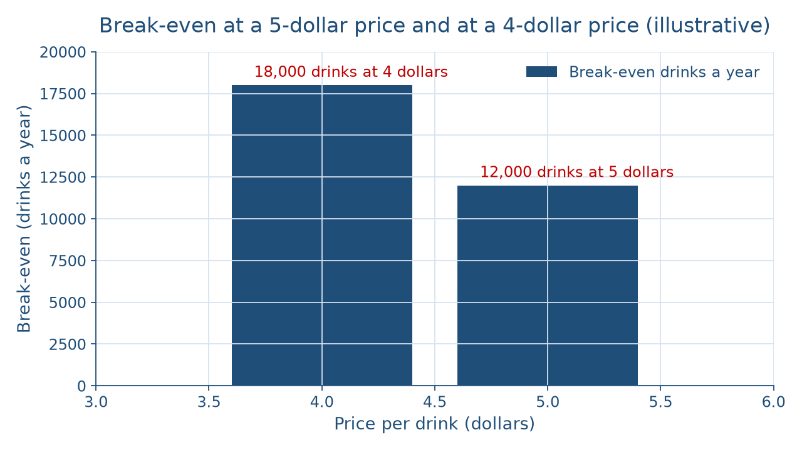
Lower price, higher bar
CONCEPT 8 OF 8 · SKIMMING VS. PENETRATION
Who buys, at what price
Week 07
13
Notes:
Price skimming launches a new product at a high price to the buyers most eager for it and cuts the price over time. Penetration pricing launches it at a low price to build volume fast. Describe the picture in words: the horizontal axis is the price per drink, 4 or 5 dollars; the vertical axis is break-even drinks a year. At 5 dollars the bar reaches 12,000 drinks. At 4 dollars it reaches 18,000, because 36,000 ÷ (4 − 2) = 36,000 ÷ 2 = 18,000. Price sensitivity, how strongly buyers react to a price change, is named in words and never computed here. Name the trap: a lower price lowers the break-even. DO: ask whether a 4-dollar price raises or lowers the break-even; vetted answer, it raises it, because each drink contributes 2 dollars instead of 3.

Slide 14
Audit the chatbot
THIS WEEK'S AUDIT · CHECK THE MACHINE
Paste the cart's figures into Claude or ChatGPT
Check: 12,000 drinks, not 7,200?
Check: 150 percent markup, 60 percent margin?
Who buys, at what price
Week 07
14
Notes:
This activity puts a chatbot from the approved list, such as Claude or ChatGPT, to work on this week's material. DO: paste this prompt: A coffee cart sells drinks at 5 dollars, each drink costs 2 dollars in supplies, and fixed costs are 36,000 dollars a year. How many drinks must it sell to break even? What are its markup on cost and its margin on price? Compare the reply with the vetted answers: 36,000 ÷ (5 − 2) = 12,000 drinks, a 150 percent markup, and a 60 percent margin. Name the likely errors first: chatbots sometimes divide the fixed costs by the price and report 7,200 drinks, or call the 60 percent figure the markup. The judgment rule for this audit: the tool drafts; you recompute from the per-unit margin before you trust it.

Slide 15
Divide by what's left over
Customer first; split, then choose
Four Ps; place is the whole path
12,000 drinks; 150 vs. 60 percent
Next: midterm review, one cart to two
BEFORE NEXT CLASS
15
Notes:
Recap the week in the order it was taught. The marketing concept starts with what customers want, beats rivals, and stays profitable. Segmentation splits a market on four bases, and the target market is the group a business chooses. The four Ps are product, price, place, and promotion, and place is the whole path to the buyer. A service cannot be stored, and the product life cycle is a model of four stages. The cart breaks even at 12,000 drinks a year, 48 a day; the same 3-dollar gap is a 150 percent markup and a 60 percent margin; a 4-dollar price raises the break-even to 18,000. Next: Week 8, Midterm Review & the Growth Question, which reviews Weeks 1 to 7. DO: have each student write the break-even formula and one reason a lower price raises it.

