Slide 1
Seven tools, one new chart
WEEK 8 · REVIEW AND THE GROWTH QUESTION
Week 8 · Midterm review and the growth question
1
Notes:
Welcome to Week 8, the midpoint of the course. The orienting question has two halves: what have we learned, and what changes when one cart becomes two? First you will walk back through Weeks 1 to 7, one tool or one distinction per week, with every number you have already met. Then you will meet the one new tool, the organization chart, and draw the coffee cart's chart at one cart and at two. The week also carries the midterm, so this deck doubles as a map of the first half. For how the course runs, including how work is graded, the current syllabus is the place to look. DO: ask each student to write down the one Week 1 to 7 tool they feel least sure about, and keep the list for the closing slide.

Slide 2
Whom do you ask?
01
THE QUESTION BEHIND THIS WEEK
2
Notes:
Start with something most people have lived. On the first day at a job or a volunteer shift, someone told you whom to ask when something went wrong. That person was your boss, and the line between you was part of a chart, even if nobody ever drew it. Now picture the coffee cart. For seven weeks it has been an owner and one part-time helper, close enough to talk across the counter. A second cart changes that, because the owner can stand at only one cart at a time. DO: ask three students to name whom they asked for help on a first day, and what that person's job was. Record the answers; you will sort them into line and staff positions later in the deck.

Slide 3
Seven weeks, one cart
02
OUR DATASET THIS WEEK
3
Notes:
This week's dataset is every pinned value from Weeks 1 to 7 plus one new set, the cart's organization chart at two sizes, all illustrative and constructed for this course, not real data. You will meet the cart's SWOT with 4 inside and 4 outside entries, the strawberry schedule's match at 5 dollars and 400 pints, the 30,000-dollar start-up need and its 10,000-dollar loan, the plant's net change of 25 positions, a capacity of 30 drinks an hour, and a break-even of 12,000 drinks with a 150 percent markup and a 60 percent margin. The new set: at one cart, 2 people on 2 levels; at two carts, 7 people on 3 levels, with a span of control of 2 at each level. Every number on the next slides comes from this list.

Slide 4
Inside or outside first
CONCEPT 1 OF 9 · WEEK 1 REVIEW
Revenue is not profit
4 inside entries, 4 outside entries
Office building two blocks away: an opportunity
Seven tools, one new chart
Week 08
4
Notes:
Week 1 gave you one distinction and one tool. The distinction: revenue is the money that comes in from selling goods or services, and profit is what is left when expenses are subtracted from revenue, so revenue is not profit. A campus bookstore's busy first week shows lots of revenue, but not necessarily profit. The tool is the SWOT, sorted with two questions: inside or outside the cart, then helps or hurts. The cart has 2 strengths plus 2 weaknesses, which is 4 inside entries, and 2 opportunities plus 2 threats, which is 4 outside entries. The office building opening two blocks away is an opportunity, because the cart does not control it. DO: read the eight entries aloud one at a time and have the room call inside or outside; the office building is the one to pause on.

Slide 5
Below the match, a shortage
CONCEPT 2 OF 9 · WEEK 2 REVIEW
Match: 5 dollars, 400 pints
At 4 dollars: 500 − 300 = 200 short
Festival: 6 dollars, 500 pints
Cart: monopolistic competition
Seven tools, one new chart
Week 08
5
Notes:
Week 2's tool is the strawberry schedule, a classroom model of buyers and sellers. At 5 dollars a pint, buyers want 400 pints and sellers offer 400, so equilibrium is 5 dollars and 400 pints. At 4 dollars, buyers want 500 and sellers offer 300, so the shortage is 500 − 300 = 200 pints, and the price tends to rise. After the summer festival adds 200 pints of demand at every price, the new match is 6 dollars and 500 pints. Week 2 also placed the cart in monopolistic competition: many sellers, each drink a little different, and easy entry. The Week 2 trap was reading a shortage as sellers running out; at 4 dollars sellers still bring 300 pints. DO: ask the room what happens at 6 dollars before the festival; the vetted reading is a surplus of 200 pints.

Slide 6
Needs equal sources
CONCEPT 3 OF 9 · WEEK 3 REVIEW
20,000 + 2,000 + 8,000 = 30,000
Interest: 10,000 × 0.10 = 1,000
Five forces, not five rivals
Supplier and substitute count too
Seven tools, one new chart
Week 08
6
Notes:
Week 3 gave you one calculation and one framework. The calculation checks the plan: start-up needs of 20,000 plus 2,000 plus 8,000 equal 30,000 dollars, and the funding plan's 20,000 of the owner's money plus the 10,000-dollar loan also equals 30,000, so every dollar has a source. The loan's first-year interest is 10,000 × 0.10 = 1,000 dollars. The framework is Porter (1979) and the five forces: rivalry and new entrants, the chain café; supplier power, the bean supplier; substitutes, bottled cold brew in a grocery store; and buyer power, customers who can walk to another cart. The five forces are not five rivals. DO: run the two sums live; pause after each line for the class to call the total, then reveal 30,000 for both.

Slide 7
Shield the house, not stake
CONCEPT 4 OF 9 · WEEK 4 REVIEW
Sole proprietor: 20,000 + 10,000
Exposure: 30,000 dollars
Single-member LLC: 20,000 dollars
Shield removes the 10,000 loan
Seven tools, one new chart
Week 08
7
Notes:
Week 4's distinction is who is on the hook for the loan if the cart fails. Personal exposure is the most an owner could lose personally: the money put in plus any business debt repaid from personal assets. As a sole proprietor, the owner loses the 20,000 put in and still owes the 10,000 loan, so exposure is 20,000 + 10,000 = 30,000 dollars. As a single-member LLC, the loan is the LLC's debt, so exposure is 20,000 dollars, and the shield removes 10,000 dollars, the amount of the loan. Limited liability does not mean the owner cannot lose money. This is an illustrative case, not advice. DO: ask which form protects the owner's car if the cart fails; collect answers, then reveal the LLC and the 10,000-dollar shield.

Slide 8
Legal is the floor
CONCEPT 5 OF 9 · WEEK 5 REVIEW
Net change: 40 − 15 = 25 positions
120 − 25 = 95 employees
Shareholder vs. stakeholder: no verdict
Seven tools, one new chart
Week 08
8
Notes:
Week 5 kept ethics and legality apart. Legality is whether the law allows an act, and the law sets a minimum; business ethics asks what is right beyond it, so a legal act can still be unethical. The case is the illustrative appliance-parts plant with 120 employees. Automating one line eliminates 40 positions, and 15 workers are retrained, so the net change is 40 − 15 = 25 positions and the plant ends with 120 − 25 = 95 employees. The shareholder position, Friedman (1970), and the stakeholder position, Freeman (1984), both accept that count and disagree about whether the change is right; the course gives no verdict. DO: split the room in two, have each half argue one position for a minute, then name the fact both halves used.

Slide 9
Slowest step sets speed
CONCEPT 6 OF 9 · WEEK 6 REVIEW
Bottleneck: the 2-minute machine
60 ÷ 2 = 30 drinks an hour
30 × 4 = 120 in a rush
Second machine: 60 ÷ 1 = 60
Seven tools, one new chart
Week 08
9
Notes:
Week 6's calculation starts from the bottleneck, the slowest step in a process. At the cart the counter takes 1 minute per drink and preparation takes 2 minutes on the one espresso machine, so the machine is the bottleneck. Capacity with one machine is 60 ÷ 2 = 30 drinks an hour, or 30 × 4 = 120 drinks in a four-hour rush. A second machine and a second person bring preparation to an effective 1 minute, so the counter caps capacity at 60 ÷ 1 = 60 drinks an hour. The Week 6 trap was reading capacity off the fastest step. DO: ask what happens to capacity if only the counter speeds up; collect predictions, then reveal that capacity stays at 30 an hour because the machine still sets the pace.

Slide 10
Divide by what's left
CONCEPT 7 OF 9 · WEEK 7 REVIEW
36,000 ÷ (5 − 2) = 12,000 drinks
12,000 ÷ 250 = 48 a day
Markup 150 percent vs. margin 60 percent
Wrong: 36,000 ÷ 5 = 7,200
Seven tools, one new chart
Week 08
10
Notes:
Week 7's calculation is the break-even, fixed costs ÷ (price − variable cost per unit). Each drink sells for 5 dollars and costs 2, so it leaves 3 dollars toward fixed costs of 36,000 dollars a year. The break-even is 36,000 ÷ (5 − 2) = 12,000 drinks a year, and 12,000 ÷ 250 = 48 drinks a day. The same 3-dollar gap is a 150 percent markup on cost and a 60 percent margin on price, because one divides by the cost and the other by the price. The wrong answer, 36,000 ÷ 5 = 7,200, divides by the price. DO: work the break-even live; pause before each step, collect predictions, and reveal 12,000 drinks, 48 a day, then compare 150 percent with 60 percent.

Slide 11
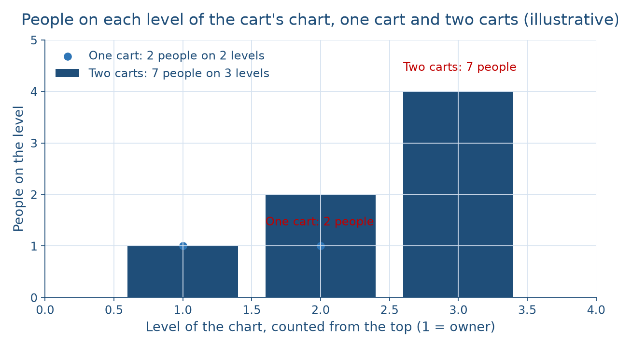
One cart becomes two
CONCEPT 8 OF 9 · PICTURE THE GROWTH
Seven tools, one new chart
Week 08
11
Notes:
Here is the growth question as a picture. Organizational structure is the way a business divides its work into positions and links them through reporting relationships, and an organization chart draws it. The figure counts people on each level, from the owner at the top. At one cart, the dots show 1 person on level 1 and 1 on level 2: the owner and one part-time helper, 2 people on 2 levels. At two carts, the bars show 1 owner, 2 cart leads, and 4 part-time baristas: 1 + 2 + 2 × 2 = 7 people on 3 levels. Each bar is twice the one above it. DO: before revealing the bars, ask the room to predict how many people the two-cart business needs if each lead runs two baristas, then reveal 7.

Slide 12
Span 2, not 7
CONCEPT 8 OF 9 · SPAN OF CONTROL
One cart: 2 people, 2 levels
Owner's span: 1
Two carts: 7 people, 3 levels
Each manager's span: 2
Seven tools, one new chart
Week 08
12
Notes:
Span of control is the number of people who report directly to one manager. At one cart, the owner's span is 1, the helper, with 2 people on 2 levels. At two carts, the owner's span is 2, the two cart leads, and each lead's span is 2, the two baristas, so the span is 2 at each level while the business has 7 people on 3 levels. That is the Week 8 trap: span of control is not the size of the whole company. One owner and two leads, 3 people, manage others, and the 4 baristas manage no one. DO: hand out a blank chart and ask each student to draw the two-cart version and circle the owner's direct reports; the vetted count is 2, not 7 and not 6.

Slide 13
Line does; staff advises
CONCEPT 8 OF 9 · LINE VS. STAFF
Line: does or runs core work
Cart leads, baristas, cooks
Staff: advises and supports
A kitchen's dietitian
Seven tools, one new chart
Week 08
13
Notes:
A line position does an organization's core work, or directly manages it, and carries direct authority over that work. A staff position advises and supports the people in line positions with specialized help, without direct authority over the core work. Every position on the cart's chart is a line position: the owner, the cart leads, and the baristas all make and sell drinks or run the people who do. In an illustrative hospital kitchen, the cooks hold line positions, and a dietitian who advises them holds a staff position. A staff position is not "the staff", meaning every employee. DO: return to the hook answers and sort each first-day helper into line or staff; expect a shift lead to be line and a trainer or adviser to be staff.

Slide 14
Who decides, how tall?
CONCEPT 9 OF 9 · WHERE DECISIONS SIT
Centralize: owner keeps the price
Decentralize: lead sets the schedule
Tall: 3 levels, span 2
Flat: 2 levels, span 6
Seven tools, one new chart
Week 08
14
Notes:
Centralization keeps most important decisions with the top managers; decentralization hands decision-making authority down to people closer to the work. At two carts, the owner might keep the 5-dollar price, because the 12,000-drink break-even rests on it, while a cart lead could set the morning schedule. A tall structure has many levels with narrow spans; a flat structure has few levels with wide spans. The two-cart chart is the taller choice, 3 levels with a span of 2. A flat choice keeps the same 7 people on 2 levels, with the owner over all 7 − 1 = 6 others, a span of 6. Flat still has a manager. DO: vote on tall or flat for the two carts, then ask each side for one cost of its choice.

Slide 15
Audit the chatbot
THIS WEEK'S AUDIT · CHECK THE MACHINE
Paste the two-cart chart into Claude or ChatGPT
Check: 7 people on 3 levels?
Check: owner's span is 2, not 6 or 7?
Seven tools, one new chart
Week 08
15
Notes:
This activity puts a chatbot from the approved list, such as Claude or ChatGPT, to work on this week's new tool. DO: paste this prompt: A coffee cart business has an owner, two cart leads who report to the owner, and four baristas, two reporting to each lead. How many people and levels does its organization chart have, what is the owner's span of control, and is a cart lead a line or a staff position? Compare the reply with the vetted answers: 7 people on 3 levels, a span of control of 2 for the owner, and a line position. Name the likely error first: chatbots sometimes count everyone below the owner and report a span of 6 or 7. The judgment rule for this audit: the tool drafts; you count the direct lines yourself.

Slide 16
One tool per week
One tool or distinction per week
Two carts: 7 people, 3 levels, span 2
Midterm: Weeks 1 to 7
Next: reaching more customers
BEFORE THE MIDTERM
16
Notes:
Pull the half together, one line per week. Revenue is not profit, and a SWOT sorts inside or outside first. The strawberry market matches at 5 dollars and 400 pints. The cart's 30,000 dollars of needs match its sources. The LLC cuts exposure from 30,000 to 20,000 dollars. Legal is the floor. The slowest step sets capacity at 30 drinks an hour. The break-even is 12,000 drinks, with a 150 percent markup and a 60 percent margin. And at two carts the chart holds 7 people on 3 levels with a span of 2. The midterm covers Weeks 1 to 7. Next week, Week 9, takes the growing cart to more customers. DO: return to the list from the title slide and assign one review slide to each tool students named as least sure.

