Slide 1
Reading the cart's year
WEEK 13 · KEEPING SCORE
Week 13 · Accounting and financial statements
1
Notes:
Welcome to Week 13. The orienting question is simple to ask and harder to answer: the coffee cart has finished its first full year, so how did the year actually go? You will meet who reads accounting numbers and the five steps that produce them. Then you will read three financial statements, the balance sheet, the income statement, and the statement of cash flows, check that each balance sheet balances to the dollar, follow the cash, and compute four ratios a lender or an owner would read. Everything here is read at the statement-reader level; you never build a statement from single sales, and nothing is tax or investment advice. For course policy, deadlines, and how your work is graded, the current syllabus is the place to look.

Slide 2
What did the year say?
01
THE QUESTION BEHIND THIS WEEK
2
Notes:
DO: ask the room to open, in their heads, a bank app at the end of a month. Ask two or three students what the balance tells them and what it cannot tell them. Collect answers on the board in two columns, what the balance shows (the money there right now) and what it hides (whether the month went well, where the money went, what is still owed). Then reveal the point: one number cannot carry all three stories, so a business keeps three statements. A snapshot of what it owns and owes, a record of what it earned over the year, and a trace of where its cash went. The coffee cart has finished its first full year and now needs all three views.

Slide 3
Meet the first-year statements
02
OUR DATASET THIS WEEK
3
Notes:
Introduce the dataset by name: the coffee cart's first-year statements, an illustrative dataset constructed for this course and not real data. It carries forward numbers students already know. The start-up list from Week 3 becomes the start-up balance sheet: cash 8,000, inventory 2,000, cart and equipment 20,000 dollars, funded by a 10,000-dollar loan and 20,000 dollars of owner's equity. The year's 15,000 drinks sold at 5 dollars with a 2-dollar variable cost, the Week 7 numbers. The 16,000 dollars of part-time wages is the Week 11 hiring plan, and the 3,000 dollars of promotion is the Week 9 budget. DO: ask the room to predict the year's net income before any arithmetic, and whether the cash rose by the same amount; hold the answers until the profit-versus-cash slide.

Slide 4
Five readers, one set
CONCEPT 1 OF 9 · WHO READS IT
Owners, managers, lenders, investors, tax authorities
Loan officer: will the bike shop repay?
Food bank board: did donations serve the mission?
Reading the cart's year
Week 13
4
Notes:
Accounting is the work of recording, classifying, summarizing, reporting, and analyzing a business's money activity so that owners, managers, lenders, investors, and tax authorities can make decisions with it. Each reader brings a question. An illustrative bank loan officer reads a neighborhood bike shop's numbers and asks whether the loan will be repaid. The board of an illustrative community food bank asks whether a year of donations went to the mission. The coffee cart's owner, who is also its manager, asks what the cart can afford next. Name the trap: accounting is not only for taxes; the tax authority is one reader out of five. DO: read out the three readers and have pairs name each one's user type; vetted answers are lender, the board overseeing a not-for-profit, and owner and manager at once.

Slide 5
Five steps, then decide
CONCEPT 2 OF 9 · THE ACCOUNTING CYCLE
Record, classify, summarize, report, analyze
One latte: a 5-dollar sale recorded
15,000 × 5 = 75,000 dollars of revenue
Reading the cart's year
Week 13
5
Notes:
The accounting cycle is the five steps that turn a business's activity into usable numbers: record each sale and bill, classify them into groups such as drink sales, rent, and wages, summarize each group for the period, report the totals in the financial statements, and analyze the statements to decide. Follow one latte. The card reader records a 5-dollar sale; it is classified as a drink sale; at year-end it is summarized with the rest, 15,000 × 5 = 75,000 dollars; that total is reported as revenue; then the owner analyzes it against the costs. DO: give pairs the five step names on cards and ask them to order them; then ask which step turns numbers into a decision. Vetted answer: analyze, because a report nobody reads changes nothing.

Slide 6
Opening day balances
CONCEPT 3 OF 9 · WORKED EXAMPLE
Assets: 8,000 + 2,000 + 20,000 = 30,000
Claims: loan 10,000 + equity 20,000 = 30,000
assets = liabilities + owners' equity
Reading the cart's year
Week 13
6
Notes:
DO: run the start-up balance sheet live. An asset is something of value a business owns; a liability is a debt it owes to someone outside it; owners' equity is the owners' claim on the assets. The accounting equation says assets = liabilities + owners' equity, because everything a business owns was paid for either by what it owes or by what its owners put in. As of opening day, the cart's assets are cash 8,000 + inventory 2,000 + cart and equipment 20,000 = 30,000 dollars. The claims are the equipment loan 10,000 + owner's equity 20,000 = 30,000 dollars. They match. This is Week 3's start-up list and funding plan, rearranged as a balance sheet. Ask whether the owner holds 20,000 dollars of cash; vetted answer, no, cash is only 8,000, because equity is a claim, not a pile of money.

Slide 7
Sales down to profit
CONCEPT 4 OF 9 · WORKED EXAMPLE
Revenue 75,000 − cost of goods sold 30,000 = 45,000
Operating expenses 35,000; operating income 10,000
Interest 1,000; net income 9,000
Reading the cart's year
Week 13
7
Notes:
DO: build the income statement for the year ended on the cart's first anniversary line by line, asking the room for each subtraction before revealing it. Revenue is 15,000 drinks × 5 dollars = 75,000 dollars. Cost of goods sold, the direct cost of the drinks, is 15,000 × 2 = 30,000 dollars, so gross profit is 75,000 − 30,000 = 45,000 dollars. Operating expenses are permit and insurance 5,000 + commissary-kitchen rent 7,000 + part-time wages 16,000 + promotion 3,000 + depreciation 4,000 = 35,000 dollars, so operating income is 45,000 − 35,000 = 10,000 dollars. Interest expense is 10,000 × 0.10 = 1,000 dollars. Net income is 10,000 − 1,000 = 9,000 dollars. Depreciation spreads the cart's cost over the years it is used and pays out no cash this year.

Slide 8
Snapshot vs. span
CONCEPT 4 OF 9 · READ THE HEADING
Balance sheet: as of one date
A photo of one moment
Income statement: for the year ended
A video of the year
Reading the cart's year
Week 13
8
Notes:
Name the trap: students often think a balance sheet covers a year, because both statements are prepared at year-end. The cure is to read the heading first. On the left, a balance sheet is headed as of one date, a photo of one moment: as of opening day, as of the first anniversary. On the right, an income statement is headed for the year ended a date, a video of the whole year; the statement of cash flows is headed the same way. DO: read out four headings, as of opening day, for the year ended on the first anniversary, as of the first anniversary, and the cash-flow statement for the year ended on the first anniversary, and have the room call snapshot or span for each. Vetted answers: snapshot, span, snapshot, span.

Slide 9
Break-even, then profit
CONCEPT 5 OF 9 · PLAN MEETS YEAR
Fixed costs 35,000 + 1,000 = 36,000
Break-even 36,000 ÷ (5 − 2) = 12,000 drinks
Sold 15,000: 3,000 past break-even
(15,000 − 12,000) × 3 = 9,000
Reading the cart's year
Week 13
9
Notes:
This is Week 7's break-even meeting a real year. On the left, the costs that did not change with the number of drinks are the operating expenses and the interest, 35,000 + 1,000 = 36,000 dollars, and the break-even is 36,000 ÷ (5 − 2) = 12,000 drinks. On the right, the cart sold 15,000 drinks, 3,000 past break-even, each adding its 3-dollar per-unit margin, so (15,000 − 12,000) × 3 = 9,000 dollars, the same net income. The 60 percent margin on price returns as the gross margin. DO: ask whether the gross margin should be 150 percent, the markup on cost; vetted answer, no, markup divides the 3-dollar gap by the 2-dollar cost, while gross margin divides by revenue, so it is 60 percent.

Slide 10
Year-end still balances
CONCEPT 6 OF 9 · WORKED EXAMPLE
Assets: 10,000 + 2,000 + 16,000 = 28,000
Liabilities: payable 4,000 + loan 8,000 = 12,000
Equity: 20,000 + 9,000 − 13,000 = 16,000
12,000 + 16,000 = 28,000
Reading the cart's year
Week 13
10
Notes:
DO: check the year-end balance sheet live, as of the first anniversary. Assets are cash 10,000 + inventory 2,000 + cart and equipment 16,000, which is 20,000 − 4,000 of depreciation, for 28,000 dollars. Accounts payable is money owed to suppliers for goods already received, 4,000 dollars, and the equipment loan is 10,000 − 2,000 repaid = 8,000 dollars, so liabilities are 12,000 dollars. Owner withdrawals are money the owner takes out for personal use. Owner's equity is 20,000 + 9,000 of net income − 13,000 of withdrawals = 16,000 dollars. The check: 12,000 + 16,000 = 28,000. Name two traps: withdrawals are not an expense, they reduce equity; and a balance sheet that does not balance is never close enough.

Slide 11
Where the cash went
CONCEPT 7 OF 9 · WORKED EXAMPLE
Operating: 9,000 + 4,000 + 4,000 = 17,000
Investing: 0
Financing: (2,000) + (13,000) = (15,000)
Net change: 17,000 − 15,000 = 2,000
Reading the cart's year
Week 13
11
Notes:
DO: walk the statement of cash flows for the year ended on the first anniversary, one section at a time. Operating activities, the cash from running the cart: net income 9,000, plus 4,000 of depreciation, which used no cash, plus 4,000 more owed to suppliers, gives 17,000 dollars. Investing activities, cash for long-lived assets such as equipment, are 0 because the cart bought none. Financing activities, cash to and from lenders and owners: loan principal repaid (2,000) plus owner withdrawals (13,000) = (15,000) dollars. Accountants show a negative amount in parentheses. The net change in cash is 17,000 − 15,000 = 2,000 dollars, so cash moved from 8,000 to 10,000, the same 10,000 on the year-end balance sheet. Ask which section carries the withdrawals; vetted answer, financing.

Slide 12
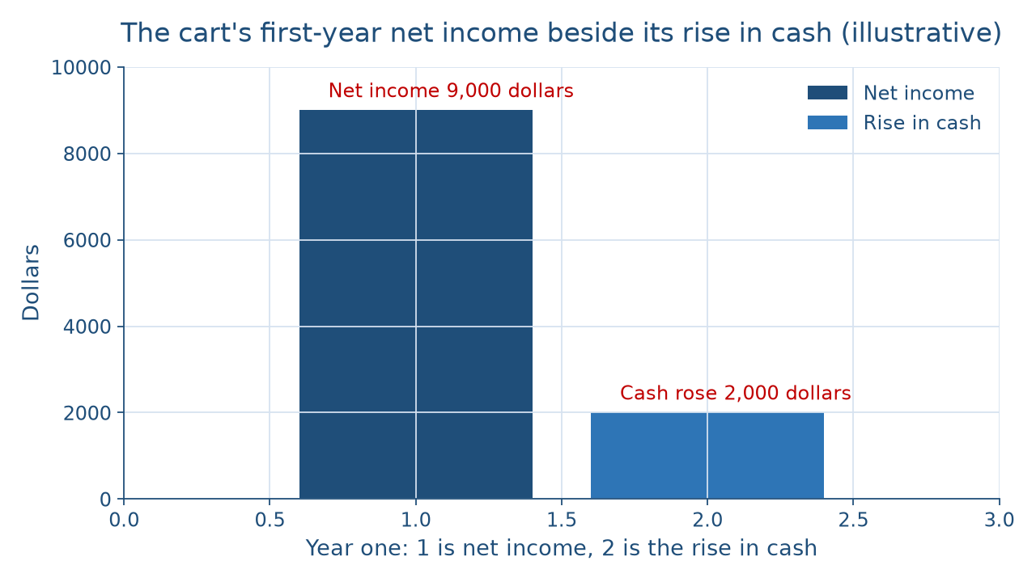
Profit is not cash
CONCEPT 8 OF 9 · PROFIT VS. CASH
Reading the cart's year
Week 13
12
Notes:
Describe the picture in words for everyone. Two bars stand side by side. On the left, the net income bar reaches 9,000 dollars. On the right, the rise-in-cash bar reaches only 2,000 dollars. The gap is 9,000 − 2,000 = 7,000 dollars. Profit counts revenue and expenses when they are earned and used; cash counts money when it moves. The owner's 13,000 dollars of withdrawals and the 2,000 dollars of loan repayment took cash without touching net income, while the 4,000 of depreciation and the 4,000 owed to suppliers cut net income or added costs without taking cash. An illustrative family farm shows the same thing: profitable over the year, short of cash in spring. DO: return to the predictions from the dataset slide and ask who expected cash to rise by 9,000; then name the cure.

Slide 13
Four ratios, two lines
CONCEPT 9 OF 9 · WORKED EXAMPLE
Current ratio: 12,000 ÷ 6,000 = 2.0
Debt-to-equity: 12,000 ÷ 16,000 = 0.75
Gross margin 60 percent; net profit margin 12 percent
Reading the cart's year
Week 13
13
Notes:
DO: compute the ratio set live, naming the two lines before each division. Current assets, cash and other assets expected to be used or turned into cash within a year, are 10,000 + 2,000 = 12,000 dollars. Current liabilities, debts due within a year, are 4,000 + 2,000 = 6,000 dollars. Current ratio = current assets ÷ current liabilities = 12,000 ÷ 6,000 = 2.0. Debt-to-equity = total liabilities ÷ owners' equity = 12,000 ÷ 16,000 = 0.75. Gross margin = gross profit ÷ revenue × 100 = 45,000 ÷ 75,000 × 100 = 60 percent. Net profit margin = net income ÷ revenue × 100 = 9,000 ÷ 75,000 × 100 = 12 percent. Name the trap: 6,000 ÷ 12,000 = 0.5 flips the lines and is not the current ratio. A ratio is a fact; whether it is strong enough is a judgment.

Slide 14
Audit the chatbot
THIS WEEK'S AUDIT · CHECK THE MACHINE
Paste the cart's year into Claude or ChatGPT
Check: net income 9,000, not a loss?
Check: does 12,000 + 16,000 equal 28,000?
Reading the cart's year
Week 13
14
Notes:
This activity puts a chatbot from the approved list, such as Claude or ChatGPT, to work on this week's material. DO: paste this prompt: A coffee cart had revenue of 75,000 dollars, cost of goods sold of 30,000, operating expenses of 35,000, interest of 1,000, and owner withdrawals of 13,000. Find net income and the owner's year-end equity if it started at 20,000. Compare the reply with the outline. A likely error is subtracting the 13,000 dollars of withdrawals as an expense and reporting a loss of 4,000 dollars; the vetted answer is net income of 9,000 dollars and equity of 20,000 + 9,000 − 13,000 = 16,000 dollars. Then check that liabilities of 12,000 plus that equity equal 28,000. In this audit, the tool drafts; you check every number.

Slide 15
The year, read three ways
30,000 at opening; 28,000 at year-end
Net income 9,000; cash up 2,000
Ratios 2.0, 0.75, 60 and 12 percent
Next: paying for the second cart
BEFORE NEXT CLASS
15
Notes:
Recap in the order taught. Accounting serves five readers through five steps, record, classify, summarize, report, analyze. Every balance sheet obeys assets = liabilities + owners' equity: 30,000 = 30,000 as of opening day and 12,000 + 16,000 = 28,000 as of the first anniversary. The income statement turned 75,000 dollars of revenue into 9,000 dollars of net income, exactly the 3,000 drinks past break-even. Withdrawals reduced equity, never net income. The cash-flow statement showed cash up only 2,000 dollars, because profit is not cash. The ratios: current ratio 2.0, debt-to-equity 0.75, gross margin 60 percent, net profit margin 12 percent. DO: have each student write the one statement they would hand a lender and why. Next week, Paying for Growth reads these statements to weigh how a second cart could be paid for.

