Slide 1
Why trade, and how far?
WEEK 15 · BEYOND BORDERS
Week 15 · Global business and the course synthesis
1
Notes:
Welcome to Week 15, the last instructional week of the course. The orienting question has two halves: why would two places trade when one of them is better at making everything, and how far abroad should a small business go? You will build comparative advantage one ratio at a time on an illustrative two-island table, meet the barriers to trade and the documented answer to who owes a tariff at the border, and climb the entry ladder with the coffee cart's bottled cold brew. Then you will retell the cart's whole life and name the skills you carry out of the course. For course policies, the current syllabus is the place to look. Let's start with something already in your pocket.

Slide 2
Better at everything, still trading?
01
THE QUESTION BEHIND THIS WEEK
2
Notes:
DO: ask everyone to check the label on their phone, shoes, or water bottle and call out where it was made. Write the places on the board in two columns, made here and made elsewhere. Expect most of the room to land in the made-elsewhere column. Then pose the puzzle: if one country could make every one of those things itself, why would it buy any of them? Collect two or three guesses. Common ones are cheaper labor or resources the country lacks. Keep the guesses on the board; by the end of the comparative advantage slides you will return to them and show a reason none of the guesses named, that trade follows the lower opportunity cost even when one side is better at everything.

Slide 3
Meet the two islands
02
OUR DATASET THIS WEEK
3
Notes:
Introduce the dataset by name: the two-island trade table, an illustrative dataset constructed for this course and not real data. In one worker-day, East Island makes 6 baskets of fruit or 3 nets of fish, and West Island makes 4 baskets of fruit or 1 net of fish. Each island has 10 worker-days. The settled results you will reach are these: a fish costs East 2 fruit and West 4 fruit, a fruit costs East 0.5 fish and West 0.25 fish, the pinned terms of trade are 3 fruit per fish, and the world moves from 50 fruit and 20 fish to 52 fruit and 24 fish. Beside the islands, the coffee cart's bottled cold brew is the first rung of the entry ladder, and an illustrative bike shop carries the tariff case.

Slide 4
The beans crossed a border
CONCEPT 1 OF 12 · TRADE STARTS AT HOME
Import: beans bought from another country
Export: cold brew sold across the border
Trade rules and foreign buyers sit outside
Why trade, and how far?
Week 15
4
Notes:
The cart's beans grew in another country, so the cart already depends on international trade, the buying and selling of goods and services across national borders. An import is a good or service a country's buyers purchase from sellers in another country, such as those beans. An export is a good or service a country's sellers sell to buyers in another country, such as bottled cold brew sent to a distributor across the border. This is Week 1's SWOT rule in a new setting: strengths and weaknesses sit inside the business, opportunities and threats sit outside it. A new tax on imported beans is a threat, beside the first SWOT's rising bean prices. A cross-border distributor is an opportunity, never a strength, because the cart does not control it. Ask inside or outside before good or bad.

Slide 5
Who makes more?
CONCEPT 2 OF 12 · WORKED EXAMPLE
East: 6 fruit or 3 fish a worker-day
West: 4 fruit or 1 fish a worker-day
East has the absolute advantage in both
Why trade, and how far?
Week 15
5
Notes:
DO: show the table and ask the room which island makes more fruit and which makes more fish. Collect a show of hands for each good, then reveal. Absolute advantage is the ability to make more of a good than another producer can from the same resources. In one worker-day East makes 6 fruit or 3 fish, and West makes 4 fruit or 1 fish. Fruit: 6 is more than 4. Fish: 3 is more than 1. So East has the absolute advantage in both goods. Pause on the puzzle this creates: if East is better at everything, it seems East should make everything for itself. Tell the room that the next slide breaks that guess, because output is not the cost that decides who should make what.

Slide 6
Price a fish, a fruit
CONCEPT 3 OF 12 · WORKED EXAMPLE
Fish: East 6 ÷ 3 = 2 fruit
Fish: West 4 ÷ 1 = 4 fruit
Fruit: East 3 ÷ 6 = 0.5 fish
Fruit: West 1 ÷ 4 = 0.25 fish
Why trade, and how far?
Week 15
6
Notes:
DO: compute the four ratios live, one at a time, asking the room to say each cost in words before dividing. Opportunity cost is what you give up to get something; opportunity cost of A = units of B given up ÷ units of A gained. On the left, a fish costs East 6 ÷ 3 = 2 fruit and costs West 4 ÷ 1 = 4 fruit, so East has the comparative advantage in fish. On the right, a fruit costs East 3 ÷ 6 = 0.5 fish and costs West 1 ÷ 4 = 0.25 fish, so West has the comparative advantage in fruit. Comparative advantage is the ability to make a good at a lower opportunity cost. Name the two traps: giving both goods to East, and flipping a ratio so a fish seems to cost East 0.5. The principle is credited to Ricardo (1817), named and never keyed.

Slide 7
Specialize, then swap
CONCEPT 4 OF 12 · WORKED EXAMPLE
Before: East 30 fruit, 15 fish; West 20, 5
After: East 24 fish, 12 fruit; West 40 fruit
Trade 6 fish for 18 fruit at 3 per fish
Why trade, and how far?
Week 15
7
Notes:
DO: run the before-and-after table live, revealing one line at a time after a prediction. Specialization is putting more time and resources into the good made at the lower opportunity cost. With 10 worker-days each, split evenly, East makes 5 × 6 = 30 fruit and 5 × 3 = 15 fish, West makes 5 × 4 = 20 fruit and 5 × 1 = 5 fish, and the world has 50 fruit and 20 fish. Then East puts 8 days on fish and 2 on fruit, 8 × 3 = 24 fish and 2 × 6 = 12 fruit, and West puts all 10 days on fruit, 10 × 4 = 40 fruit. The terms of trade, the swap rate, must sit between 2 and 4 fruit per fish; the pinned rate is 3. East sends 6 fish for 6 × 3 = 18 fruit and ends with 12 + 18 = 30 fruit and 24 − 6 = 18 fish. West ends with 40 − 18 = 22 fruit and 0 + 6 = 6 fish.

Slide 8
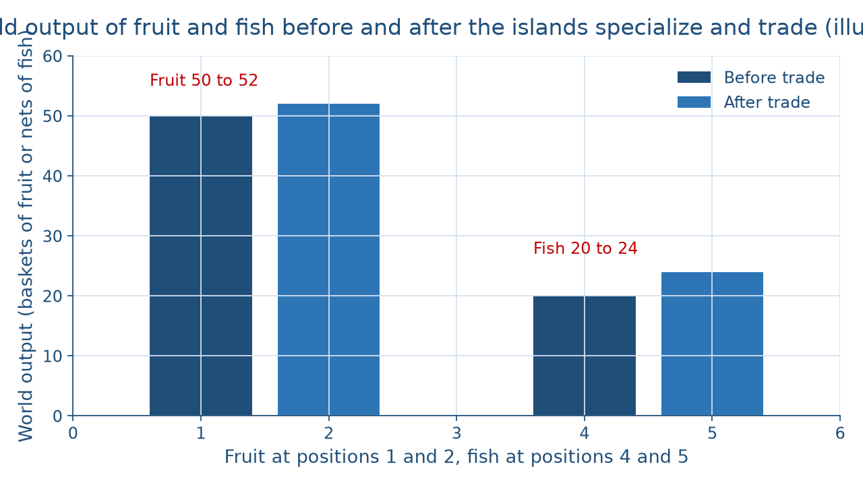
Same work, more of both
CONCEPT 4 OF 12 · THE PICTURE
Why trade, and how far?
Week 15
8
Notes:
DO: before revealing the bars, ask the room to predict whether the world will have more fruit, more fish, or both after trade. Then describe the picture in words for everyone. Four bars stand in two pairs. On the left, fruit: the before-trade bar reaches 50 baskets and the after-trade bar reaches 52. On the right, fish: the before-trade bar reaches 20 nets and the after-trade bar reaches 24. From the same 10 + 10 = 20 worker-days, the world gained 2 fruit and 4 fish. East kept its 30 fruit and gained 3 fish; West gained 2 fruit and 1 fish. Neither island is worse off. Land the punchline: a country can be better at making everything and still gain by specializing where its opportunity cost is lowest.

Slide 9
Tax, cap, ban, currency, rule
CONCEPT 5 OF 12 · BARRIERS
Tariff, quota, embargo
Exchange controls, non-tariff barriers
The jam farm meets a cap and a label rule
Why trade, and how far?
Week 15
9
Notes:
A barrier to trade is a rule or cost a government puts in the way of goods crossing its border. A tariff is a tax a government charges on an imported good when it crosses the border. A quota is a limit on how much of a good may be imported in a period. An embargo is a ban on trade with a country or in a good. Exchange controls are limits on buying or selling foreign currency. A non-tariff barrier is any other rule that makes importing harder, such as a licensing requirement or a product standard imported goods struggle to meet. DO: read three cases from an illustrative family farm selling jam abroad, a cap on jars, a label rule, and a tax on each jar, and have the room name each barrier: quota, non-tariff barrier, tariff.

Slide 10
The importer owes it
CONCEPT 6 OF 12 · WORKED EXAMPLE
Importer of record owes the duty at the border
Bike shop: 4,000 × 0.10 = 400 dollars
Who bears it afterward: an open question
Why trade, and how far?
Week 15
10
Notes:
DO: ask who pays when a bike shop's imported parts reach a U.S. port, collect answers, then reveal the documented fact. The importer of record is the business or person responsible for bringing goods into the United States, who owes the customs duty to the federal government at the border; the rule is 19 CFR 141.1(b). An illustrative bike shop imports 4,000 dollars of parts at a 10 percent tariff and owes 4,000 × 0.10 = 400 dollars at the border. How that cost is shared afterward among importers, their buyers, and foreign sellers is an empirical question, with one reading that importers pass much of it to buyers and another that foreign sellers cut prices. The cart's imported beans carry the same question in words. Cure the trap that the foreign country pays.

Slide 11
Freer trade vs. protection
CONCEPT 7 OF 12 · POSITIONS, NO VERDICT
Freer trade: lower prices, wider choice
Bigger markets for exporters
Protection: jobs and industries at home
National security, unfair practices
Why trade, and how far?
Week 15
11
Notes:
This is contested terrain, so it gets the same treatment Week 11 gave unions and the minimum wage: each position at full strength and no verdict. On the left, supporters of freer trade cite comparative advantage, the gain the islands showed, plus lower prices and wider choice for buyers and bigger markets for exporters. On the right, supporters of more protection cite jobs and industries at home, national security, and answering trade practices they judge unfair. Every figure either side brings needs a source and a year. DO: ask pairs to write the strongest one-sentence case for the side they find weaker, then label one fact and one judgment in it. Keep the fact apart from the judgment: the importer owing the duty is a fact; whether a tariff is wise is a judgment.

Slide 12
Rules, stability, projects, blocs
CONCEPT 8 OF 12 · WHO SETS THE RULES
WTO: trade rules; IMF: money and payments
World Bank: development projects
Blocs: the EU and the USMCA (2020)
Why trade, and how far?
Week 15
12
Notes:
The World Trade Organization is an international organization in which member countries negotiate and agree on the rules for trade between nations. The International Monetary Fund is an international organization of member countries that works on the stability of the world's money and payments system. The World Bank is an international institution that lends money to, and funds development projects in, lower-income countries. A trading bloc is a group of countries that agree to cut trade barriers among themselves. The European Union is one. The United States-Mexico-Canada Agreement is another; it entered into force in 2020 and took the place of NAFTA. DO: read four situations, a rules dispute, a payments crisis, a port project, and cold brew crossing into Canada, and have the room match each to its body.

Slide 13
A deficit is a flow
CONCEPT 9 OF 12 · NOT A DEBT
Trade balance: exports minus imports
2025 deficit: about 900 billion dollars, revised
A flow of purchases, not a loan
Why trade, and how far?
Week 15
13
Notes:
The trade balance is the value of a country's exports minus the value of its imports over a period. A trade deficit means imports were larger than exports; a trade surplus means exports were larger. The BEA and the Census Bureau first reported a 2025 U.S. goods and services deficit of 4,333.8 − 3,432.3 = 901.5 billion dollars, about 900 billion dollars, and revised it up 2.2 percent in an annual revision. Teach it in words, as about 900 billion dollars and revised; the course never keys it. Cure the trap that a deficit is a debt the country owes: it measures a year's flow of purchases and sales, not a loan. DO: ask the room whether spending more than you earn in a month means you borrowed, then connect the reply to the trade balance.

Slide 14
Risk and control climb together
CONCEPT 10 OF 12 · GOING ABROAD
Exporting, licensing, franchising
Contract manufacturing, joint venture
Direct foreign investment: most risk, most control
Why trade, and how far?
Week 15
14
Notes:
The entry ladder is the ordered ways a firm can enter a foreign market, with the money at risk and the firm's control rising together. Exporting sells goods made at home to buyers abroad. Licensing lets a foreign firm use your brand, recipe, or process for a fee. Franchising, from Week 4, sells the right to run outlets under your brand and system. Contract manufacturing pays a foreign producer to make your product to your specification. A joint venture is a new business owned with a foreign partner. Direct foreign investment means owning facilities abroad outright. DO: hand out the six rungs on cards and have small groups order them for the cart's cold brew. The distributor across the border is the first rung, exporting; owning a bottling plant abroad is the top rung.

Slide 15
One cart, one story
CONCEPT 11 OF 12 · THE SYNTHESIS
Start-up 30,000; break-even 12,000 drinks
Net income 9,000; ratios 2.0 and 0.75
1,600 interest or keep 75 percent; cold brew abroad
Why trade, and how far?
Week 15
15
Notes:
DO: retell the cart's life as a chain, asking a different student to supply each week's number. Every value is illustrative. A SWOT; a 30,000-dollar start-up funded by 20,000 dollars of the owner's money and a 10,000-dollar loan, from Week 3; an LLC for its liability shield; 30 drinks an hour at the bottleneck; a break-even of 12,000 drinks a year; a 3,000-dollar promotion budget; 7 people on 3 levels at two carts; a 16,000-dollar helper; 9,000 dollars of net income in year one; a current ratio of 2.0 and a debt-to-equity of 0.75 from Week 13; a financing choice between 1,600 dollars of yearly interest and keeping 75 percent; and now cold brew sold across a border. Ask which earlier number each later one used.

Slide 16
Skills that travel
CONCEPT 12 OF 12 · YOUR NEXT STEP
Analyze a case; run the numbers
Weigh a recommendation; check AI output
Research careers in the Occupational Outlook Handbook
Why trade, and how far?
Week 15
16
Notes:
Transferable skills are abilities that carry from one job or field to another. This course practised four of them week after week: analyzing a case with the right tool, running the numbers and saying them in words, making a weighed recommendation that names who gains and who gives something up, and checking AI output by recomputing every number. The Occupational Outlook Handbook is the Bureau of Labor Statistics' career-guidance source, which describes hundreds of occupations, what the work involves, and their employment projections. DO: ask each student to name two occupations, look one up in the handbook after class, and write one sentence on which course skill it leans on most. Remind the room that hospitals, transit agencies, and farms all hire people with these skills.

Slide 17
Audit the chatbot
THIS WEEK'S AUDIT · CHECK THE MACHINE
Paste the island table into Claude or ChatGPT
Check: does East get fish only?
Check: is a fish 2 fruit for East?
Why trade, and how far?
Week 15
17
Notes:
This activity puts a chatbot from the approved list, such as Claude or ChatGPT, to work on this week's islands. DO: paste this prompt: East Island makes 6 baskets of fruit or 3 nets of fish per worker-day, and West Island makes 4 fruit or 1 fish. Which island has the comparative advantage in fish, and which in fruit? Show each opportunity cost. Compare the reply with the outline. A likely error is giving East the comparative advantage in both goods because it makes more of both, or flipping a ratio and saying a fish costs East 0.5. The correct reading: a fish costs East 2 fruit and West 4, so East has fish; a fruit costs East 0.5 fish and West 0.25, so West has fruit. The judgment rule for this activity: the tool drafts; you check every ratio.

Slide 18
Two islands, one cart
A fish: East 2 fruit, West 4 fruit
World: 50 and 20 become 52 and 24
Importer of record owes the tariff
Next: the cumulative final
BEFORE THE FINAL
18
Notes:
DO: ask each student to write the week's one sentence on a card, trade follows the lower opportunity cost, not the bigger output, and collect the cards. Recap in the order taught. Trade news lands outside the cart. East has the absolute advantage in both goods, yet a fish costs East 2 fruit and West 4, so East specializes in fish and West in fruit. At 3 fruit per fish, the world goes from 50 fruit and 20 fish to 52 and 24. The importer of record owes a tariff at the border; who bears it afterward is open. Trade policy gets two positions and no verdict. A deficit is a flow, not a debt. The entry ladder trades risk for control. Next comes the cumulative final, which samples every week from the SWOT to comparative advantage.

