Slide 1
Different, not finished
WEEK 7 · HOW PEOPLE WON CHANGE
Week 7 · African American Experiences II: Civil Rights and Black Freedom Movements
1
Notes:
Welcome to Week 7, the second of two weeks on African American experiences. Before anything else, point students to the current syllabus as the authoritative source for how the course runs, then keep this opening on the ideas. The week's orienting question: how did people win change in the law, and what did the new laws change and leave in place? Preview the path. We read Brown v. Board of Education, then the Montgomery bus boycott, then the Civil Rights Act of 1964 and the Voting Rights Act of 1965, then redlining through the illustrative lending table, then de jure and de facto segregation, and finally Black Power and the founding of Black studies. Say the term rule once: Black and African American are both in common use, and Black is the broader term. Then move to the hook.

Slide 2
A bus route that skips
01
THE HOOK · A ROUTE THAT SKIPS
2
Notes:
Open with a scene students can picture: a city bus route, an illustrative one, that runs through downtown and the shopping streets and then turns and skips one neighborhood entirely. Nobody on the bus is rude. Nobody posts a sign. The route map does the work, and the people who live in the skipped neighborhood spend longer on every trip to a job or a clinic. Name the week's big contrast: some rules sort people loudly, with a sign, and others sort people quietly, with a map. DO: give the room one minute to list two rules in their own lives that are quiet maps rather than posted signs, such as a delivery zone or a school boundary. Collect three aloud and keep them on the board; the lending table later this hour is the same kind of quiet map.

Slide 3
The lending table and timeline
02
SHARED DATA · DATASET D AND DATASET B
3
Notes:
Introduce this week's shared data by name. Dataset D is the illustrative lending table: a model in the style of the 1930s lending maps, not a reconstruction of any real city or lender. A city's 50 neighborhoods are rated A to D, and lenders approve loans by the rating; there are 1,000 applications and 590 approvals in all. Dataset B is the law-and-case timeline, every year pinned from the issuing body's own page, and this week's years are 1954, 1964, 1965, and 1968. We also call back two scenarios from Week 2's concept-sorting set, N1 and S1, and E2's line from the course archive. DO: write the four years in a row across the board now, and write the four letters A, B, C, D in a column beside them, so each later slide can hang its result on the right spot.

Slide 4
Separate is inherently unequal
CONCEPT 1 OF 6 · THE RULING
Brown v. Board of Education (1954): unanimous
"Separate educational facilities are inherently unequal"
Overruled Plessy (1896) for public schools
1954 − 1896 = 58 years
Different, not finished
Week 07
4
Notes:
In Brown v. Board of Education (1954), the Supreme Court held unanimously that "Separate educational facilities are inherently unequal." That holding overruled the separate but equal doctrine of Plessy v. Ferguson (1896) for public schools. Week 6's Plessy reading still governs the setup here: the Court had upheld state-required separation as law, so only the Court or the Constitution could undo it. Count how long the doctrine stood in public schools: 1954 − 1896 = 58 years. DO: before revealing the subtraction, ask the room to estimate how many years separate but equal stood for schools; take three guesses, then reveal 1954 − 1896 = 58 years and point to both years on the board's timeline. Then ask one student to read the Court's sentence aloud, word for word.

Slide 5
A ruling, no deadline
CONCEPT 1 OF 6 · THE TRAP
Brown II (1955): "with all deliberate speed"
No deadline; considerable resistance
Separate-schools thread: boarding schools to Brown
Different, not finished
Week 07
5
Notes:
Name the wrong turn: Brown read as ending segregation at once. It is tempting, because the decision is famous and its words are strong. But in Brown II (1955), the Court told the states to desegregate "with all deliberate speed", which set no deadline, and the order met considerable resistance. The honest reading is that Brown changed the law, but it did not change every school at once. Then place Brown on the course's separate-schools thread, Dataset F, which runs from the federal Indian boarding schools of Week 4 to Brown in 1954; Week 9 adds another case to it. DO: ask pairs to rewrite the sentence "Brown ended school segregation in 1954" so it is accurate. Take two rewrites and keep the one that names both the holding and the slow change after it.

Slide 6
381 days of walking
CONCEPT 2 OF 6 · A MOVEMENT
Rosa Parks arrested, December 1955
Black residents refused the buses
Ended December 1956 after a court ruling
Many people, over time
Different, not finished
Week 07
6
Notes:
The civil rights movement is the organized, mass effort of the 1950s and 1960s to end segregation and win equal rights under law for Black Americans. In December 1955, Rosa Parks was arrested in Montgomery, Alabama, and Black residents of Montgomery then refused to ride the city's segregated buses. The Montgomery bus boycott lasted 381 days and ended in December 1956, after the Supreme Court upheld a ruling that bus segregation violated the 14th Amendment, the equal protection promise students read in Week 6. Say the length in words; the quiz never asks for it. Name the trap: the boycott read as one woman's single act. DO: ask the room what a family would have had to give up to keep refusing the bus for more than a year, collect four answers, and use them to show that a movement is many people acting over time.

Slide 7
The 1964 law versus 1965
CONCEPT 3 OF 6 · TWO FEDERAL LAWS
Civil Rights Act of 1964
Jobs and public accommodations
Voting Rights Act of 1965
Enforced the 15th; banned literacy tests
Different, not finished
Week 07
7
Notes:
Set the two laws side by side. On the left, the Civil Rights Act of 1964 outlawed discrimination based on race, color, religion, sex, or national origin in employment and in places of public accommodation, which are businesses that serve the public, such as restaurants, hotels, and theaters. On the right, the Voting Rights Act of 1965 enforced the 15th Amendment and banned literacy tests as a condition of voting. This is Week 6's literacy test in a new setting: the device former Confederate states wrote into law is the device the 1965 law banned. DO: read three short cases aloud and have the room hold up one finger for the 1964 law or two for the 1965 law: a lunch counter that refuses service by race (one), a voting office's reading test (two), and a hiring rule that excludes a religion (one).

Slide 8
95 years to enforce
CONCEPT 3 OF 6 · HOW LONG IT WAITED
15th Amendment ratified: 1870
Voting Rights Act: 1965
1965 − 1870 = 95 years
1964 − 1954 = 10 years
Different, not finished
Week 07
8
Notes:
Measure how long the 15th Amendment's promise waited. It was ratified in 1870 and barred denying the vote on account of race, color, or previous condition of servitude. The Voting Rights Act came in 1965, so 1965 − 1870 = 95 years passed before the law that enforced it. One more gap: Brown came in 1954 and the Civil Rights Act in 1964, so 1964 − 1954 = 10 years separate a ruling about schools from a law about jobs and public places. Recall Week 6's comparison, where the 15th Amendment and the Indian Citizenship Act of 1924 both showed a right on paper narrowed by state law in practice. DO: run both subtractions live, pausing before each result for predictions, then reveal 95 years and 10 years and mark both spans on the board's timeline.

Slide 9
A map that sorts families
CONCEPT 4 OF 6 · REDLINING DEFINED
Redlining: loans refused by neighborhood
Whatever the applicant's own creditworthiness
1930s federal maps rated neighborhoods A to D
Lowest letter outlined in red
Different, not finished
Week 07
9
Notes:
Redlining is refusing loans or other credit to people because of the neighborhood they live in, whatever their own creditworthiness. In the 1930s the Home Owners' Loan Corporation, a federal agency created after the Great Depression's mortgage crisis, drew maps that rated city neighborhoods A through D by the racial, ethnic, and economic characteristics of residents, with the lowest letter outlined in red. We describe the real maps in words, with no real figure; to see how such a rule works, the course uses its illustrative lending table. Name the trap now, before the numbers: redlining read as only private prejudice. The maps came from a federal agency. DO: ask the room who drew the maps, a few prejudiced bankers or a federal agency, take a show of hands, and then reveal the agency's name.

Slide 10
Four ratings, four rates
CONCEPT 4 OF 6 · WORKED EXAMPLE
A: 180 ÷ 200 × 100 = 90 percent
B: 240 ÷ 300 × 100 = 80 percent
C: 150 ÷ 300 × 100 = 50 percent
D: 20 ÷ 200 × 100 = 10 percent
Different, not finished
Week 07
10
Notes:
Work the table's approval rates. An approval rate is approved loans ÷ applications × 100, a percent. For the A-rated neighborhoods, 180 ÷ 200 × 100 = 90 percent. For B, 240 ÷ 300 × 100 = 80 percent. For C, 150 ÷ 300 × 100 = 50 percent. For D, 20 ÷ 200 × 100 = 10 percent. Check the totals first, the way a careful reader always does: 10 + 15 + 15 + 10 = 50 neighborhoods, 200 + 300 + 300 + 200 = 1,000 applications, and 180 + 240 + 150 + 20 = 590 approved, so the overall rate is 590 ÷ 1,000 × 100 = 59 percent. DO: split the room into four groups, give each group one rating's counts, and have each group compute its rate; collect the four rates on the board in order and then add the overall 59 percent beneath them.

Slide 11
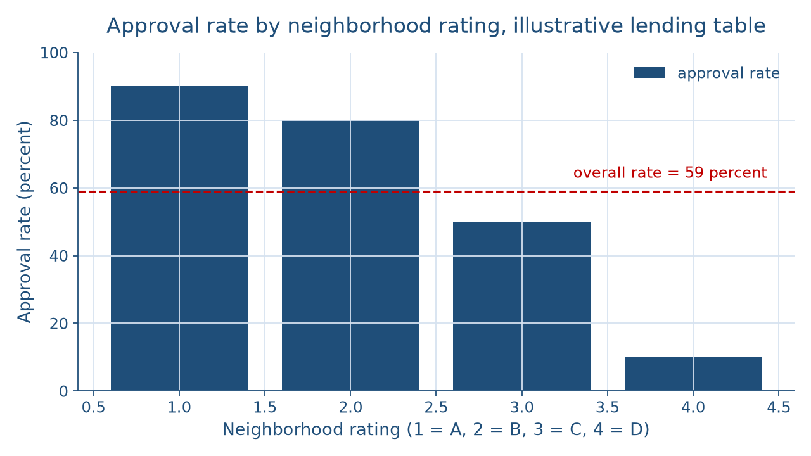
Watch the bars fall
CONCEPT 4 OF 6 · SEE THE PATTERN
Different, not finished
Week 07
11
Notes:
Show the picture before naming the pattern. The bar chart has one bar per neighborhood rating, A to D from left to right, and the bars fall: 90 percent for A, 80 percent for B, 50 percent for C, and 10 percent for D. A dashed line marks the overall rate of 59 percent, sitting between the B and C bars, so the overall number hides how far apart the ends are. Describe it aloud for anyone who cannot see the screen: four bars, tallest on the left, shortest on the right, and the tallest is 9 times the height of the shortest. DO: before saying anything about fairness, ask the room to describe the shape in one sentence without using the word unfair; take two descriptions, then ask which single rule could produce this shape with no one intending it.

Slide 12
Percent versus percentage points
CONCEPT 4 OF 6 · THE GAP
90 − 10 = 80 percentage points
90 ÷ 10 = 9 times as often
Per neighborhood: 18 versus 2
18 ÷ 2 = 9, a ratio of 9 to 1
Different, not finished
Week 07
12
Notes:
Name the unit carefully. A share of a total is a percent; a difference between two percentages is in percentage points. So 90 − 10 = 80 percentage points between the A and D ratings, not 80 percent. Another way to see it: 90 ÷ 10 = 9, so an applicant in an A-rated neighborhood is approved 9 times as often as one in a D-rated neighborhood. Then count per neighborhood. The A-rated neighborhoods get 180 ÷ 10 = 18 approved loans each, the B-rated 240 ÷ 15 = 16, the C-rated 150 ÷ 15 = 10, and the D-rated 20 ÷ 10 = 2, so 18 ÷ 2 = 9, a ratio of 9 to 1. DO: write "80 percent" on the board, ask the room what is wrong with it, and have one student correct it to 80 percentage points and explain why.

Slide 13
N1 versus S1
CONCEPT 4 OF 6 · NAME THE CONCEPT
N1: one rule, every lender
Institutional discrimination
S1: decades of lower values
Structural inequality
Different, not finished
Week 07
13
Notes:
This is Week 2's concept-sorting set in a new setting. On the left, N1: a lender follows a written rule that rates every loan in a D-rated neighborhood as too risky, no matter who applies. Every lender follows the same rating, and no single lender needs to intend the result for it to be unequal, so the rule is institutional discrimination. On the right, S1: decades after lending maps rated neighborhoods, homes in once-redlined areas are worth less, families there have less wealth to pass on, and schools funded by local property taxes have less money; that is structural inequality. Then hear E2: there "were neighborhoods where the bank would not lend to us." The table shows the rule from outside; her words show it from inside. DO: have pairs sort the table's rule and its decades-later result into N1 or S1, and debrief any pair that split.

Slide 14
Fair housing, four years on
CONCEPT 4 OF 6 · THE LAW ANSWERS
Fair Housing Act of 1968
Sale, rental, or financing of housing
1968 − 1964 = 4 years
Stops a practice; does not undo it
Different, not finished
Week 07
14
Notes:
The Fair Housing Act of 1968, Title VIII of the Civil Rights Act of 1968, made discrimination in the sale, rental, or financing of housing unlawful. It came 1968 − 1964 = 4 years after the Civil Rights Act of 1964. Now state the reading in one plain sentence: the lending rule is institutional discrimination, because every lender applies the same rating and D-rated applicants are approved 10 percent of the time against 90 percent in A-rated neighborhoods, a gap of 80 percentage points, and the Fair Housing Act of 1968 made that kind of lending discrimination unlawful without undoing the inequality it had already built. DO: have pairs write that plain sentence in their own words, read two aloud, and check each one names the rule, the rates, and what the law could not undo.

Slide 15
De jure versus de facto
CONCEPT 5 OF 6 · TWO KINDS
De jure: required by law
The school laws Brown struck down
De facto: in practice, no law
Built by housing and lending
Different, not finished
Week 07
15
Notes:
On the left, de jure segregation is separation required by law, like the school laws Brown v. Board of Education (1954) struck down. On the right, de facto segregation is separation that exists in practice without a law requiring it, often built by housing patterns and lending. Use the fresh scenario of a school boundary drawn along a highway: no law names any group, but the boundary and the housing on each side do the sorting. Name the trap: de facto segregation read as accidental. If those neighborhoods were shaped by lending ratings, a rule built the line. Then cure a second trap, the movement read as only Southern: E2's northern city had no posted seating rules and still had the bank's map. DO: read two cases, a state school law and the highway boundary, and have the room call de jure or de facto for each.

Slide 16
Community control, new field
CONCEPT 6 OF 6 · A NEW FIELD
Black Power, popularized 1966
Self-determination, community control, cultural pride
1968–1969 strikers demanded Black Studies
Different, not finished
Week 07
16
Notes:
Black Power, a phrase popularized in 1966, named a strand of the Black freedom movement that stressed self-determination, community control, and cultural pride. Black studies is the academic field that studies the history, cultures, and experiences of people of African descent. At San Francisco State, the strikers of 1968 and 1969 demanded a Black Studies department, one of the four departments in the College of Ethnic Studies that Week 1 used to explain where this field came from. Add the limitation: Black Power was one strand of the movement, not the whole of it, and people within it disagreed about methods and goals. DO: ask the room to name the four departments from Week 1, write them on the board, and circle Black Studies as the link between this week and the field's origins.

Slide 17
Audit the chatbot
THIS WEEK'S AUDIT · CHECK THE CHATBOT
Paste the lending-table prompt
Check: percent or percentage points?
Check: rule, or only prejudice?
The tool drafts; you check
Different, not finished
Week 07
17
Notes:
This activity puts a chatbot from the approved list, such as Claude, Gemini, or ChatGPT, to work on this week's material. DO: paste this exact prompt: In an illustrative lending table, lenders approve 180 of 200 applications in A-rated neighborhoods and 20 of 200 in D-rated neighborhoods. Work out each approval rate and the gap between them, and explain whether this is individual or institutional discrimination. Then check the reply for three named errors: calling the gap 80 percent instead of 80 percentage points; calling the result individual discrimination or private prejudice, when one rule applied by every lender is institutional discrimination; and claiming the Fair Housing Act of 1968 undid the inequality, when it made the practice unlawful without undoing what it built. The tool drafts; you check.

Slide 18
Different, not finished
Brown 1954; Brown II set no deadline
1964 and 1965 laws; 95 years waited
Lending table: 80 percentage points; 9 to 1
Next: midterm review and oral history
BEFORE NEXT WEEK
18
Notes:
Recap in the order taught. Brown v. Board of Education (1954) held that separate schools are inherently unequal, 58 years after Plessy, but Brown II set no deadline. The Montgomery bus boycott was a movement of many people that ended with a court ruling. The Civil Rights Act of 1964 outlawed discrimination in jobs and public accommodations, and the Voting Rights Act of 1965 banned literacy tests, 95 years after the 15th Amendment. In the illustrative lending table, one rule produced a gap of 80 percentage points and a ratio of 9 to 1, and the Fair Housing Act of 1968 followed. De jure segregation is written in law; de facto is built by practice. Next week reviews Weeks 1 to 7 and adds oral history as evidence. DO: give an exit question: write one sentence that names the lending rule's concept and its gap, and collect the cards.

