Slide 1
One distinction per topic
WEEK 8 · REVIEW AND A NEW METHOD
Week 8 · Midterm Review & Exam
1
Notes:
Welcome to Week 8, the midterm week. Before anything else, point students to the current syllabus as the authoritative source for how the course runs and how the midterm is set up, then keep this opening on the ideas. The week's orienting question has two halves: what have we learned in Weeks 1 to 7, and how is a community's own account read as evidence? Preview the path. We review the first seven weeks one distinction at a time, rerunning examples students have already worked, so no new numbers appear in the review. Then we meet the week's one piece of new material: oral history and testimonio as evidence, and the line between a primary source and an oral history. We finish by reading the archive's seven excerpts once as sources. Then move to the hook.

Slide 2
Two versions of one story
01
THE HOOK · ONE STORY, TWO VERSIONS
2
Notes:
Open with something every student has lived: the oldest story a family tells. Maybe it is the year the family moved, or the winter the power went out. Ask two relatives and you hear two versions. One remembers the snow; the other remembers who brought soup. Neither is lying, because each remembers what mattered to them. Now set a dated record beside the story, such as a yearbook or a dated notice. It will not say what the move felt like, but it will give the date. That pairing is the whole new method of the week. DO: ask two volunteers to tell, in one sentence each, the first detail they remember from a family move or a big storm. Write both on the board, then ask which detail a dated record could confirm and which only the teller can give.

Slide 3
Callbacks, then the archive
02
SHARED DATA · CALLBACKS AND THE ARCHIVE
3
Notes:
Introduce this week's shared data by name. Every worked example is a callback to a value students already met: the strike years, 1968 and 1969; the illustrative concept-sorting set, Dataset E, with 15 keyed scenarios; the dated attributions, Dataset H, from Zangwill in 1908 to Portes and Zhou in 1993; the law-and-case timeline, Dataset B, from the Fort Laramie Treaty of 1868 to the 1975 act; and the illustrative lending table, Dataset D, a model of how a rating rule produces unequal outcomes, not any real city or lender. The new material reads Dataset A, the running community oral-history archive, an illustrative, unnamed public library's collection. Its 7 excerpts, E1 to E7, are identified by role and decade, never by name. Tell students no new data enters the review.

Slide 4
Four fields, compared
DISTINCTION 1 · WEEK 1
Strike began 1968; College established 1969
1969 − 1968 = 1 year apart
4 departments match 4 core fields
Comparative, not one group, not blame
One distinction per topic
Week 08
4
Notes:
Week 1's distinction keeps the field's shape. Ethnic studies is the interdisciplinary, comparative study of how race and ethnicity have been made, lived, and contested in the United States. At San Francisco State the strike began in November 1968, led by the Black Student Union and the Third World Liberation Front, and the College of Ethnic Studies was established there in 1969. So 1969 − 1968 = 1 year apart. The strikers demanded 4 departments, and they match the course's 4 core fields: Native American and Indigenous studies, African American studies, Chicana/o and Latina/o studies, and Asian American and Pacific Islander studies. The trap: the field is comparative, not the study of one group, and not a course about blame. DO: ask the room to match each of the 4 departments to its core field aloud, then confirm all four pairs.

Slide 5
Three questions, one form
DISTINCTION 2 · WEEK 2
Race: social classification
Not a biological group
Ethnicity: ancestry, language, customs
Nationality: citizenship
One distinction per topic
Week 08
5
Notes:
Week 2 asks for three pairs that sound alike. On the left, race is a social classification of people by perceived physical difference, made and changed by societies over time, with real effects; it is not a biological group. On the right, ethnicity is shared ancestry, language, religion, customs, or a sense of common origin, and nationality is legal membership in a state, which is citizenship. The same week split prejudice, an attitude, from discrimination, an action. The Census Bureau says its race categories reflect a social definition of race, not an attempt to define race biologically. DO: describe an illustrative student who speaks Portuguese at home and was born in the United States. Ask which fact is ethnicity and which is nationality; the home language is ethnicity and the citizenship is nationality. The trap is using race and ethnicity as synonyms.

Slide 6
Who or what does it?
DISTINCTION 3 · WEEK 2 SORTING
P1: an attitude, no act — prejudice
I1: one landlord acts — individual
N1: a written rule — institutional
S1: built up over time — structural
One distinction per topic
Week 08
6
Notes:
Week 2 also asks you to sort by who or what does it, and we rerun four keys from the illustrative concept-sorting set, Dataset E. P1 is prejudice: a shopper privately assumes a new neighbor will not keep up the yard, but says and does nothing. I1 is individual discrimination: one landlord acts on a caller's accent. N1 is institutional discrimination: a lender's written rule rates every loan in a D-rated neighborhood as too risky. S1 is structural inequality: outcomes built up across housing, wealth, and schools. The whole set is 4 + 4 + 4 + 3 = 15 keyed scenarios, and 4 + 4 = 8 of them are acts of discrimination. DO: read each scenario aloud before showing its key, collect a show of hands for the four levels, then reveal the keys. The trap: institutional discrimination does not need a prejudiced person.

Slide 7
Frameworks, dated and tested
DISTINCTION 4 · WEEK 3
Kallen answered Zangwill: 1915 − 1908 = 7 years
Portes and Zhou after Gordon: 1993 − 1964 = 29 years
E3: immigrant account
E4: colonized or incorporated people
One distinction per topic
Week 08
7
Notes:
Week 3 asks for three distinctions. Assimilation asks a group to take on the dominant culture and enter its institutions; cultural pluralism, from Kallen (1915), keeps room for distinct cultures within a shared democracy. Kallen's essay answered Zangwill's play, first staged in 1908, so 1915 − 1908 = 7 years later. Assimilation pictures one path; segmented assimilation, from Portes and Zhou (1993), finds three paths for the children of immigrants, 1993 − 1964 = 29 years after Gordon (1964). Then the field's central line: immigrant peoples came by choice under a country's immigration rules, and colonized or incorporated peoples became part of the United States by conquest, annexation, or force. DO: ask which archive excerpt fits each side. E3, the nurse who arrived after the 1965 law, is an immigrant account; E4, the family relocated in the late 1950s, is the account of a colonized or incorporated people.

Slide 8
A status, not a race
DISTINCTION 5 · WEEKS 4 AND 5
Fort Laramie Treaty (1868): between nations
Self-determination act: 1975
1975 − 1868 = 107 years
E4: "My children are citizens of our nation."
One distinction per topic
Week 08
8
Notes:
Weeks 4 and 5 ask you to keep tribal sovereignty as a political status, not a racial category. Tribal sovereignty is the inherent right of Native nations to govern themselves, and tribal citizenship is membership in a nation, set by that nation's own government. The Fort Laramie Treaty (1868) was an agreement between nations. The Indian Self-Determination and Education Assistance Act came in 1975, so 1975 − 1868 = 107 years later, and under it tribes run their own programs. E4, from the illustrative archive, says it in one line: "My children are citizens of our nation." Point to the present tense. DO: ask the room to finish the sentence "Tribal citizenship is a political status because..." and collect two answers; the strongest names a nation's own government deciding membership. The trap is speaking of Native nations only in the past.

Slide 9
De jure versus de facto
DISTINCTION 6 · WEEKS 6 AND 7
Plessy (1896) to Brown (1954)
1954 − 1896 = 58 years
90 − 10 = 80 percentage points
18 ÷ 2 = 9, a ratio of 9 to 1
One distinction per topic
Week 08
9
Notes:
On the left, the law. De jure segregation is separation required by law. Plessy v. Ferguson (1896) upheld it on railways, and Brown v. Board of Education (1954) struck it down for public schools 1954 − 1896 = 58 years later. On the right, the practice. De facto segregation is separation that exists in practice without a law requiring it, often built by housing patterns and lending. In the illustrative lending table, A-rated neighborhoods have a 90 percent approval rate and D-rated neighborhoods 10 percent, so the gap is 90 − 10 = 80 percentage points, not 80 percent. A-rated neighborhoods get 18 approved loans each against 2, and 18 ÷ 2 = 9, a ratio of 9 to 1. DO: ask which half of E2's account fits each column; the train car is de jure, and the bank that would not lend is de facto, built by a rule.

Slide 10
Oral history as evidence
03
NEW MATERIAL · READING A VOICE
10
Notes:
Mark the turn. The review is done, and now the week adds its one piece of new material. An oral history is a recorded first-person account, gathered by interview with the narrator's informed consent. It is a source for how people experienced events, and you read it alongside documents, not in place of them. The narrator is the person telling their own experience, and informed consent means the narrator agreed after understanding what would be asked and how the account would be used. Week 1's intake rules already put consent first: every narrator is an adult who agreed. Then name the caveat: memory is selective and reconstructive. People remember what mattered to them and retell it in later terms. So you read an excerpt for experience and meaning, and you check its dates and figures against dated records.

Slide 11
Primary source versus oral history
NEW DISTINCTION · WHEN WAS IT MADE?
Primary source: made at the time
Statute, opinion, letter, photograph
Oral history: recorded later
By interview, about one's own experience
One distinction per topic
Week 08
11
Notes:
On the left, a primary source is a record made at the time by a participant or witness, such as a statute, a court opinion, an executive order, a letter, or a photograph. On the right, an oral history is an account recorded later, by interview, about the narrator's own experience. Neither is less true than the other; each answers different questions. The document tells you what was required or recorded, and the account tells you what it meant to live it. DO: hold up four items in words and have pairs sort them: the opinion in Plessy v. Ferguson (1896), which is a primary source; E2, interviewed in the 1990s about the 1940s, which is an oral history; an illustrative letter a worker wrote home in 1943, which is a primary source; and E4, interviewed in the 2000s, which is an oral history.

Slide 12
Testimonio: I carries we
NEW TERM · A WITNESS FOR MANY
First-person account of collective struggle
Narrator speaks as a witness for a community
Associated with Latin American writing
Not one person's private story
One distinction per topic
Week 08
12
Notes:
Testimonio is a first-person account of collective struggle, told by a narrator who speaks as a witness for a community. The form is associated with Latin American writing and is used in Chicana/o and Latina/o studies. Its I carries a we. Use the illustrative tenants' committee: a member tells the story of a rent strike so that her neighbors' part is on the record too, naming who knocked on doors and who kept the list. E4 is an oral history, not a testimonio, but his last words, "We are still here", turn from I to we and speak for a nation. DO: read the tenants' committee scenario, then ask the room for whom the narrator speaks; the answer they should reach is her neighbors, the community in the strike. The trap is reading testimonio as one person's private story.

Slide 13
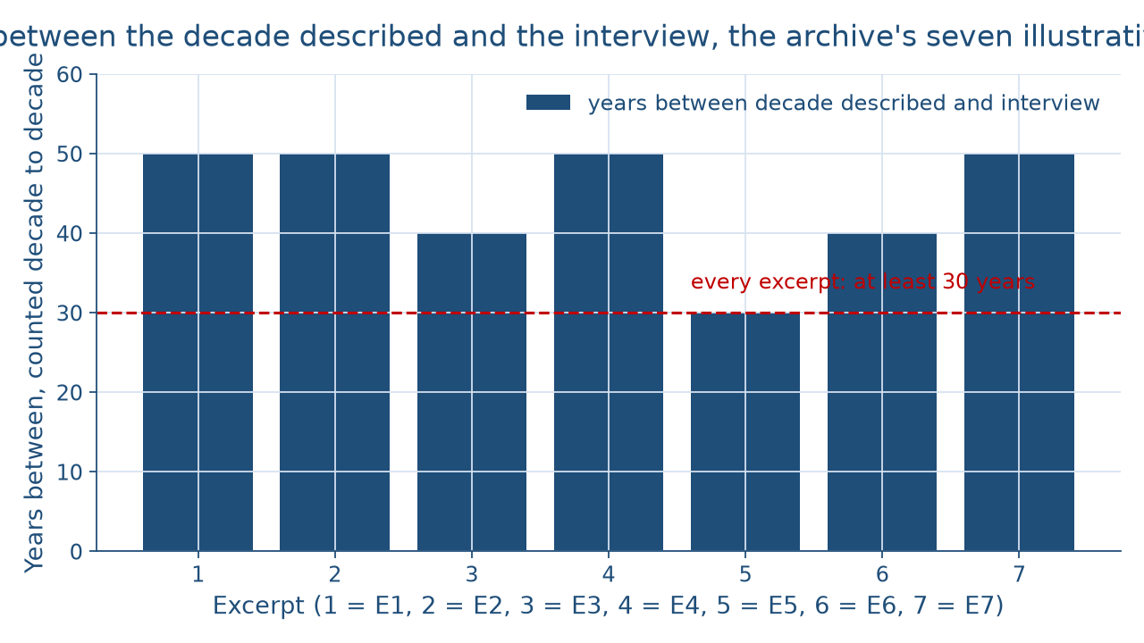
Recorded decades later
THE ARCHIVE · SEVEN SOURCES
One distinction per topic
Week 08
13
Notes:
Show the picture before naming the pattern. The bar chart has one bar per archive excerpt, E1 to E7 from left to right. Four bars, for E1, E2, E4, and E7, reach 50 years; two, for E3 and E6, reach 40 years; and one, for E5, reaches 30 years. A dashed line at 30 years touches the shortest bar. Describe it aloud for anyone who cannot see the screen: counting decade to decade, every excerpt was recorded at least 30 years after the decade it describes, and 4 + 2 + 1 = 7 excerpts. The laws and events tied to E1, E5, E6, and E7 come in Weeks 9 to 12, so this week those four are read only as sources. DO: ask what a 50-year gap changes about how you read an excerpt, and steer to the answer: read it for meaning and check its dates elsewhere.

Slide 14
Two dates, both check out
WORKED EXAMPLE · CHECK TWO DATES
E2: 1943, inside the Great Migration
1943 − 1896 = 47 years after Plessy
E4: offices 1951, law 1956
1956 − 1951 = 5 years; late 1950s fits
One distinction per topic
Week 08
14
Notes:
Run the week's worked check. E2's family left in 1943, and the Great Migration ran from roughly the 1910s to the 1970s, so the date fits the dated record. Her train car came 1943 − 1896 = 47 years after Plessy v. Ferguson (1896), the Week 6 case. E4's family moved in the late 1950s. The relocation offices opened in 1951 and the Indian Relocation Act came in 1956, so 1956 − 1951 = 5 years apart, and a late-1950s move falls after both, the Week 5 timeline. Then name what an interview can and cannot prove. E4 can tell you the promised job lasted four months; it cannot tell you how many families the program moved. DO: have pairs write one thing E4 can prove and one it cannot, collect three pairs' lists, and sort them on the board into experience and figures.

Slide 15
Audit the chatbot
THIS ACTIVITY · CHECK THE CHATBOT
Paste the E2 source prompt
Check: is it called a primary source?
Check: is 1943 treated as proof alone?
The tool drafts; you check
One distinction per topic
Week 08
15
Notes:
This practice activity puts a chatbot from the approved list, such as Claude, Gemini, or ChatGPT, to work on this week's material. It is for review practice only; the midterm itself is taken without it. DO: paste this exact prompt: An illustrative oral-history excerpt from a woman interviewed in the 1990s says her family left the South in 1943 and rode in a train car set aside for Black passengers. Is this a primary source made at the time? What can it prove, and what should be checked against dated records? Then check the reply for two named errors: calling the excerpt a record made at the time, when it is an oral history recorded about 50 years later; and treating 1943 as proven by the interview alone, when the date is checked against the Great Migration's span. The tool drafts; you check.

Slide 16
Keep the line clear
One distinction per topic, Weeks 1 to 7
Primary source: at the time; oral history: later
Testimonio speaks for a community
Next: Week 9, a new unit
BEFORE THE MIDTERM
16
Notes:
Recap in the order taught. Week 1 keeps the field comparative across 4 core fields. Week 2 separates race, ethnicity, and nationality, and sorts P1, I1, N1, and S1. Week 3 sets cultural pluralism and segmented assimilation against assimilation, and E3 against E4. Weeks 4 and 5 keep tribal citizenship a political status. Weeks 6 and 7 separate de jure from de facto, with a gap of 80 percentage points and a ratio of 9 to 1. Then the new material: a primary source is made at the time, and an oral history is recorded later and read for experience and meaning; testimonio speaks as a witness for a community. The midterm checks Objectives 1 to 5 as taught in Weeks 1 to 7. Next comes Week 9, a new unit. DO: give an exit card: write one distinction in one sentence, and collect the cards.

